Slide 1
Harborview Medical Center
Maleng Single Patient Room Project
Application to use Progressive Design-Build
Project Review Committee Meeting: May 27th, 2021

Slide 2
Agenda
Introductions
Project Description
Budget
Schedule
Equity & Social Justice
Why Progressive Design-Build
Questions

Slide 3
Introductions – Presenting Team
King County
Joe Hicker,
Project Manager
Harborview Medical Center
Ted Klainer,
Director of Capital Development
OAC Services
Melissa Teichman,
Senior Director / Healthcare
Dan Chandler,
Principal-In-Charge

Slide 4
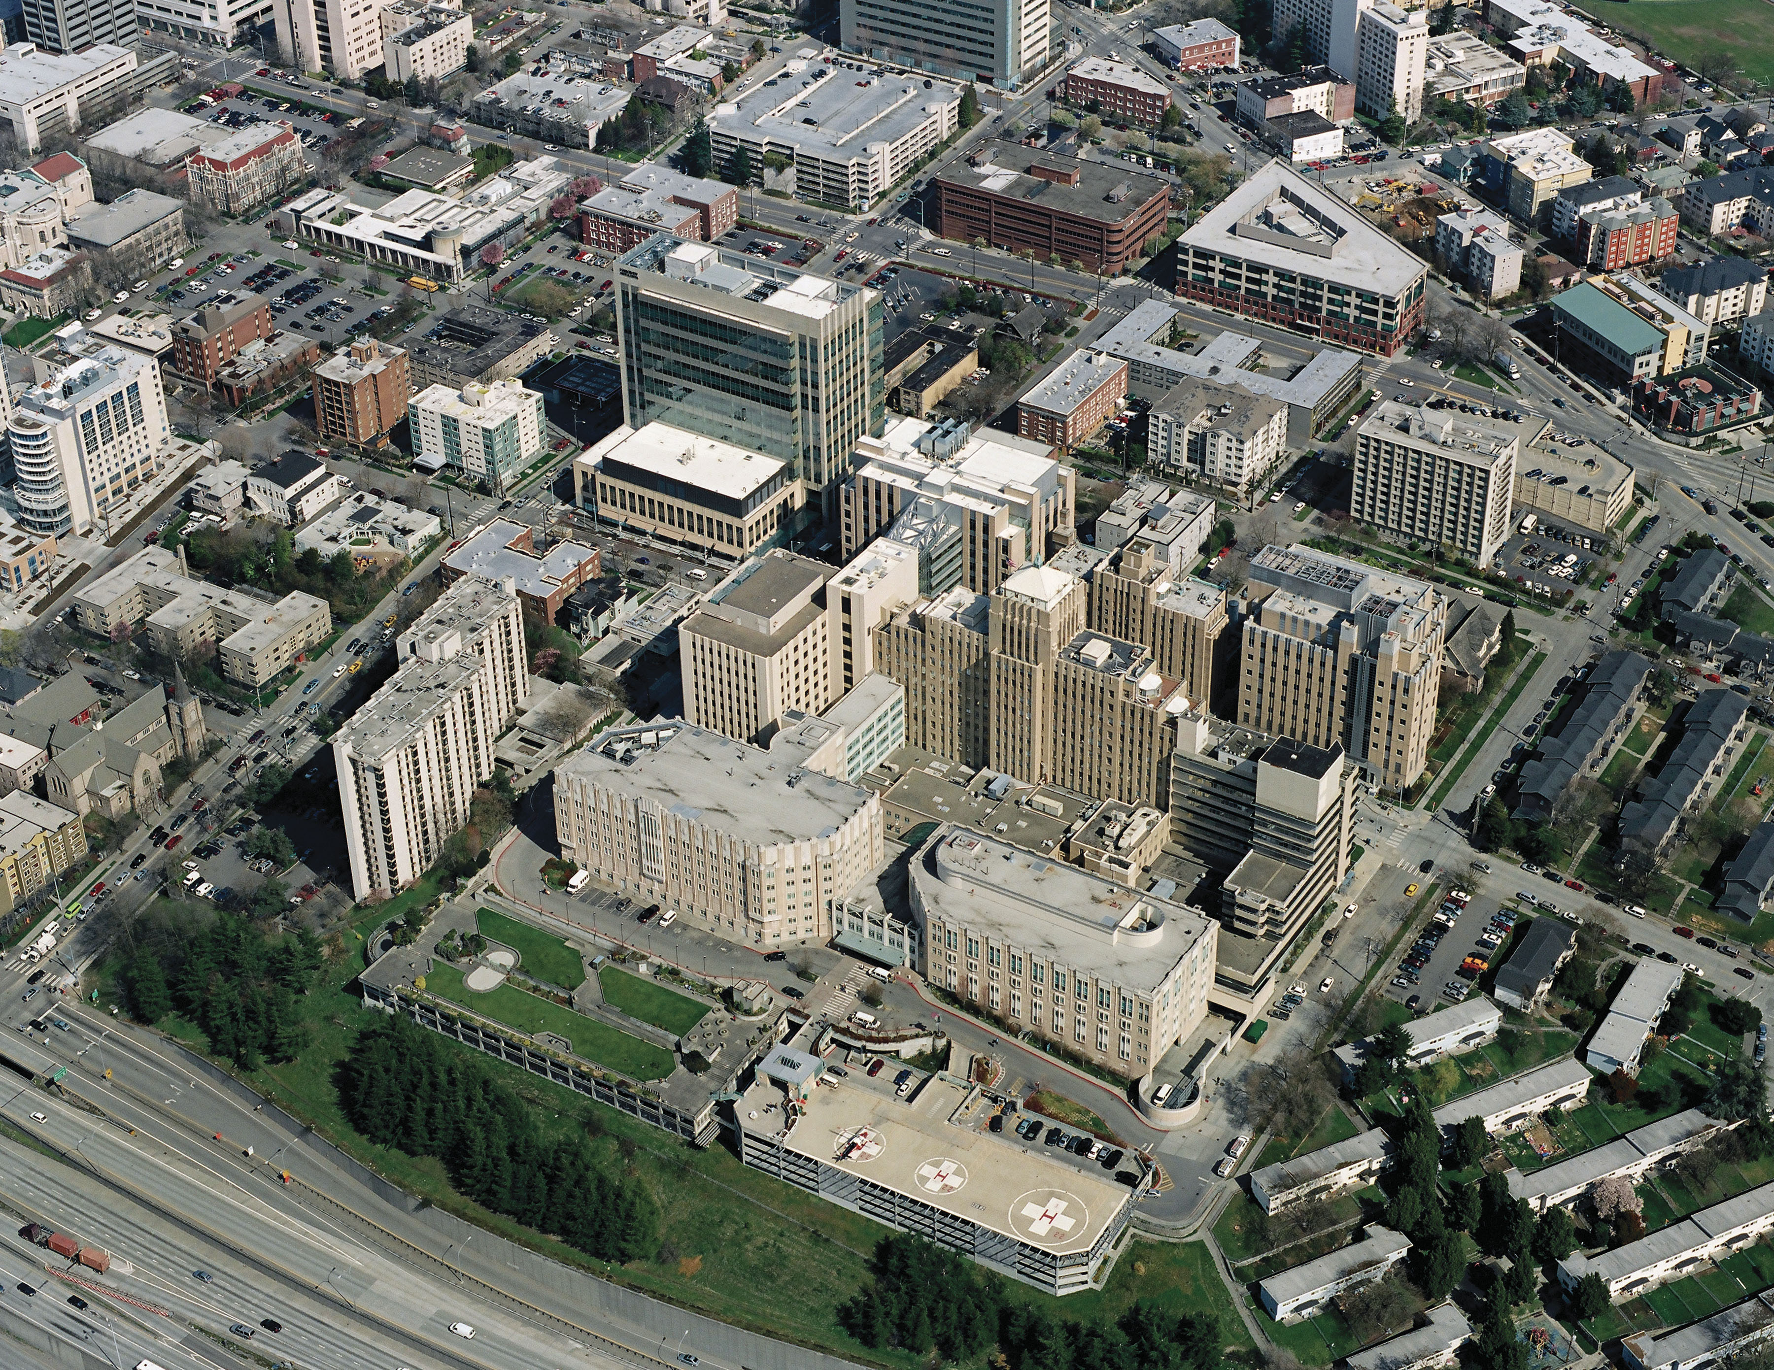
Harborview Medical Center is the only Level 1 Trauma Center serving a 4-state region and is one of the nation’s leading academic medical centers.
HMC is owned by King County, operated by the UW Medicine and governed by King County appointed Board of Trustees.
Hospital Services Agreement

Slide 5
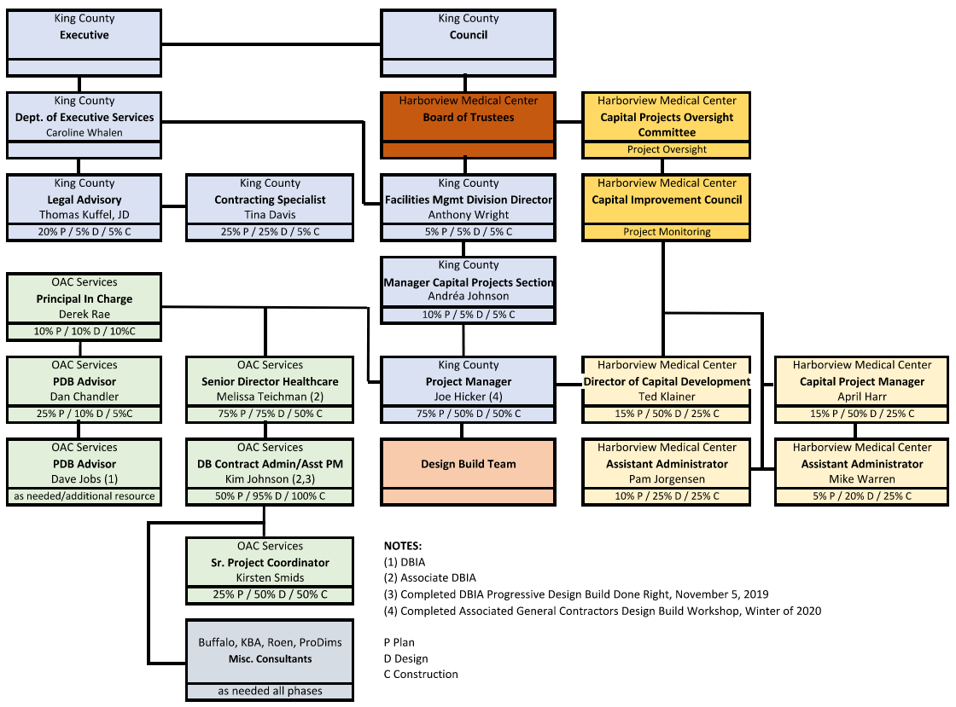
Organization Chart

Slide 6
King County Capital Project Delivery Experience & Qualifications
FMD team has over 3 decades of public works expertise.
King County has embraced culture of Alternative Delivery.
Many of King County’s FMD project team staff members have completed DBIA training and/or AGC Education Design-Build Workshop.
Design-Build Children & Family Justice Center project nearing completion.
Internal processes and control systems to efficiently plan and execute the work.

Slide 7
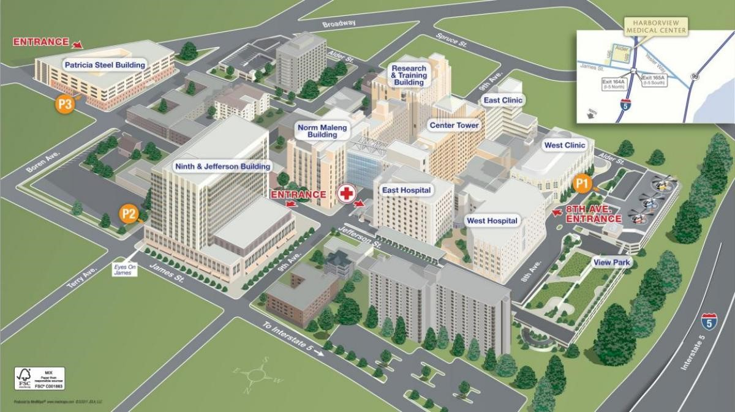
Project Description – Campus Map

Slide 8
Project Scope
Project Goal:
Convert 2 floors in the Maleng Building into inpatient units in order to increase the number of single patient rooms.
Project Sequence:
Phase 1: Renovate NJB and move Maleng outpatient clinics.
Phase 2: Convert 2 floors in Maleng Building into inpatient rooms.

Slide 9
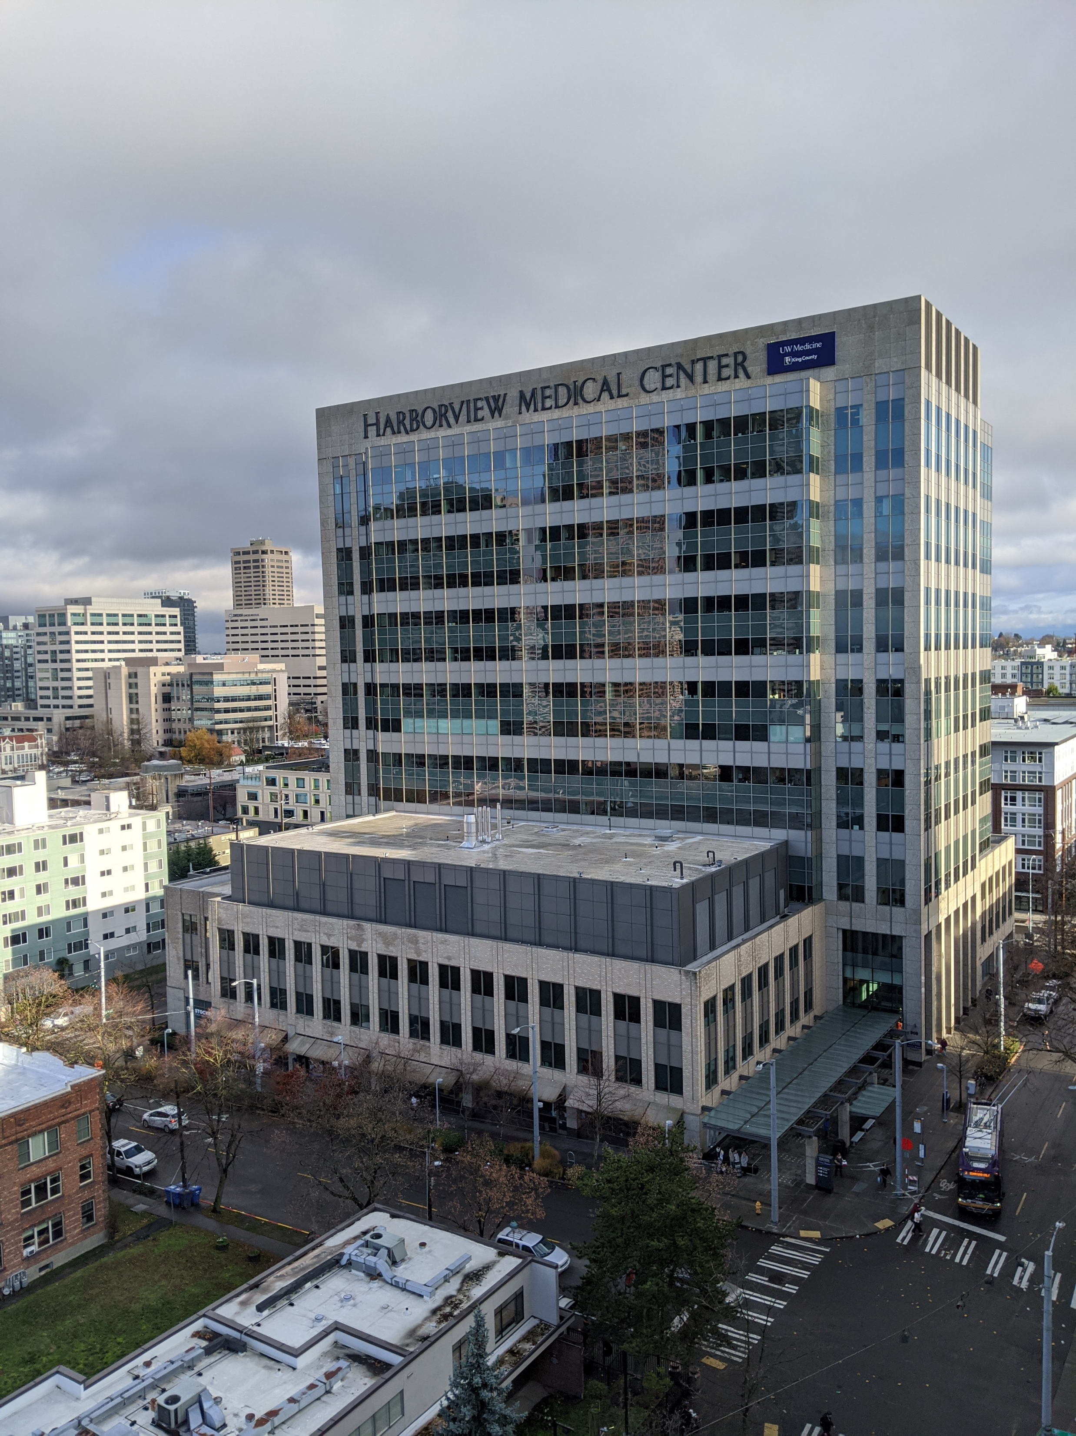
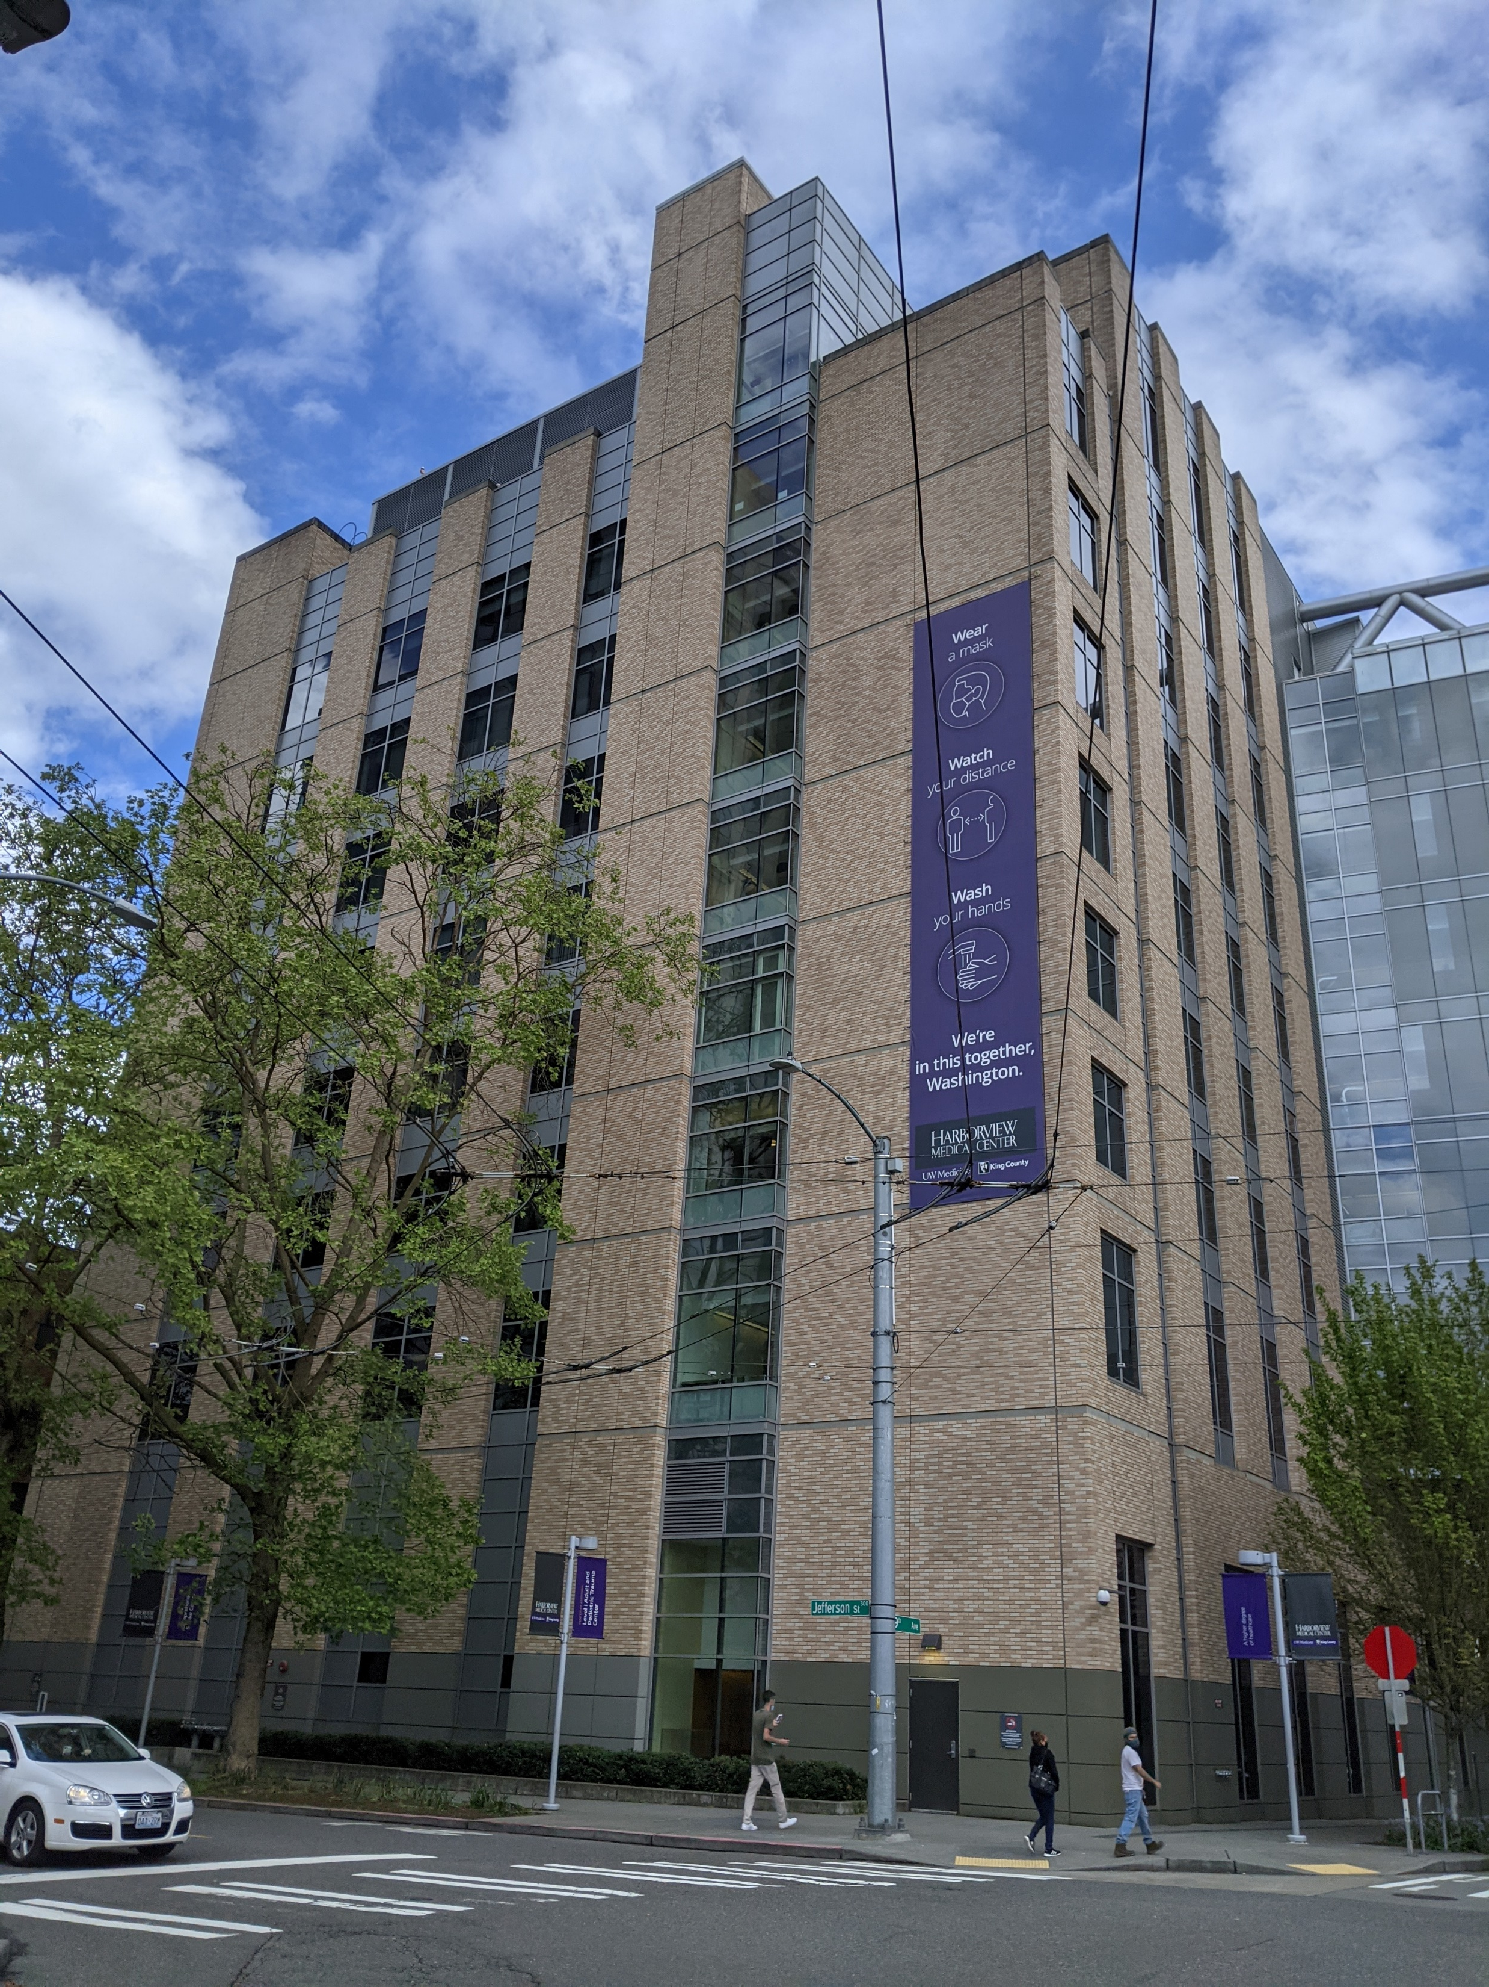
The Maleng Single Patient Room project will deliver up to 40 new critically needed single patient rooms by converting two floors in the Maleng building into inpatient units.
The 40 new single patient rooms will allow Harborview to make significant improvements to the existing bed capacity challenges.
Ninth and Jefferson Building
2009
Maleng Building
2007

Slide 10
Budget & Funding
Project fully funded from Harborview Medical Center’s Operating Cash.
Adopted by King County Council in Ordinance 19163 and approved 9/25/20.
Budget
Costs for professional services (A/E, legal, etc.) | $5,408,759
Estimated project design & construction costs (including contingencies): | $52,264,609
Equipment and furnishing costs | $336,548
Contract administration costs (Owner, CM etc.) | $4,376,102
Contingencies (Owner) | $6,751,176
Other related project costs (KC 1% Art program) | $737,068
Sales Tax | $5,125,738
Total | $75,000,000
**This is NOT part of the bond program.

Slide 11
Anticipated Procurement Schedule
Description | Duration | Start | Finish
Outreach | 1 month | May 2021 | Jul 2021
PDB RFQ Process (pending PRC approval) | 1 month | 6/2/2021 | 6/30/2021
Post RFQ |  | 6/2/2021 | 6/4/2021
Pre-proposal Meeting |  | 6/9/2021 | 6/9/2021
SOQ due |  |  | 6/24/2021
SOQ Review, Shortlist |  | 6/24/2021 | 7/6/2021
PDB RFP Process | 1.5 month | 7/8/2021 | 8/24/2021
Issue RFP |  |  | 7/8/2021
Proprietary Interactive Meetings |  | 7/29/2021 | 7/30/2021
Proposals due |  |  | 8/11/2021
Management Plan Review / Scoring, Fee Opening |  | 8/11/2021 | 8/18/2021
Notice of Intent to Award |  | 8/19/2021 | 8/24/2021

Slide 12
Anticipated DB Schedule
Description | Building | Duration | Start | Finish
Contracting Period (Successful PDB team and KC Procurement) |  | 2-3 months | Aug 2021 | Oct 2021
Preliminary Agreement / Work Plan development
Validation Phase >30% Scope/Schedule/Budget/Concept Design | NJB/Maleng | 5-6 months | Oct 2021 | Mar 2022
Design through development of GMP
>60% Design, development of GMP (Pending DB input) | NJB/Maleng | 8 months | Mar 2022 | Nov 2022
Construction
Final Design/Permitting/Construction (Pending DB input) | NJB/Maleng | 24 months | Nov 2022 | Oct 2024
Closeout Phase | NJB/Maleng | 5 months | Nov 2024 | Apr 2025

Slide 13
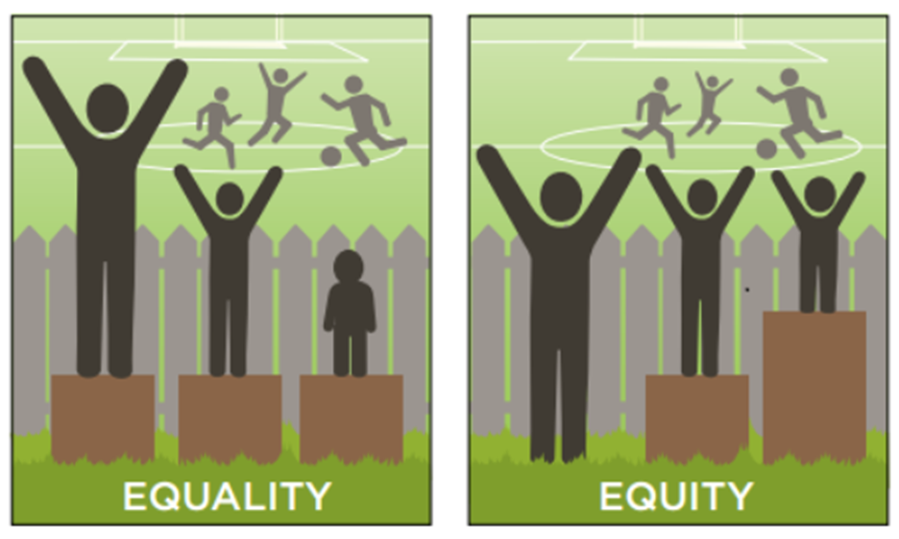
Equity & Social Justice
ESJ Innovation Plan
Expand opportunities for Certified DBE, MBE and WBE firms throughout design and construction
Voluntary Utilization Goals:
DBE/MBE = 20%
DBE/WBE = 5%

Slide 14
Why PDB? Meets RCW 39.10.300 Criteria
Activities are Specialized
24/7 acute care environment – careful planning, disruption avoidance, and infection control measures.
Special training, enhanced communication, detailed scheduling, and collaboration with hospital staff.
Opportunity for Greater Innovation and Efficiencies
Maintaining ongoing operations and patient care will require complex phasing, early investigation, planning, procurement, and delivery sequencing.
Coordination of design and construction in 2 active buildings with unique ongoing operational challenges.
Savings in Project Delivery Time
Streamlining and integration. Integrated approach between DB team, King County, and Harborview.
Efficient sequencing of design, fabrication, and construction in phased project.
Confirm budget early in design. Predictable outcomes.
More single beds faster = better patient care!

Slide 15
Thank You / Questions
PRC Panel
Ato Apiafi
Panel
Ato Apiafi Architects
Cory Hamilton
Panel
UW Medicine
Michelle Helmholz
Panel
Laborers Local 242
Jim Dugan
Panel Chair
Parametrix
Karl Kolb
Panel
Coffman Engineers
Jessica Murphy
Panel
City of Seattle-SDOT
Mike Pelitteri
Panel
Pellco Construction
Louise Sweeney
Panel
WSU
Maleng Team
Joe Hicker,
King County, Project Manager
Ted Klainer,
Harborview Medical Center, Director Capital Development
Melissa Teichman,
OAC Services,
Senior Director
Dan Chandler,
OAC Services,
Principal in Charge

