Slide 1
Chelan County Public Utility District No. 1 Service Center
Application to use the GC/CM Project Delivery Method
January 24, 2018
“Shaping our utility to do the best for the most for the longest”
Notes:
Good day, panel: I’m Jim Dugan, Master of the Universe and today’s facilitator for the Public Utilities District No. 1 for Chelan County. We’d like to thank you for the opportunity to present our application for approval GC/CM delivery for our ‘Service Center’ replacement project.

Slide 2
Agenda
Introductions
District Background
The Project
Project Budget
Project Schedule
Why GC/CM
Qualifications-Public Body
Organization- Project Team
Summary
Notes:
Today’s agenda is to:
Provide information about our agency, and the selected project team.
Tell you about our planned project program.
Demonstrate why this program is eligible for and worthy of being approved for use of GCCM.
Show you we have the, personnel, resources, and skills needed to successfully execute GCCM for this program.

Slide 3
Team Introductions
Notes:
1. We will begin by introducing our team...

Slide 4
Project Team – Here Today
Chelan County PUD:
Dan Frazier – Director, Shared Services
David Lodge, PMP, LEED AP – Project Manager
Casey Headlee – Construction Manager
Parametrix:
Jim Dugan – Program Manager, GC/CM Advisor
Dan Cody – GC/CM Procurement and PM/CM Advisory Support
Jesse Noga – GC/CM Procurement Support
TCF Architecture:
Randy Cook, AIA, LEED AP – Partner, Principal In Charge, Design Team Lead
Gail Merth, AIA, LEED AP BD+C – Project Manager, Designer
Perkins Coie Law:
Graehm Wallace – External GC/CM Advisory Services & Legal Counsel
Notes:
Team members with me today are:

Slide 5
Additional Team Members
Chelan County PUD:
Steve Wright – General Manager
Justin Erickson – Managing Director, District Services
Erick Wahlquist – General Counsel
Katie Yount – Contract Legal Review/ Public Records Officer
Brenda Guske – Contract Specialist
Parametrix:
Maggie Anderson – GC/CM Project Controls and Support
TCF Architecture:
Brian Ho – Partner, AIA, LEED AP BD+C, ALEP; GC/CM Advisor
Ted LeCompte – Registered Architect (TX); Project Specifications
Scott Olson – Registered Architect (WA); Associate Lead Designer
Gerry Pless – Registered Architect (WA) AIA, LEED AP; Technical & QA/QC Review
Notes:
Team members not presenting with us today are:
Our Consultants and sub consultants share our vision about the project; all of these individuals are highly skilled, have many years of experience with GC/CM and other delivery methods, and are a pleasure to work with.

Slide 6
District Background
Notes:
1. Next I would like to tell you a little bit about the PUD of Chelan County:

Slide 7
The District
Headquartered in Wenatchee and serving Chelan County
The PUD was established by a vote of the people in 1936, and features the second largest, non-federal, publicly owned hydroelectric generation capacity in the U.S.
Approx. 800 Employees
3,000 square mile service territory
Operations Include:
Retail electric service for approx. 50,000 customers
Water/Wastewater services for approx. 5,000 customers
Fiber/Telecom services for approx. 13,000 customers
Parks & Recreation management, including 14 parks along the Columbia River and Lake Chelan
Three Hydroelectric dams (Lake Chelan, Rock Island, Rocky Reach)
Essential Services
Notes:
The Public Utility District is located in Wenatchee; servicing Chelan County since 1936.
We are a customer-owned utility district with over 50,000 Customers.
We have a service area ranging to approximately 3000 square miles.
We employ approximately 800 staff members, and are primarily composed of Power, Water, and Wastewater Utility Services, along with support crews/administrative staff.
Our hydroelectric plants at 3 nearby dams generate power for all Chelan County, as well as providing additional power which is placed onto the energy market for sale.
We have been around a long time and have a storied history of community support and involvement around public works
Funding for project comes from a board-of-commissioners-approved Facilities Improvement Fund ($50M current bal.) with 2019 budget funds for acquisition and design of the facility

Slide 8
PUD Community Inclusion Plans
Chelan County PUD is committed to Equity and Excellence. Developing strong business relationships and community partnerships are critically important to fulfilling the District’s mission.
The District’s goals include:
Robust Stakeholder Engagement for all District Projects and Initiatives
Growing Diversity Programs for Future Workforce Development:
2016 Creation of Community Outreach Position
Community Needs Assessment – Find the Gaps in Knowledge, Skills & Abilities
2017 Development of Multiple Diversity Outreach Programs (Discover Us, “Pizza, Pop & Power Tools”, STEM Academy, WorkSource Veterans Program)
2018 New CAMP (College Assistance Migrant Program) development
Notes:
Need to identify actions planned by Design team and PUD for public outreach, as well as inclusion of any MWBE/DBE requirements planned for RFP/

Slide 9
The Project: Service Center GC/CM Delivery Program
Notes:
For our ‘Service Center’ Project, we have elected to use the GC/CM Delivery Method

Slide 10
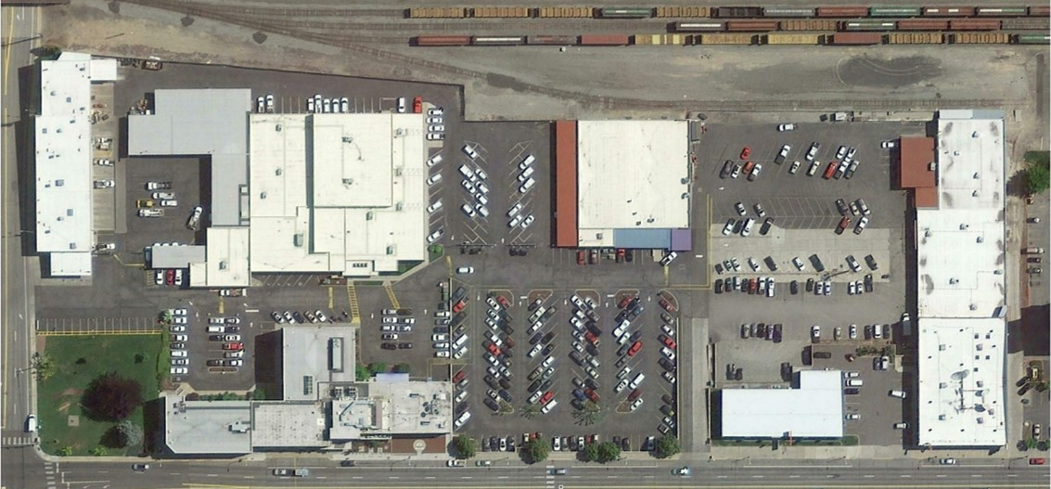
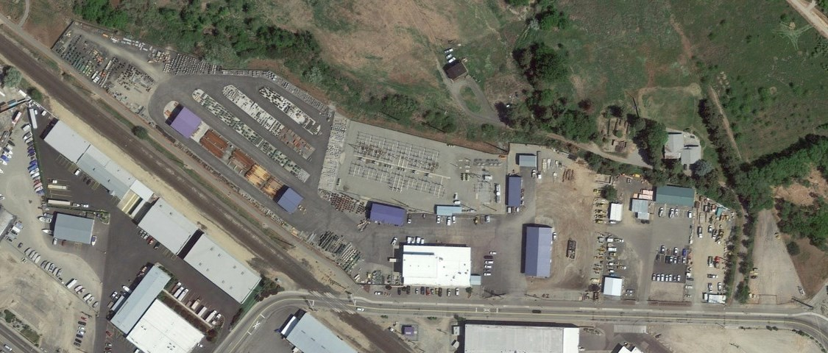
Existing District Operations
Headquarters Campus
Hawley Street Campus
Notes:
This photo shows our existing PUD service and administration sites, which will be relocated over the course of the project.
These locations will remain occupied until new facilities are ready for move-in; however, there will be overlap between substantial completion of new facilities and move in, which the GC/CM will need to have anticipation of along with commensurate scheduling to coordinate and manage all move activity.

Slide 11
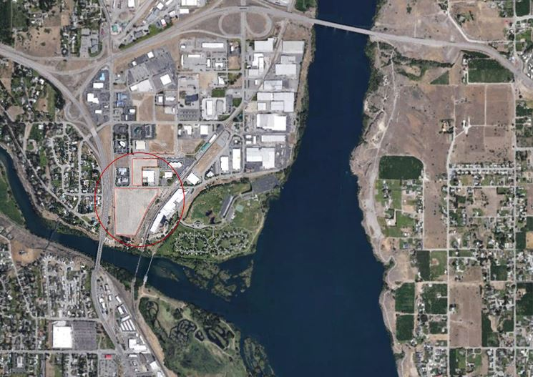
New Location
Confluence of the Wenatchee and Columbia rivers
22 acres on split parcels in a commercial-light industrial area
Bordered by a highway, the Wenatchee River, and a regional storm pond
Surrounding developments include a fruit packing business, offices and light industrial
Centrally located to serve all of Chelan County
Notes:
This is our new campus site as it exists today.
Centrally located to serve all of Chelan County

Slide 12
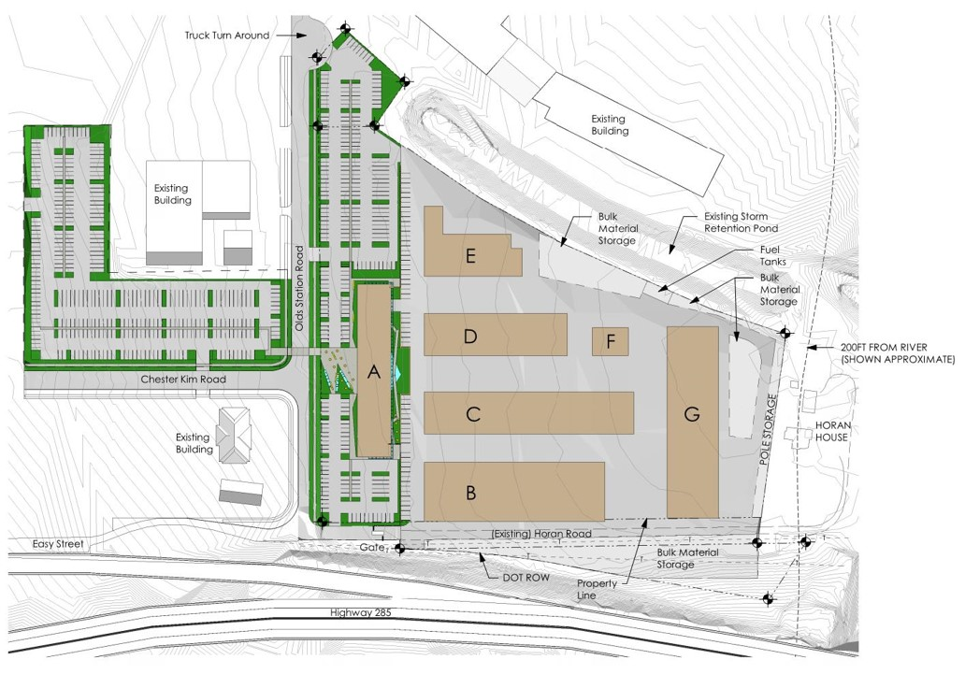
Conceptual Site Plan
Notes:
This drawing shows construction areas as identified by the design team, and associated concepts for building footprints of the project.

Slide 13
Project Details
500+ Employees: More than 50 separate Departments & Workgroups
150 District-owned Vehicles
One Stop Customer Service for all District services
Consolidated field crews (Line / Fiber / substations / water F&W).
Consolidated administrative functions.
Boardroom and commissioners offices.
Building | Gross Area
A: Office Building | 100,000 SF
B: Warehouse & Line Dock | 49,300 SF
C: Shops / Heated Storage | 40,500 SF
D: Vehicle Storage | 27,800 SF
E: Fleet Shop | 17,200 SF
F: Fuel & Wash | 4,600 SF
G: Covered Material Storage | 44,300 SF
Approximate Total Area | 283,700 SF
Notes:
Our project details are still coming together in programming and through schematic design, but some details we do know already are:

Slide 14
Project Budget
GC/CM MACC | $84,221,000
GC/CM Risk Contingency (3% of MACC) | $2,527,000
GC/CM Fee, SGC's & NSS Allowance (13.5% of MACC) | $11,406,000
GC/CM Total Contract Cost (TCC) | $98,154,000
Owner's Construction Contingency (5% of TCC) | $4,908,000
Furniture, Fixtures, Equip. & Data Allowance (7.2% of MACC) | $6,066,000
Professional Services Allowance (Architects & Engineers) (11.7% of MACC) | $9,887,000
Owner's Consultants (Survey, Geo-Tech, HazMat, Test & Inspect) (2.5% of MACC) | $2,100,000
Contract Administration Costs (PM/CM, etc.) (3.3% of MACC) | $2,750,000
Other Related Project Costs (Permits, Fees, etc.) (1.1% of MACC) | $920,000
WA State Sales Tax (Calculated @ Current WSST @ 8.4% of TCC + FF&E) | $8,754,000
Total Project Budget | $133,539,000
Notes:
Here’s a snapshot of our project budget, including significant contingency funds set aside to allow for late-stage design changes, market escalation, etc.

Slide 15
GC/CM Procurement Schedule
PRC Application | 12/20/2018
PRC Presentation | 1/24/2019
First publication of RFP for GC/CM Services | 2/19/2019
Second publication of RFP for GC/CM Services | 2/26/2019
Project Information Meeting (Date subject to change.) | 2/28/2019
Last Day for questions to be submitted | 3/1/2019
Addendum to RFP issued | 3/5/2019
RFP Submittal Deadline | 3/12/2019
Review & Score Submittals Received | 3/13/2019
Notify Submitters of Most Highly Qualified Submitters & Invite to Interview | 3/19/2019
Interviews with Short‐Listed Firms | 3/28/2019
Notify Submitters of Most Highly Qualified Firms & Invited to Submit RFFP | 4/1/2019
Last day for questions to be submitted | 4/4/2019
Addendum to RFFP issued | 4/8/2019
RFFP Submittal Deadline & Opening | 4/18/2019
Notify Submitters of Scoring and Most Qualified GC/CM | 4/22/2019
Early Services Contract with GC/CM | TBD
Pre‐Con Work Plan Due | 5/17/2019
Board Approval of GC/CM Selection | 6/3/2019
GC/CM Agreement w/ Pre‐Con Services Executed | 6/7/2019
Notes:
Our procurement schedule is set up to move expeditiously through the GC/CM selection process, so that the GC/CM will be on board prior to the end of Schematic Design for the project, and can provide assistance in cost assessments at SD level.
Bid schedules are tight due to rapid-paced market conditions and the need to match Board approval schedules and begin construction with enough time for substantial completion prior to winter.
The Schedule shown here includes expected starts/completion of sequencing; to be continually validated and adjusted through design completion and contract awarding.

Slide 16
Project Schedule
Schedule Item | Start | Finish
Programming Design | December 2018 | February 2018
Schematic Design | March 2019 | July 2019
Design Development | July 2019 | January 2020
Site Development Review | September 2019 | July 2020
Building Department Review/Permitting | September 2019 | July 2020
Construction Documents | January 2020 | September 2020
Early Bid Packages (Mini MACCs) | May 2020 | July 2020
Begin Construction (Early Work, Site Development) | June 2020 | August 2020
Negotiate GMP (90% CDs) | August 2020 | September 2020
Subcontract Bidding | October 2020 | October 2020
Begin Construction (Building) | September 2020 | September 2022
Owner Move‐in (Final Phase) | September 2022 | October 2022
Warranty | August 2022 | July 2023
Notes:
The next slide shows the schedule for Design & Construction
Each component of our project will follow the same primary construction schedule with regard to design and development, and is currently set to show when work is anticipated to start on-site, and be substantially complete.
For the first portion of our work this time period is from _____________________________.
Our project begins with a renovation at ___________, to renovate / build new space for __________________, then move to the new facilities, prior to_________________.
On-site construction overlaps are expected between occupancy at certain phases of the construction’s sequencing.
We have plans to review this situation with GCCM contractors and confirm through the procurement process which can most effectively handle the overlapping activity, and to schedule the remaining work..

Slide 17
Summary Schedule
Notes:
The next slide shows the schedule for Design & Construction
Each component of our project will follow the same primary construction schedule with regard to design and development, and is currently set to show when work is anticipated to start on-site, and be substantially complete.
For the first portion of our work this time period is from _____________________________.
Our project begins with a renovation at ___________, to renovate / build new space for __________________, then move to the new facilities, prior to_________________.
On-site construction overlaps are expected between occupancy at certain phases of the construction’s sequencing.
We have plans to review this situation with GCCM contractors and confirm through the procurement process which can most effectively handle the overlapping activity, and to schedule the remaining work..

Slide 18
Why GC/CM Delivery Method
Notes:
Why did we think that the GC/CM delivery method is best for this project?

Slide 19
GC/CM Project RCW Criteria
* This Project meets 3 items of 6 criteria for GC/CM Delivery per RCW 39.10.340:
Implementation of the project involves complex scheduling, phasing, or coordination.
The project involves construction at an occupied facility which must continue to operate during construction.
The involvement of the General Contractor/Construction Manager during the design stage is critical to the success of the project.
The project encompasses a complex or technical work environment
The project requires specialized work on a building that has historic significance.
The project is, and the public body elects to procure the project as a heavy civil construction project.
Notes:
This slide shows the criteria that our school replacement project meets RCW 39.10.340 for use of GCCM procedures:
In short, we meet the criteria of:
Complex Scheduling and Phasing.
b. Construction will be at Occupied, and “Essential” Facilities
Critical to our success, is the Involvement of the GCCM during design.
We believe GCCM best provides the potential for success of the project work, and will bring the best value to the Public Utility District and its Customer-Owners in the community.

Slide 20
GC/CM Specific Project Details:
Project will include relocation of essential 24-hour operations, requiring reliable scheduling and sequencing in order to minimize downtime during relocation.
Project includes complex coordination with essential technical facilities and equipment, including relocation of corporate data center, fiber to the home network operations center, and other essential facilities.
Early involvement of the GC/CM to develop phasing plan may support early occupancy of operations functions, prior to administrative and customer service functions. Phased occupancy would require construction to continue in an operating campus, but would help to realize operational efficiencies early.
Successful phased occupancy would also allow for phased redevelopment of existing campus, reducing community impact of vacancy at the District’s downtown campus.
Notes:
The “Because”:
\ The next few slides show more specific information about why we believe GC/CM is most appropriate for this project.

Slide 21
Other Factors for Success via GC/CM Delivery
Involvement of a GC/CM during the design phase gives collaborative approach to project; allows for better planning and design efficiencies; Value Engineering; reduces learning curve for team on a long range phased plan; ongoing lessons learned add value
Execution of planned sequential components with a continuous, common team from design through construction; improved scheduling and phasing opportunities
Improved cost controls, market access to subcontractors, suppliers, and more streamlined administrative controls
Improved potential for early bid packages for early work and long-lead items in an escalating Labor and Materials marketplace
Notes:
We believe GC/CM ultimately gives the PUD our best opportunity for success on the project by way of (but not limited to) these other qualifying factors // Dugan to read slide or riff ad-hoc
Potential for early bid packages.
Potential for early procurement of long-lead items.
Improved management of local access, egress, and traffic control during construction.
Improved management of potential complex off-site work over the public roadways.
These are benefits that are not available or often missing on design/bid/build projects.

Slide 22
Public Benefits of GC/CM Delivery
Greater ability to provide for safety considerations during the project
Enhanced Budget and Schedule Control through the Design phase
More appropriate Risk Allocation
Greater Fiscal Accountability
Greater ability for public outreach than traditional Design/Bid/Build method
Notes:
We believe GC/CM ultimately gives the Public additional multiple benefits as opposed to traditional Design Bid Build method
2. Some of those benefits experienced have been, but are certainly not limited to:

Slide 23
Project Team Qualifications
Notes:
1. Next I would like to tell you about the leadership team for this project, and a bit about our GC/CM experience.

Slide 24
Project Team Qualifications
Chelan County PUD:
Extensive Capital Projects experience with a long history of on-time & on-budget projects
No WA State Audit findings
This program will be District’s second opportunity to use GC/CM – first is still ongoing at Hydroelectric Projects
David Lodge; Project Manager; prior GC/CM experience
Parametrix:
Vast experience assisting in procurement on over 25 GC/CM projects; and also on more than 10 projects through Pre-Construction/Construction in a PM/CM role.
Jim Dugan; Program Director, GC/CM Advisor 39 GC/CM Projects
Dan Cody; GC/CM PM/CM and Procurement Advisory Support
Jesse Noga; GC/CM Procurement and Project Support (Completed GC/CM Workshop in 2018; Provided PM support on GC/CM Procurement of BHS, GC/CM Closeout & CM Work@ ECC)
Maggie Anderson; GC/CM Project Controls & Support (Completed GC/CM Workshop in 2017; Provided Project Support on GC/CM Procurement of BHS, VPS, Tumwater)
Notes:
The District has extensive construction experience, including projects of large scope and great complexity.
We are proud of a long track record of completing our projects on-time and within budget.
__________ will manage the project for the District during the pre-construction phase and will have _________ supporting ___.
The District has hired Parametrix as their GC/CM procurement consultant and advisor, as well as program management and elective PM/CM support.
The District has retained Graehm Wallace as GCCM legal counsel.
The District has hired TCF Architecture as the project architect, with Randy Cook as Principal In Charge.
TCF and Parametrix have completed a number of GC/CM projects.
TCF’s team has a reputation and history of working collaboratively with Owners and contractors on GC/CM projects, as well as now with the District. We believe this team’s approach is a natural fit for our program.
This team satisfies the public body qualification under RCW 39.10 for staff augmentation with consultants.

Slide 25
Project Team Qualifications
TCF Architecture:
Extensive utility, maintenance, and operations experience, assisting owners throughout WA
Firm has designed over twenty publicly-owned Maintenance, Operations & Administrative (MOA) projects including four of the largest campus-style facilities in Washington.
Two current GC/CM projects with Chelan PUD.
Total of 9 projects delivered via GC/CM.
Recent GC/CM experience with Mount Vernon, Olympia, Wenatchee, and Lake Wilderness School Districts
Randy Cook; Principal-in-Charge (Recognized regional leader in publicly-owned MOA Facilities.
Perkins Coie:
Retained as legal counsel and GC/CM Advisor
Firm has provided legal counsel for over 50 GC/CM projects in Washington State
Experts in GC/CM contracts and procedures
Graehm Wallace; providing project attorney and GC/CM advisory services
**The District’s assembled Project Team meets Statutory Requirements of the RCW (Sec. 39.10.350) for GC/CM Delivery by way of having experienced, qualified staff, augmented with hired consultants and designers with vast expertise, and prior experience managing GC/CM projects.
Notes:
More info regarding our Project Team:

Slide 26
Key Project Team GC/CM Experience
Name | Experience
Dan Frazier Director of Shared Services Chelan County PUD | 27 Years: Public Works/ Public Utility experience 14 years working in Wenatchee/Chelan County Public Utilities at management level Over $30M in project management; all completed- varying from small modernization projects to highly-complex, multi-phase modernization and construction projects 2nd GC/CM program; 1st still ongoing at Rock Island / Rocky Reach Hydro Projects Extensive work experience with Architectural firms, Contractors, and Public Owners- Championing Alternative Project Delivery on multiple Public Works projects in Eastern Washington- using both GC/CM and D/B Delivery
David Lodge PMP, LEED AP Project Manager Chelan County PUD | 14+ Years Project & Construction Management 4 completed GC/CM & CM/GC Projects Degree in Construction Management Capital Project Management experience totaling over $175M Vast Construction administration experience in competitively bid, design/build and negotiated fee projects, including 4 GC/CM, over the last 10 years.
Dan Cody Procurement & PM/CM Support | 30+ years of Design & PM/CM experience 7 GC/CM projects completed as PM/CM Successful GC/CM procurement on over 20 Public Works projects
Jim Dugan Program Director, GC/CM Advisor Parametrix | 40+ Years Program / Project Management 39 GC/CM Projects completed; 12 as PIC/PM or CM Elected to Project Review Committee July 1, 2016; currently Vice Chair
Randy Cook AIA, LEED AP Architect, Principal-in-Charge TCF Architecture | 27 Years Specializing Maintenance, Operations & Administrative Facility Design for public owners throughout Washington State 2 current GC/CM projects with Chelan County PUD Managing Principal of TCF Architecture with 9 successfully-delivered GC/CM projects
Notes:
This chart shows the level of project management and GC/CM experience for key team members.
Every individual has extensive design, construction, and/or project management experience.
A quick look shows each key team member has at least a decade of project delivery experience.
Conclusion: This is a well seasoned group, with multiple people on the team and bench who have significant GC/CM experience.

Slide 27
Project Management Organization Chart
Notes:
Here’s a snapshot of our overall ORG chart for the project; a couple changes have been made to this Organization since the version appearing on the application provided previously. You should have a handout in your packet with a larger, more readable size.

Slide 28
Summary
Project is funded with the appropriate budget and time allowances
Project meets several criteria of RCW 39.10.340 for GC/CM Delivery
Utilization of the GC/CM delivery method will provide multiple benefits for the District; its customer-owners will benefit greatly from the value of this program
Project Team has the necessary experience and will provide leadership continuity for the Project’s various pieces
Project Team has the capacity and availability for the Project’s program
Project Team is prepared and ready to proceed
Project Team has an appropriate management plan to service the critical needs of the project and its performance
Notes:
In summary:
Program is funded and has an appropriate budget.
Program meets criteria of RCW 39.10.
Team has the necessary experience and is prepared to provide continuity of experience throughout the project scope.
Team has the capacity for the entire program.
Team is prepared and ready to proceed.
Utilization of the GC/CM delivery method will provide multiple benefits for the Utility District district and its Customer Owners, and help ensure the success of this program.
In closing:
The District is proud of our history of successfully completing projects and expect to continue that tradition with this project.
We measure this success by building our projects as promised to the community, finishing on time and within budget, and completing projects in a manner that is safe and minimizes Operational disruptions.
We believe the GCCM delivery method will held ensure success of this program. We also want this to be a model to show how use of GCCM can have added benefits when used on a complex sequencing/multi-phase program at what is currently multiple occupied sites, and what will be at completion; a very busy consolidated hub of District activity for both the public and its staff.

Slide 29
Thank you!
Notes:
Thank you for your time.
We look forward to your questions and deliberations.

