Slide 1
GCCM Recertification Presentation to the Project Review Committee | 3.28.19
Notes:
Thank you for this opportunity, we are excited to share with you our work over the last three years since gaining Public Body Certification.
We take our role as a Certified Public Body very seriously and understand the value that this procurement method provides us as a public agency.

Slide 2
Agenda
Introductions
Lake Washington School District Overview
Program Overview
Internal GC/CM Approval Process
Lessons Learned – Program wide
Lessons Learned – Project Specific
Discussion

Slide 3
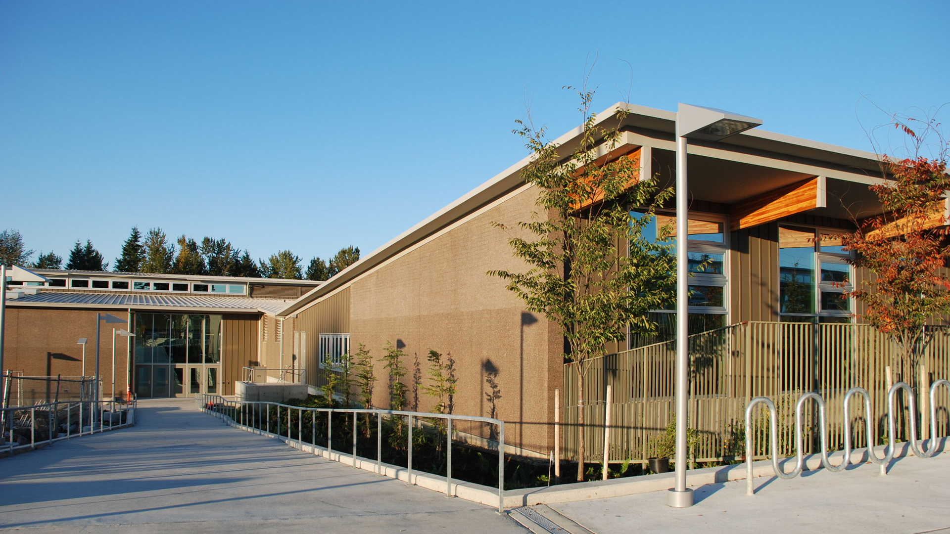
Recertification Panel Members: Barbara Posthumus Associate Superintendent Business & Support Services LWSD Brian Buck Director Support Services LWSD Stephen Murakami Construction Program Manager Support Services LWSD/OAC Services Chris Hirst GC/CM Attorney Pacifica Law Group

Slide 4
District Personnel: Dr. Jane Stavem Superintendent Appointed in 2018 Barbara Posthumus Associate Superintendent, Business and Support Services 28 years with the district Brian Buck Director, Support Services 6 years with the district Scott Emry, Risk, Health and Safety Manager 15 years with the district

Slide 5
Contract Employees and Consultant Personnel: Stephen Murakami, Construction/Program Manager 22 years experience, 2 with the district Dan Chandler, Principal – Strategy Advisor 38 years experience, 5 with the district Howard Hillinger, Principal – Strategy Advisor 38 years experience, 5 with the district PRC Member Chris Hirst, Partner – Legal Advisor CPARB member 2007-2015 16 with the district David Alskog, Partner – Legal Advisor 25 with the district

Slide 6
Lake Washington School District GC/CM Organizational Structure
Dr. Jane Stavem Superintendent
Barbara Posthumus Associate Superintendent, Business and Support Services
Shannon Parthemer Director, Communications and Community Engagement
Kristina C Bowman Support Services Communication and Public Engagement Coordination
Margo Allen Accounting Manager
Brian Buck Director, Support Services
Chris Carlson School Board
Mark Stuart Vice President, School Board
Siri Bleisner President, School Board
Eric Laliberte School Board
Cassandra Sage School Board
Robert Trepanier Procurement Manager
Scott Emry Risk, Health and Safety Manager
Jon Kollman Maintenance Manager
Cheryl Hendrix Admin. Support Supervisor
Chris Hirst GC/CM Attorney
Steve Murakami Construction Program Manager
Dan Chandler Construction Services
Jed Reynolds Resource Conservation Manager
Project Managers (10) supporting construction program
Mary Ganz Admin. Secretary III
Lydia Wheeler Admin. Secretary III
Ryan Vucinovich Maintenance & Field Supervisor
Drew Hrcek Maintenance & Field Supervisor
Lynne Pyke Budget & Fiscal Manager
John Love Capital Fund Analyst
Key
Additional GC/CM experience since 2016 certification
New to LWSD since 2016 certification
Contracted Support

Slide 7
Lake Washington School District Mission
Each student will graduate prepared to lead a rewarding and responsible life as a contributing member of our community and greater society.
Lake Washington School District Vision
Every Student Future Ready:
Prepared for College
Prepared for the Global Workplace
Prepared for Personal Success

Slide 8
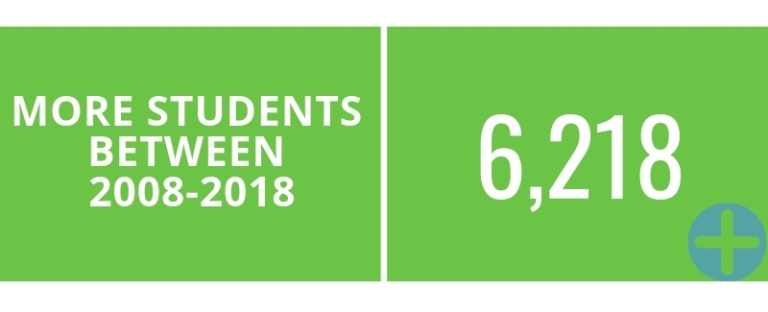
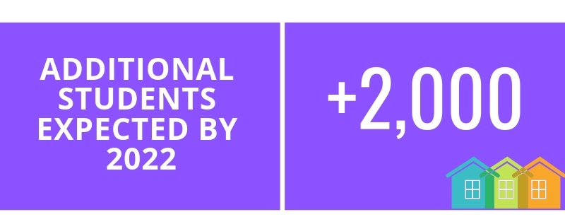
LWSD Enrollment
Notes:
Lake Washington School District is experiencing uncommon and rapid growth.

Slide 9
LWSD Enrollment and Available Classroom Space
+5,000 students
Permanent Classrooms

Slide 10
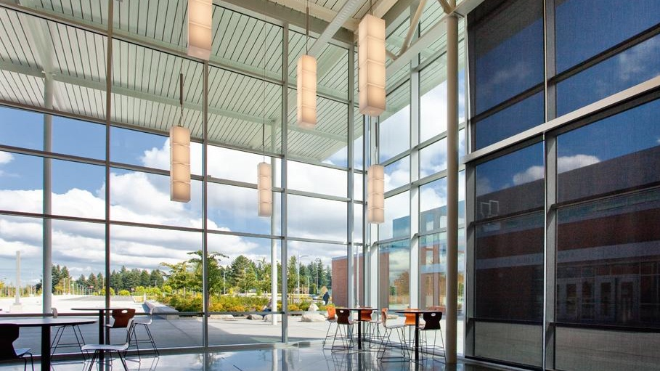
Program Overview

Slide 11
The district will open it’s 55th School this Fall with the new Timberline MS
Small Works Projects: Funded Capital Levies ($15M - $20M per year)
Small Works Roster [MRSC]
Job Order Contracting [2 contracts currently]
Design-Bid-Build
KCDA & Other cooperative purchasing agreements
ESCO
Major Capital Projects: funded through Capital Levies and Bonds
Design-Bid-Build
GC/CM
[3] GC/CM Projects completed prior to Public Body Approval in 2016
[6] GC/CM Projects currently in construction
[5] GC/CM Projects currently in design

Slide 12
Benefits of GC/CM Delivery:
Greatest control for occupied site construction
Flexibility for early construction activities
Contractor’s lens brought to the preconstruction process
Notes:
Land acquisition opportunities are becoming incredibly limited in Kirkland, Redmond, and Sammamish – forces District to replace facilities on occupied sites
School construction is typically bound by summer break, early construction activities can allow for projects to create more calendar time than the hard-bid process. In addition to release of early bid packages, we are able to bid long-lead items such as prefabricated steel and vaults.
Brings the lens of a contractor to the preconstruction process, for existing sites, this promotes more in-depth investigation of site conditions and assemblies. Exploratory demolition and 3D laser scanning of buildings – for checking how level the floors or plumb the walls are

Slide 13
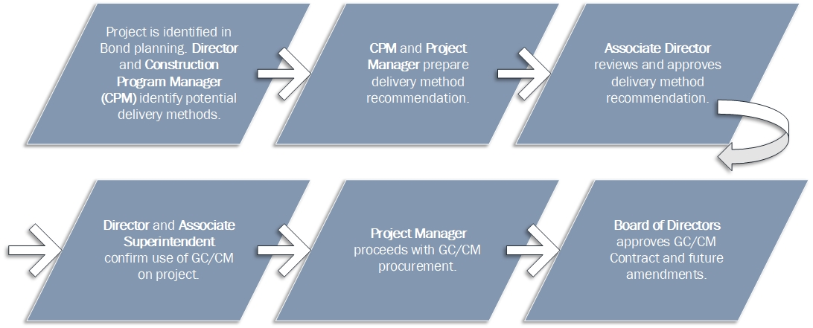
LWSD GC/CM Approval Process
Notes:
We see our internal process as an extension of yours
Step 1 – Project is identified in Bond Planning. Director and Construction Project Manager (CPM) identify potential delivery methods
Step 2 - CPM & Project Manager prepare delivery method recommendation
Step 3 - Associate Director reviews and approved delivery method recommendation – this follows the similar process that the PRC convenes for project approval
Step 4 – Presentation to Director and Associate Superintendent confirm use of GC/CM on project
Step 5 - Project Manager Proceeds with GC/CM procurement
Step 6 - Board of Directors approves GC/CM Contract and future amendments
RCW project requirements:
Subject to the process in RCW 39.10.270 or 39.10.280, public bodies may utilize the general contractor/construction manager procedure for public works projects where at least one of the following is met:
(1) Implementation of the project involves complex scheduling, phasing, or coordination;
(2) The project involves construction at an occupied facility which must continue to operate during construction;
(3) The involvement of the general contractor/construction manager during the design stage is critical to the success of the project;
(4) The project encompasses a complex or technical work environment;
(5) The project requires specialized work on a building that has historic significance; or
(6) The project is, and the public body elects to procure the project as, a heavy civil construction project. However, no provision of this chapter pertaining to a heavy civil construction project applies unless the public body expressly elects to procure the project as a heavy civil construction pr oject

Slide 14
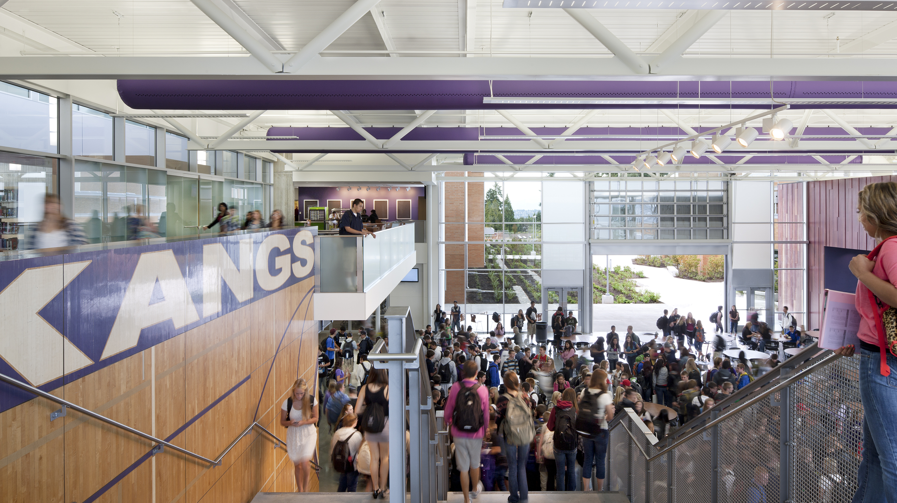
GC/CM Projects List Since 2016 Certification
Construction Completed:
None
In Construction Phase: [2016 Bond]
Ella Baker Elementary School – New Opened Fall 2018
Clara Barton Elementary School – New Opened Fall 2018
Juanita High School – Rebuild & Enlarge Opening Fall 2019/2020
Timberline Middle School – New Opening Fall 2019
Kirk Elementary School – Rebuild & Enlarge Opening Fall 2019
Mead Elementary School – Rebuild & Enlarge Opening Fall 2019
In Design Phase: [2019 Levy]
Lake Washington High School - Addition Opening Fall 2020
Benjamin Franklin Elementary School – Addition Opening Fall 2021
Mark Twain Elementary School – Addition Opening Fall 2021
Rose Hill Elementary School – Addition Opening Fall 2021
Rachel Carson Elementary School – Addition Opening Fall 2022
Notes:
District History:
Mann Elementary School – 1st GC/CM Project and part of the K12 GCCM Pilot Projects - $13M 2002-2003
Rush ES - $40.6M GC/CM 2011-2014
LWHS - $113.7M GC/CM 2008-2011 [Lydig]

Slide 15
2016 Bond Program
*GC/CM Project approved by PRC prior to Public Body Certification
Project | Budget | GC/CM Approval | Design-Bid-Build [Bid Date] | Project Status [% Complete]
Juanita High School – Rebuild & Enlarge | $137.4M | 3/4/16* |  | 50%
Timberline Middle School – New | $76.8M | 7/1/16 |  | 80%
Barton Elementary School – New | $46.2M | 8/24/16 |  | 98%
Baker Elementary School – New | $52.8M | 7/1/16 |  | 97%
Kirk Elementary School – Rebuild & Enlarge | $48.7M | 1/18/17 |  | 50%
Mead Elementary School – Rebuild & Enlarge | $50.8M | 1/18/17 |  | 50%
Old Redmond Schoolhouse Preschool | $7.8M |  | 10/16/18 | 30%
Explorer Community School | $2.3M |  | 6/7/17 | 100%

Slide 16
2019 Levy Program
Project | Budget | GC/CM Approval
Lake Washington High School Addition | $120.0M | 6/4/18
Franklin Elementary School Addition |  | 12/20/18
Rose Hill Elementary School Addition |  | 12/20/18
Twain Elementary School Addition |  | 12/20/18
Carson Elementary School Addition |  | 12/20/18
Notes:
February 2018 Bond failed – LWHS was included in the Bond measure – preliminary planning had been started with GC/CM approval on 6/4/18

Slide 17
GC/CM Utilization
Project | Construction Budget | % Self Performed | # Bid Packages | Budget-Bid Variance
Juanita High School – Rebuild & Enlarge | $97.1M | 11.8% | 29 | 2.9% over
Timberline Middle School – New | $60.9M | 28.7% | 25 | 3.6% under
Baker Elementary School – New | $35.7M | 24.0% | 23 | 11.1% under
Barton Elementary School – New | $40.3M | 21.4% | 22 | 3.2% under
Kirk Elementary School – Rebuild & Enlarge | $37.1M | 13.1% | 33 | 6.9% over
Mead Elementary School – Rebuild & Enlarge | $39.0M | 16.4% | 35 | 11.4% over

Slide 18
MC/CM & EC/CM Utilization
*Independent audit required per RCW 39.10.385.11
Project | MC/CM Budget | EC/CM Budget | Project Status [% Complete] | Audit Required*
Juanita High School | $16.6M | $10.6M | 52% | Scheduled
Timberline Middle School | $8.8M | $6.0M | 83% | Scheduled
Ella Baker Elementary School | $4.7M | $3.7M | 97% | In-process
Notes:
In Lessons Learned we discuss the independent audit and how we are expanding the scope of services

Slide 19
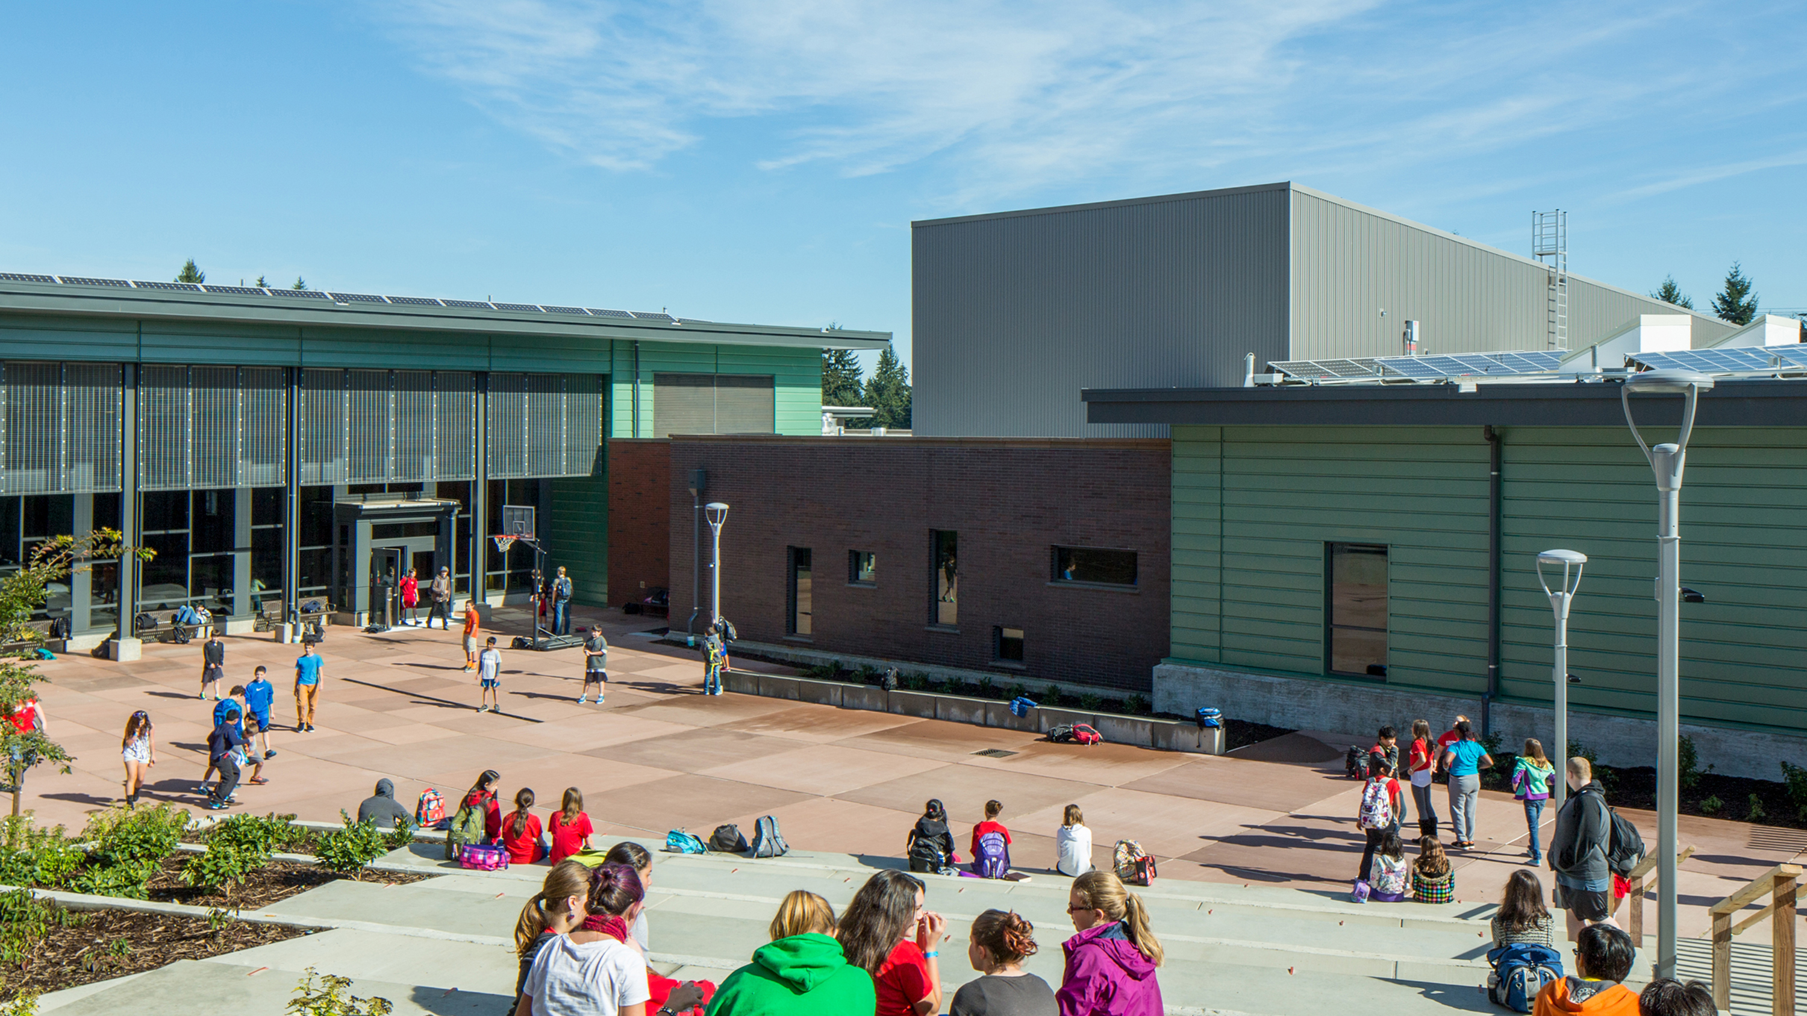
Apprenticeship Utilization & MWBE Efforts
MWBE Efforts:
The district partners with our GC/CMs to leverage their relationships and outreach efforts to promote the use of minority and women-owned business enterprises. Efforts to date include:
GC/CM open houses/local outreach events & project information meetings
Contact local labor organizations & provide public notices
Leverage GCCM vendor databases
Review size and scope of bid packages so that there are opportunities for smaller firms to be successful
Provide support to potential subcontractors and suppliers with bid form and proposal requirements
Project | JHS | TMS | Baker | Barton | Kirk | Mead
Apprenticeship Utilization | 20% | 23% | 18% | 21% | 17% | 17%
Notes:
For consideration, the requirement of bonding over $300,000 is a barrier to entry and would likely increase participation if it was raised.

Slide 20
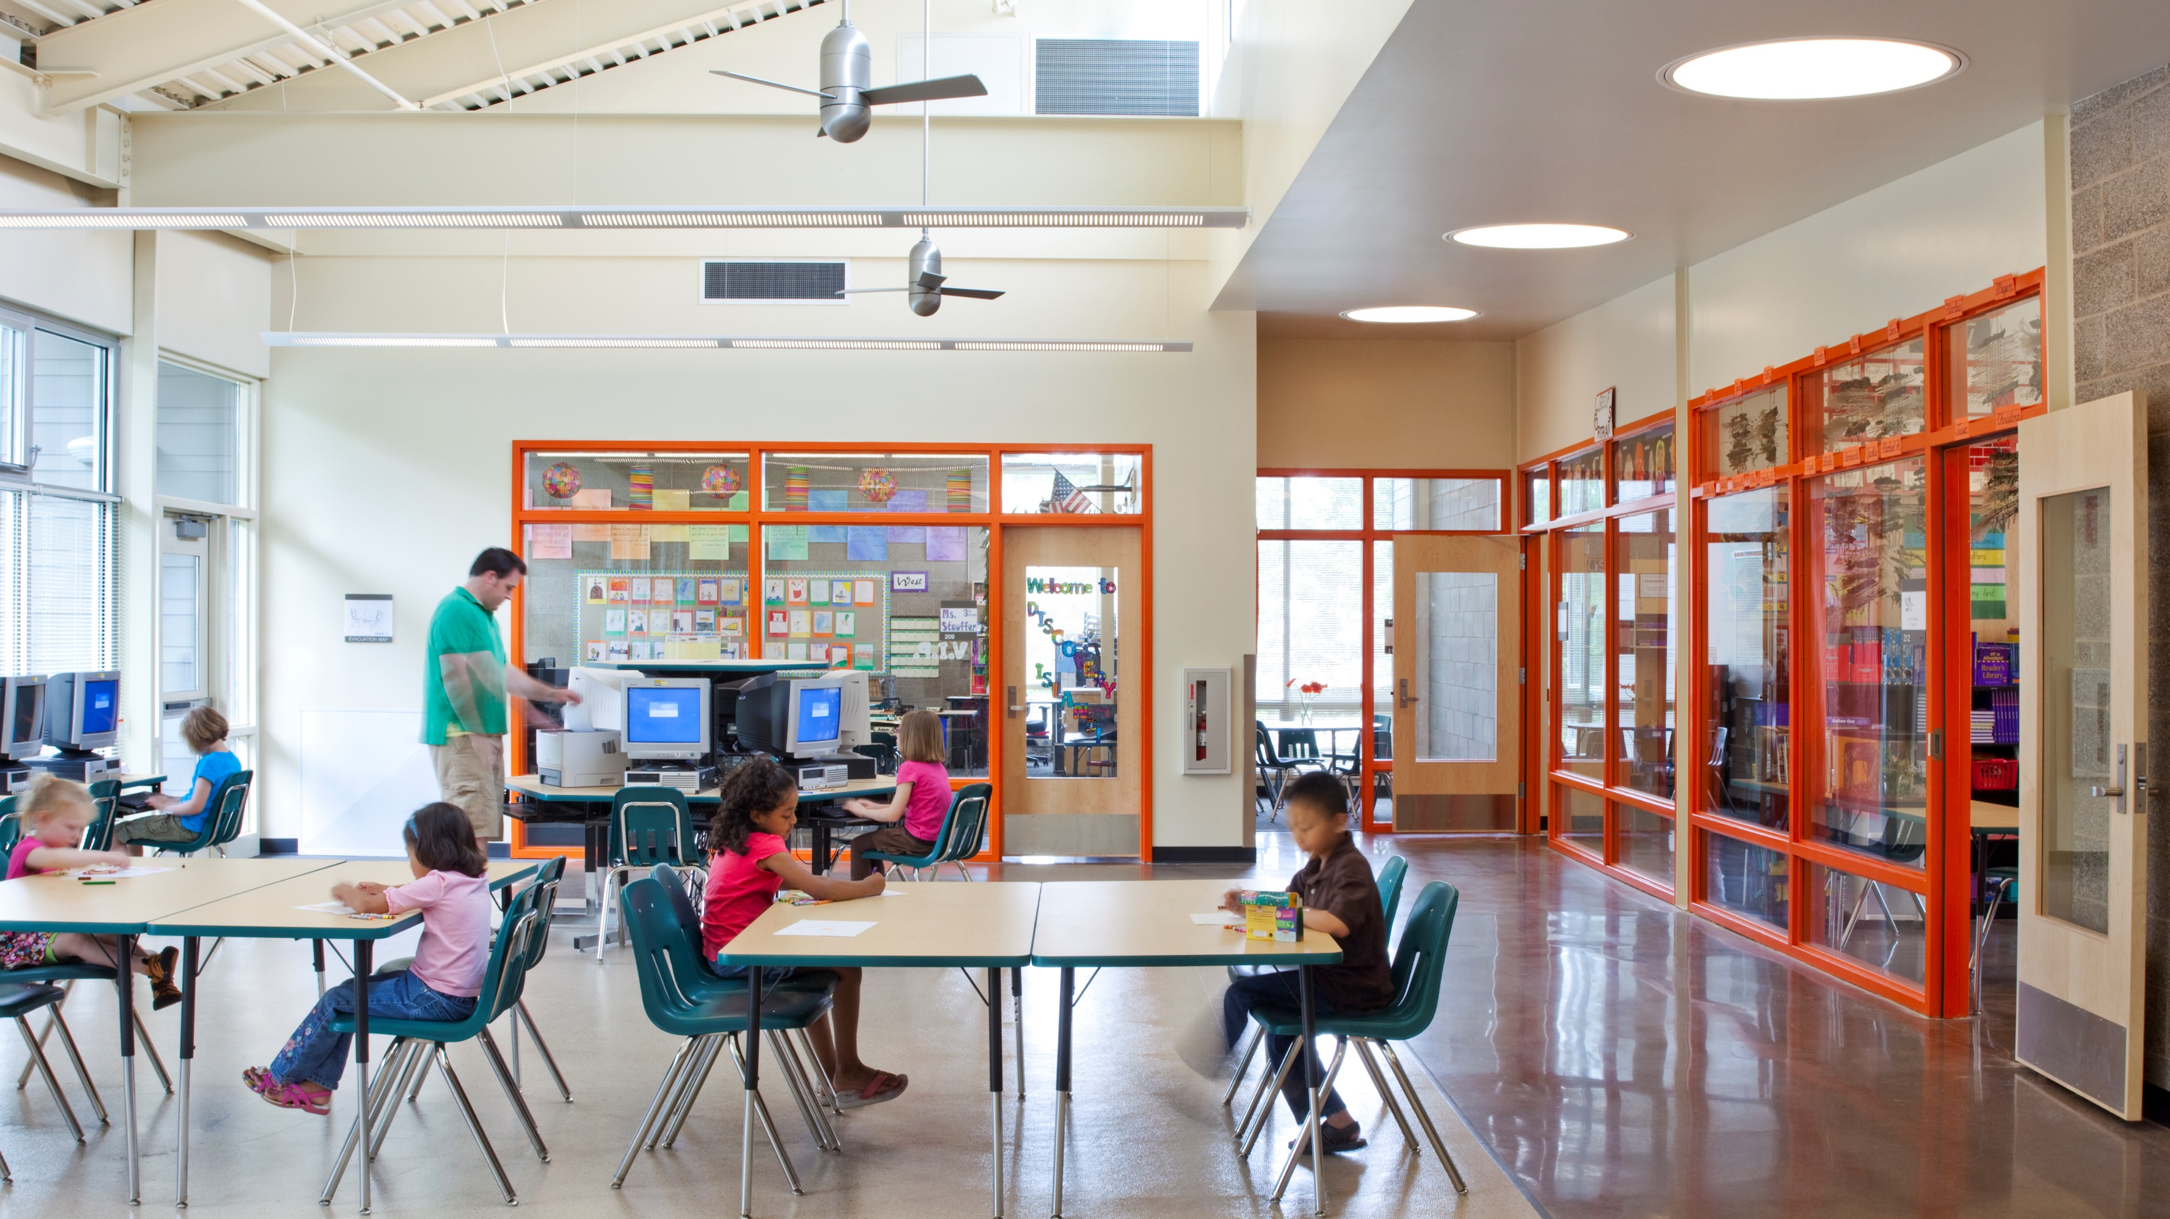
Lessons Learned

Slide 21
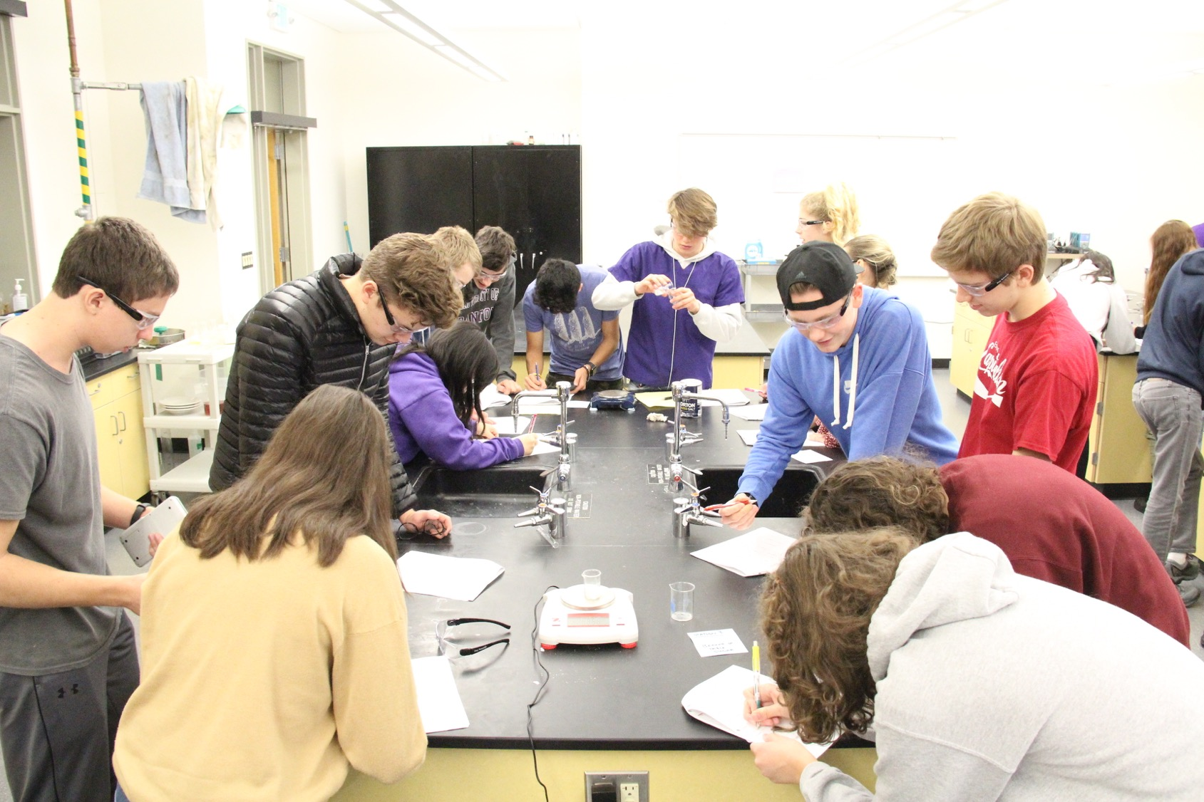
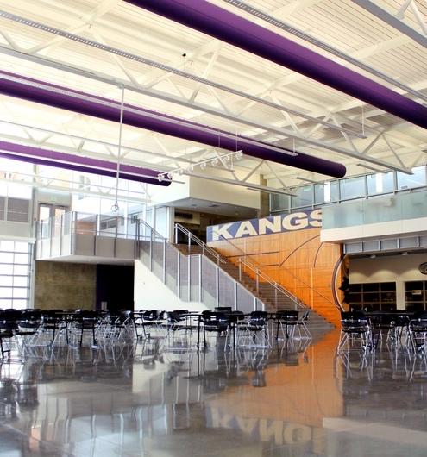
Lessons Learned: Program-wide
Bring the GC/CM on as early as possible
Benefits of using consultants
Cost & schedule certainty
Bundle projects
Bundle packages
Notes:
Bring the GC/CM on as early as possible – Integrated Design Process
Ability for the contractor to fully understand the District’s goals, standards, schedule and overall expectations and ensure that they are achieved at all levels of the project; This has been helpful in partnering with the Authorities having jurisdiction early on in the project
Benefits and disadvantages of using consultants – The risk for using consultants is the potential for losing institutional knowledge when they leave, we mitigate this risk by establishing long-term contracts with staff housed in-district as contract employees that are badged and collaborate with internal departments.
Cost & Schedule Certainty – Through cost modeling options in an iterative process to maximize value and meet programmatic goals and objectives;
Bundle Projects where possible – similar construction types or by proximity of project locations – leverage buying power
Bundle packages and better understand market opportunities and constraints

Slide 22
Lessons Learned: GC/CM Procurement Process
Specified General Conditions for RFFP solicitation
GC/CM Self Performance:
Bid package prep
Limited response
Expanding 3rd Party Audits for MC/CM and EC/CM to GC/CM
Notes:
SGC’s – specify the number of staff that you expect to see on the job so that the District gets comparable levels of services proposed by each firm to level the playing field
For all bid packages that the GC/CM will be bidding on to self perform the work, we ensure that we are part of the process for getting the word out, we advertise on our Bid Connect, as well as open bids at a neutral office and we facilitate the formal bid opening.
Many bid package openings where the GC/CM is proposing to self perform get reduced responses – this is informing our process to be more proactive in our outreach
The District is expanding the use of the auditor for 3rd party MCCM and ECCM review to include GCCM audits as well as early kick-off meetings to establish the expectations

Slide 23
Lessons Learned: Juanita High School
Integrated Design Process benefits – Phasing & Occupancy
Start early and end early
Critical Systems Failure – electrical room fire
Notes:
Benefits of the Integrated Design Process resulted in an iterative plan to build the 219,000 SF within the footprint of the existing high school that would remain in operation through the duration of the project
Early site demo and construction phase allowed the project to start early and was part of several initiatives that together will allow the school to open one year ahead of the original scheduled opening
During the first major scope of demolition the 55 year old switch gear in the main electrical room caught on fire, it was determined that it had not been switched on or off in a long time and that the repeated action had allowed a conductor to arc against an adjacent conductor. The gear that we lost was no longer available and this could have been a catastrophic issue with the school having very limited time to be back online for the start of the school year. Having the EC/CM on board allowed the District to leverage the partnership and quickly recover with new gear being installed concurrent with the onsite demolition and the school was re-opened on time.

Slide 24
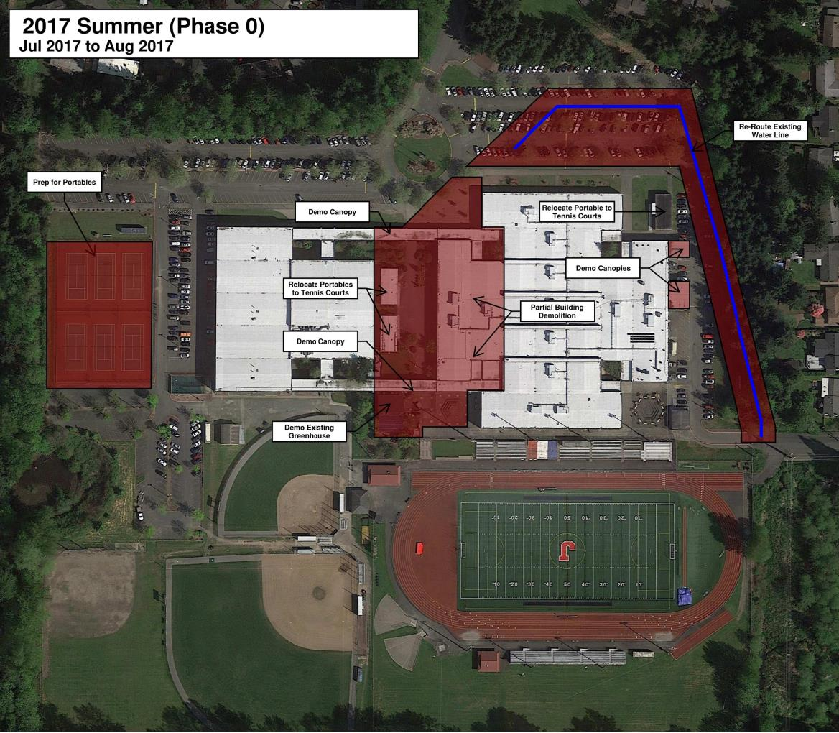
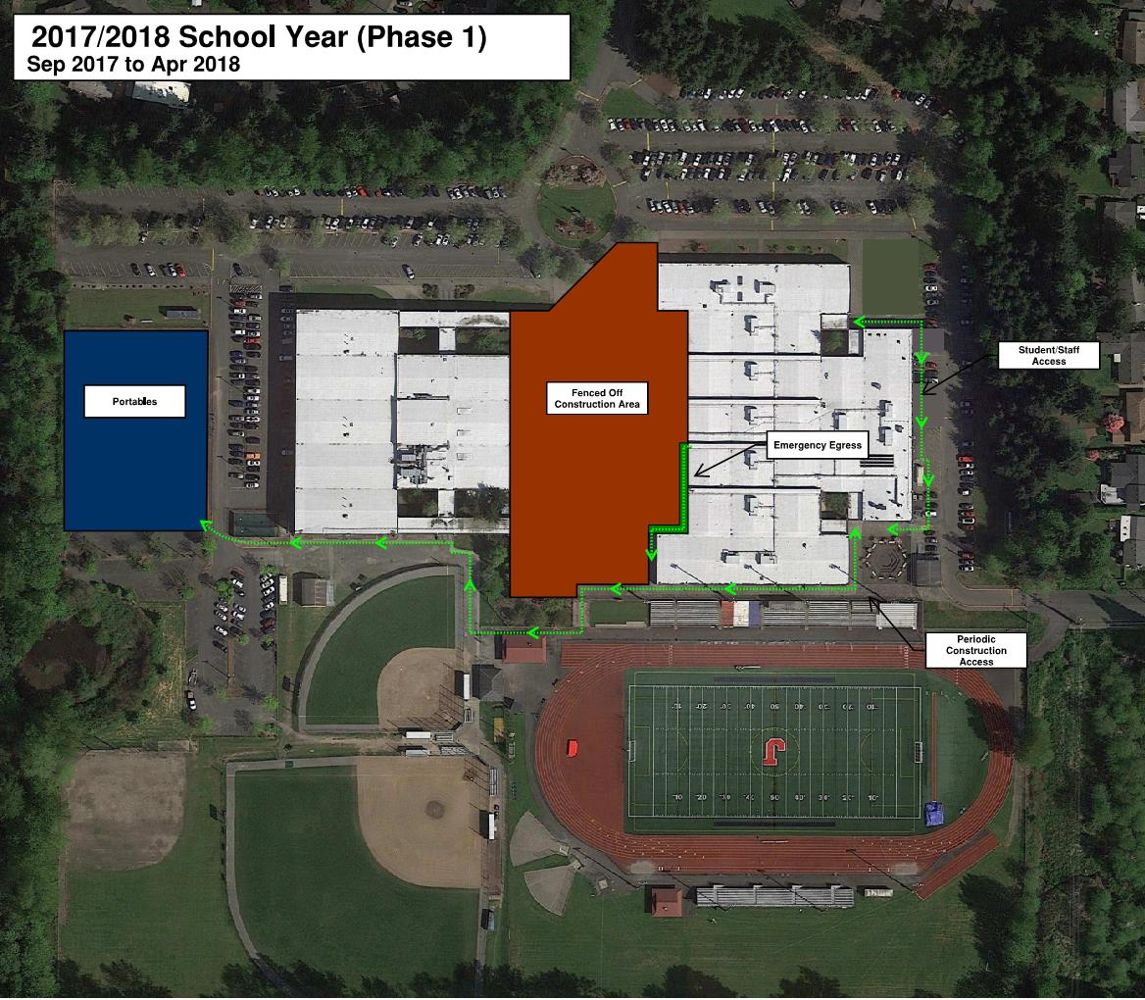
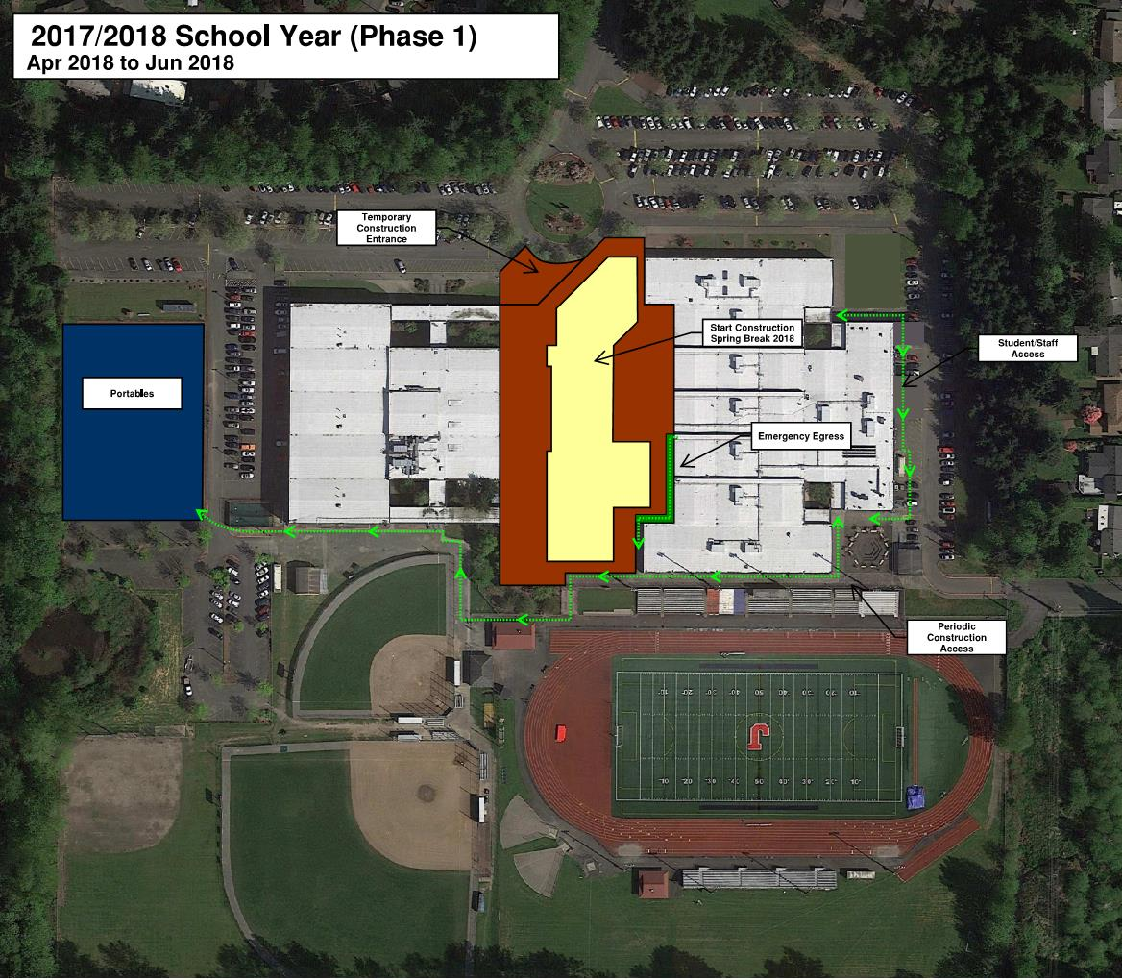
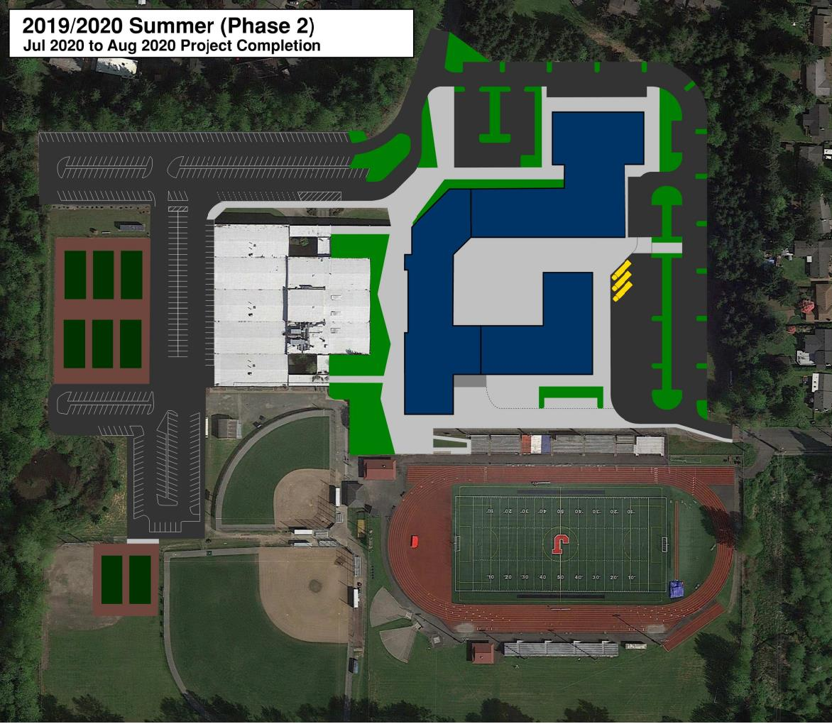
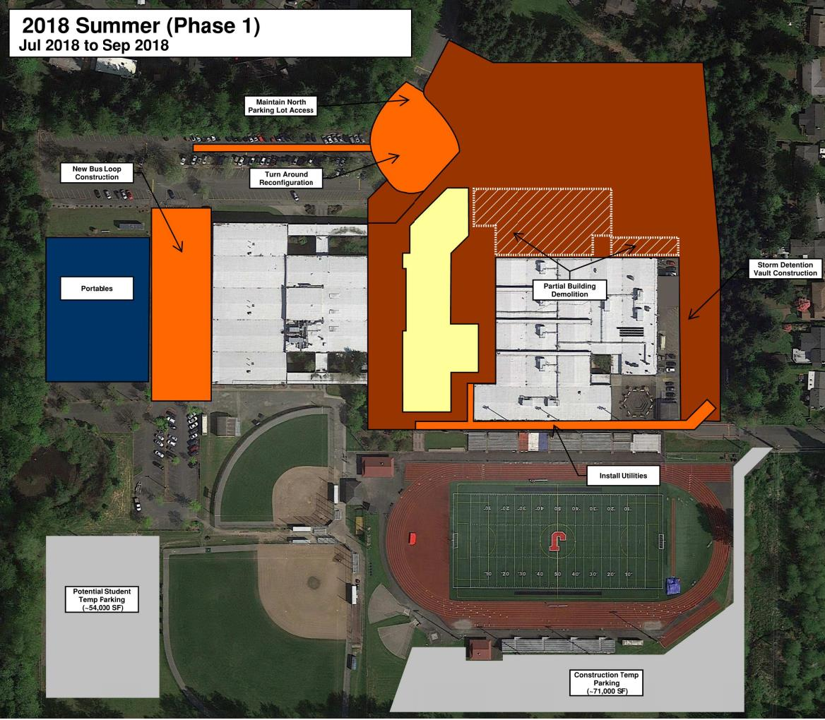
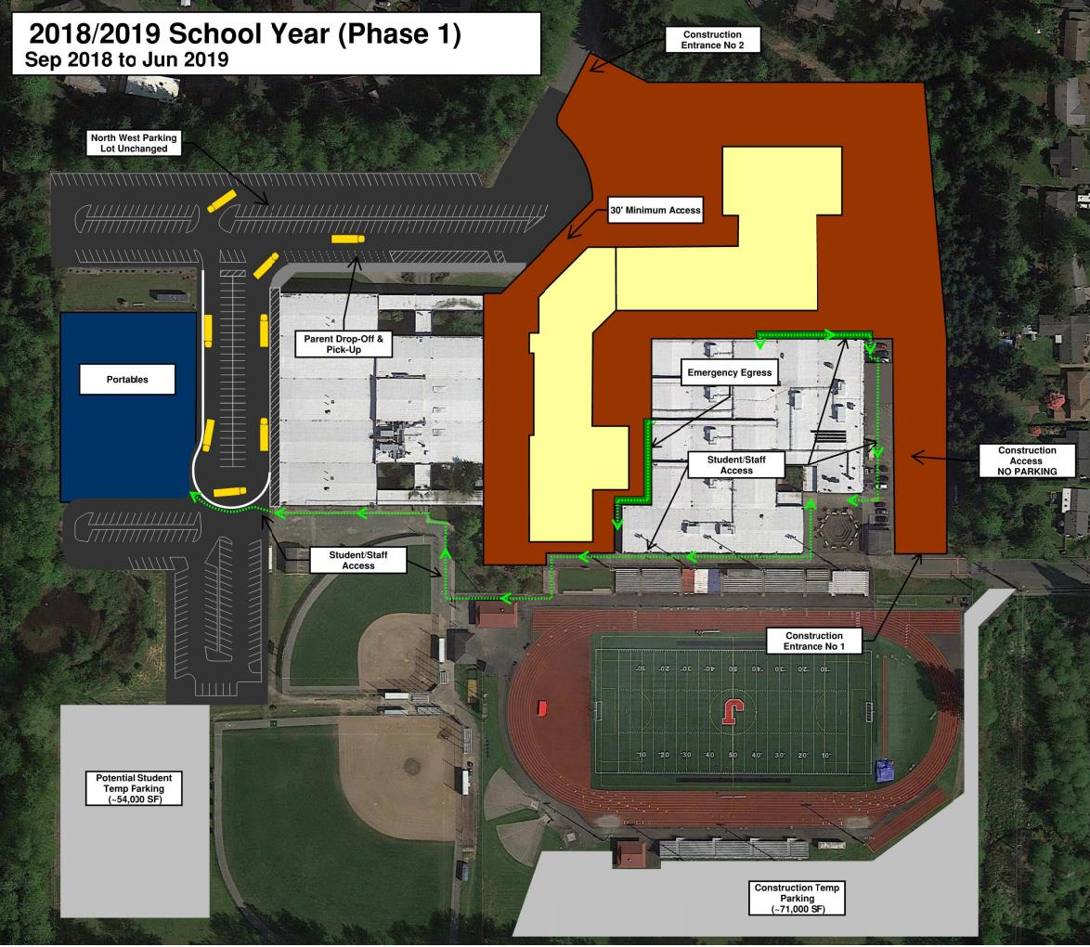
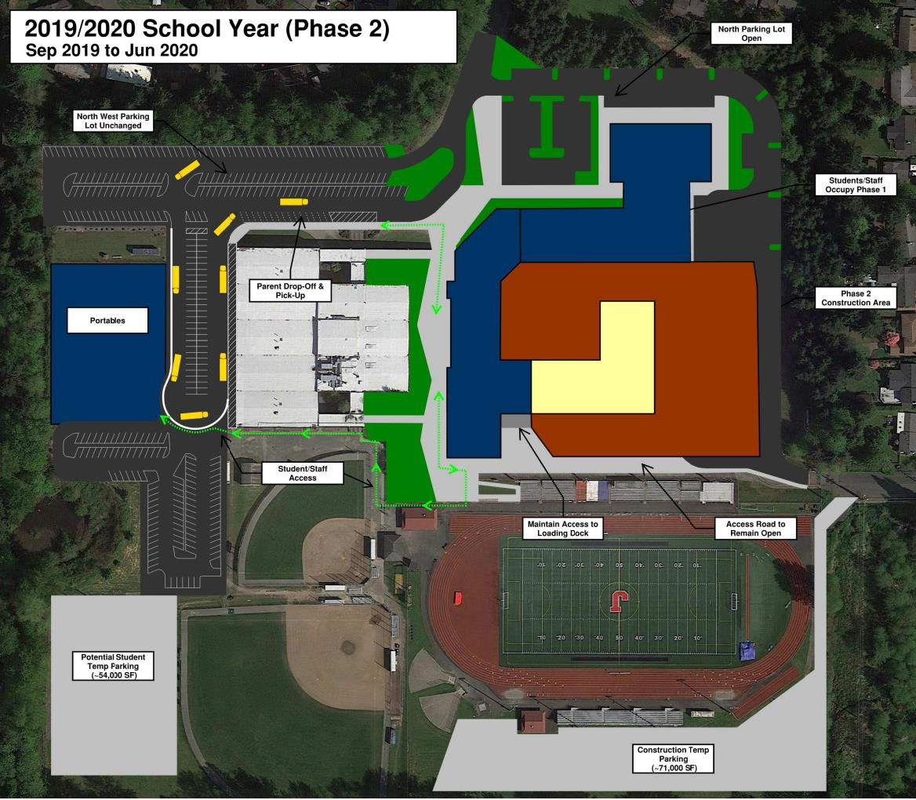
Lessons Learned: Juanita High School

Slide 25
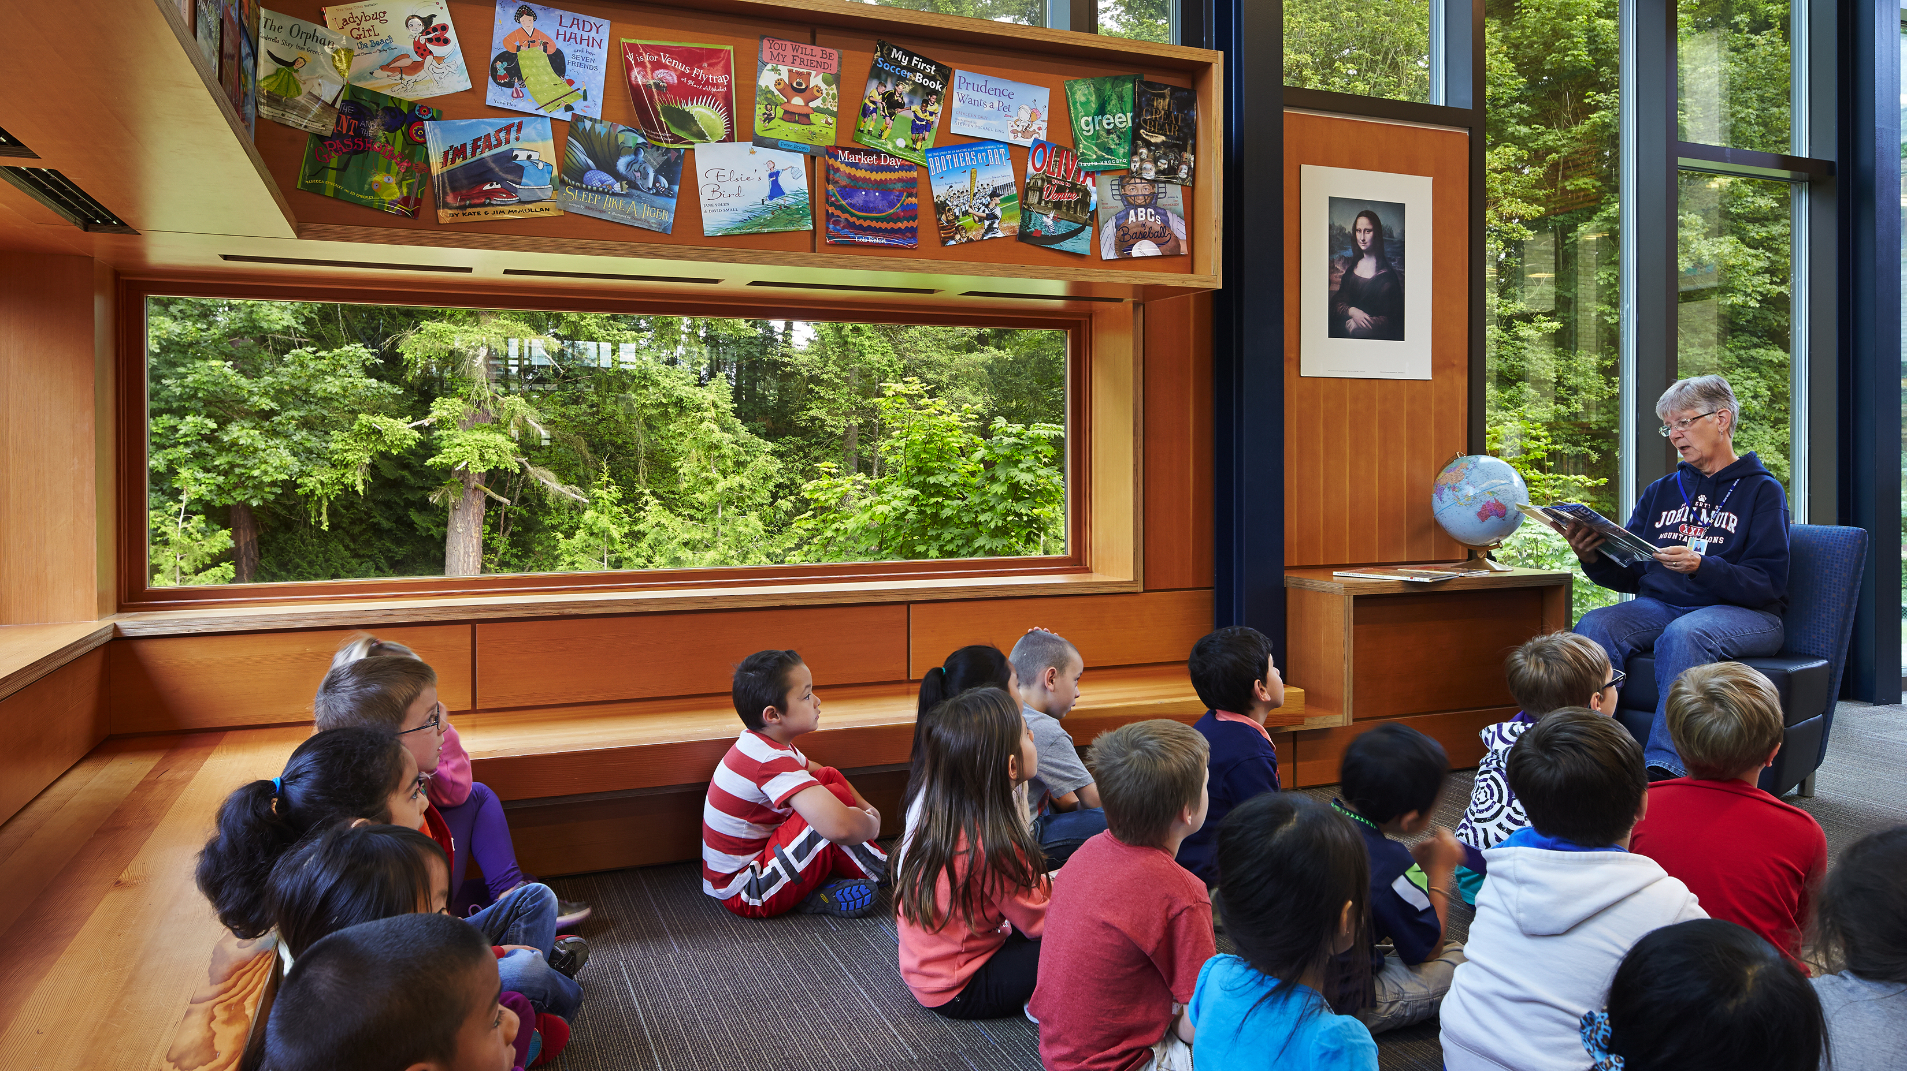
Lessons Learned: Kirk and Mead Elementary Schools
The Integrated Design Process – Operations, Siting & Access
Iterative, cost-modeled siting approach
Access & occupancy
Grading & close proximity to existing building
Geothermal wells & storm drain vaults
Notes:
The Integrated Design Process was critically important on these two similar elementary school replacement projects
New buildings were designed to be built on adjacent playfields, an iterative, cost-modeled approach was taken to site the buildings, down a foot, over a foot – check the cost, etc.
balancing site access, grading implications, proximity to existing buildings and maintaining all utilities, to ensure that the occupied construction site would not impact the student’s day
In addition the GC/CM partnership helped shape how the geo-thermal well field and underground stormwater vaults were constructed within these highly complex and compact sites

Slide 26
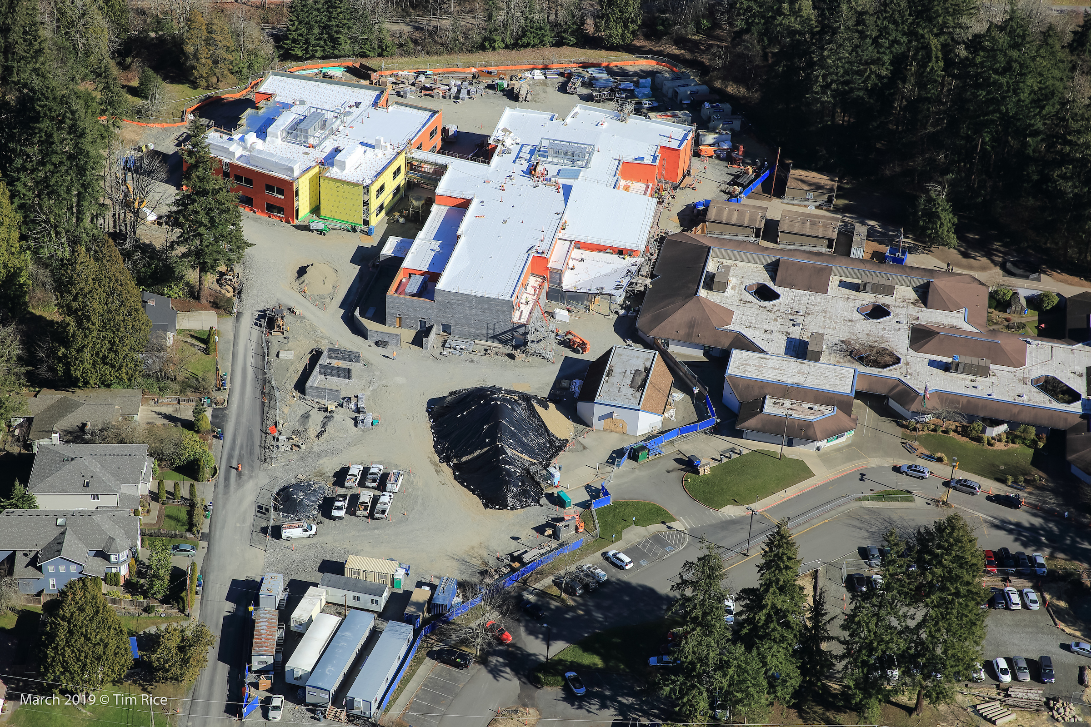
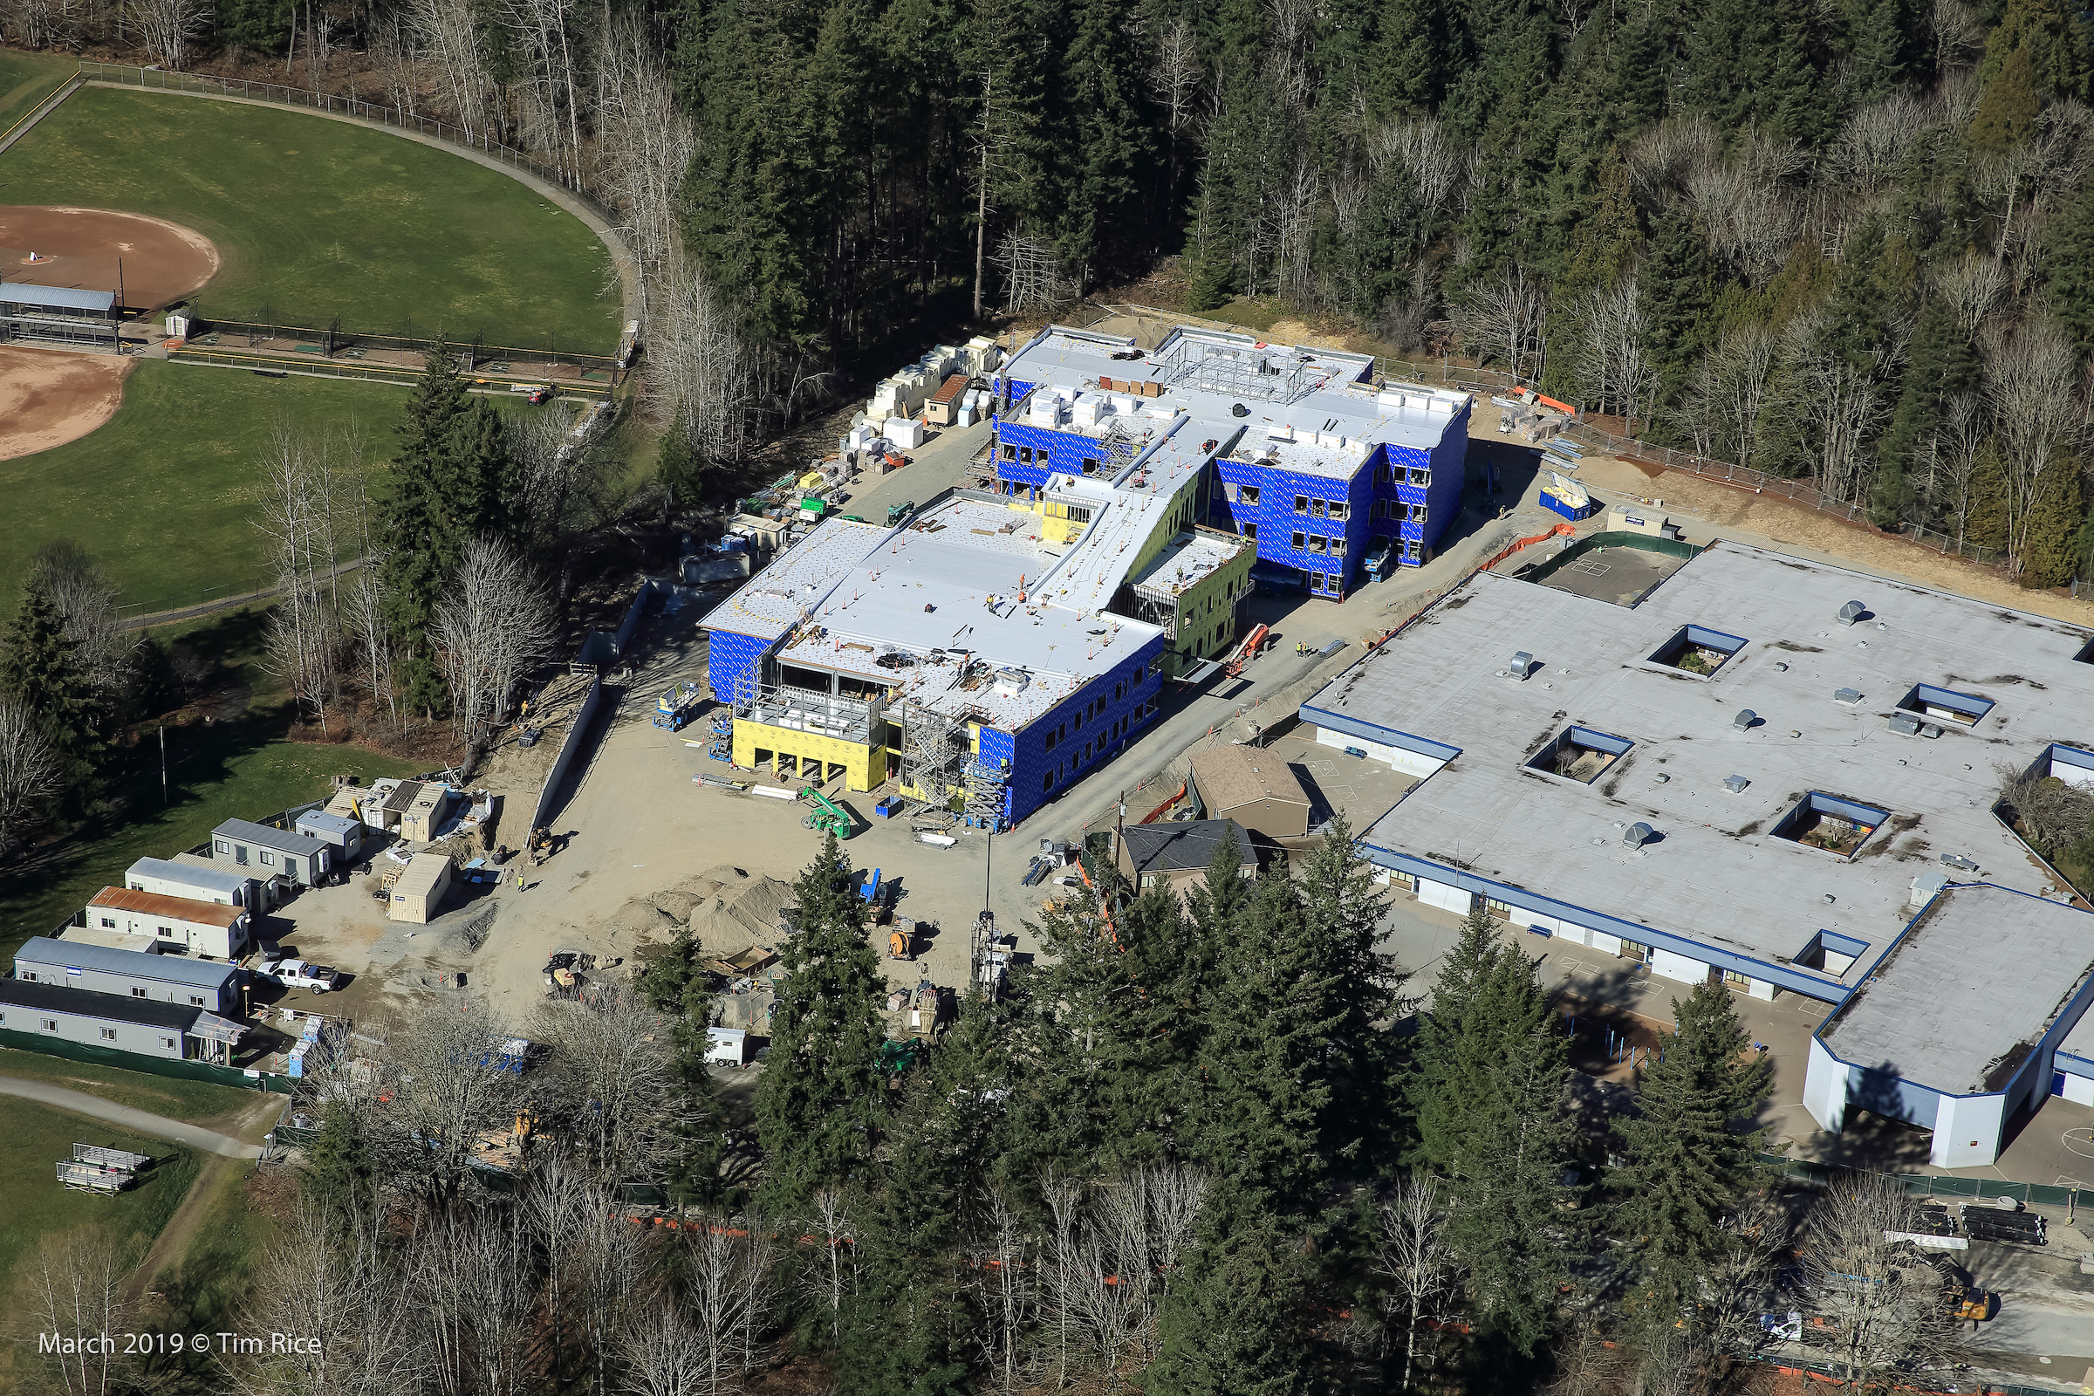
Lessons Learned: Kirk and Mead Elementary Schools
Kirk Elementary School Mead Elementary School
Notes:
Note the tight proximity between the existing structure and new.
What’s not so easily apparent is the grade change at Mead. There is a 10’ grade change between the two buildings. Now imagine that we have over 600 students, 60+ staff and the parents & buses coming in for drop-off and pick-up. Highly complex and compact sites.
In addition there is X geothermal wells and large underground detention vaults outside of the building foundations.

Slide 27
Questions

