Slide 1
Pacific Avenue/ SR 7 Corridor Bus Rapid Transit Project
GC/CM Project Approval Application
July 25th, 2019

Slide 2
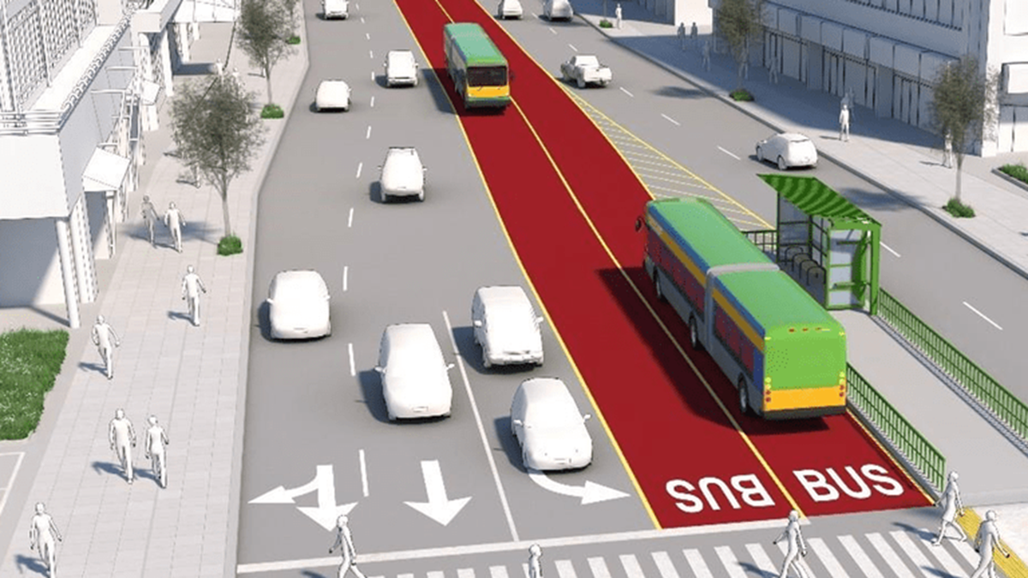
Pacific Avenue/ SR 7 Corridor Bus Rapid Transit Project
GC/CM Project Approval Application
July 25th, 2019

Slide 3
Agenda
Introductions
Project Background
Meets Applicable Criteria
Qualifying project
Management Plan
Project Team
Schedule
Budget
Funding
Public benefits
Summary

Slide 4
Project Background

Slide 5
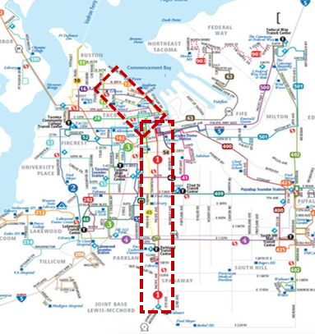
Project Overview
Connects downtown Tacoma to Spanaway Towne Center
32 new BRT stations on each side of the street,
branded station at Tacoma Dome Station
Exclusive and semi-exclusive rights-of-way, and sidewalk
Goals
Speed travel along highest use corridor
Decrease congestion
Increase accessibility
Increased amenities:
Comfortably hold 90 passengers
Wi-Fi and multiple boarding doors
Pre-payment options, real-time travel info and weather protection
Economic development opportunities

Slide 6
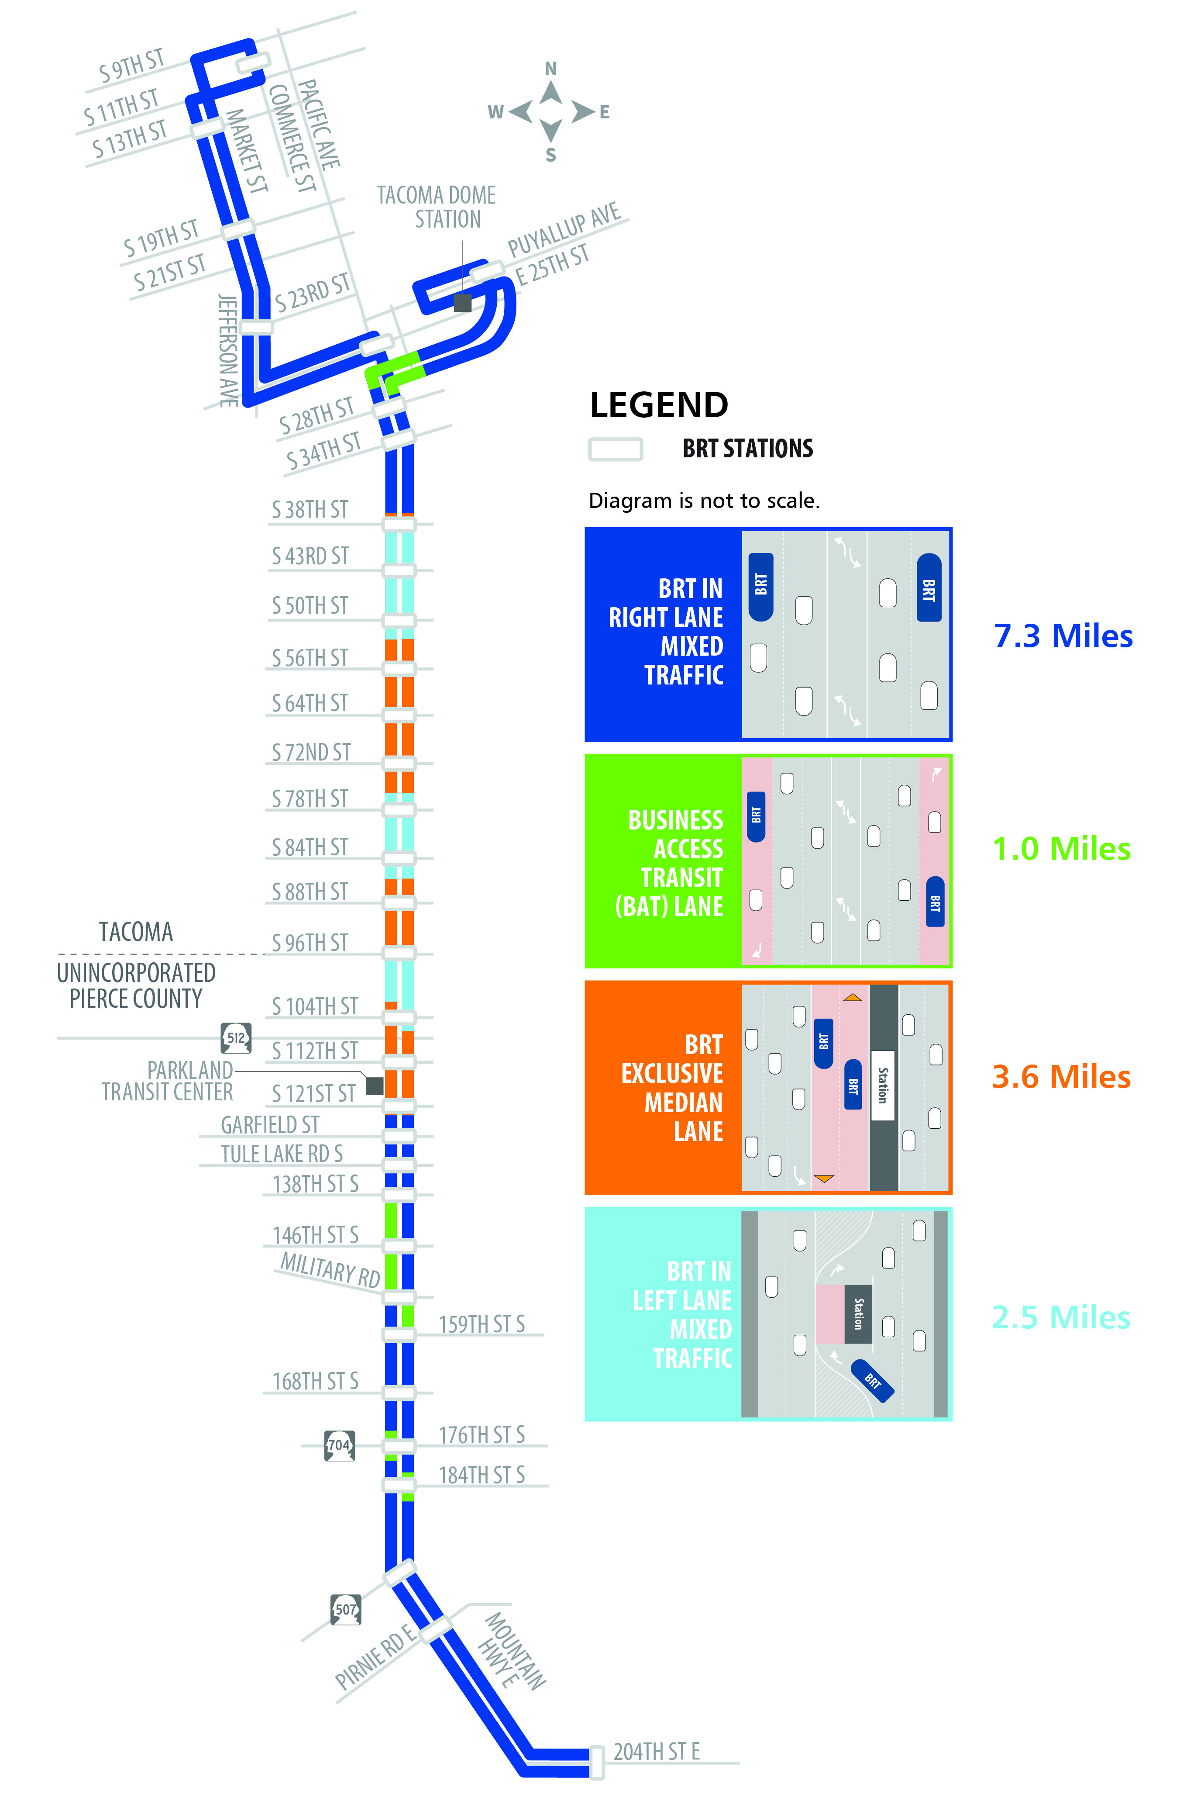
Configurations

Slide 7
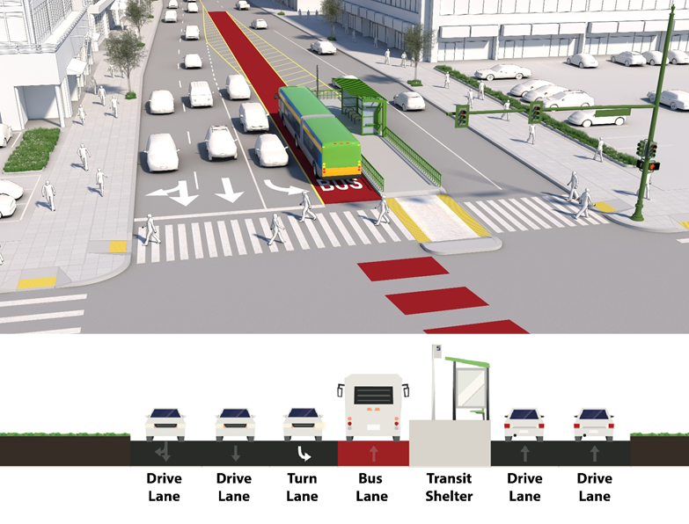
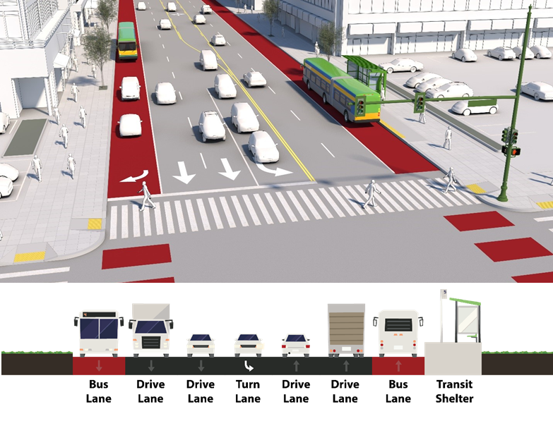
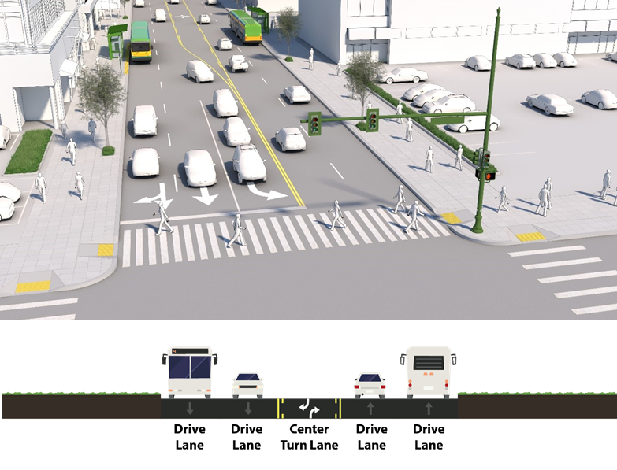
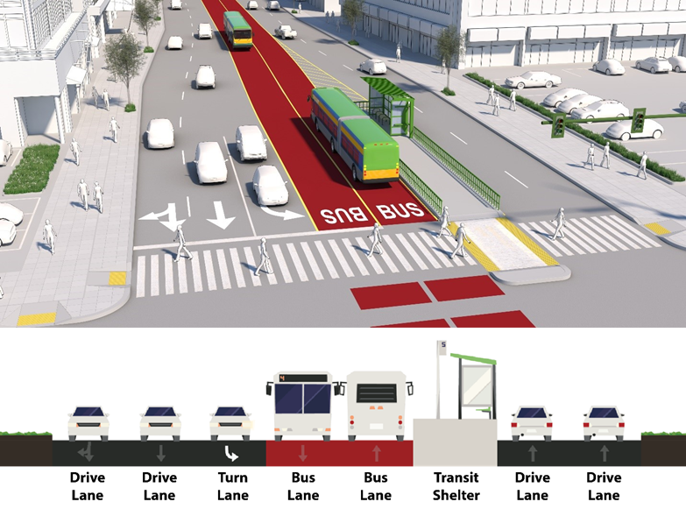
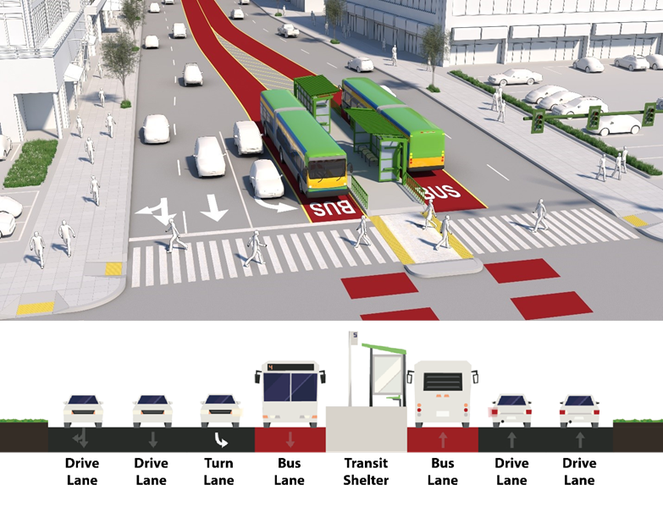
Mixed Traffic: Left Lane
Curbside Running: BAT Lane
Current Condition:
Mixed Traffic, Four Lanes
Median Lane: Right-Side Boarding
Median Lane: Left-Side Boarding

Slide 8
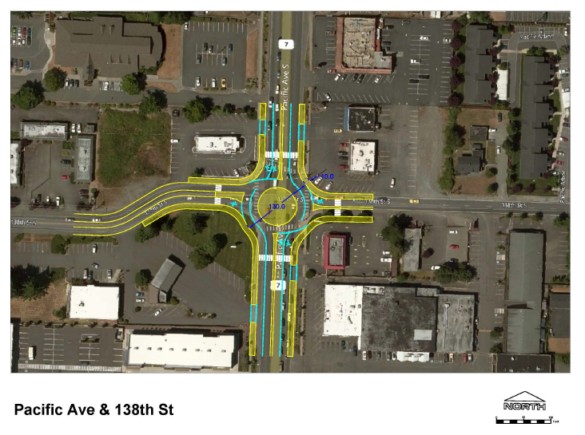
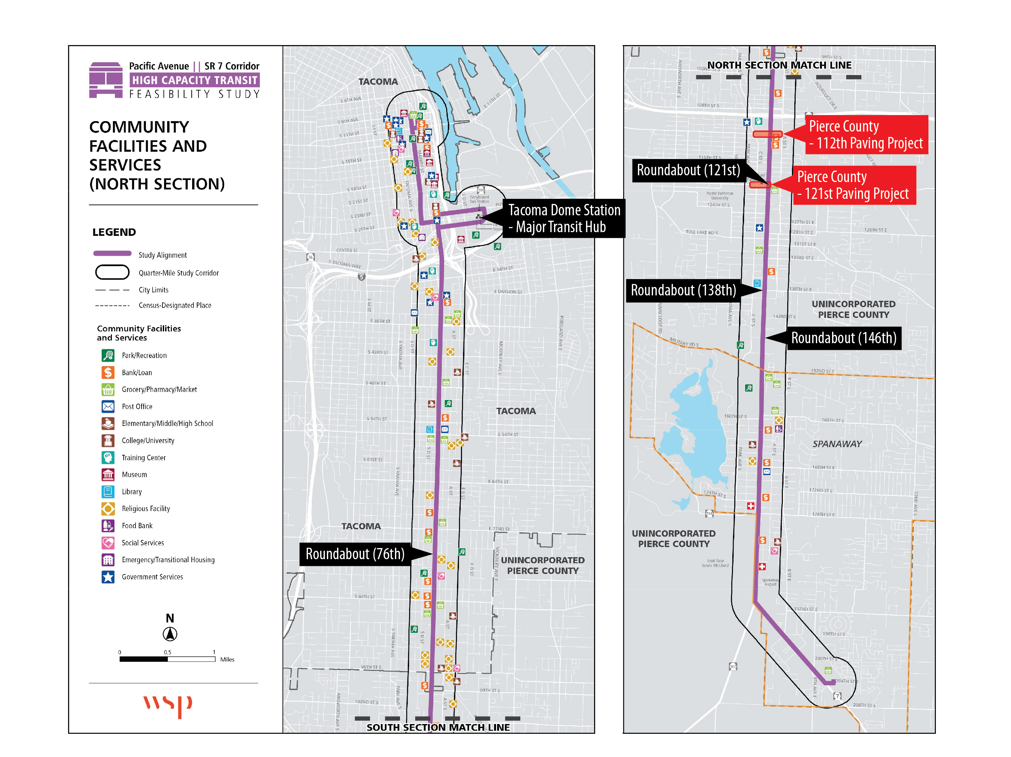
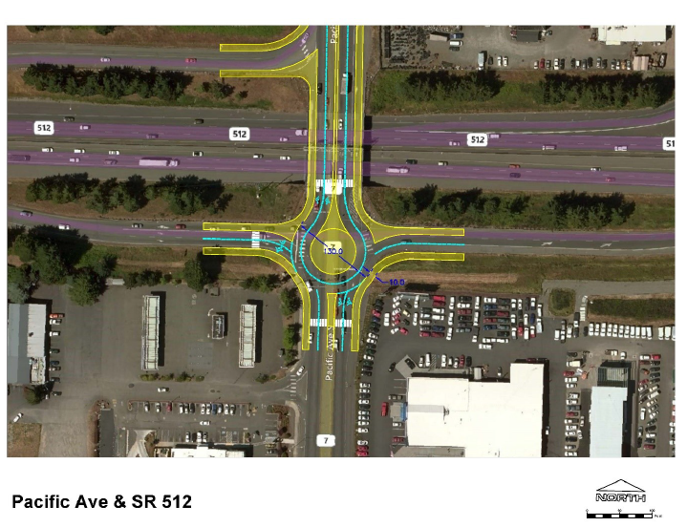
Potential Roundabouts
12 intersections under study by WSDOT
WSDOT likely to require roundabouts at four intersections
Challenge: Maintain traffic flows during construction

Slide 9
Funding
Proposed Budget: $150 M
Currently secured: $ 90 M
Sound Transit (ST3) funding: $ 60 M
State of Washington Grant: $ 15 M
Various federal and state grants: $ 15 M
Remainder $ 60 M
Highly scored for FTA Small Starts grant (decision likely Summer 2020)
If funding delay or shortfall, will build in phases

Slide 10
Schedule
Project Milestones
GC/CM Procurement Schedule
Project Schedule

Slide 11
GC/CM Qualification

Slide 12
Qualifying Criteria
Complex scheduling, phasing or coordination
Involves construction at an occupied facility
Involvement of the GC/CM during design is critical
Complex or technical work environment
Historic significance – N/A
Heavy Civil

Slide 13
1. Complex Scheduling / Phasing
Match funding flows
Three major AHJs: WSDOT, City of Tacoma, Pierce County
Rights of way and easement acquisitions
Project interfaces:
City of Tacoma Pacific Avenue Corridor study
WSDOT ADA and access improvements down corridor
Pierce County –
112th Street South - C Street South to A Street South
121st Street South (C St S to SR7)
Roundabouts

Slide 14
2. Occupied Facility
Maintain transit operations
Maintain access:
291 driveways restricted to right-in/right-out only.
35 unsignalized roadway intersections would be restricted to right turn only.
Signalized intersections would be modified to provide for left turns and U-turns.
The project would need to be phased to allow for U-turns before left turn ability was removed.
Affects colleges, schools, libraries, commercial businesses, recreational facilities, first responders, residential
Maintain utilities – power, water, sewer, communications, storm drainage (red areas)
Signals - transit signal priority systems

Slide 15
3. GC/CM Involvement is Critical
Community concerns include parking, access, minimization of disruption
GC/CM must actively partner on design and commit to solutions
Constructability, cost estimating, scheduling
Communication

Slide 16
4. Complex or Technical Environment
Utility relocations
Signal priority systems
Fare collection system
Closed - Circuit Television (CCTV) systems
Roundabouts – multiple intersections may be required to be reconstructed as roundabouts
Real Time Information System/signage

Slide 17
5. Heavy Civil
Work is primarily infrastructure
Roadway
Utilities
Systems
Facilities (minority of budget)
Negotiated work where greatest value to project
Industry input will be sought

Slide 18
Management

Slide 19
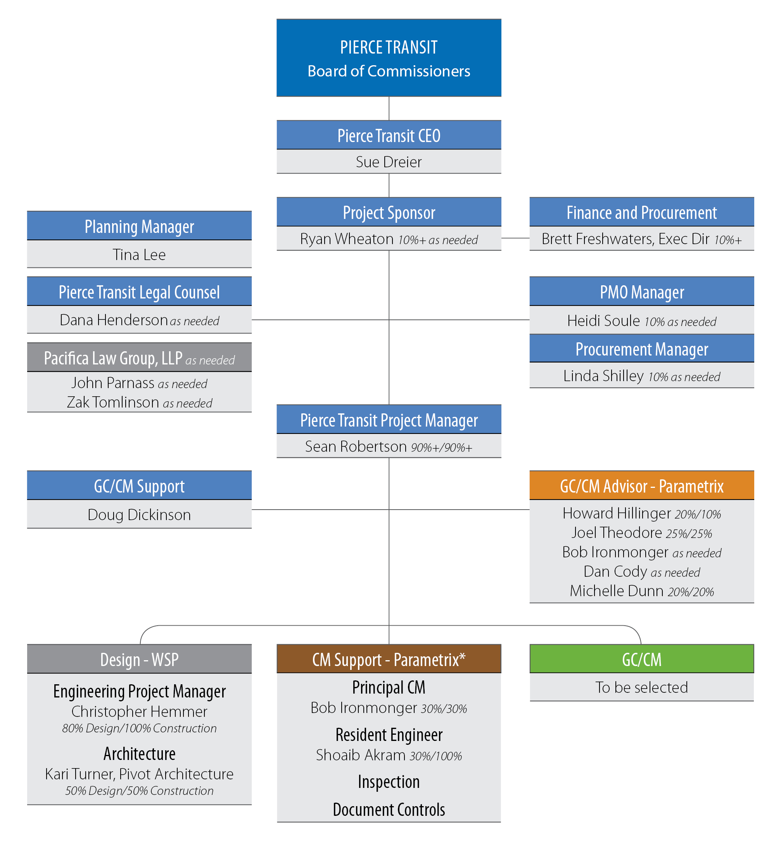
TEAM ORGANIZATION

Slide 20
Project Team
Ryan Wheaton, Pierce Transit
Executive Director of Planning and Community Development
Project Sponsor
Experience: City Manager (Shelton, WA) , managed paratransit operations
Tina Lee, Pierce Transit
Project Manager during planning
Grants and interlocal agreements manager
Planning executive team for design and construction
Sean Robertson, Pierce Transit
Civil Engineering Supervisor for SDOT Major Permits group
Projects included Sound Transit Northgate Link, Amazon, and major utility relocations
Will take GC/CM training
Doug Dickinson
Advisor and resource to project team
GC/CM experience: Pierce Transit MOBi, two prior
Other Support (all experienced on current MOBi project):
Brett Freshwaters – CFO
Heidi Soule – Project Management Office
Linda Shilley, Naomi Graham - Procurement

Slide 21
PROJECT TEAM
Howard Hillinger, Parametrix
30+ Years PM/CM experience, CCM
GC/CM experience: 12+ projects including four Heavy Civil
PRC member 5 yrs, CPARB Heavy Civil GC/CM committee
Bob Ironmonger, Parametrix
GC/CM experience: Seattle Multi Modal Terminal reconstruction for Washington State ferries, Northgate Light Rail Station for Sound Transit
Other Parametrix Support (Heavy Civil GC/CM experience):
Joel Theodore, Parametrix (Lynnwood Link, Tri-Met, Pierce Transit MOBi)
Shoaib Akram, Parametrix (WSF Colman Dock)
Dana Henderson, Pierce Transit General Counsel
Support by Pacifica Law Group - Extensive GC/CM experience
Both involved with Pierce Transit MOBi project

Slide 22
PROJECT TEAM
Christopher Hemmer, Engineering Project Manager (WSP USA)
Kari Turner, Architect (Pivot Architecture)
Eugene OR BRT projects (all CM/GC):
Franklin Corridor (2007)
Gateway Corridor (2011)
West Eugene EmX Extension (2017)
Division Transit Project, Portland, OR (2021)
Provo/Orem BRT, Provo/Orem, UT (2018)
Will participate in GC/CM orientation

Slide 23
Public Benefits

Slide 24
Public Benefits
GC/CM
Schedule
Risk Management
Enhanced Cost Control
Predictable Schedule Management
Heavy Civil
More control of delivery of critical safety needs
More flexibility to level work
May improve the attractiveness of the project
Predictable Schedule Management

Slide 25
Response to Questions

Slide 26
Response to Questions
Process for selecting GC/CM
Coordination and occupancy issues have been studied for several years
Median lane option not selected until recently
Was Design Build considered?
Competitive (traditional or bridging) DB was screened out due to difficulties with establishing permitting and right of way variables
Progressive Design Build would require too much time to develop process

Slide 27
SUMMARY
Meets two Qualifying Criteria + Heavy Civil
Occupied
Complex schedule with multiple linkages
Technically complex
Involvement of the GC/CM during design is critical
Heavy Civil (primarily infrastructure)
GC/CM will be under contract at 30% design
Public body has necessary management plan
Experienced personnel and resources
Clear and logical management plan
Necessary funding and budget
Public benefits: risk management, time, cost

Slide 28
Questions?

