Slide 1
Downing Elementary School
RCW 39.10 Alternative Public Works Contracting – Progressive Design/Build
March 28, 2019

Slide 2
Agenda
Introductions
Tacoma Public Schools
Business Equity
Capital Project History
The Project
Project Budget
Project Schedule
Why Design Build
Public Body Qualifications
Summary

Slide 3
Presenting Team
Tacoma Public Schools
Morris Aldridge – Director of Planning and Construction
Parametrix
Jim Dugan – Alternative Project Delivery Program Advisor
Dan Cody – Design Build Advisory/Procurement & PM Support
Michelle Langi – Project Manager
Maggie Anderson – Project Controls

Slide 4
Additional Team Members
Tacoma Public Schools
Chris Williams – Tacoma Public Schools Chief Operating Officer
Perkins Coie
Graehm Wallace – External D/B Legal Counsel
Andrew Greene – External D/B Legal Counsel

Slide 5
Tacoma Public Schools
Founded in 1869
Comprised of:
36 Elementary Schools
11 Middle Schools
10 High Schools
Numerous Special Programs
4th largest school district in the State of Washington
Approximately 30,000 students
Over 5,000 employees
Serving Pre-K thru 12th grade
One of the largest employers in Tacoma

Slide 6
Tacoma Public Schools

Slide 7
Business Equity: TPS Community Inclusion Plan
Tacoma Public Schools is committed to Community Inclusion, as partnerships are critical to student education and community health and sustainability.
In 2018, Tacoma Public Schools committed to:
Maintain and increase contracts with local businesses by:
Increasing local share of total construction from 15% to 30%
Adopt Governor’s diverse business goals, including:
10% Minority-Owned Business Enterprises,
6% Woman-Owner Business Enterprises, and
5% Small Business Enterprises (SBE)

Slide 8
Business Equity: TPS Community Inclusion Results
Local
TPS exceeded 30% local inclusion for past five years
TPS exceeded 40% local inclusion in four out of five of those years
All major construction projects have exceeded 30% local inclusion since the commitment was adopted
MBE/WBE
MBE and WBE spending on TPS projects under $300,000 has increased from a total of $181,224 (1.1%) in 2015-16 to a combined $954,470 (10.27% MBE and 1.47% WBE) in 2017-18
Recent major construction projects are showing progress on minority and women inclusion goals, including two current projects (Grant and Boze) that expect to exceed 20% minority inclusion
Recent construction management contracts have inclusion plans that meet or exceed MBE and WBE goals
SBE
All but one recent major construction project reports exceeding the small business inclusion goal
Apprenticeships
All major construction projects are exceeding apprenticeship utilization requirements

Slide 9
Capital Project History

Slide 10
TPS Project Delivery Experience & Qualifications
Since 2001, TPS has successfully delivered 34 large capital projects valued at nearly $1.2 billion.
Augmenting and Enhancing the internal team – Since 1998 teaming with external consulting teams.
TPS has developed internal processes and control systems to efficiently plan and execute the work.
TPS has utilized D/B/B, GC/CM, & D/B methods of project delivery.
Notes:
Controls
-Weekly Staff Meetings
-Weekly progress meetings
-One on one PM daily and weekly meetings
-Standing daily and weekly meetings with COO
-Multi Vista- Photographic Interactive As-Built
-Digitized As Builts and OEM Manuals in the Cloud (Skisite)
-Chalk Schools- Soup to nuts process for Project approvals

Slide 11
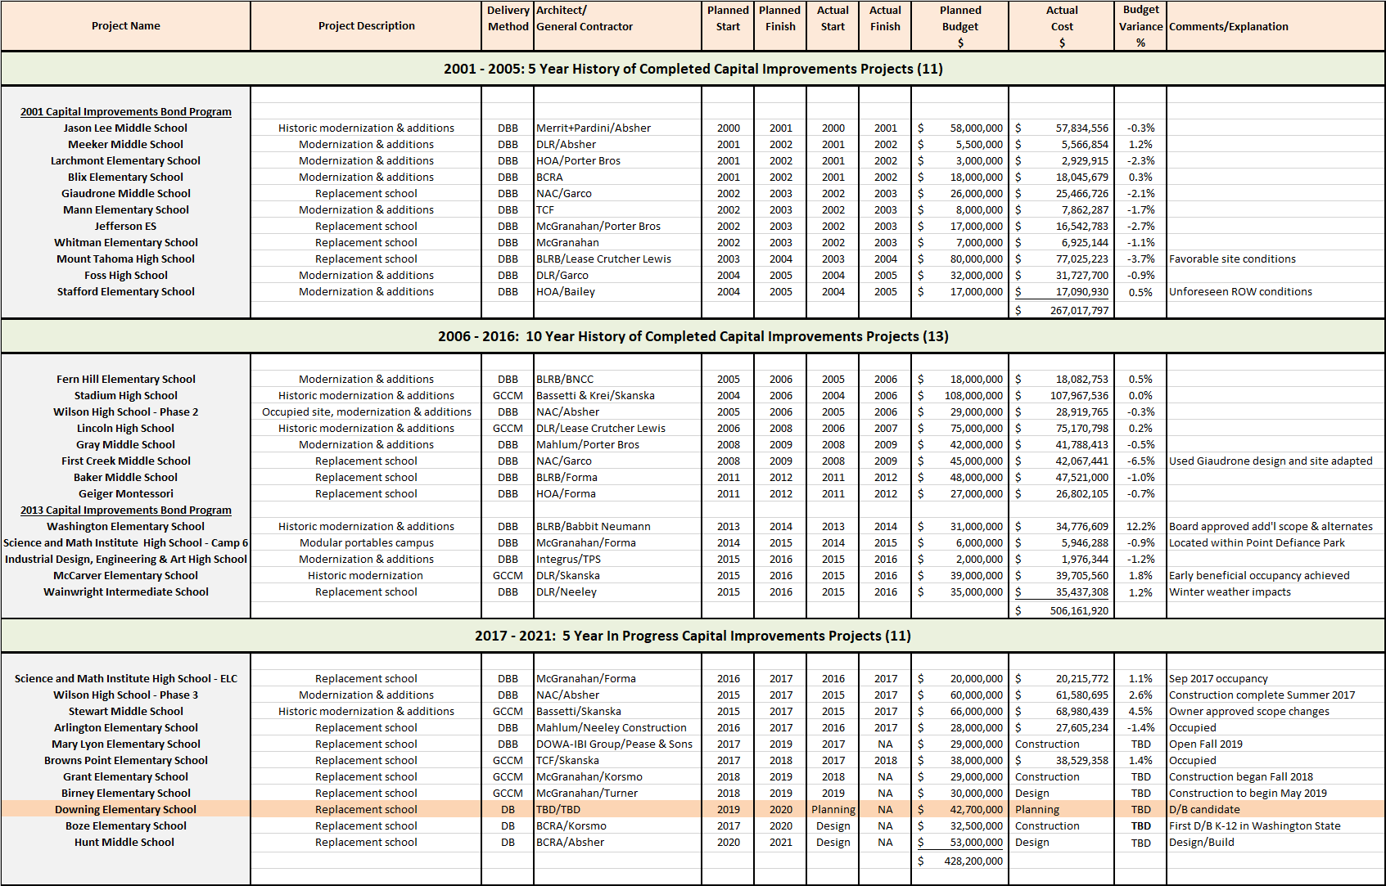
TPS Public Body Experience: 2001 - 2019
Notes:
As a public body depth of public works experience
TPS is a major capital project builder

Slide 12
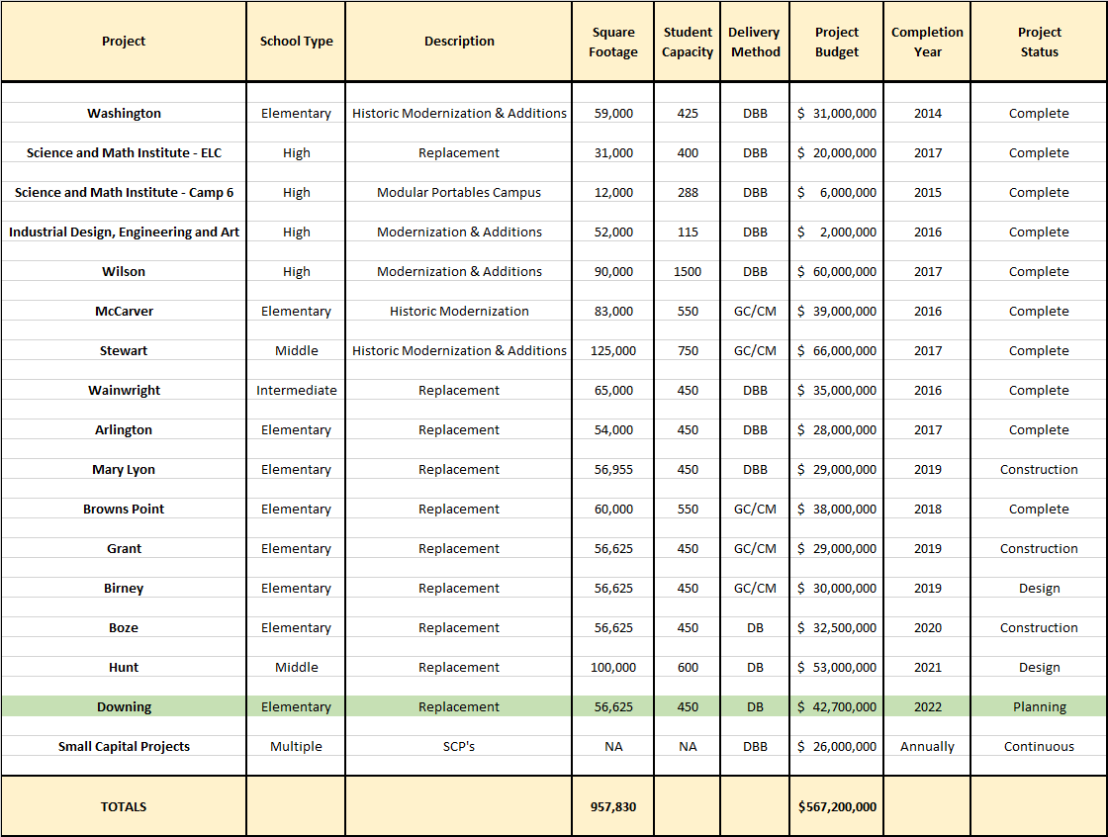
TPS 2013 Capital Bond Program
Notes:
Yellow Highlighted GCCM Projects
Green Highlighted- Just beginning or starting in the next couple of years
May or may not be occupied

Slide 13
The Project

Slide 14
Project Location
Downing Elementary School

Slide 15
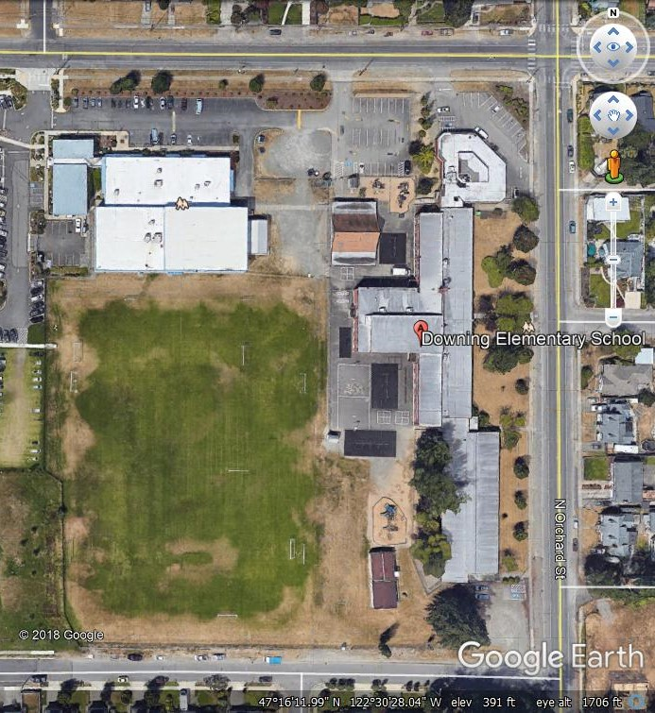
Current Site Overview
Police Sub-station
Boys & Girls Club
Future Site Location

Slide 16
Project Description
Located in Northwest Tacoma
10-acre site
Replace the existing facility
Build to house 450 students
50,000 sq. ft.; Multi-story
Build new school first
Demolish existing buildings next - for development of parking, yards and playfields
Board approved budget: $42.7M (construction & soft costs)
Construction timeline: April 2021-June 2022
Occupancy - Fall of 2022

Slide 17
Project Budget
Category | Budget
Costs for professional services (A/E provided by D/B) | $3,383,181
Estimated project construction cost (including 3% D/B contingency) | $28,193,174
Equipment & furnishing costs (includes technology) | $1,490,000
Off-site costs | $600,000
Contract administration costs (Owner, CM etc.) | $1,350,000
Contingences (Owner project contingency @ 5% of MACC) | $1,410,000
Other soft costs (Owner’s consultants, permits/fees, etc.)(3.3%) | $3,055,169
Sales Tax (@ 10.1% of A/E + Construction Cost) | $3,189,212
TOTAL: | $42,670,736

Slide 18
Project Schedule
PRC Presentation and Approval | March 28, 2019
April & June 2019 PRC Application Submittal Dates are Full | April – June 2019
Advanced Notice Advertised | August 2019
Request for Qualifications Advertised | October 2 & 9, 2019
Pre-Submittal Meeting | October 16, 2019
Statement of Qualifications Due | October 25, 2019
Score SOQs/Shortlist Finalists | October 28-November 1, 2019
Notify Submitters/Release RFP | November 4, 2019
Proposals Due | November 20, 2019
Interviews Complete; Award Recommendation | November 26-29, 2019
D/B Contract Negotiations (3 weeks) | December 2019
TPS Capital Bond to Voters | February 2020

Slide 19
Project Schedule
TPS Board Approval of D/B Contract/NTP | March 2020
Preconstruction Phase | March 2020-November 2020
Negotiate GMP; Final Design Phase | December 2020 – June 2021
Construction (Includes Early Site Package) | April 2021 – June 2022
Occupancy/Move In | July-August 2022
First Day of School | September 2022

Slide 20
Project Schedule
Procurement schedule allows for team formation, questions, addenda as needed prior to SOQ’s due
Assumes qualifications-based selection – design concepts discouraged - with cost factors playing a major role in selection.
Interviews will discourage design concepts by teams and focus on qualifications and approach.
Assumes cost-reimbursable contract – negotiated GMP
Possible early release of key bid packages and long lead items
Overall approach follows WSU and UW approach – highly collaborative and transparent

Slide 21
Why D/B Delivery Method

Slide 22
Market Conditions
In Washington State, Between 2011 and 2019, Voters Approved $14.47B in K-12 Funding
Total of $14.47 B in 8 Years - $1.8 B/Yr.
Unprecedented Cost Increases in D/B/B Market for K-12 projects @ $20 M to $30 M MACC Range
Budgets at $320/sf – Bidding at 30% to 50% Higher
Change Order Rates due to E & O have been on the rise.
Need to Reduce Owner Risk
Need to Improve Cost Control/Cost Certainty
Design/Build is the Owners Best Strategy

Slide 23
Cost Certainty
Need to “Lock Down” the Project Cost Earlier
Project Budget and Program Drive Design
In D/B, the Contractor Holds the Design Contracts and Warrants the Design
Limited Risk of Change Orders – Only Change in Scope or Unforeseen Conditions
Design/Build is the Owners Best Strategy to Minimize Risk and Expedite Cost Certainty

Slide 24
Escalation
Construction Escalation Continues
No Significant Decrease in the Near Future
Goal: Decrease Project Schedule Over D/B/B Delivery
Using D/B Method of Delivery Results in 4-6 months Savings in Project Schedule
Recent D/B on Boze ES Went from Precon to Permit in 12 Months
Similar Elementary Schools Delivered D/B/B or GC/CM take 16-20+ Months Programming to Permit
Design/Build is the Owners Best Strategy To Reduce Time and Minimize Impact of Construction Escalation
D/B Method Enables the District to Conduct the D/B Procurement Process Prior to the Passing of the Capital Bond in February 2020 and Have a Negotiated D/B Agreement in Hand and Ready for Board Approval so the Project can Proceed Immediately into Pre Construction Services.

Slide 25
Statutory Compliance
(5.1) If the construction activities are highly specialized and a D/B approach is critical in developing the construction methodology
(5.2) If the project provides opportunity for greater innovation and efficiencies between the designer and builder
(5.3) If significant savings in project delivery time would be realized

Slide 26
Public Benefit
Cost Certainty
Cost Savings
Risk Mitigation
Earlier Occupancy
Accountability

Slide 27
Public Body Qualifications

Slide 28
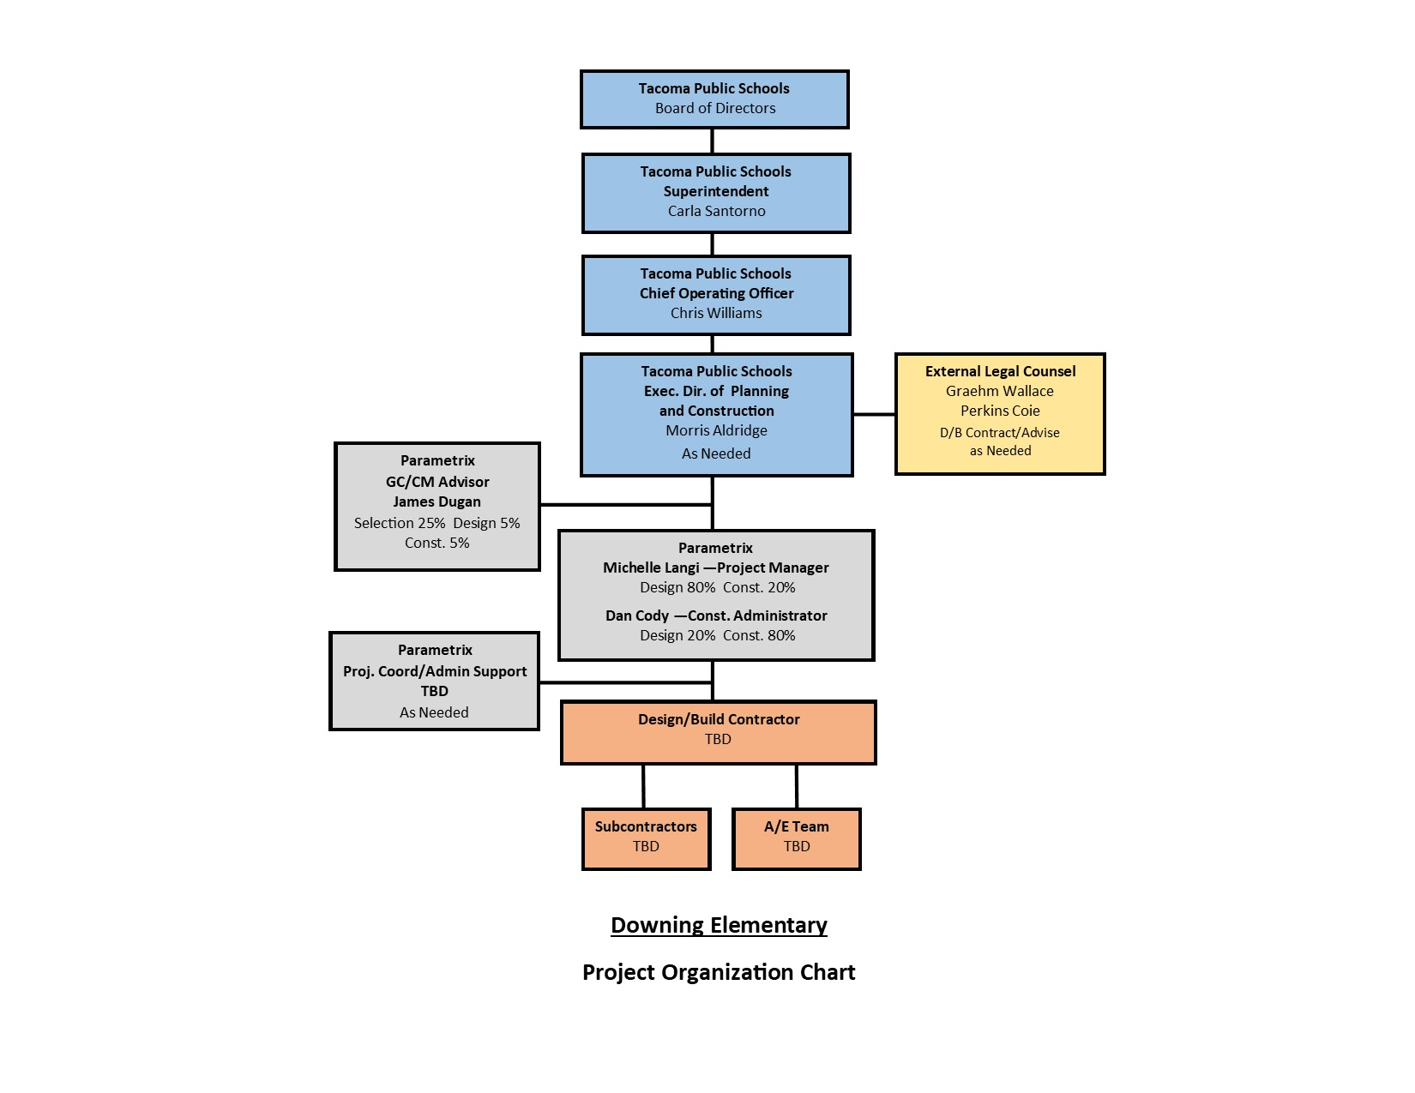
Project Organizational Chart

Slide 29
Leadership Team
Recent K-12 capital projects experience on projects of similar scope and complexity
All of which have been delivered using Design-Bid-Build or GC/CM.
Track record of building projects on-time and within budget.
Track record of RCW 39.10 compliance
TPS has two projects (Boze ES & Hunt MS) currently utilizing the D/B delivery method. The D/B method has been effective on both projects.
Tacoma Public Schools
Morris Aldridge, Executive Director of Planning and Construction
34 Years of K-12 Experience
3 Years D/B Experience
4 Years CMAR/GC/CM Experience
TPS satisfies the public body qualifications by staff augmentation with consultants.

Slide 30
Leadership Team
Parametrix: PM/CM Support and Internal D/B Advisor
Dan Cody - D/B Advisor and PM/CM Support
32 Years of experience
DBIA 3 Day Certification Workshop
AGC D/B Training - 2018
5 Design-Build Projects
D/B project values ranging from $1.5 to $300M
Michelle Langi - PM/CM Support
9 Years of experience
Current Project Manager for TPS Boze Elementary School (D/B Project)
AGC GC/CM and Design/Build training in 2017. DBIA D/B Training in 2019
Graehm Wallace: External D/B Legal Counsel

Slide 31
Design Build Experience

Slide 32
Summary
Project meets qualifying RCW criteria
Project Management Plan is developed and has clear and logical lines of authority
Appropriate funding is in place for management of the job
Project Schedule allows for appropriate time to manage and complete the project
Project team has the necessary experience
Project team has the capacity
Appropriate construction budget has been identified for the project
Scheduled procurement process would result in a “signature ready” D/B Agreement just prior to the Capital Bond vote
D/B Agreement would not be signed and Preconstruction Services would not commence until after passage of Capital Bond that would ensure full funding of construction and soft costs.

Slide 33
Thank You

