Slide 1
Cushman 2 Unit 31, 32 Rebuild Project
Project Review Committee | Project Approval Presentation | Design-Build Contracting
December 3, 2020 Presentation

Slide 2
Team Introductions
Tacoma Power
Brad Ennis, Project Sponsor
Ram Veeraraghavan, PE, Program Manager
David Wagner, PE, Assoc. DBIA, Project Manager
Tony Daniels, Assistant Project Manager
Martha Lantz, JD, Internal Legal Counsel
Doreen Klaaskate, Senior Buyer
Thaxton Parkinson
Robynne Thaxton, JD, FDBIA, DB and Legal Advisor

Slide 3
City of Tacoma Organization
City of Tacoma
City Council
Public Utility Board
City Manager
Director of Public Utilities
Environmental Services
Public Works
Planning and Development Services
Tacoma Power
Tacoma Water
Tacoma Rail

Slide 4
Tacoma Power
Publicly owned since 1893
795 employees
179,000 customers
180 square miles of service area
23 hydro units – 834 megawatts generation

Slide 5
Project Organization Chart
Tacoma Public Utilities (TPU)
Public Utilities Board
Director of Utilities
Jackie Flowers
Tacoma Power
Superintendent
Chris Robinson
Tacoma Power
Generation Manager
Chris Mattson
Generation Electrical Engineering Supervisor/ Rebuild Program Manager
Ram Veeraraghavan
PRO 50% DES 35% CON 35%
Project Manager
David Wagner
PRO 90% DES 90% CON 75%
Assistant PM
Tony Daniels
PRO 40% DES 40% CON 40%
Lead Electrical Engineer
Eric Hoffman
PRO 50% DES 50% CON 50%
Lead Mechanical Engineer
Dustin Hale
PRO 50% DES 50% CON 50%
Internal Legal Counsel
Martha Lantz
PRO 40% DES/CON As Needed
Owner’s Engineer
Project Manager
TBD
PRO 50% DES 50% CON 25%
Hydro Turbine Engineer
TBD
PRO 30% DES 40% CON 25%
Hydro Generator Engineer
TBD
PRO 30% DES 40% CON 25%
Construction QA/QC Agent
TBD
DES 25% CON 75%
DB Advisor
Thaxton – Parkinson
Robynne Thaxton
PRO 30% DES/CON As Needed
Design Builder
TBD
Subcontractor & Suppliers
TBD

Slide 6
Project Location
Project Site
Tacoma

Slide 7
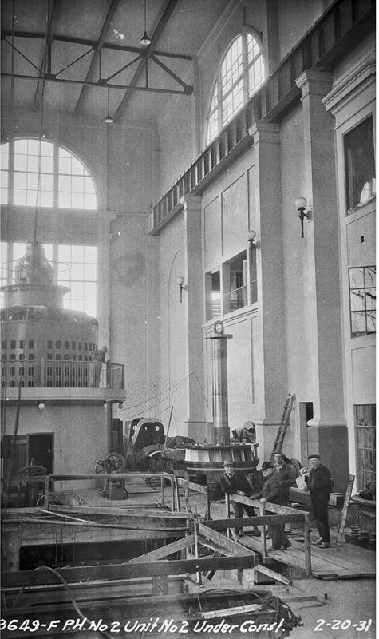
Project Background
Units commissioned in early 1930’s
Last major generator work in 1975 and 1977
Turbine runners replaced in 1990’s
Many original components still in service today
Condition assessment completed in 2017
Business case for project approved in 2019

Slide 8
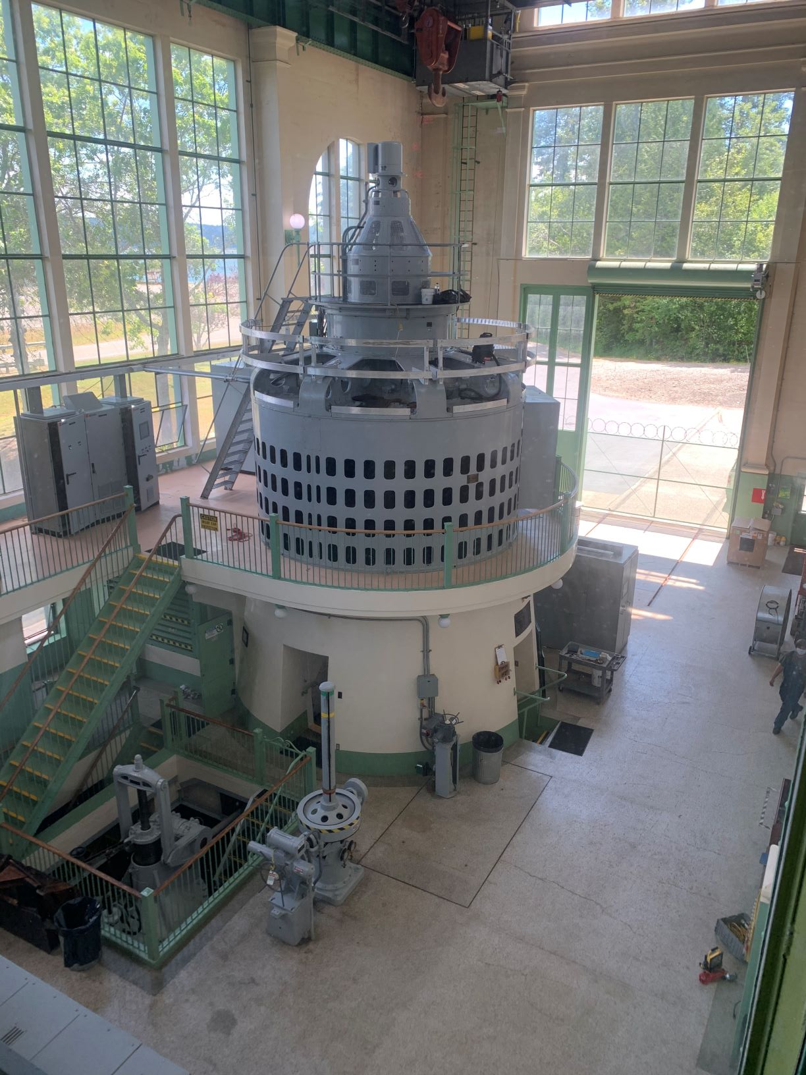
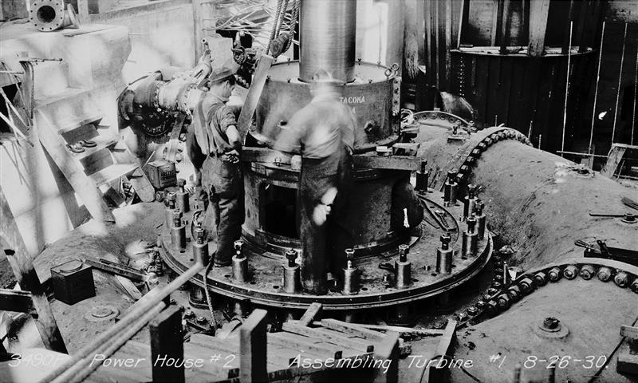
Project Scope
Design and manufacture new components
Construction
Unit disassembly
Assess components
Repair and re-machine some components to original dimensions and tolerances
Unit reassembly
Testing and commissioning

Slide 9
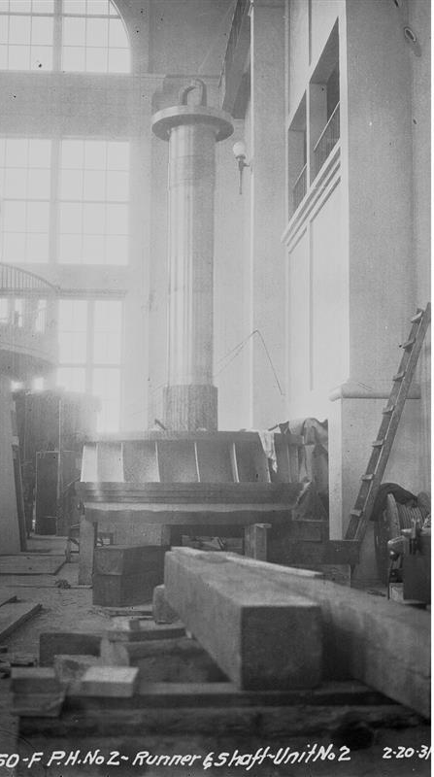
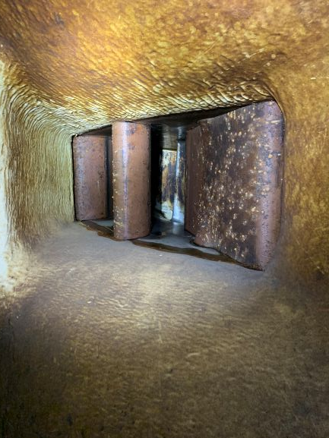
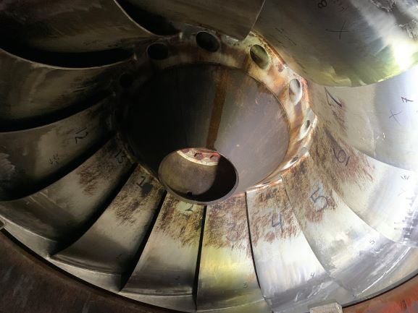
Project Scope - Turbine
Weld and machine worn and corroded parts to be reused
Replace wear components
Provide greaseless bushings
New wicket gates with end seals

Slide 10
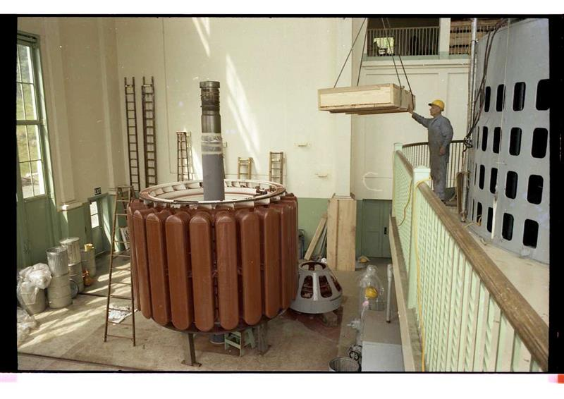
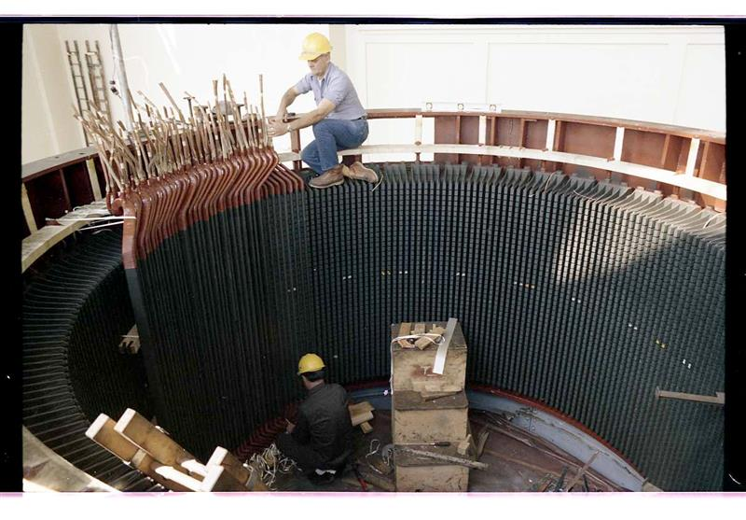
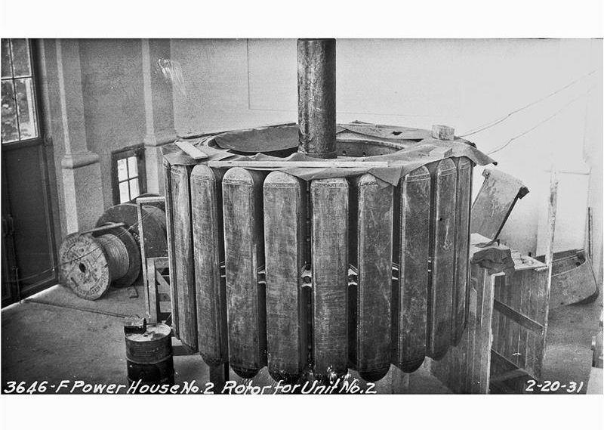
Project Scope - Generator
Inspect stator frame and rotor spider
Rewind stator (new windings)
Restack core (new laminations)
Refurbish rotor poles

Slide 11
Lessons Learned
Request for Qualifications will include more detail of anticipated scope of work
Use multiple proprietary one-on-one meetings towards developing creative solutions to meet City’s Project Goals
Emphasize City’s interest in formal Partnering agreement

Slide 12
Project Budget
Category | Cost
Costs for Professional Services (A/E, Legal etc.) | $912,000
Estimated project construction costs (including construction contingencies) | $24,683,000
Equipment and misc. service contract costs | $397,000
Contract administration costs (owner, cm etc.) | $1,948,000
Contingencies (5%) | $1,397,000
Total | $29,337,000

Slide 13
Project Schedule
Activity | Estimated Date
PRC Presentation | December 3, 2020
Publication of RFQ for Design-Build Services | December, 2020
RFQ Submittal Deadline | February, 2021
Identify Finalists | March, 2021
Issue RFP to Finalists | March, 2021
Proprietary Meetings | April - May, 2021
RFP Submittal Deadline (Price & Technical Proposals) | June, 2021
Evaluate Technical Proposals | June, 2021
Design-Builder Interviews | June 22-24, 2021

Slide 14
Project Schedule
Activity | Estimated Date
Open Price Proposals & Complete Scoring | June 25, 2021
Notify Design-Builders of Scoring and Recommendation to Award | July, 2021
Design-Build Contract Negotiation | July - August, 2021
Execute Design-Build Contract | November, 2021
Design & Manufacturing | December, 2021 - February, 2023
Site Set-up and Mobilization (Unit 32) | March, 2023
Construction Phase (Unit 32) | April - October, 2023
Site Set-up and Mobilization (Unit 31) | March, 2024
Construction Phase (Unit 31) | April - October, 2024
Final Completion and Closeout | October, 2024 - January, 2025

Slide 15
Statutory Criteria
RCW 39.10.300(1)(a) “The construction activities are highly specialized and a design-build approach is critical in developing the construction methodology”
Limited access for removal and reinstallation
Massive scale/size of components
Very specialized machining/fabrication will be required
Very tight clearances/tolerances required between operational and stationary components
RCW 39.10.300(1)(b) “Greater innovation or efficiencies between the designer and the builder”
Maximum possibility for coordination of design, condition assessment and construction
RCW 39.10.300(1)(c) “Significant savings in project delivery time”
Manufacturing of long lead items can begin much sooner

Slide 16
Qualifications
City of Tacoma is an approved Public Body to use Design-Build
Tacoma Power has extensive construction experience
Tacoma Power has assembled a team with necessary Design Build, project management, and technical knowledge and experience
Tacoma Power Program Manager and Project Manager have attended DBIA training
The same team was approved for Design-Build for a similar project

Slide 17
Summary
Project is funded with the appropriate budgets
Project meets RCW criteria
Project team has the necessary experience and capacity
Project team is prepared and ready to proceed

Slide 18
Questions

