Slide 1
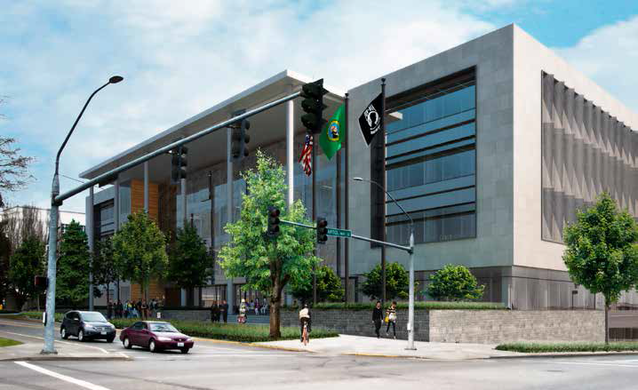
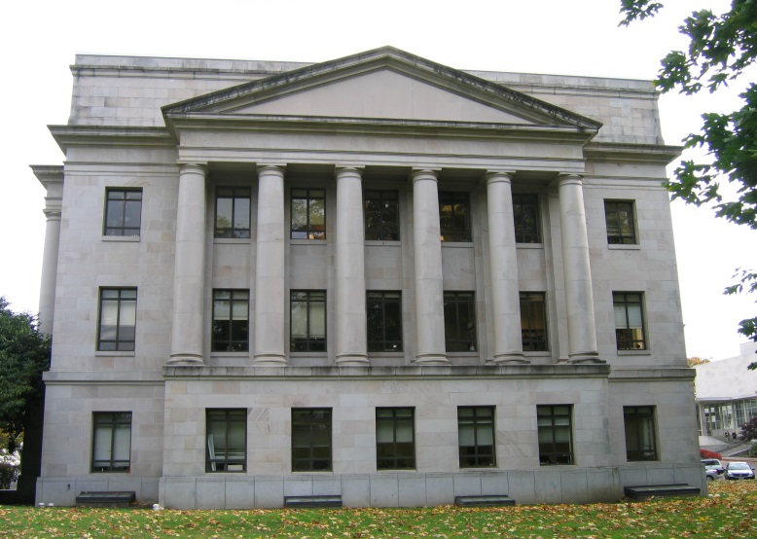
High Performance Green Building
Implementation of RCW 39.35D through July 2014
1063 Building
LEED Platinum Goals
O’Brien Building LEED Gold
Notes:
Pick a logo for the main page of your presentation. Delete the other logo.

Slide 2
Benefits since 2005
Improved energy and water efficiency
Enhanced indoor environmental quality
Reduced stormwater impacts to rivers, lakes and Puget Sound
Creation of local jobs through use of regional materials
Reduced construction waste to landfills

Slide 3
Benefits since 2005
Increased markets for recycled content materials
Protection and restoration of habitat
Reduced automobile reliance
LEED demonstrates the state’s commitment to environmental and health principles
Use of LEED as a rigorous quality assurance tool

Slide 4
Status of State-owned Projects
Status | # of projects
Design | 14
Construction | 16
Substantial Completion/Completed (but not yet certified) | 33
Projects with LEED Certification | 65

Slide 5
Report Highlights
139 total state-owned LEED projects, worth $1.6 billion
Certified 65 Pending 47
Platinum 2 4
Gold 34 20
Silver 28 23
Certified 1

Slide 6
Report Highlights
91% projects actively pursing LEED, (State agencies, universities, & colleges)
Added cost for LEED certification .9 % - 2.0 % total project cost.
15 year average payback
Estimated energy savings: 12 % - 46 %.
10 projects recycled ~94% construction debris (diverted from landfills)
Challenges continue for metering and reporting actual use

Slide 7
LEED Building Cost

Slide 8
% Added Cost

Slide 9
Energy Cost Savings

Slide 10
Reduction of Water Cost

Slide 11
Annual EUI

Slide 12
Overview of Quality Assurance
Overview of the DES LEED Quality Assurance (QA) Process
Schematic Design
Design Development
Construction Documents
Post-Construction

Slide 13
Thank you
DES LEED Green Building
Quality Assurance Process
http://des.wa.gov/services/facilities/Energy/GreenBldg/Pages/default.aspx
Sidney Hunt, 360-407-9357, Sidney.hunt@des.wa.gov
Architect, Project Manager, LEED Green Building Advisor

