Slide 1
Travel workshop
11.01.2022
Small Agency Financial Services
Norma Rosado, Megan Finger, & Ian Shelley
Notes:
Ian

Slide 2
agenda
Agency Travel Policy Game & Payment Stats
SAAM Travel Policy Review
TEMS Demonstration
Meals With Meetings & Light Refreshments
Telework & Travel
Q&A
Notes:
Ian

Slide 3
Travel policy game SAAM 10.10.10
Answer the poll questions about SAFS agency policy status
Notes:
Ian

Slide 4
Travel policy game SAAM 10.10.10
Out of 34 small agencies with AP services, how many travel policies are more than 5 years old?
15
Notes:
Ian

Slide 5
Travel policy game SAAM 10.10.10
Out of 34 agencies, how many travel policies reference the outdated “3 hours beyond shift” per diem rule?
Notes:
Ian

Slide 6
Travel policy game SAAM 10.10.10
What is the most common breakfast meal period set by agency policy?
Notes:
Ian

Slide 7
Travel policy game SAAM 10.10.10
What is the most common lunch meal period set by agency policy?
Notes:
Ian

Slide 8
Travel policy game SAAM 10.10.10
What is the most common dinner meal period set by agency policy?
Notes:
Ian

Slide 9
Travel trends
Notes:
Ian

Slide 10
Travel trends
FY20
Notes:
Ian

Slide 11
Travel trends
FY21
Notes:
Ian

Slide 12
Travel trends
FY22
Notes:
Ian

Slide 13
Travel trends
FY23
Notes:
Ian

Slide 14
SAAM Travel Policy Review policy, rates, and rules
Notes:
Ian

Slide 15
Lodging Reimbursements SAAM 10.30
10.30.10.a: Lodging receipts are required for reimbursement.
10.30.20: If adequate lodging rates are not available, and the listed exceptions are met, agency can approve (prior to travel) rates that exceed the maximum per diem.
10.30.30.a: Lodging per diem rate covers the basic room cost, resort/amenity fees, cleaning fees, and service fees. Lodging taxes are reimbursable beyond the maximum per diem.
10.30.30.b: Lodging must be more than fifty miles away from the closer of either official residence or official station.
Notes:
Megan

Slide 16
Lodging reservations NASPO value point
https://us.travelctm.com/naspo/
The NASPO ValuePoint Travel Center is for public agencies to meet their travel needs and is designed to be a one stop travel shopping site.
Participating properties offer at or below GSA per diem rates and will not charge certain fees, including resort fees, booking fee, timely cancellation fees, etc.
Register your work email address to receive a login ID in the “Online Booking Tool”
Notes:
Megan

Slide 17
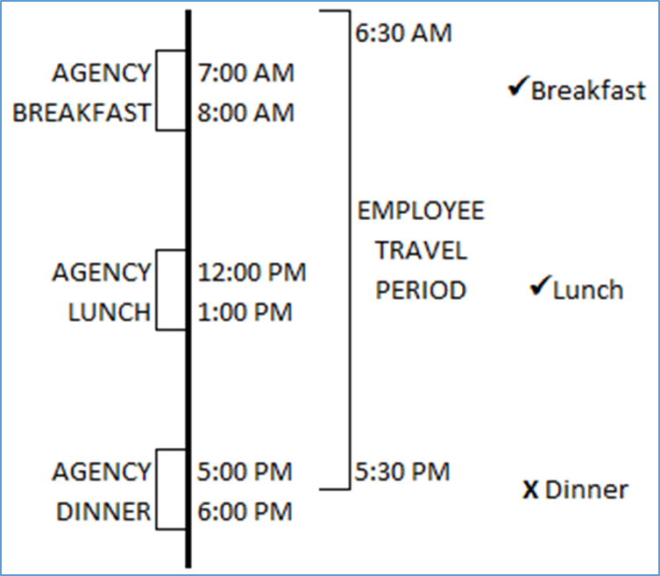
meal Reimbursements saam 10.40
10.40.30: Meal per diem rates cover the basic meal cost, tax, tips, and incidentals (i.e. – delivery fees).
10.40.50: Travelers are eligible for meal reimbursement if they are in travel status for the entire agency defined meal period and:
when travel includes an overnight stay
OR
when travel lasts for 11 or more hours on non-overnight assignments
Notes:
Megan

Slide 18
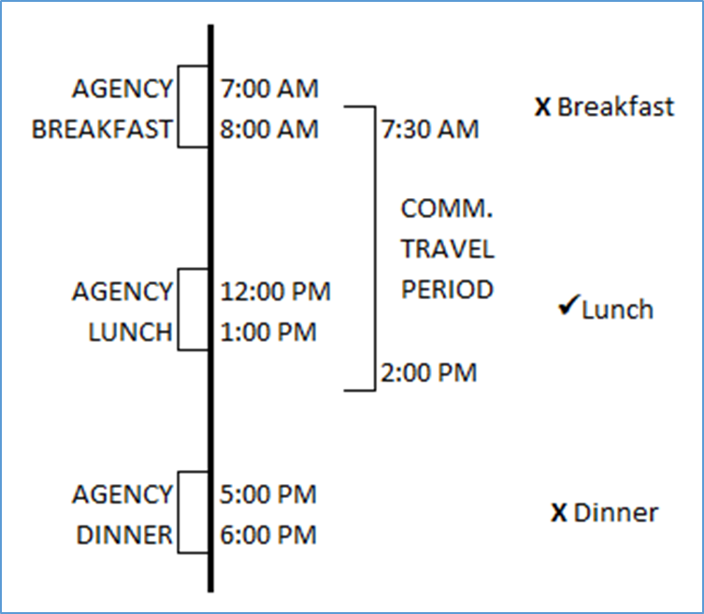
meal Reimbursements saam 10.40.50.b
Exception to the 11 hour rule:
Volunteers, board members, and commissioners may be reimbursed for meals if they are in travel status for at least 5 hours on non-overnight assignments
Agency meal periods still apply
If meals with meetings are provided, no meal reimbursement.
**This rule does not apply to boards and commissions following the daily or hourly rate.**
Notes:
Megan

Slide 19
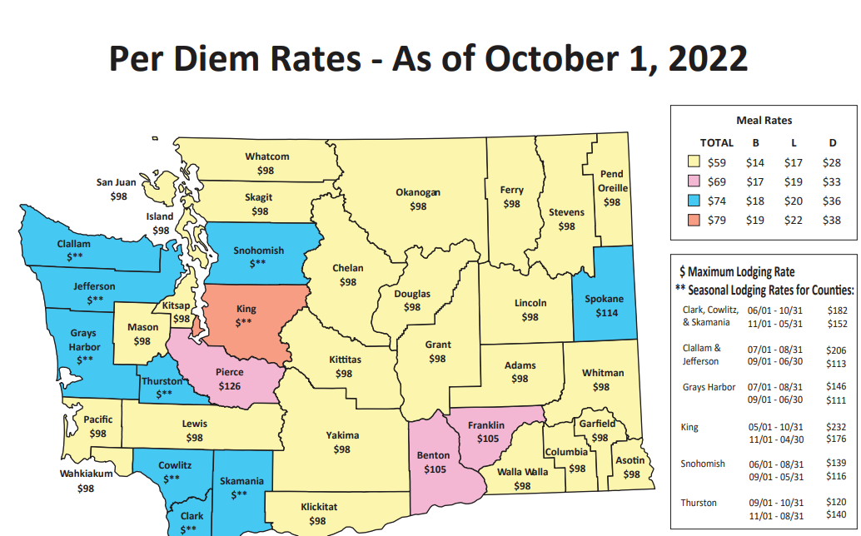
Reimbursement rates SAAM 10.90.20
Out-of-State Per Diem Rates can be determined by using the GSA Rate Finder:
https://www.gsa.gov/travel/plan-book/per-diem-rates
International Per Diem Rates can be determined using the U.S. Department of State Rate Finder:
https://aoprals.state.gov/web920/per_diem.asp
Notes:
Megan

Slide 20
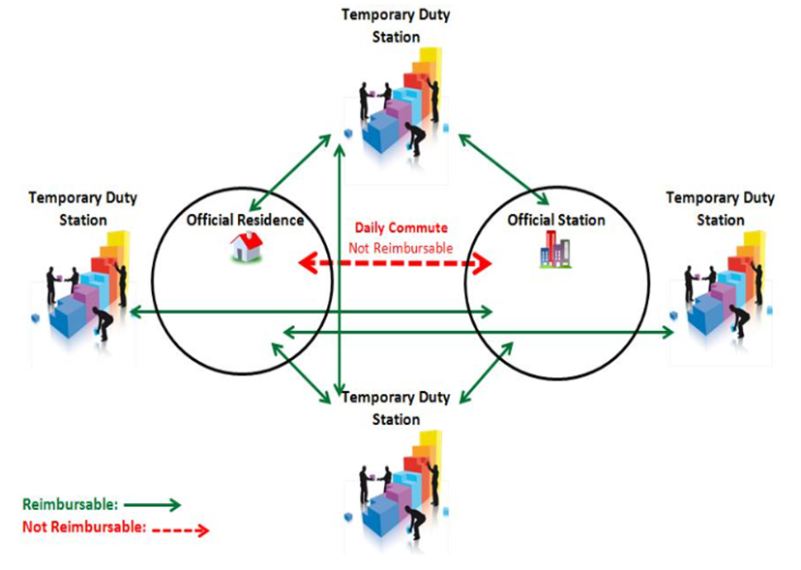
Mileage reimbursements SAAM 10.50
10.50.20: Mileage in a Privately Owned Vehicle (POV) can be reimbursed at the rate specified in 10.90.20 – currently $0.625 per mile in 2022. The rate changes every January 1st.
10.50.25: Daily commute between official residence and official station is not reimbursable – all other miles driven on official state business are reimbursable.
Notes:
Norma

Slide 21
Miscellaneous travel rules SAAM 10.60.10
Reimbursable Expenses:
Parking and Bridge Tolls
Transportation Services (taxis, shuttles, Lyft/Uber, ferries, etc.)
Event/Registration Fees
Checked Baggage
Notes:
Norma

Slide 22
Miscellaneous travel rules SAAM 10.20.20
Non-reimbursable expenses:
Valet services
Entertainment expenses
Seat upgrades
First class airfare
These types of costs are considered personal preference and cannot be reimbursed.
Notes:
Norma

Slide 23
Receipt requirements SAAM 10.80.40 & SAAM 10.60
Expense | Any Amount | Over $50
Hotel
Laundry/Dry Cleaning*
Uber/Lyft
Rental Car Gas
Conference Reg Fees
Meeting Room Rental
Fax Services
Internet Access Fees
Checked Bags*
Overnight Parking
Day Parking
Bus/Ferry/Bridge Toll
Taxi/Shuttle/Limo
Payphone
Expenses exceeding $50 should be paid by or billed-to agency if possible.
Send receipts to: Travel.Safs@des.wa.gov
Include Reimbursement Request ID or Trip ID in email subject line
Notes:
Norma

Slide 24
Receipt requirements SAAM 10.80.40 & SAAM 10.60
Why require receipts?
Maintain transparency
Prevent abuse of reimbursement processes
Safeguard public funds
Avoid audit findings
The bottom line
More documentation is better than less
Submit all required receipts
Submit optional receipts when able
**SAFS AP may reach out for optional receipts**
Notes:
Ian

Slide 25
Prior approval SAAM 10.10 & 10.30
10.10.50: Out-of-state travel (except neighboring counties)
10.30.30: Lodging less than 50 miles from the closer of either the traveler’s residence or official station, when one of the following conditions is met:
To avoid a traveler driving back and forth for back-to-back late night/early morning business
When the health and safety of the traveler is a concern
When an agency can demonstrate that staying overnight is more economical to the state
Notes:
Norma

Slide 26
Prior approval SAAM 10.30.20
Lodging over per diem
Up to 150% - must meet at least 1 of the 6 exceptions in section (a)
Traveler is assigned to accompany an elected official and required to stay in the same facility
Temporary cost escalation in the area during special events or disasters
Savings from staying at a different location are consumed by an increase in transportation costs
Expected business interaction and maximum benefit will be achieved
To comply with ADA provisions, or the health and safety of a traveler is at risk
More economical to acquire a suite rather than both a meeting room and a room for lodging
Exceeds 150% - must meet all 3 of the exceptions in section (b)
Expected business interaction
Maximum benefit will be achieved
Lowest available advertised rate
Notes:
Norma

Slide 27
Air travel SAAM 10.50.40 to 10.50.80
Statewide Master Contract
Alaska Air - EasyBiz
Approved Travel Agents under master contract 02219
Purchase airfare with agency Charge Card
Employees/Commissioners must not purchase airfare with personal funds, unless the state charge card system is not available.
Depending on the circumstances, the reimbursable amount may be capped at the contracted government rate.
Agency cannot purchase or reimburse:
Seat upgrades (except ADA accommodations)
Business or First-Class travel
Notes:
Norma

Slide 28
Tems refresher user requests, tips & tricks
Notes:
Ian

Slide 29
TEMS links
TEMS website:
https://tems.ofm.wa.gov
New User Request:
https://des.wa.gov/services/hr-finance/small-agency-services/small-agency-financial-services/tems-access-request-form
Preparer name & email – only fill out the top section if someone will be preparing TEMS on behalf of the traveler
Supervisor/manager – this is the traveler’s approver
Approver/preparer – only check YES in these fields if the traveler will be approving or preparing other traveler’s requests
Notes:
Ian

Slide 30
Tems tips & TRICKS
Microsoft Edge and Google Chrome are currently the only browsers that fully support TEMS
Submitting a request is a two step process:
Create a trip
Create a reimbursement
Attach trip(s) to the reimbursement
Send for approval
Per Diem rates:
Washington rates will be auto-filled
Out-of-state will default to the lowest rate – so be sure to update
International rates can be manually entered if not available from the drop down
Notes:
Ian

Slide 31
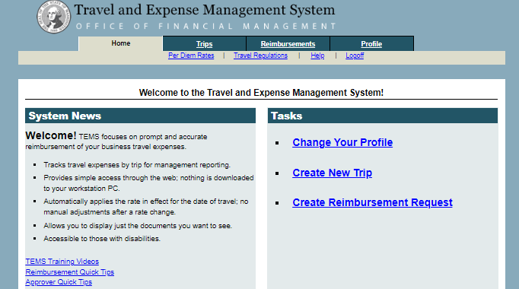
Tems Live demo
How to create a travel reimbursement:
Notes:
Megan

Slide 32
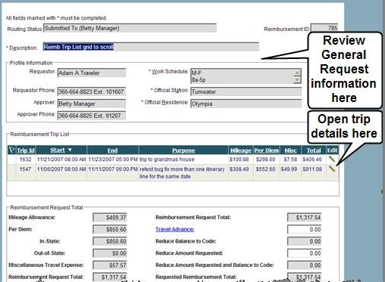
Tems – approver side
Review Tab – contains reimbursement requests submitted to the approver.
What can/should the approver do in a reimbursement?
Check for accuracy of travel details
Modify anything in the trip
Reroute the trip back to requestor
Approve/Deny the trip
Any trouble with TEMS, reach out to:
travel.safs@des.wa.gov
Notes:
Megan

Slide 33
Meeting basics meals, coffee, light refreshments
Notes:
Ian

Slide 34
Coffee & light refreshments saam 70.10
Agency policy and procedure is required
Prior approval is required for each meeting
Refreshments can be served when:
Purpose of meeting is to conduct state business or formal training
Integral part of the meeting
Receipt(s) for actual costs are retained and submitted with payment
Meeting takes place away from regular workplace
Boards & commissions may provide coffee/refreshments at official public meetings, including executive sessions.
Notes:
Norma

Slide 35
Meals with meetings saam 70.15
Agency policy and procedure is required
Prior approval is required for each meeting
Meals can be served when:
Purpose of meeting is to conduct state business or formal training
Integral part of the meeting
Receipt(s) for actual costs are retained and submitted with payment
Meeting takes place away from regular workplace
Meals are to only be served to state employees or state officials and must be within the per diem allowance (including taxes, tips, and delivery fees).
Notes:
Norma

Slide 36
Other considerations saam 70.10 & 70.15
Documentation required:
Signed prior approval
Purpose of the meeting
List of meeting attendees
Meals, coffee, or refreshments are prohibited when:
Agency anniversaries, individual employee receptions (new hire, retiring, elected, etc.)**
Hosting activities: social rather than governmental business events, such as lobbying.
**All-staff meetings/general employee recognition is okay.
Notes:
Norma

Slide 37
Telework For out of state & out of area employees
OFM guidance found here: Out-of-state remote work guidance and resources | Office of Financial Management (wa.gov)
Create telework agreements!
“The telework agreement that the agency creates with the out-of-state teleworker will establish who covers the cost of travel after a review of SAAM requirements, and any other necessary details.”
Consider Official Residence & Official Worksite rules. Travel from residence to worksite is considered non-reimbursable normal commute.
Notes:
Ian

Slide 38
CONTACT INFO
Travel Policy, TEMS Admin:
travel.safs@des.wa.gov
360-407-8183
Meeting Rules:
APquestions.safs@des.wa.gov
360-407-8183
Notes:
Ian

Slide 39
Questions?
Notes:
Sarah

Slide 40
What is the outdated 3 hour rule still found in some agency travel policies?
The “3 hour rule” is an outdated SAAM rule still found in some agency travel policies. It indicated that a traveler had to be in travel status for 3 hours past their normal shift to qualify for meal reimbursement.
It has been replaced in SAAM with the “11 hour rule.” For non-overnight travel, a traveler must be in travel status for 11 hours to be eligible for meals reimbursement.
Notes:
Norma

Slide 41
Tips/gratuity for uber expenses
Per SAAM “customary tip or gratuity” for uber/lyft/taxis are reimbursable. If the tip causes the expense to go over $50 a receipt should be submitted.
SAAM does not prescribe a specific tip percentage, it only uses the language “customary tip or gratuity.” An agency could establish internally an acceptable tip percentage and include that in internal agency policy.
Notes:
Norma

Slide 42
Do meal periods have to be a specific amount of time, or could an agency have dinner as for example 4-7pm?
Agencies determine meal periods with internal agency travel policy. SAAM does not prescribe any details on the times or length of meal periods. Most agencies use 1 hour meal periods. Keep in mind that a traveler has to be in travel status for the entire meal period, so dinner from 4-7pm would for example exclude a traveler that left at 5pm for an overnight trip from being eligible for dinner.
Notes:
Norma

Slide 43
Provided meals and meeting agendas
For normal travel, provided meals do not require an agenda or other substantiation. Travelers should not claim any meals that were provided. Conference registrations sometimes substantiate which meals were provided.
For meals with meetings and coffee/light refreshments meeting agendas and attendee lists should be included with the pre-approval forms.
Notes:
Norma

Slide 44
Provided meals & “continental breakfasts”
Per SAAM 10.40.20.d: “Meal payments are not required to be reduced for continental breakfasts”
Notes:
Norma

