Slide 1
Ellensburg SD
New Elementary and
Mt. Stuart Elementary Project
CPARB
Project Review Committee
GC/CM Application for Project Approval
March 28, 2019
Notes:
Brian thanks PRC panel for opportunity
Present team introductions at the table.

Slide 2
AGENDA
Project Team and ESD Overview
Project Overview
Why GC/CM
Project Concept Site Plan
Project Budget
Project Schedule (GC/CM/ Design/Construct)
Owner Summary
Questions and Answers
Notes:
Brian slide

Slide 3
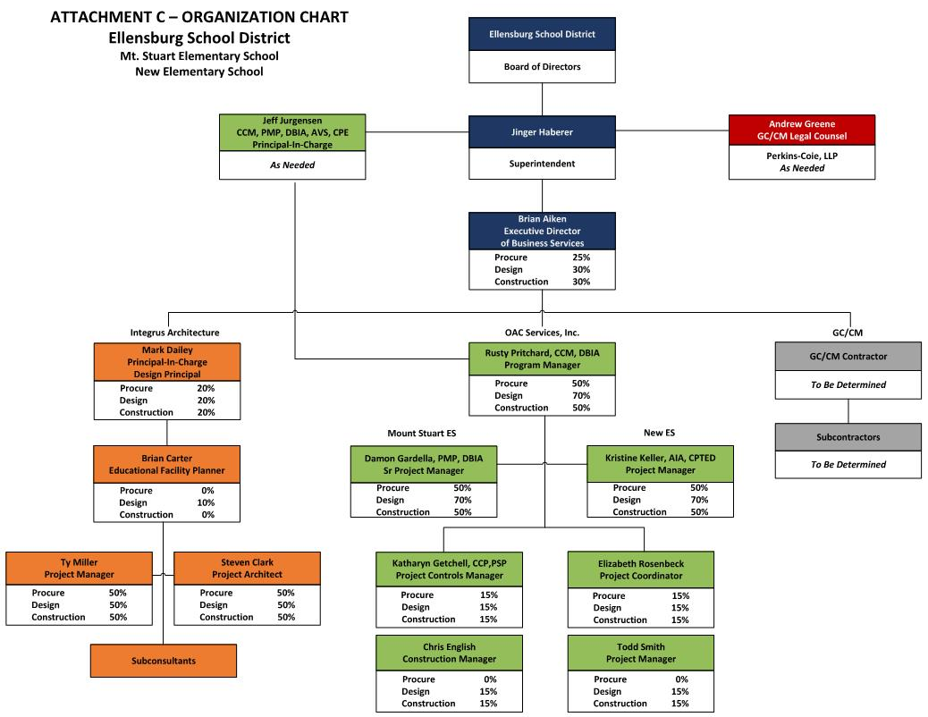
PROJECT TEAM
Notes:
Brian: Clear mgmt. plan and lines of communication
District is the decision maker; OAC and Integrus manage/facilities the process
Note Andrew Green from Perkins Coie;
Note % of effort on each phase of the projects

Slide 4
ELLENSBURG SD OVERVIEW
Located in Central WA; CWU; Ag & Natural Resources
Enrollment 3,200 students
Strong Board and Community support for education
Notes:
Brian; BRIEF synopsis of the Eburg Community and school district

Slide 5
PROJECT OVERVIEW
$59.5M Capital Improvement Bond Passed Nov 2018
$14.5M in State Funding Assistance
The Program
Build new Elementary School
Build new Mt Stuart Elementary School
Lincoln ES modernize and new addition
Community Design Team underway
Notes:
Brian: Successful Bond passage and HIGHLIGHTED TWO SCHOOLS in ONE project. Mention Lincoln to follow in the bond program.
Segue to RUSTY next slide

Slide 6
WHY GC/CM – RCW 39.10.340
Complex scheduling, phasing and coordination
Construction at existing facility
Involvement of GC/CM critical in design phase
Complex or technical work environment
Historical significance
Heavy Civil
Notes:
Rusty SLIDE

Slide 7
PROJECT OVERVIEW
$700M +/- construction forecast in Eastern and Central WA (2020-2022)
Marketing outreach to General Contractors
ESD Board modified its bond proposal based on Mt. Stuart from modernization to new construction
Program/Project Criteria for modification
Educational programmatic opportunities
Project scope and delivery (GC/CM & One Project new ES and new Mt. Stuart ES)
Market conditions – GC and Subcontractor availability
Mitigate fiscal/construction escalation risk
Notes:
Rusty Slide
Segue to STEVEN

Slide 8
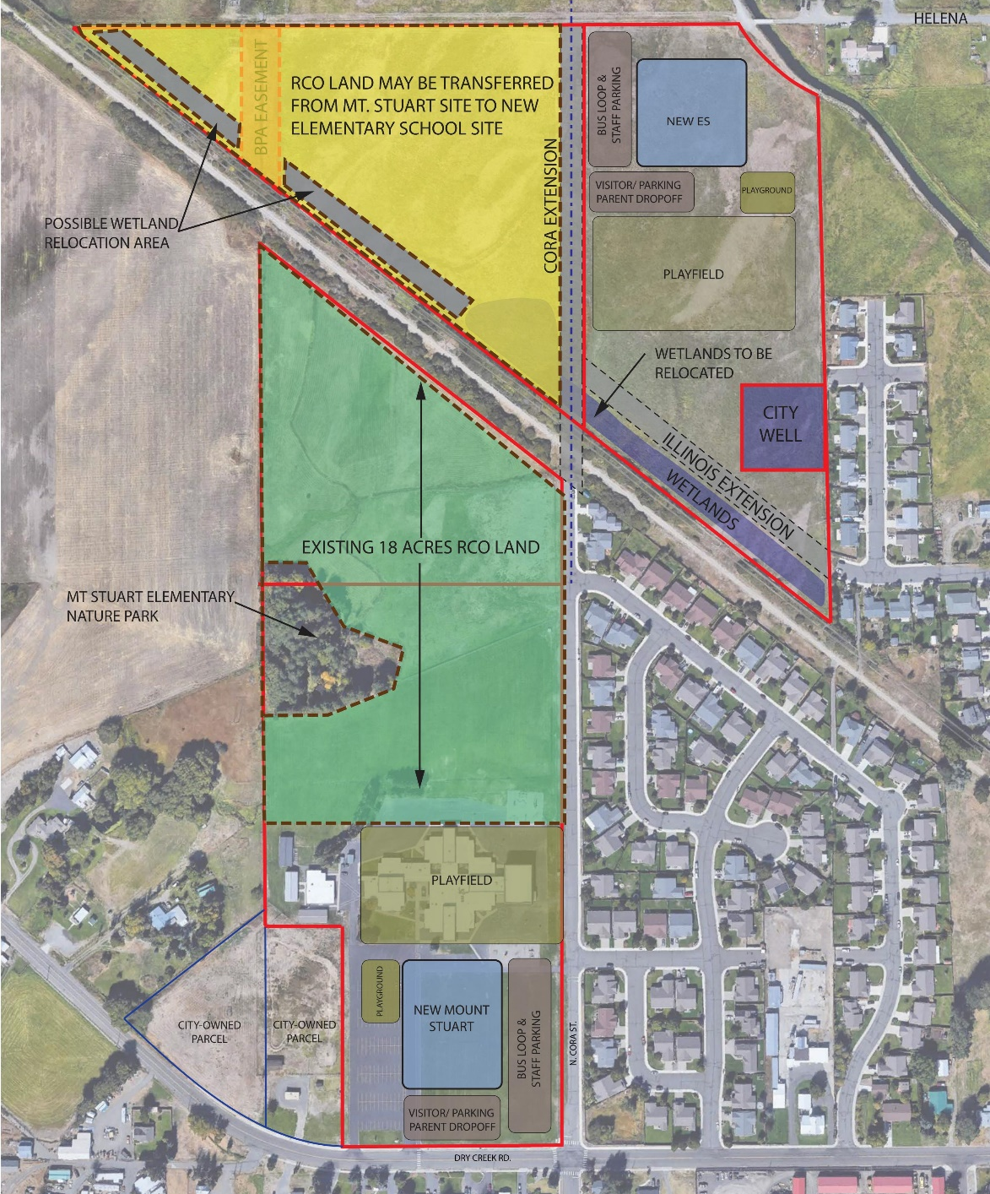
PROJECT OVERVIEW
New School Site
29 Acres
Undeveloped farmland
Wetlands
Multiple ROW Stakeholders
DOE
State Parks
BPA
USACE
Ellensburg Irrigation District
City of Ellensburg
Mt Stuart ES Site
31 Acres – 18 Acres RCO
Developed/Existing School Site
Wetlands
Multiple Stakeholders
DOE
State Parks
BPA
USACE
Ellensburg Irrigation District
City of Ellensburg
Notes:
STEVEN:
Site, stakeholders, challenges, WHY GC/CM is critical in design!
SEGUE TO RUSTY IN BUDGET

Slide 9
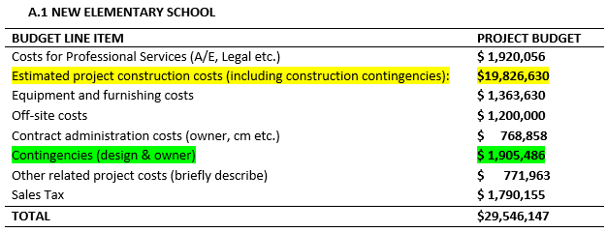
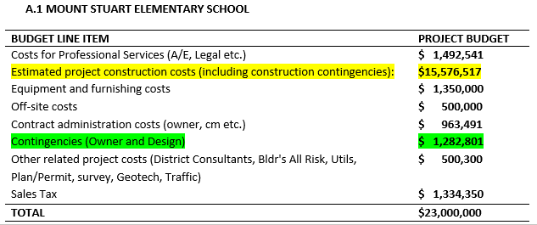
PROJECT BUDGET
Notes:
9
RUSTY MACC/GMP and contingencies

Slide 10
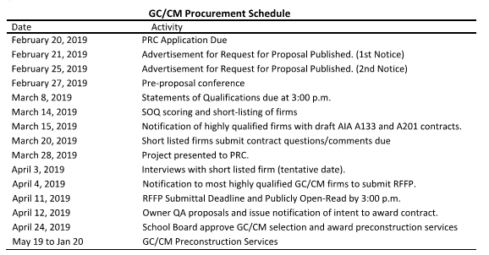
GC/CM PROCUREMENT SCHEDULE
Notes:
RUSTY – Where we are in the process and then on board w/ PRECON SVCS
SEGUE TO STEVEN ON SCHEDULE

Slide 11
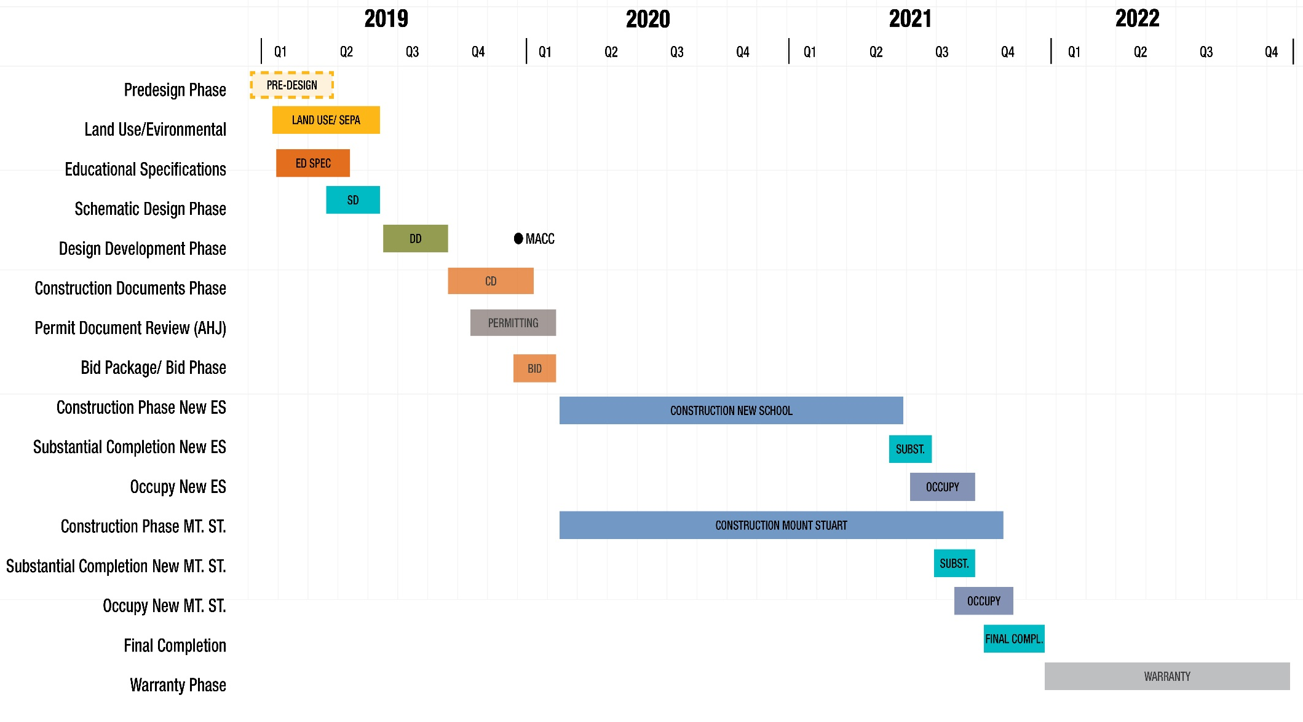
DESIGN & CONSTRUCTION SCHEDULE
Notes:
CITY AHJ NOTES and CONSTRUCTION
SEGUE TO BRIAN

Slide 12
OWNER SUMMARY
Substantial fiscal benefit to the public
Meets qualifying criteria under RCW 39.10.340
Public body has necessary experience or team
Project knowledge and experience
Sufficient contract admin staff & experience
Clear management plan & logical lines of authority
Necessary/appropriate funding & time
Continuity of PM team with GC/CM experience
Zero audit findings
Notes:
BRIAN ; Short and sweet; hit all points, qualified team, right budget, right experience

Slide 13
QUESTIONS & ANSWERS
Notes:
Rusty: Fields Q&A time.

Slide 14
GC/CM LESSONS LEARNED
Frequent Leadership Team meetings
Focus on business decisions and operations
Take the pulse of the project and team members
Increase frequency of design meetings
Model open and transparent communications
Improve issues identification and resolution responsibilities

Slide 15
DISTRICT PM COMMITMENTS

