Slide 1
Seattle Public Schools
New Rainier Beach High School
Application to use the GC/CM Delivery Method
January 23,2020 Presentation
Seattle Public School is committed to eliminating opportunity gaps to ensure access and provide excellence in education for every student.

Slide 2
Presentation Agenda
Introduction of key Team Members
Project Overview
Scope, Budget and Schedule
GC/CM as Appropriate Method
Team Organization Chart and Qualifications
Agency Experience
Summary
Questions

Slide 3

Introductions

Slide 4
The Project Team – Here Today
Seattle Public Schools
Richard Best, Director of Capital Projects & Planning
Mike Skutack, Senior Project Manager, Capital Projects and Planning
Parametrix
Paul Popovich, Senior Project Manager

Slide 5
The Project Team
Other Team Members
Seattle Public Schools
Ronald Boy, Acting Chief Legal Council
Perkins Coie
Graehm Wallace, Perkins Coie, External GC/CM Legal Advisor

Slide 6
Project Overview

Slide 7
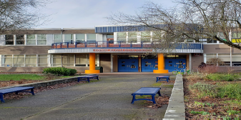
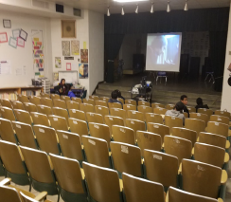
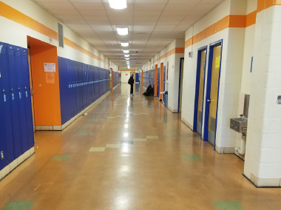
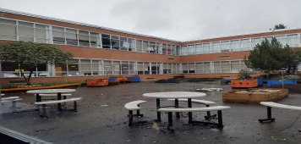
Rainier Beach High School

Slide 8
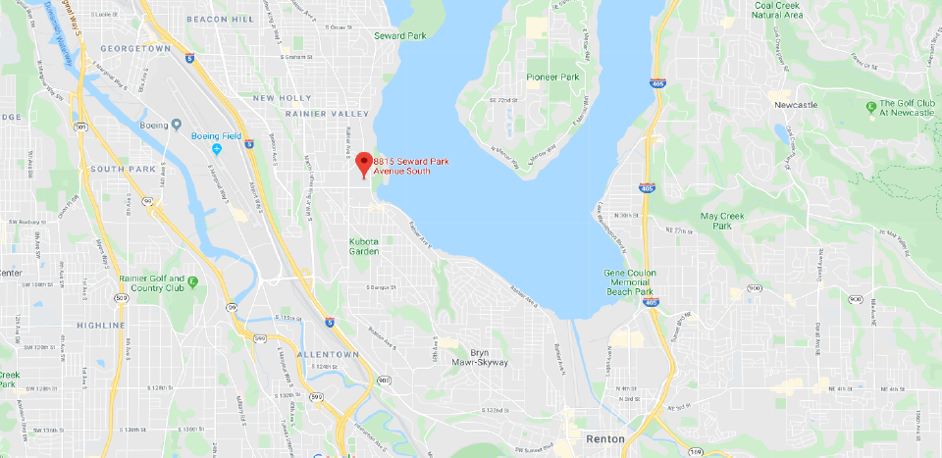
Project Overview – Site Location in South Seattle

Slide 9
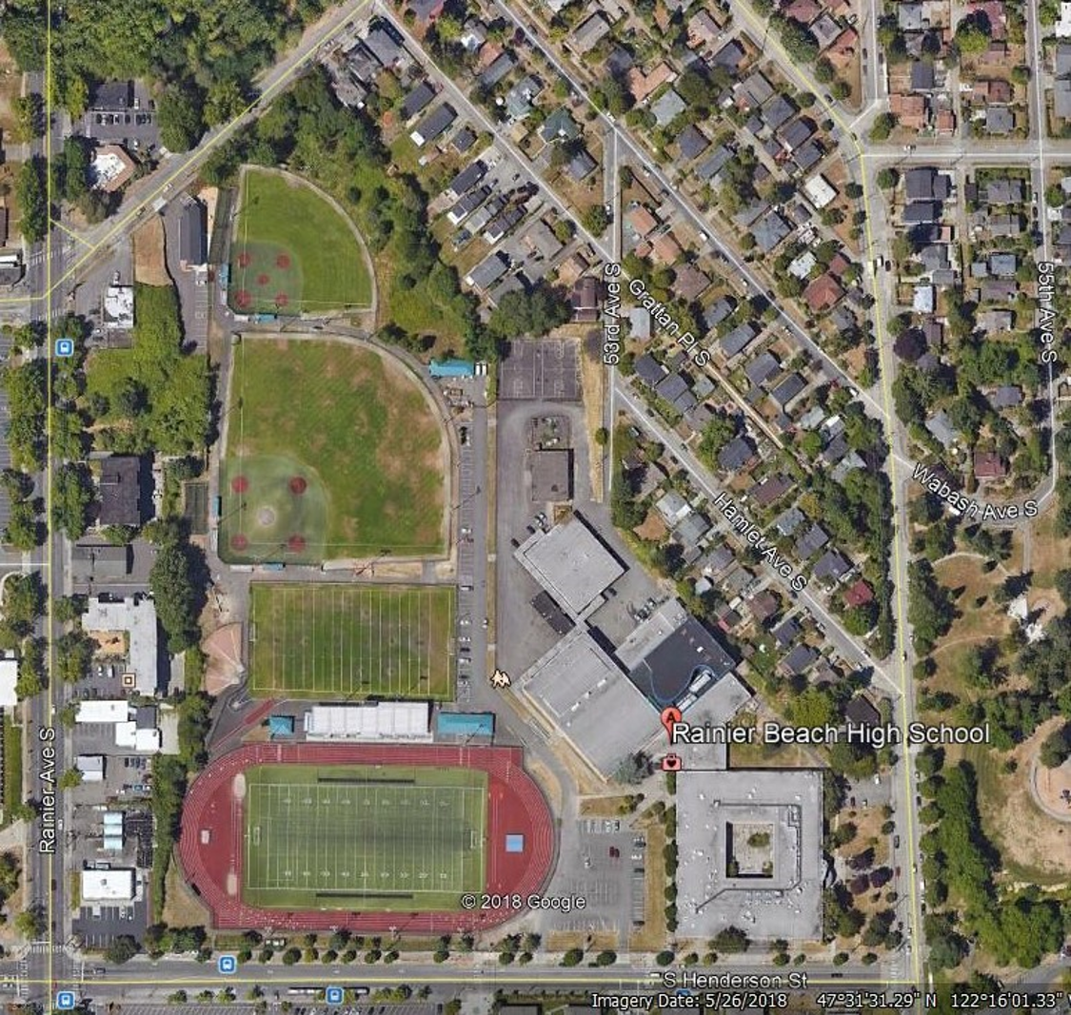
Project Overview - Neighborhood
Project is in a dense neighborhood of single-family and small commercial developments.
Projected growth and density due to higher density development
Community and off-site impacts requires coordinating off-site utility work as well as traffic impacts to the community and the school.
The Rainier Beach High School is located across the street from a public park as well as the publicly populated sports fields.

Slide 10
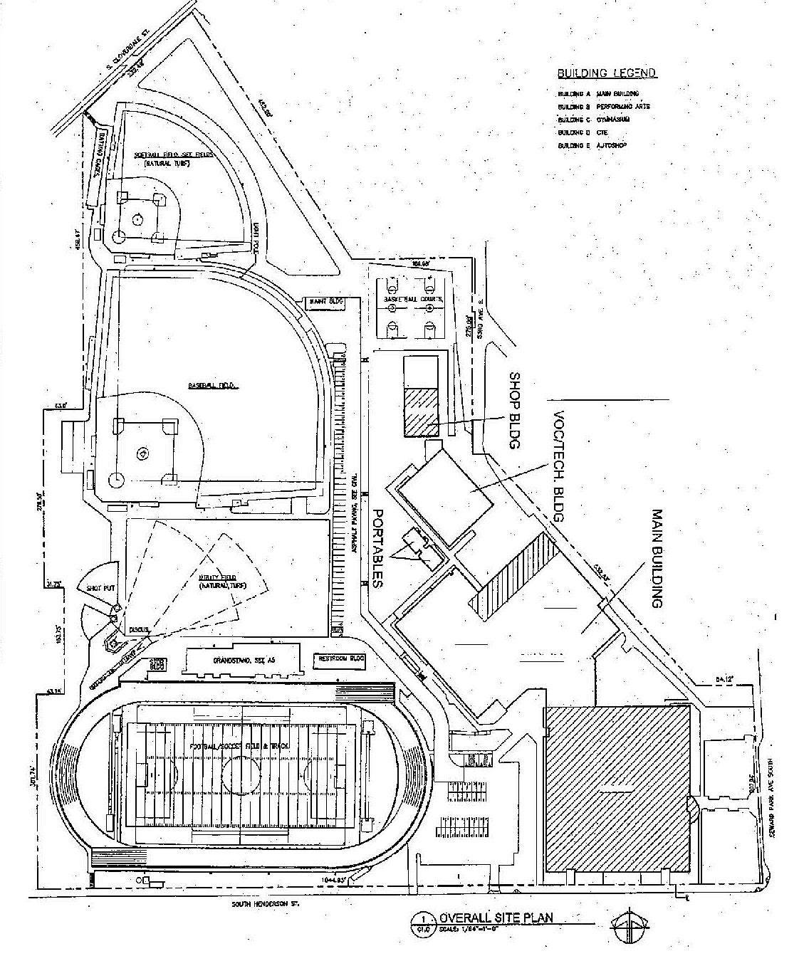
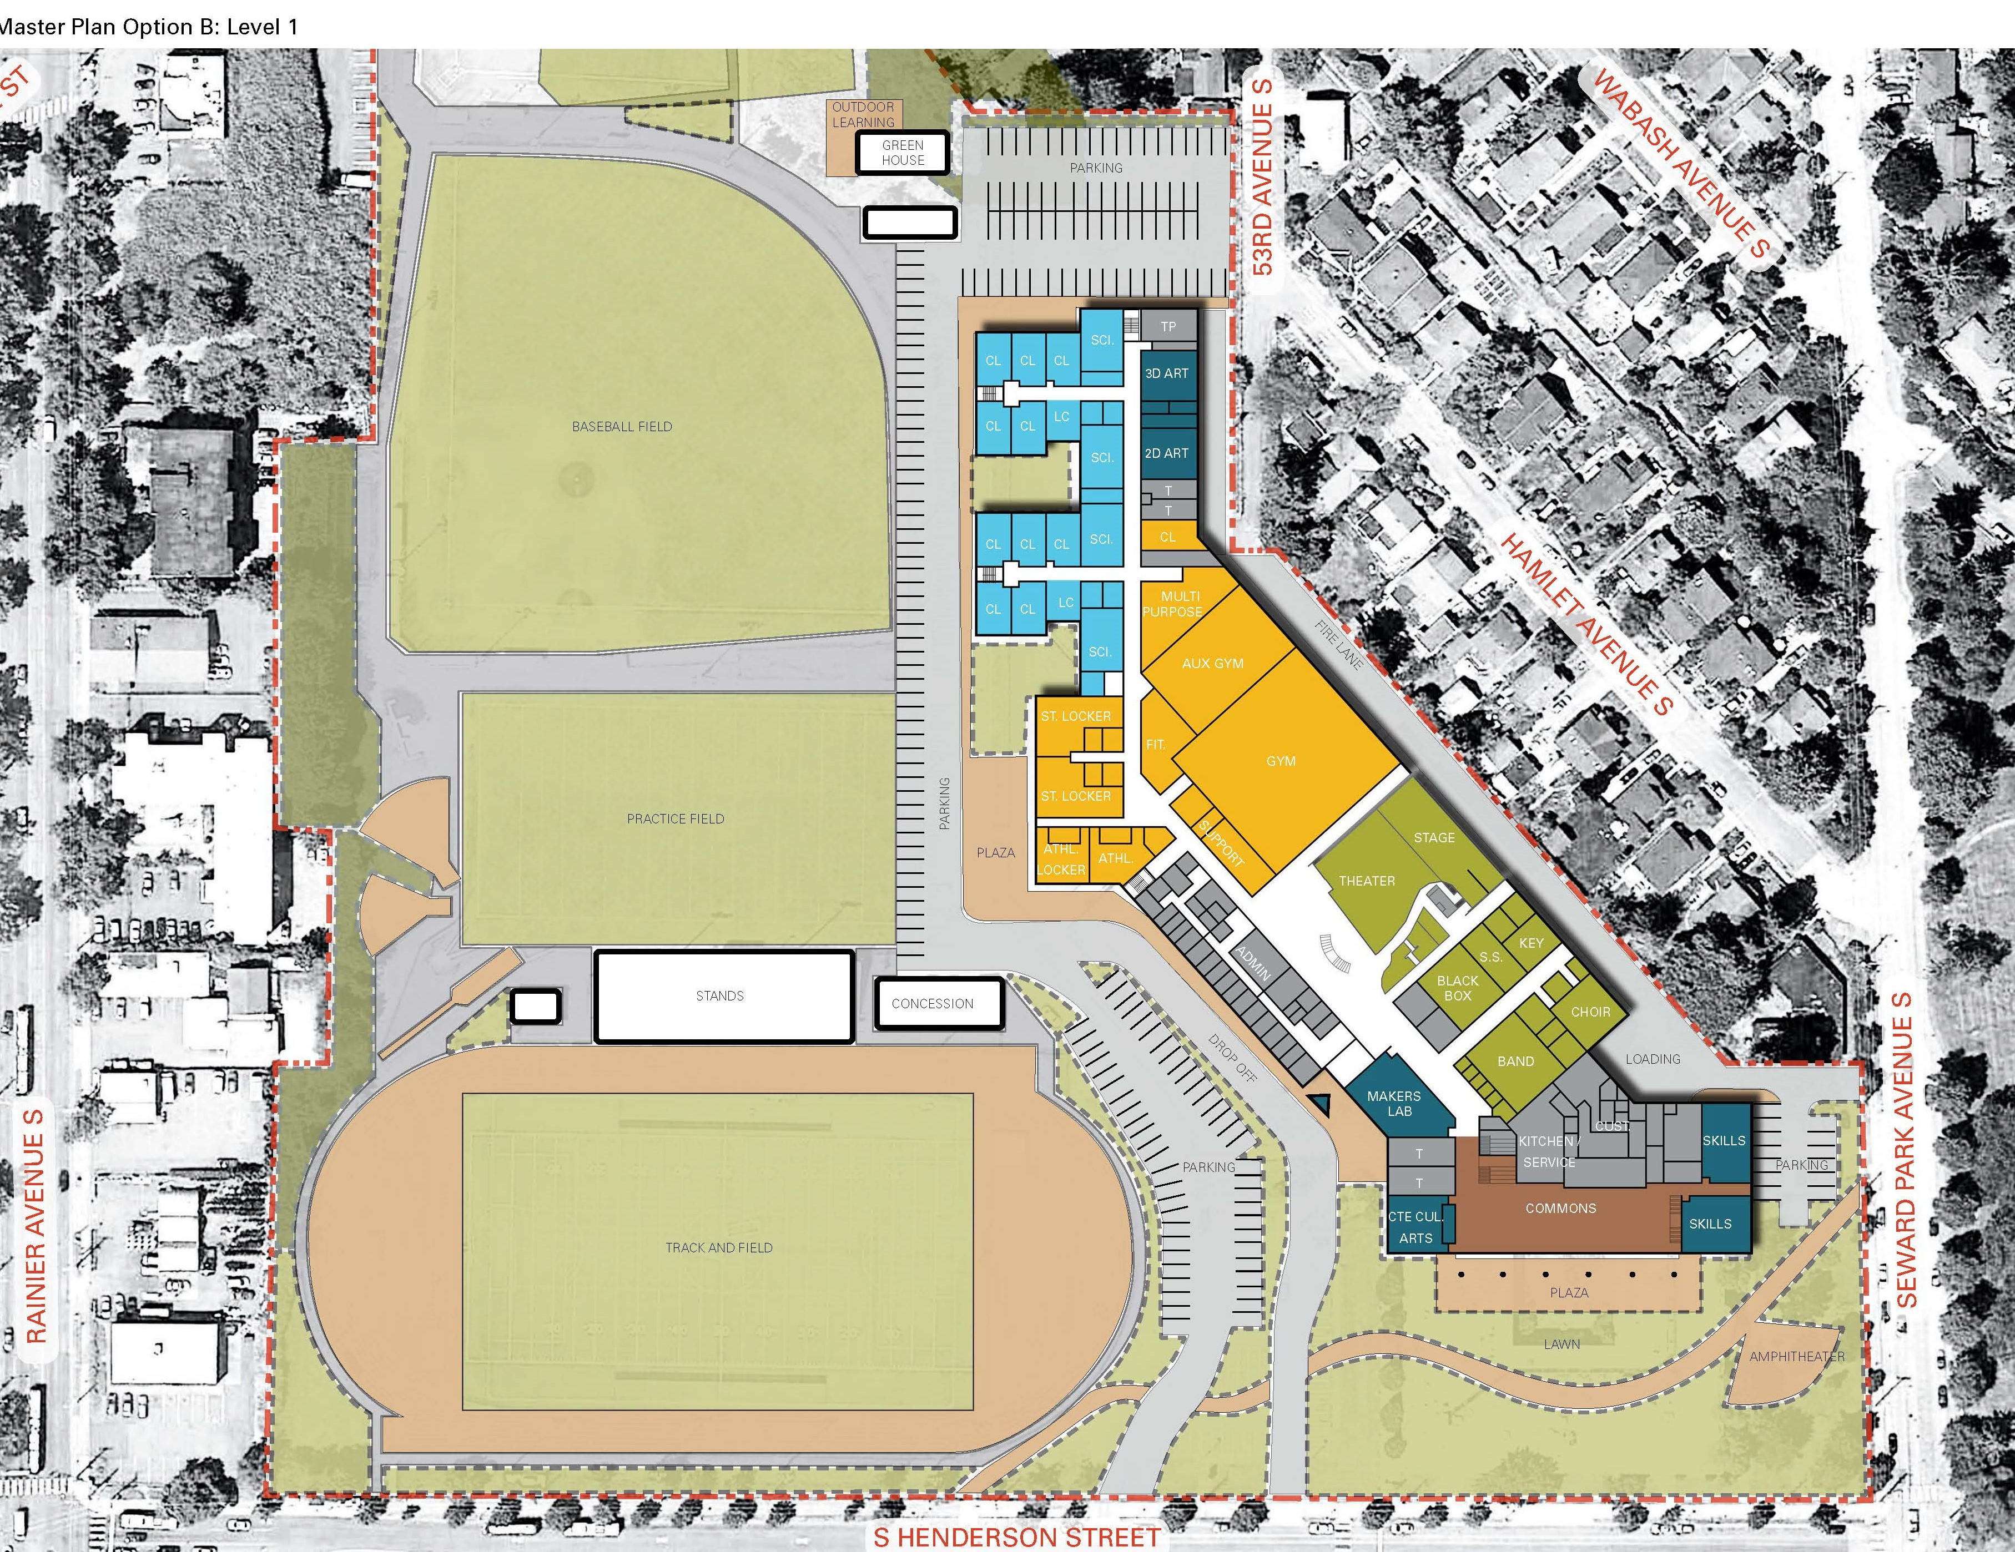
PROJECT OVERVIEW CONCEPTUAL PHASING
PHASE I
PHASE III
PHASE II
EXISTING SITE PLAN
CONCEPT PLANPLAN

Slide 11
Rainier Beach High School Site Evaluation
Total site area is 21.52 acres
Limited buildable land area. New staged construction will further limit available laydown/work and parking space.
Difficult soil conditions including liquefaction zones exist on the site; limiting buildable area.
24’ topo change from north to south. The site is L shaped with the existing building in a narrow area to the east.
Existing sports fields shared with community.

Slide 12
Scope, Budget and Schedule

Slide 13
Project Overview – Scope and Budget
New Rainier Beach High School
Project Overview - Scope and Budget
Funding Source: BEX V Levy, approved February 2019 and School Construction Assistance Program for OSPI
Approximately 233,700 SF replacement high school for 1,600 Students
Retain and modernize the existing 19,300 SF theater
Existing school to remain fully operational through construction
$238.3M total project cost
$157.6M construction cost (including construction contingencies)
Potential Landmark Status Pending

Slide 14
Project Overview – Preliminary Schedule

Slide 15

Why GC/CM Delivery Method for The New Rainier Beach High School Project

Slide 16
GC/CM AS APPROPRIATE DELIVERY METHOD
There is no interim site for this school so this will be phased occupied construction. At least three of the fields will be in continuous use by students and community.
Very constrained site for the scope of work (size, shape and topo).
Critical coordination needed with contractor and school to ensure a safe and productive school setting during construction.
School has significant transient and homeless population leading to the higher need for special programs and after school services. A highly qualified GC/CM is critical to coordinate construction with specialized needs of an occupied school.
Current market conditions indicate labor shortages, bidders are more reluctant to hard bid a technically challenging project like this.
Site use coordination: Limited site area for contractor staging, parking, hauling & laydown, teacher/student parking and sports field use.

Slide 17
Complies with 4 of the 5 Statutory Criteria
(1) Implementation of the project involves complex scheduling, phasing, or coordination.
(2) The project involves construction at an occupied facility which must continue to operate during construction.
(3) The involvement of the General Contractor/Construction Manager during the design stage is critical to the success of the project.
(4) The project encompasses a complex or technical work environment.
(5) The project requires specialized work on a building that has historic significance.

Slide 18
Public Benefit: From this ….
GC/CM selection based on qualifications and relevant experience will be critical to success of project with significant site constraints, schedule requirements and sensitivity to active school needs.
Design participation will improve GC/CM familiarity with issues and reduce errors or omissions, thus saving cost and improving quality.
GC/CM will participate in developing the schedule and phasing to help ensure timely turn-over of spaces.
Top tier contractors are more likely to compete for this project as a GC/CM, leading to likelihood of improved quality, timely completion, better sub coverage and better safety and integration with school.
Earlier cost information to better manage budget and prioritize needs.

Slide 19
Team Organization Chart and Qualifications

Slide 20
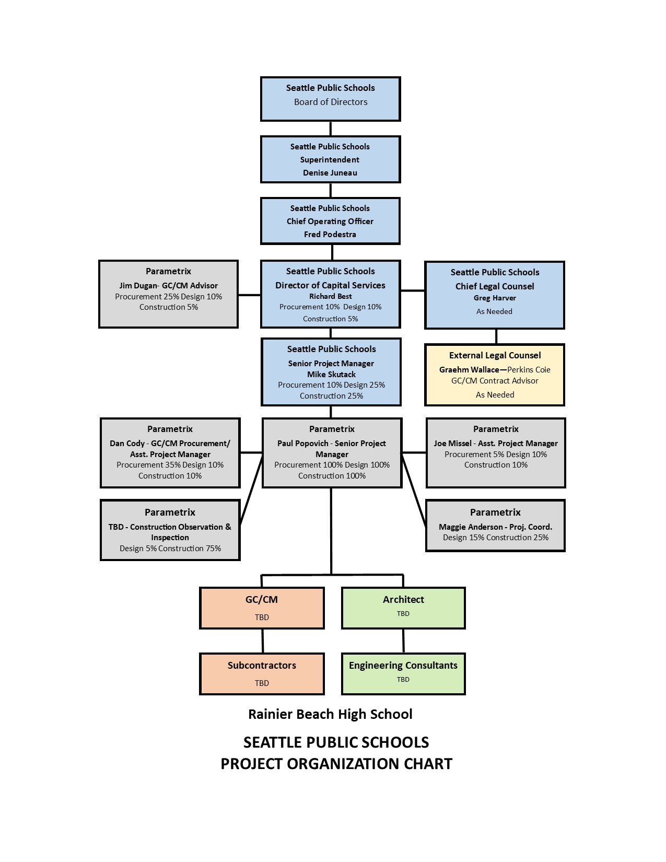

Slide 21
SPS Leadership Team
The District has a successful history of building and modernizing schools
1 GC/CM project currently under construction
Led by Richard Best, Director of Capital Projects and Planning.
District has on-staff team of project managers, project support and administration professionals
SPS satisfies the public body qualifications by staff augmentation with consultants who provide depth of GC/CM experience
  Parametrix is providing GC/CM Advisory and Procurement Services.
  Graehm Wallace/Perkins Coie provides legal counsel for GC/CM compliance

Slide 22
Project Team GC/CM Experience

Slide 23
Richard Best Director of Capital Services Seattle Public Schools | 37 yrs. Architectural and Construction Experience 7+ GC/CM Projects: Webster ES, Bagley ES, Ingraham HS Auditorium, Lincoln HS, Loyal Heights ES, Olympic Hills ES, Cascadia ES and Robert Eagle Staff Middle School
Mike Skutack Senior Project Manager Seattle Public Schools | 20 yrs. Program/Project Management 2+ GC/CM Projects: Lincoln HS, Denny MS Phase III
Paul Popovich, AIA Senior Project Manager/Construction Manager Parametrix | 39 yrs. Program/Project Management 5+ GC/CM Projects: Mount Vernon HS Old Main Building, MVSD East Division ES, TPS Browns Point ES, TPS Stewart Middle School Renovation, TPS McCarver ES
Jim Dugan GC/CM Procurement & Advisor Parametrix | 40 yrs. Of Design & PM/CM 11 GC/CM Projects (PM/CM): MVSD Old Main Building, BISD Blakely Elementary School, MVSD Madison Elementary, MVSD East Division Elementary, CKSD Central Kitsap HS/Central Kitsap MS, CKSD Olympic HS, TPS Browns Point Elementary School, MPT Eastside Community Center, TPS Stewart Middle School, TPS McCarver Elementary School, TPS Stadium High School.

Slide 24
Summary
Projects are funded with the appropriate budgets
Projects meet qualifying RCW 39.10 criteria
Project Management Plan for this project is developed and has clear and logical lines of authority
Project team has the necessary experience in addition to continuity for this project
Project team has the capacity for this project
Project team is prepared and ready to proceed
GC/CM RFP is nearly complete and can be ready to publish

Slide 25
Questions

Slide 26
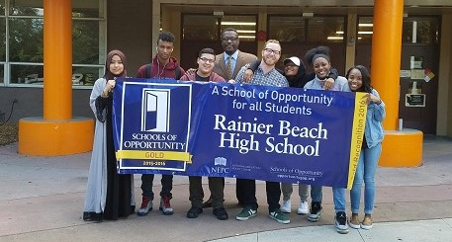
Thank you

