Slide 1
How to get involved with Public Works The Small Works Roster- What is it? How can I get registered?
Curtis Pate
Greater Tacoma Convention & Trade Center
June 1, 2016

Slide 2
The Small Works Roster (SWR)
Is a listing of State of Washington licensed contractors who have applied for and been placed on the roster.
Is used for projects under $300,000.
Makes it easier for contractors to compete for public works projects.
Are not advertised.

Slide 3
How does the Small Works Roster work?
Contractors apply online to be placed on the roster.
Organizations, use the roster to generate a list –roster– of contractors based on the contractor type, type of work, and project location.
Contractors on the list receive instructions by e-mail on how to obtain project documents; interested contractors may respond.

Slide 4
Who uses the Small Works Roster
Bellevue College
Bellingham Technical College
Centralia College
Clark College
Dept. of Corrections
Dept. of Enterprise Services
Dept. of Fish & Wildlife
Dept. of Licensing
Dept. of Social & Health Services
Edmonds Community College
Military Department
North Seattle College
Parks & Recreation Commission
Peninsula College
Seattle Central College
Skagit Valley College
South Puget Sound Community College
Tacoma Community College
The Evergreen State College
Washington State Patrol
Wenatchee Valley College
Yakima Community College

Slide 5
How do I apply to be on the Small Works Roster
Go to http://www.des.wa.gov Type; small works roster in the search box

Slide 6
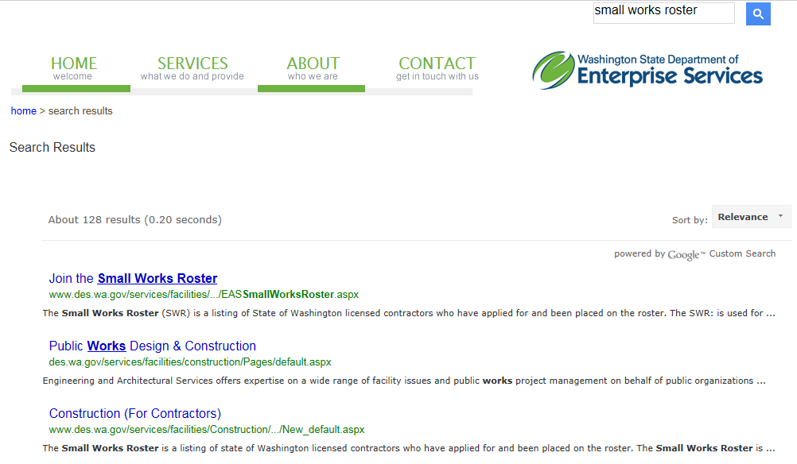
The first result starts your path to the application!

Slide 7
Have your UBI # handy

Slide 8
I’m a new contractor to the SWR
Hey, I’m already in there!

Slide 9
Enter your firm’s information
MWBE category
Firm type
Contact name, address, phone
Very Important – email address
Tip – If possible use an email that several employees can check, such as “bids@, administrator@

Slide 10
County or Counties you will Mobilize to
01 - Adams | 14 - Grays Harbor | 27 - Pierce
02 - Asotin | 15 - Island | 28 - San Juan
03 - Benton | 16 - Jefferson | 29 - Skagit
04 - Chelan | 17 - King | 30 - Skamania
05 - Clallam | 18 - Kitsap | 31 - Snohomish
06 - Clark | 19 - Kittitas | 32 - Spokane
07 - Columbia | 20 - Klickitat | 33 - Stevens
08 - Cowlitz | 21 - Lewis | 34 - Thurston
09 - Douglas | 22 - Lincoln | 35 - Wahkiakum
10 - Ferry | 23 - Mason | 36 - Walla Walla
11 - Franklin | 24 - Okanogan | 37 - Whatcom
12 - Garfield | 25 - Pacific | 38 - Whitman
13 - Grant | 26 - Pend Orielle | 39 - Yakima

Slide 11
61 Recognized Contractor Types
Commercial/Industrial Refrigeration - Boiler/Steam Fitting/Process Piping - Plumbing - Appliances, Equipment - Concrete - Drywall - Elevator - Fencing - Fire Protection - Glass and Glazing - House Moving - Institutional equipment, stationary furniture, lab tables, lockers - Irrigation/Sprinkling Systems - Landscaping - Masonry - Painting/Wall Covering - Roofing - Metal Fabrication/Sheet Metal - Siding - Structural Pest Control - Water Conditioning Equipment - Water Proofing - Gutters and Downspouts - Electrical - Electrical - Sign - General Contractor - Limited Energy - Overhead/Garage Doors - Glass and Glazing - Suspended Ceiling and Acoustical Tile - Swimming Pools, Spas and Hot Tubs - Tank and Tank Removal - Tile, Ceramic, Mosaic & Nat/Man Stone - Tree Removal Service - Utilities and Telecommunications - Window Coverings - Welding and Ornamental Metal - Awnings, canopies, patio covers and exterior screens - Cabinet/Millwork/Finish Carpentry - Construction Clean-up - Demolitions and Salvage - Doors, Gates and Activation Devices - Drilling, Blasting, Soil Sampling - Excavation, Grading and Land Clearing - Fireproofing and coating - Floor Covering and Counter Tops - Framing and Rough Carpentry - Heating, Ventilating, Air-Conditioning (HVAC) - Industrial Equipment/Machines - Insulation and Acoustical - Lathing and Plastering - Lock/Security Equipment - Manufactured/Mobile Home Set-up - Paving/Striping/Seal Coating - Sandblasting - Sanitation Systems &/or Side Sewers - Signs - Steel Erectors - Telecommunications - Well Drilling - Asbestos and Lead

Slide 12
187 Different Specialties
Aggregate Surfacing-Air Cleaning Devices-Air Conditioners, Packaged-Air Handling Units-Air Outlets & Inlets-Aluminum Windows-Antenna Towers-Applied Fireproofing-Architectural Woodwork-Asbestos Abatement-Back Fill-Basic Electrical Materials & Methods-Building Demolition-Building Insulation-Carpet-Cast-In-Place Concrete-Cement Concrete Curbs-Chain Link Fences & Gates-Chilled Water Distribution-Clay Masonry Units-Cold-Formed Metal Framing-Communications-Communications Circuits-Compaction-Compartment & Cubicles-Concrete Restoration and Cleaning-Concrete Unit Masonry-Damproofing & Waterproofing-Demolition Salvage-Domestic Water Conditioning-Domestic Water Filtering Equipment-Domestic Water Piping-Drainage and Containment-Driven Piles-Dry Chemical Fire Extinguishing-Dry-Pipe Fire Suppression Sprinklers-Ducts-Electric and Electronic Controls-Electrical Power-Electrical Testing-Elevators-Energy Recovery Units-Erosion & Sedimentation Control-Escalators & Moving Walks-Excavation-Exterior Painting-Exterior Signage-Fences & Gates-Finish Carpentry-Finish Grading-Fire & Smoke Protection-Fire Alarms-Flashing & Sheet Metal-Flexible Pavement-Flexible Pavement Coating and Micro-Surfacing-Floor Treatment-Flooring-Flooring Restoration-Formed Metal Fabrications-Fuel Dispensing Equipment-Furnaces-Furring & Lathing-Glass-Glass Unit Masonry-Glazing-Grading-Gypsum Board-Gypsum Plaster-Hazardous Material Remediation-Heat Exchangers-Heat Pumps-Heating & Cooling Piping-Heating Boilers & Accessories-Heavy Timber Construction-High-Voltage Switching & Protection-Historic Restoration-Hot Water Distribution-HVAC Instrumentation & Controls-Hydro-Punching/Seeding-Industrial & Process Equipment-Interior Painting-Interior Signage-Intrusion Detection-Irrigation System-Lead Paint Abatement-Lifts-Lighting-Lighting Poles and Standards-Lightning Protection-Liquid Petroleum Gas Distribution-Log Structures-Low Voltage Distribution-Masonry Restoration & Cleaning-Medium Voltage Switching and Protection-Membrane Roofing-Metal Building Systems-Metal Deck-Metal Door Restoration-Metal Doors and Frames-Metal Fastenings-Metal Joists-Metal Restoration & Cleaning-Microwave Antenna Systems-Microwave Transmission & Reception Equipment-Mobile Cranes-Motors and Generators-Oil Distribution-Ornamental Metal-Ornamental Metal Fences & Gates-Overhead Doors-Paint Restoration-Pavement Markings-Pavement Repair-Planting-Plaster Restoration-Plastic Windows-Play Field Equipment and Structures-Plumbing Fixtures & Equipment-Pole Construction-Polychlorinated Biphenyl (PCB) Abatement-Power Factor Controllers-Pre-Engineered Structures-Prefabricated Structural Wood-Protective Covers-Raceway & Boxes-Relining Underground Piping and Units-Resilient Flooring-Restoration of Underground Piping-Restoration of Underground Piping and Units-Rigid Pavement-Rigid Pavement Rehabilitation-Roof Maintenance and Repairs-Roof Tiles-Roofing & Siding Panels-Rotary Uninterruptible Power Units-Rough Carpentry-Rough Grading-Sanitary Sewerage-Sealing Underground Piping and Units-Security Access & Surveillance-Selective Clearing-Septic Tank Systems-Sheet Metal Flashing and Trim-Sheet Metal Roofing-Shingles-Shoreline Protection and Mooring Structures-Site Clearing-Site Improvements and Amenities-Site Precast Structural Concrete-Site Remediation-Skylights-Soil Stabilization-Specially Placed Concrete-Specialty Doors-Stainless Steel Windows-Standpipe & Hose Systems-Steam Distribution-Steel Windows-Storage Tanks-Storm Drainage-Structural Metal Framing-Structure Moving-Subdrainage Systems-Swimming Pools-Test Wells-Testing Inspection Services-Testing, Adjusting, and Balancing-Thermal Protection-Tile-Tilt-Up Precast Concrete-Transmission & Distribution Accessories-Transmission Towers-Tree Transplanting-Tree/Shrub Trimming/Removal-Tunneling, Boring and Jacking-Underground Electric Power Transmission-Video Surveillance-Wall Finish Restoration-Water Distribution-Water Supply Wells-Wet-Pipe Fire Suppression Sprinklers-Window Restoration and Replacement-Wood And Plastic Door Restoration-Wood And Plastic Doors-Wood Fences, Gates, & Masonry-Wood Flooring-Wood Restoration and Cleaning

Slide 13
What happens after I submit
I verify with Labor & Industries that
Contractors License
UBI Number
Bonding
Insurance
Are all current
Check the email address
Send you a confirmation email

Slide 14
Questions?

Slide 15
Thank you

