Slide 1
The 3 C’s of the U.S. Small Business Administration
Capital , Counseling, and Contracting
Spokane Branch Office
John Dicus, Business Opportunity Specialist
www.sba.gov/wa
Notes:
Good Morning! My name is Ted Schinzel, and I am the Branch Manager of the SBA Spokane Office.
The presentation today will provide you with important resource information about SBA and small business programs.

Slide 2
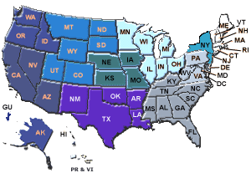
Agency Mission
The U.S. Small Business Administration was created in 1953 to:
Aid, Counsel, Assist and Protect the interests of small business concerns, preserve free competitive enterprise, and maintain & strengthen overall economy for our nation.
Notes:
This is the agency’s mission statement.
What are real job is: Help businesses start, grow, and expand. Actually about 1/3 of our loans and counseling services goes to start-ups.

Slide 3

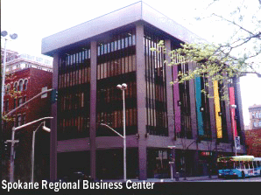
5/4/2015
SBA - Spokane Branch Office
Serving Eastern WA and North ID since 1963
Strategically located in the
Spokane Regional Business Center (SRBC)*
801 W. Riverside Ave, Suite 444
Spokane, WA 99201
www.sba.gov/wa
509-353-2800
*Co-located with SCORE
Notes:
Here is where our SBA Spokane Office in located. We host workshops and business counseling sessions.
You will be hearing about our local SBA resources, but SBA is nationwide, so you can access and district office in any state through our website, and all states will have similar program offerings as what you will be hearing today.

Slide 4
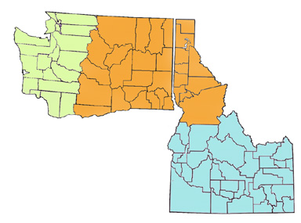
SBA - Spokane Branch Office
Serving 20 counties in
Eastern WA and
10 counties in
North ID
www.sba.gov
Notes:
Here is where our SBA Spokane Office in located. We host workshops and business counseling sessions.
You will be hearing about our local SBA resources, but SBA is nationwide, so you can access and district office in any state through our website, and all states will have similar program offerings as what you will be hearing today.

Slide 5

Fast Facts:
How many Small Businesses are there?
Number of Businesses under 500 employees in the US total 31 million
  Washington State >300,000 businesses under 500 employed
How many do they employee?
  < 500 employees employ 55 million
  < 20 employees employ 20 million
  <4 employees employ 5.8 million
*Source 2011 US Census Bureau
Notes:
How many net new jobs have been created by Large Firms over the past 10 – 15 years??? ZERO!!

Slide 6
Benefits of Small Business
90% (Approximately) of all employer firms
65% of all new jobs generated annually
55% of all new product innovations
52% share of the National GDP
45% of total U.S. payroll; $1.5 Trillion
23% of federal prime contracts
7% Self-Employed
97% Of All Identified Exporters/28% Export Value

Slide 7
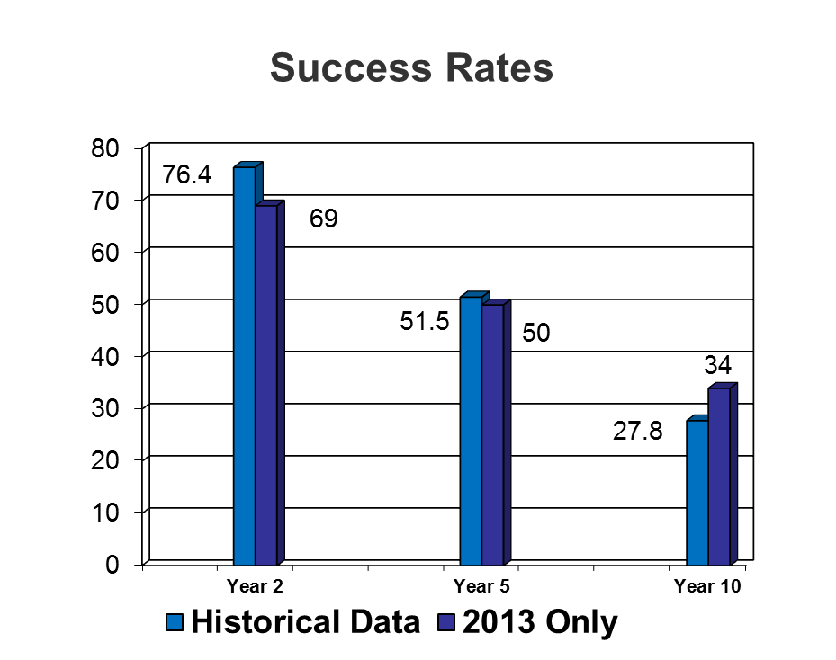
Small Business Success Rates
Approximately 25% of Small Businesses Fail within the first two years.
Approximately 50% of Small Businesses Fail within the first five years.
Approximately 75% of Small Businesses Fail within the first ten years.
Notes:
25% of businesses fail with first two years;
Nearly 50% by 5 years; and
Approximately 75% by 10 Years.
The business failure rate is better during good economic times, and worse during worse times.

Slide 8
Programs & Services Overview
“The 3 C’s of SBA”
Capital
Counseling & Training
Contracting
Notes:
Essentially SBA has three major program areas: 1) Capital/Financial Assistance 2) Counseling, Business Counseling and Training programs for business; and 3) Contracting- Government Contracting for women and minority business owners- 8(a) program.

Slide 9

Capital: How SBA Business Loans Work
SBA is not a direct lender (with the exception of disaster loans).
SBA guarantees loans
that Lenders make to businesses.
Businesses work with their Lenders.
The Lender applies to SBA.
If a borrower defaults, SBA pays guaranty to Lender.
Loan application guidance – SBA Resource Guide pg 13
Notes:
SBA is not a direct lender.
But, SBA can be important to a Lender if there are any perceived “gray areas” where there might be weaknesses (in one or two areas of the 5 C’s i.e., Credit History, Capacity, Cash Flow, Contribution, Collateral).
SBA can provide a 75% - 85% guarantee, like an insurance policy to support the loan. Right Now under the Obama American Recovery Stimulus it is 90%!
This can enable businesses to get financing that might not have normally been able to get funding.
Even the big conglomerate- NIKE got started with an SBA Loan.
For the taxpayer, the SBA Loan program is a really good investment because of the job creation that occurs from helping finance small business. Small business is the fastest job creator.
ecause of the job creation that occurs from helping finance small businesses.

Slide 10
SBA Loans - National
100,000 goal
Notes:
By 2007, our peak year, the total number of SBA Loans Nationally had virtually doubled since FY 2002. In 2008, total SBA loans began to drop to about 75,000 nationally, and by 2009, 55,000 nationally.

Slide 11
Spokane Total Loans
Notes:
The Spokane Region also saw considerable growth in loans from 249 in 2001, to nearly 727 in the peak year of 2007, dropping back to 599 in 2008, and 550 in 2010. Still, this drop is considerably less than the national average drop, so the Spokane Region has actually faired better. For 2012 the total number of loans were 466 for $ 185.6 million (Record); less loans but no stimulus like 2009 – 2011. More Normalized. For 2013 loans totaled $155.2 Million.

Slide 12
Seattle/Spokane NAICS Rankings TOP 25
NAICS Code NAICS Description Count of NAICS Loans Sum Of NAICS Loans
722110 Full-Service Restaurants 94 $38,396,600
447110 Gasoline Stations with Convenience Stores 60 $62,622,000
721110 Hotels (except Casino Hotels) and Motels 59 $117,964,000
621210 Offices of Dentists 51 $33,078,800
722211 Limited-Service Restaurants 46 $11,070,200
621111 Offices of Physicians (except Mental Health Specialists) 38 $23,091,300
621310 Offices of Chiropractors 31 $7,465,800
445110 Supermarkets and Other Grocery (except Convenience) Stores 28 $24,831,000
238990 All Other Specialty Trade Contractors 27 $5,405,900
541940 Veterinary Services 25 $10,611,100
238910 Site Preparation Contractors 23 $5,711,700
445120 Convenience Stores 20 $5,925,000
541110 Offices of Lawyers 19 $3,164,500
812112 Beauty Salons 19 $2,560,400
722213 Snack and Nonalcoholic Beverage Bars 18 $2,988,500
236118 Residential Remodelers 17 $1,817,400
238210 Electrical Contractors 16 $3,840,000
621340 Offices of Physical, Occupational and Speech Therapists, and Audiologist 16 $3,959,200
713940 Fitness and Recreational Sports Centers 16 $11,254,700
113310 Logging 15 $8,956,300
624410 Child Day Care Services 15 $6,800,200
332710 Machine Shops 15 $7,060,100
451110 Sporting Goods Stores 14 $4,075,000
561730 Landscaping Services 13 $3,086,500
236115 New Single-Family Housing Construction (except Operative Builders) 12 $2,489,600
238220 Plumbing, Heating, and Air-Conditioning Contractors 12 $591,000
722410 Drinking Places (Alcoholic Beverages) 12 $3,812,500
811111 General Automotive Repair 12 $7,101,200
446110 Pharmacies and Drug Stores 12 $9,295,000
541330 Engineering Services 12 $4,521,000
541990 All Other Professional, Scientific, and Technical Services 12 $2,583,700

Slide 13
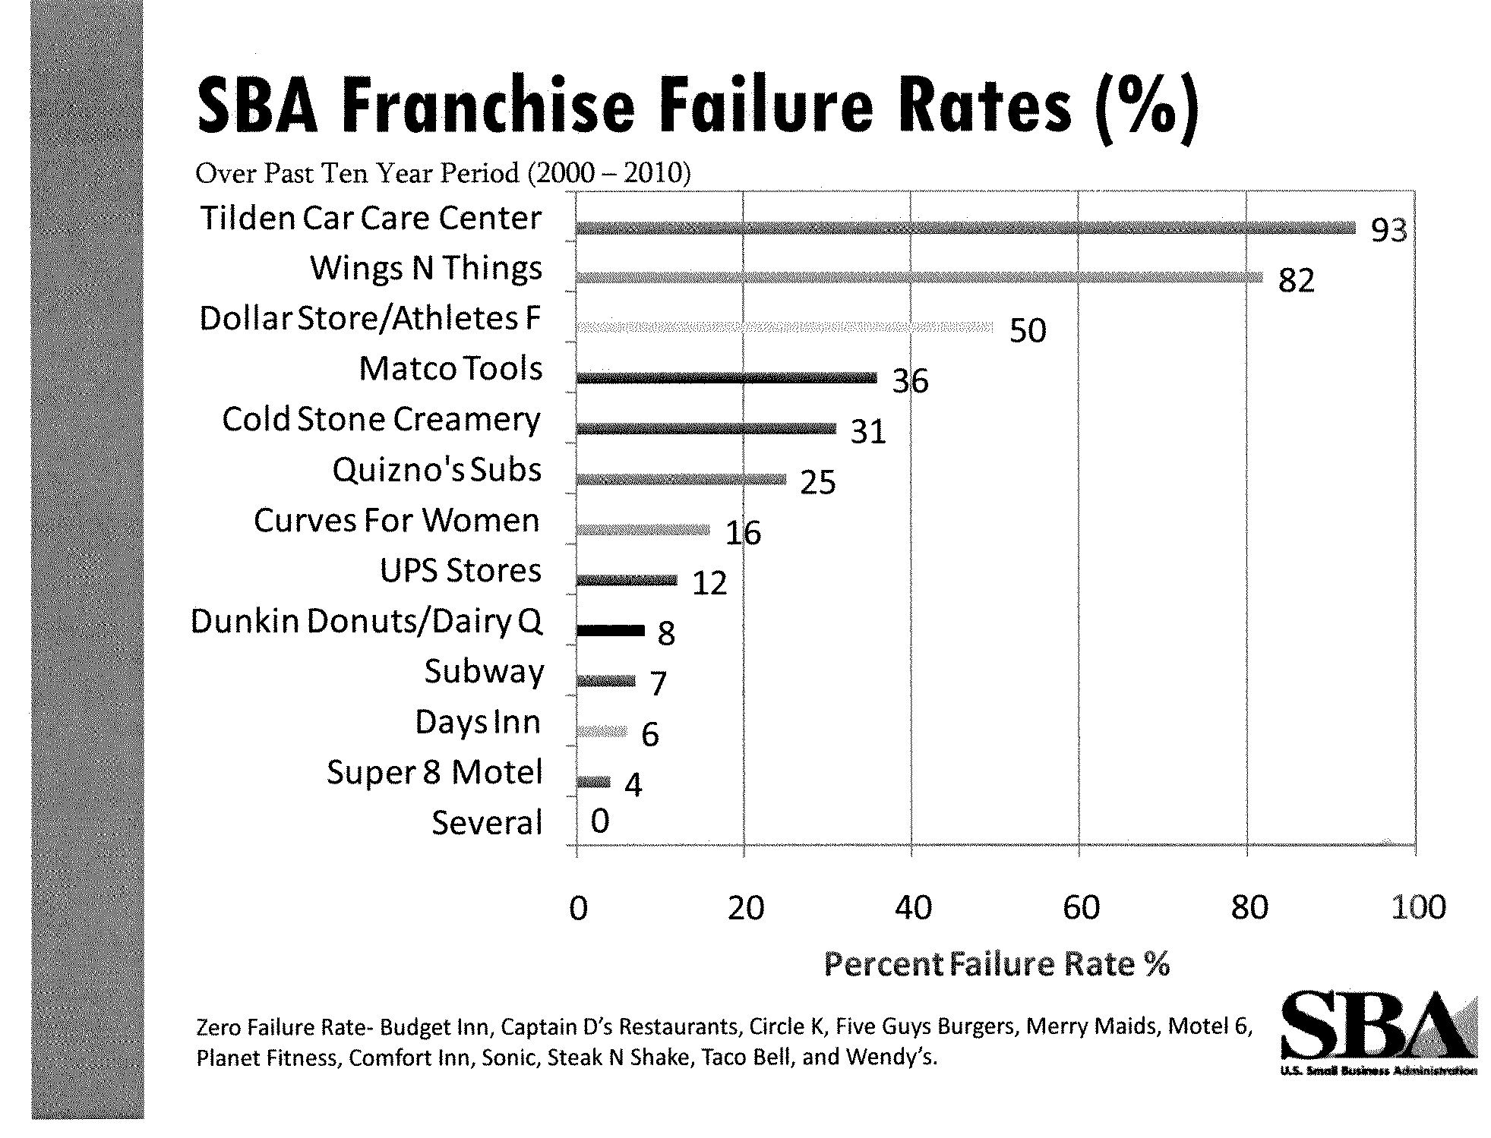

Slide 14
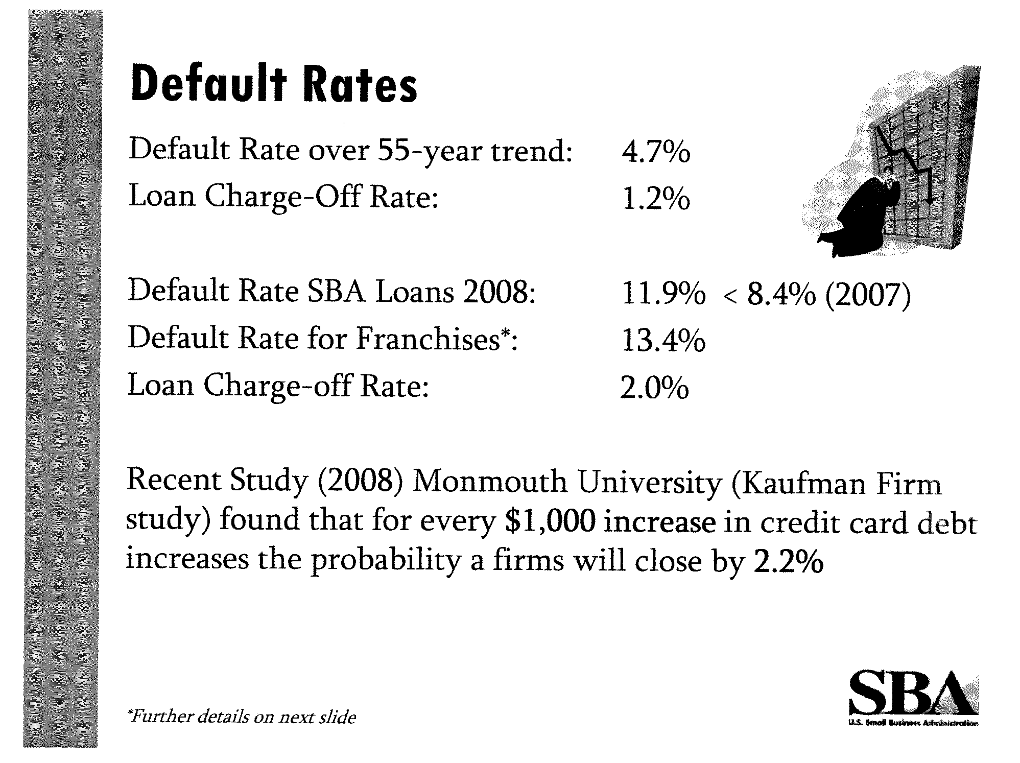

Slide 15
Why Lenders Use SBA Financing
SBA Guarantees up to 85% of loan
Mitigates risk to Lender
Lender wants to give borrower a longer term
Collateral may not be adequate for loan
Economic conditions
Lending institution policy
Business Sector / Industry issues
New businesses
Notes:
There are several reasons why a lender might want to use SBA Financing. (Explain the list)

Slide 16
Counseling
Women’s Business Center
SCORE
Small Business Development Center

Slide 17

500 S. Stone
Spokane, WA
509-456-7106, ext. 123
Snapwa.org/wbc
Business plans
Market Research
Formal Training
Online Training
Computer Lab
Counseling
Loan App. Packages
Technology Grant

Slide 18

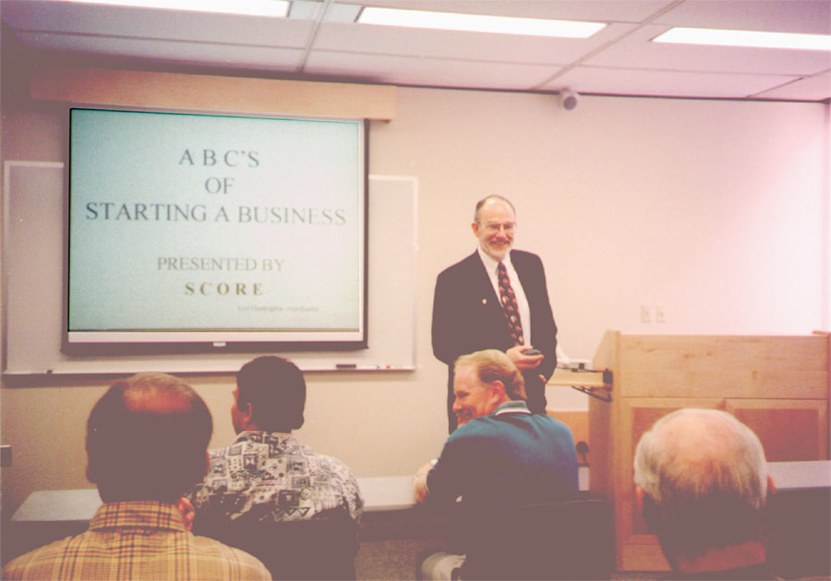
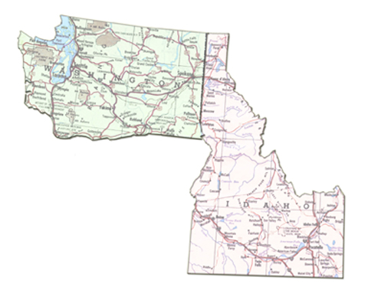
There are over 300 SCORE Volunteers in Washington and Idaho:
Free confidential counseling
  In person
Low cost workshops
Locations
Contact
www.scorespokane.org
To sign-up for SCORE counseling or workshops.
In Spokane call:
  509-353-2821
SCORE counseling by email available through: info@scorespokane.org
More Info
SBA Resource Guide
page 12
Notes:
There are eight (8) SCORE Chapters across Washington State and very in the size of the members from 10 in the Tri-Cities to over 150 in Seattle. There are probably 300 SCORE members statewide. SCORE Counselors provide free business counseling and also provide a series of workshops. SCORE helps a number of start-up businesses and can sometimes supply a good business “mentor” match to the prospective business.

Slide 19


Small Business Development Centers
SBDC Counseling
Information
Washington
Long-term Counseling Relationships
  No Charge
  Confidential
  One-on-one
Over 25 Locations!*
Evening Workshops
* Internet Counseling also available in WA
Locations
www.wsbdc.org
Idaho
www.idahosbdc.org
SBA Resource Guide
pg. 13
Contact
Spokane:
509-358-7890
Post Falls:
208-665-6085
Notes:
SBDCs have day and evening workshops.
SBDCs are an SBA funded operation. We have about 25 locations nationwide. All Certified Business Counselors have MBA’s or equivalent and have to go through an extensive certification process. Counseling is “free” to the business public, primarily for existing businesses.
Alan Stanford is a veteran from the financial and banking industry.
Tammy Everts has an in-depth marketing background.
SBDC also has a focus in exporting which many companies don’t even know they do.

Slide 20
Contracting
To participate in SBA Contracting Programs,
a business
- and all of its affiliates in the aggregate -
must be a small business
in its primary industry.
Notes:
In order to participate in any of our SBA Programs, a firm must be considered “small” in its primary industry.

Slide 21
Size Standards
Based on NAICS codes (North American Industry Classification System)
Firm may be capable of performing in several NAICS code areas.
www.naics.com/search
Primary code is the one that represents largest portion of business.
Currently over 1,040 NAICS codes in many different Industries
Notes:
And here is a little more information regarding Size Standards.

Slide 22
Core Size Standards for Sectors
Service
$7.5 Million
Manufacturing
Construction
$15 Million – Special Trade Construction
$36.5 Million – General Construction
500 Employees
Wholesalers
100 Employees
* 500 Employees for Government Procurement
Notes:
These are the general Small Business Administration Size Standards based on a firms North American Industry Classification System, also known as the NAICS code. For dollar amount size standards, these are based on a 3 year average and for the employee size standards it is based on the preceding completed 12 calendar months. The core industry SBA size standards are:

Slide 23

Prime Contracting Government-wide Procurement Goals
Small Business (SB) - 23%
Small Disadvantaged Business (SDB) - 5%
Women-Owned Small Business - (WOSB)- 5%
HUBZone Small Business – 3%
Veteran-Owned Small Business (VOSB) - 3%
Notes:
The Federal Government uses contracting as one of it’s primary tools to help stimulate the economy and help create jobs. In order for this system to work, contracts must be awarded to small businesses rather than the large corporations like Lockheed Martin, Boeing, and Raytheon. So, the SBA Requires all Federal Contracting Agencies to meet these minimum percentages awarded to our different Contracting Certification Programs which are broken out as so. Most agencies implement their own goals, which is fine by us as long as they meet these minimum percentages.

Slide 24
FY 2013 Federal Contracting Amounts
Category | Actions | Dollar Amount
Total Small Business Eligible Contracts | 11,878,391 | $355,413,247,812
Category | Actions | Dollar Amount | Percentage | Goal
Total Small Business | 1,399,299 | $83,142,807,958 | 23.39% | 23.00%
Small Disadvantaged Business | 268,241 | $30,616,176,486 | 8.61% | 5.00%
8(a) Firms | 94,251 | $13,997,559,304 | 3.94%
Veteran Owned Small Business | 261,669 | $17,810,543,400 | 5.01% | 3.00%
Service Disabled Veteran Owned Small Business | 115,143 | $12,023,167,217 | 3.38%
Women Owned Small Business | 250,504 | $15,364,841,129 | 4.32% | 5.00%
Hubzone Small Business | 62,695 | $6,244,980,082 | 1.76% | 3.00%
Category | Actions | Dollar Amount
Total Small Business Eligible Contracts | 11,878,391 | $355,413,247,812
Category | Actions | Dollar Amount | Percentage | Goal
Total Small Business | 1,399,299 | $83,142,807,958 | 23.39% | 23.00%
Small Disadvantaged Business | 268,241 | $30,616,176,486 | 8.61% | 5.00%
8(a) Firms | 94,251 | $13,997,559,304 | 3.94%
Veteran Owned Small Business | 261,669 | $17,810,543,400 | 5.01% | 3.00%
Service Disabled Veteran Owned Small Business | 115,143 | $12,023,167,217 | 3.38%
Women Owned Small Business | 250,504 | $15,364,841,129 | 4.32% | 5.00%
Hubzone Small Business | 62,695 | $6,244,980,082 | 1.76% | 3.00%
Notes:
This is how the Federal Government did as a whole in FY2013. In FY2013, the Federal Government as whole met the 23% total small business goal for the first time since 2006. The federal Government also met the Small Disadvantaged Businesses and Veteran Owned Businesses goals, but fell short in awarding contract dollars to Women Owned Small Businesses and HUBZone certified Small Businesses.

Slide 25
FY 2013 Top Federal Contracting Agencies
Funding Department | Total Small Business Eligible Actions | Total Small Business Eligible Dollars
DEPARTMENT OF DEFENSE | 9,323,793 | $228,943,658,471
DEPARTMENT OF ENERGY | 12,361 | $21,748,134,677
DEPARTMENT OF HEALTH AND HUMAN SERVICES | 85,842 | $19,427,101,305
DEPARTMENT OF VETERANS AFFAIRS | 1,733,413 | $18,286,074,605
NATIONAL AERONAUTICS AND SPACE ADMINISTRATRION | 31,358 | $12,733,636,452
DEPARTMENT OF HOMELAND SECURITY | 83,026 | $12,518,034,976
DEPARTMENT OF JUSTICE | 150,460 | $6,502,564,560
DEPARTMENT OF AGRICULTION | 69,154 | $5,171,866,527
GENERAL SERVICES ADMINISTRATION | 129,613 | $3,508,738,365
DEPARTMENT OF COMMERCE | 28,916 | $3,337,030,628

Slide 26
Government Contracting
Is it Right for You?
Does the government buy your product or service?
Are you prepared to follow the rules, read the solicitation packages, and complete the required paperwork?
Does Your Business Have Adequate financial preparation?
Notes:
But is government contracting right for you? You must ask yourself several questions:
Does the government buy your product or service?
Are you prepared to follow the rules? Government contracting can require safety plans, technical proposals, price proposals, solicitation packages which should be read word for word, complex rules called the FAR – Fed Acq Regs.
Do you have the working capital to carry you through until you get paid? This could be approx 60 days from the time you start work.

Slide 27
SBA Certifications
8(a) Business Development Program
  Application Process
Historically Underutilized Business Zone (HUBZone)
  Application Process
Service Disabled Veteran Owned Small Business (SDVOSB)
  Self-Certification in SAM
Women Owned Small Business (WOSB) Certification
  Self-Certification in SAM
Economically Disadvantaged Woman Owned Small Business (EDWOSB)
  Self-Certification in SAM
Notes:
Next, I will talk about our SBA Certification Programs. I will go into each one in detail in the following slides. The 8(a) and HUBZone Certifications require an application, while the other certifications are self-certified in SAM.

Slide 28

HUBZone Program
Notes:
Now, I will discuss our Contracting Certification Programs and first is the HUBzone Program, which is the one program that is based on where your company is located rather than sex, race, or veteran status.

Slide 29
HUBZone Program
Economic development program
to promote business and job opportunities in high unemployment and low income areas by increasing federal contracting activity
in those areas.
Notes:
The Hubzone Program is a way the Federal Government funnels money to Historically Underutilized Business Zones, or areas with high unemployment and low income. Hubzone Program is commonly referred to as Place or Location Based Contracting.

Slide 30
HUBZones
Historically Underutilized Business Zones
Urban -- census tracts
Rural -- countywide
All federally recognized Native American reservations
Closed Military facilities (BRAC)
Notes:
These are some the types of locations that can be considered a Hubzone. The designated areas are constantly updated and can be found on our website. The Urban Areas, or census tracts, and Rural Areas, or county wide HUBZone designations can be certified and decertified by our HUBZone Office in DC; while all Native American Reservations and Closed Military Facilities areas are always designated HUBZones. If you are looking for a new business location and are interested in Government Contracting, I highly recommend looking at a HUBZone location if they are available as theses are in High Demand as you saw in the early slide where agencies are not meeting the minimum goals.

Slide 31
HUBZone Benefits
Price evaluation preferences (10%) over non-small business in full and open competition
Subcontracting Opportunities
Sole Source Contracts (rare)
Set-aside contracts
Notes:
Some benefits of being a hubzone firm include:
Price Evaluation preference of 10% in full and open competition. This means if your are submitting a proposal where price is an evaluation factor and you are a HUBZone firm, you would be eligible for award if your proposal came in at 10% or less higher than a non-HUBZone firm if all other evaluation factors were equal.
Subcontracting Opportunities – when agencies award contracts to large-businesses, or what the federal government considers “other than small”, they require large businesses to meet the same SBA goals as presented before; so your HUBZone certification can look very atttractive to these large businesses when compared to other firms without HUBZone status.
Sole Source contracts- this is rare and usually only happens towards the end of the Fiscal Year where an agency needs to award a requirement quickly, they have the opportunity to award to a trusted HUBZone firm directly rather than putting the requirement out for solicitation.
Set-Aside contracts – When agencies are trying to meet their HUBZone goal they will set aside a requirement for competition only between HUBZone certified firms, making the pool of competition smaller and raising your chances for award.

Slide 32
HUBZone Eligibility
Must be a small business
Principal office must be located in a HUBZone
At least 35% of the employees must reside in HUBZone
Must be 51% owned & controlled by U.S. citizens
Notes:
These are some of the Hubzone eligibility requirements in which a firm must meet ALL of.

Slide 33
Am I in a HUBZone?
www.sba.gov/hubzone
HUBZone mapping by:
State
County
Census Tract
Specific address
Native American Reservation
Notes:
Now you may ask yourself if you are in a HUBZone. To find out if your firm is eligible for hubzone certification, you can go to this link and you can search by each of these categories or put in your address and it will let you know if you are in a qualified area. I normally recommend putting in your exact address as this will prompt a pop-up box which will state exactly if this address is in a HUBZone designated area.

Slide 34
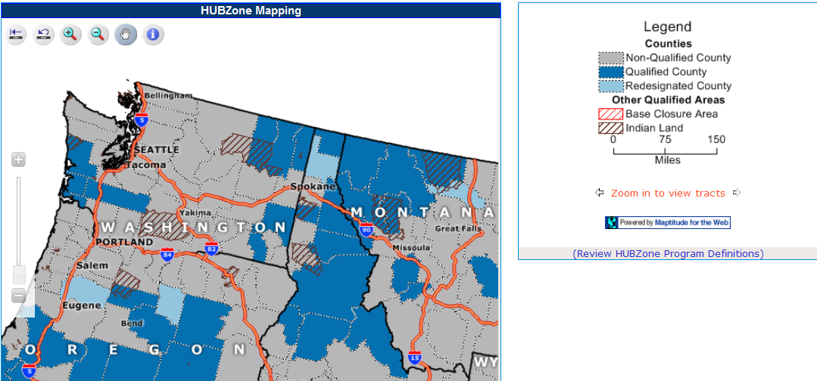
Notes:
This is a screenshot from our website with an example of our Territory. Census Tracts do not show up on the zoomed out version, which is why I recommend putting in the exact address.

Slide 35
8(a) Business Development
Program
Notes:
Next, I will discuss the 8(a) business development program, in which I handle all the firms in our territory.

Slide 36
8(a) Program
The SBA's 8(a) BD Program is named for a section of the Small Business Act.
It is a business development program created to help small disadvantaged businesses compete in the American economy and access the federal procurement market.
Notes:
The 8(a) Program is a Business Development Program for small, socially and economically disadvantaged firms to promote growth and help them compete in the Federal Procurement Market.

Slide 37
8(a) Program Benefits
Sole Source Contracts
8(a) Competitive Set-aside Contracts
7(j) Training
Mentor Protégé Program
Access to Government Surplus Property
Notes:
There are substantial benefits to being admitted into the 8(a) program, including:
Sole Source Contracts – Most 8(a) contracts are sole source awards, which is very beneficial to agencies as they can get usually smaller contracts awarded in a quick manner with a trusted 8(a) firm rather than putting it out for solicitation to save valuable time and government resources.
8(a) Competitive Set-aside contracts – this is the same as HUBZone set-asides for when agencies are trying to meet their Small Disadvantage Business Goal goal they will set aside a requirement for competition only between 8(a) certified firms, making the pool of competition smaller and raising your chances for award.
7(j) Training – SBA wants these firms to grow and have the capabilities to compete in the Federal Marketplace after graduation for the program; so we hire contractors who are subject matter experts in all things federal procurement to train the firms and even on some occasions go on site to the firm’s location and help them get set up to meet federal regulations as well as to improve efficiencies within the organization.
The Mentor Protégé Program – This program allows a firm to set up an Agreement with a firm in the same industry to foster the growth of the 8(a) firm. Protégé’s can use the mentor’s equipment, personnel, bookkeeping, bonding limits, Past Performance and other valuable tools within the Mentor’s capabilities.
Access to Government Surplus Property – 8(a) firm’s get access to surplus Government Property at great discounts.

Slide 38
8(a) Program Eligibility
51% owned by socially and economically disadvantaged U.S. citizens
Socially and economically disadvantaged individuals control daily operations.
Potential for success – must have 2 years in business.
Concern must be a small business
Notes:
These are the basic eligibility requirements for the 8(a) Program
More detail regarding these requirements can be found at our website

Slide 39
8(a) Program Eligibility
Social Disadvantage:
African Americans
Hispanic Americans
Native Americans
Asian-Pacific Americans
Sub-Continent Asian Americans
Notes:
This describes what the SBA considers a social disadvantage. If you are not an owner who falls into this category but feel you have a social disadvantage, you may apply for the 8(a) program and qualify if you fully explain in detail a social disadvantage by another race or disability

Slide 40
8(a) Program Eligibility
Economic Disadvantage
Personal Income <= $250,000 -3 yr average
Personal Net Worth <= $250,000 excluding:
Equity in personal residence
Equity in 8(a) applicant firm
Total Assets <= $4 million
IRAs when subject to significant penalty for withdrawal, and
Notes:
In order to meet the Economic disadvantage requirement of the 8(a) program, the firm and owner must meet these levels.

Slide 41
Other SBA Contracting Programs

Slide 42
WOSB Program
Set-Aside contracts in 133 industries in which women are underrepresented
Award price was limited but has recently been expanded.
Represent status in the System for Award Management (SAM) & post documents to SBA’s General Login System (GLS).
Notes:
Another program is the Women Owned Small Business Program in which the government awards set-aside to contracts in certain NAICS codes.

Slide 43
WOSB Eligibility
WOSB
EDWOSB (Economically Disadvantaged Women Owned Small Business):
Net worth < $750,000
Average income <= $350,000
FMV assets <= $6,000,000
www.sba.gov/wosb
51% Ownership & Control by 1 or more women citizens
WOSB + 51% must be Economically Disadvantaged:
Notes:
These are the elgibility requirement for Women Owned and Economically Disadvantaged Women-Owned Small Businesses.
All EDWOSB are eligible for WOSB set-asides, but not vice versa

Slide 44
SDVOSB
Service Disabled Veteran Owned Small Business:
Set-aside contracts to reach 3% goal
51% owned & controlled by service disabled vet(s)
Documentation of 0-100% service connected disability
Register at www.vetbiz.gov for VA set-asides
Notes:
The final program is the Service Disabled Veteran Owned Small Business. There is also a Veteran Owned Small Business Certification; however only the VA can set aside contracts for this certificatoin. If another agency wants to award a contract to a veteran owned business, they must set the contract aside for Service Disable Veteran Owned Small Business.

Slide 45
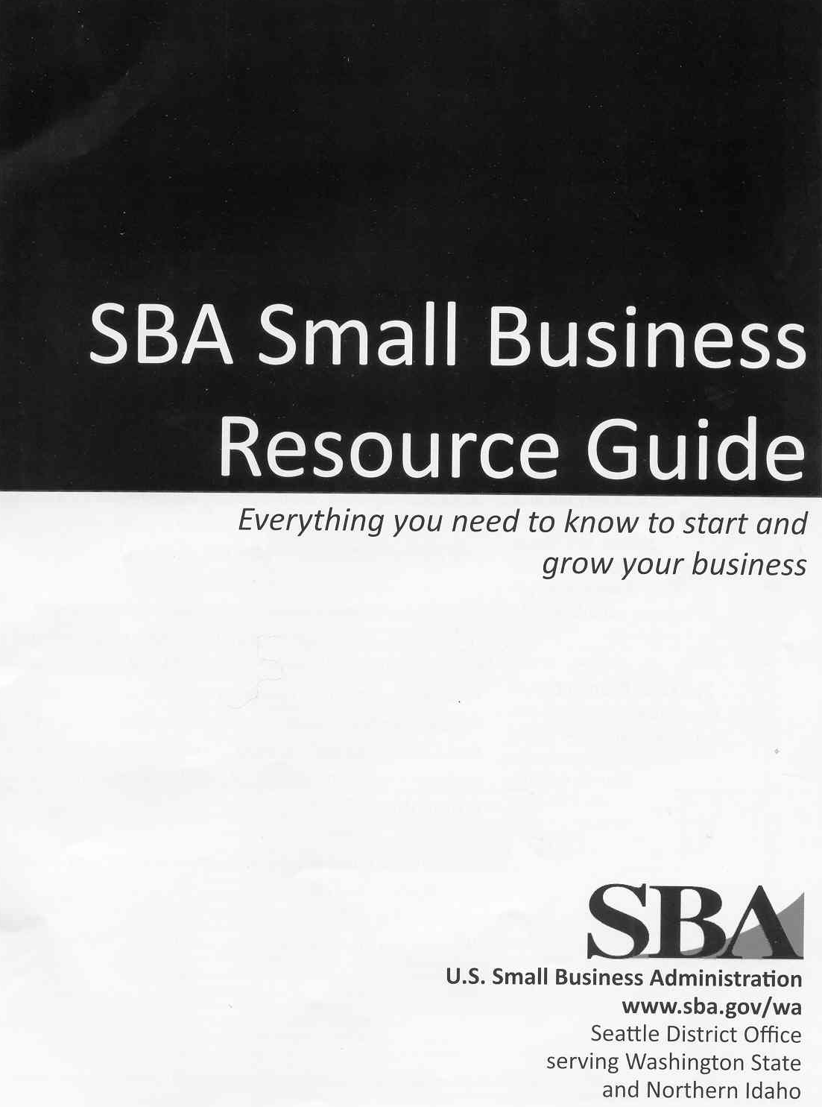
Small Business Resource Guide
Start-Up Checklist pg 2
Licensing Contact Info pgs 4-5
Business Plan Outline pg 10
Loan Programs pgs 14-19
Counseling/Workshops pgs 12-13
Government Contracting pgs 21-25
International Trade pgs 26
Regional Resources pgs 26 - 32
Notes:
Business ownership is complicated, so we provide resources to support entrepreneurs.
Here is an important resource for guidance, contacts and information.
The SBA Resource Guide. A goldmine of information. Especially Licensing Requirements for business.
Every SBA district office in the U.S. produces one of these.

Slide 46
Questions?
Thank You!
Spokane Branch Office
801 W. Riverside Avenue
Suite 444
Spokane, WA 99201
509-353-2811
www.sba.gov

Slide 47
