Slide 1
DES Fleet Operations Data Driven Fleet Management
Presented by
George Carter III – DES Fleet Operations Manager
Kim Marshall – DES Fleet Analytics Manager
Barbara Egan – Verizon Network Fleet Strategic Account Manager
Location or Date

Slide 2
Vehicle User Training - Agenda
Introduction
DES Fleet Operation’s Services
What is Telematics?
Telematics Pilot Scope
Measureable Metric
Potential for Risk and Cost Avoidance
Verizon Network Fleet Case Study
Closing and Q&A

Slide 3
What is Fleet Operations?
A team of 23 fleet management professionals providing vehicle management services
Vehicles leased to agencies long term on permanent assignment
Vehicles leased to agencies for projects lasting 30-180 days
Daily rental vehicles for rentals of 30 days or less
Maintenance shop to service all Fleet Operations vehicles
Over 4,000 vehicles currently assigned to about 70 WA State government entities
Our Goal
Provide state drivers with safe, reliable, lowest cost vehicle options

Slide 4
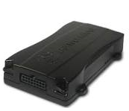
Verizon Network Fleet

Slide 5
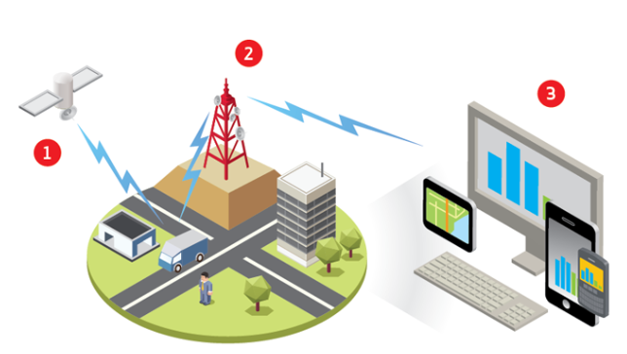
How It Works

Slide 6
Pilot Project
350 total vehicles
Ten agencies
Six (6) month trial period
Sample size provides a 95% confidence level in the results, based on a 3,500 vehicle fleet
DES Fleet Operations will coordinate the placement of the pilot Verizon Networkfleet systems in vehicles encompassing a broad range of vehicle applications, over a statewide geographical area. This approach provides a good sample set of data points for vehicles with varying duty cycles.

Slide 7
Pilot Measurable Metrics
Improvements to employee safety
Accident management cost avoidance
Decreased fuel consumption and increase MPG
Improved vehicle utilization
MMT of carbon and Social Cost of Carbon (SCC) reductions
Idle time reduction
Cellular vs Satellite connectivity requirements – geo-fence areas with poor or no cell reception
Business process improvements
Customer complaints and associated vehicle location backup

Slide 8
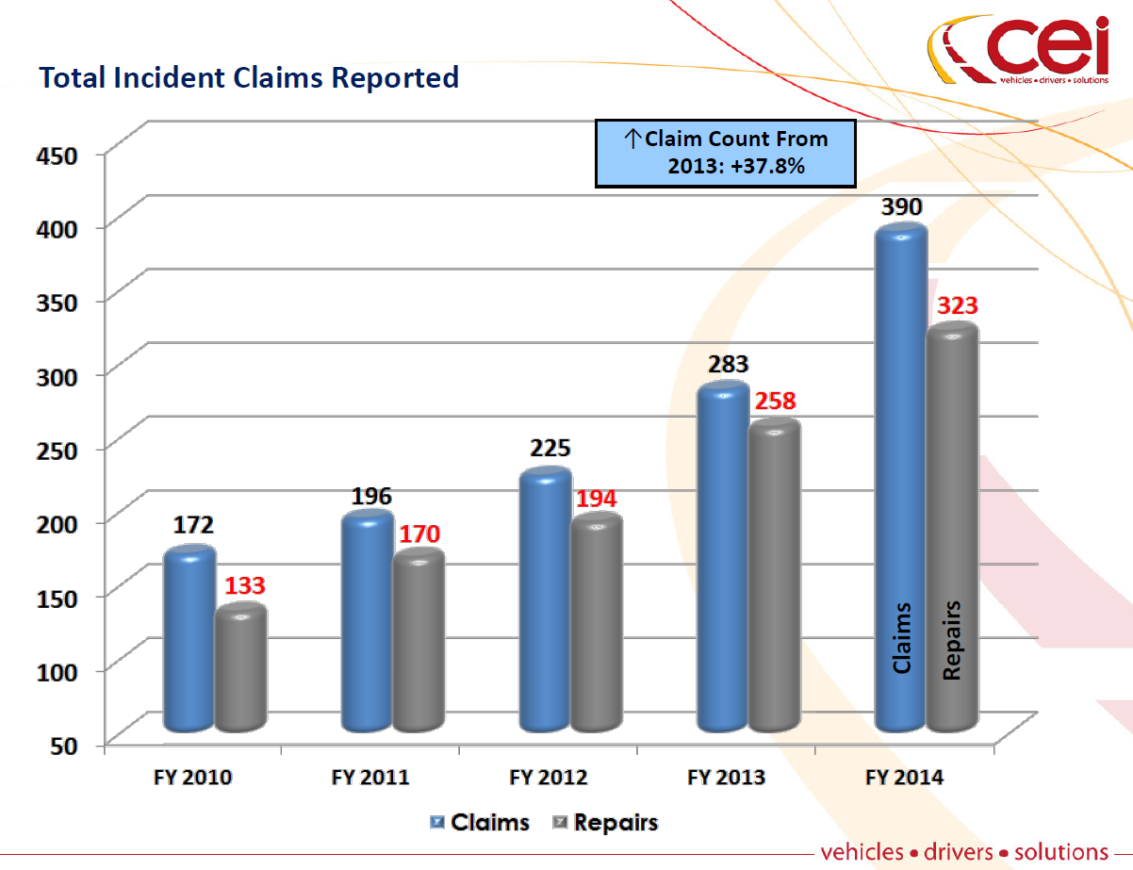
2014 Total Incident Claims Reported

Slide 9
Total Repair Costs

Slide 10
Pilot Agency 5yr Liability Claims
Agency | 2010 | 2011 | 2012 | 2013 | 2014 | Grand Total
AGRICULTURE, DEPARTMENT OF | $0 | $31,531 | $6,022 | $3,213 | $15,765 | $56,531
ATTORNEY GENERAL, OFFICE OF THE | $1,823 | $680 | $22,176 | $8,344 | $5,056 | $38,078
CORRECTIONS, DEPARTMENT OF | $51,530 | $191,063 | $11,287 | $40,829 | $45,435 | $340,144
ECOLOGY, DEPARTMENT OF | $9,352 | $27,708 | $10,072 | $19,208 | $6,372 | $72,711
ENTERPRISE SERVICES, DEPT OF | $15,626 | $0 | $4,884 | $949 | $21,819 | $43,278
FISH AND WILDLIFE, DEPARTMENT OF | $404,787 | $111,857 | $108,615 | $11,568 | $10,252 | $647,078
LABOR AND INDUSTRIES, DEPARTMENT OF | $54,552 | $14,801 | $8,471 | $11,897 | $14,185 | $103,906
LICENSING, DEPARTMENT OF | $1,322 | $9,436 | $5,139 | $0 | $14,094 | $29,991
LIQUOR CONTROL BOARD | $4,413 | $1,000 | $954 | $8,379 | $0 | $14,747
SOCIAL AND HEALTH SERVICES, DEPARTMENT OF | $73,044 | $119,076 | $11,531 | $136,789 | $86,364 | $426,804
Grand Total | $616,447 | $507,152 | $189,151 | $241,176 | $219,342 | $1,773,268

Slide 11
Future Projections
Prospective Claims Reduction | Total Claims 2014 | Repair $'s Spent 2014 | Potential Cost Avoidance
0.00% | 323 | $647,898 | $0
5.00% | 307 | $615,503 | $32,395
10.00% | 291 | $586,348 | $61,550
20.00% | 258 | $530,628 | $117,270
30.00% | 245 | $488,709 | $159,189
40.00% | 225 | $452,414 | $195,484

Slide 12
Verizon Networkfleet ROI Overview/AssetWorks & Fuel Card Integration State of XXXXXXXXXXXXX
Notes:
Default cover design.

Slide 13
Efficiency – Miles Driven / Trips Taken
Number miles driven has dropped approximately 40%
More core work being done, less unauthorized /non-work trips
Number of trips dropped from 1,724 to 1,654
More core work being done more efficiently
Notes:
13

Slide 14
Efficiency = Fuel Reduction
Fuel Use
Dropped drastically , 42%, since the go live announcement
732.62 – 431.56 = 301.06 Gallons saved for 20 vehicles
301.06 x 12 = 3,612.72 Gallon saved for 20 vehicles
180.64 Gallons savings per vehicle, per year
180.64 Gallons x $3.00 per gallon = $542
Further savings can be realized by utilizing the free fuel card fraud reporting available through the WEX fuel card/GPS integration and enforcing an idle policy.
Notes:
14

Slide 15
Driver Behavior - Speed
Posted speed violations down by 35%
85+ MPH violations dropped by 55%
Every 1 MPH over 55 MPH uses an additional 1% fuel
Notes:
Speeds over 80 are extremely high. One 101 MPH incident and multiple 90+ MPH violations
15

Slide 16
Efficiency – Work Time
With jobs and miles lower, time behind the wheel decreased 29%
Less road time meant less work time for drivers and less utilization for vehicles
Over time this can mean a smaller fleet and lower labor costs
Notes:
16

Slide 17
Driver Behavior - Idle
Total idle time was reduced 35%
Notes:
17

Slide 18
Greenhouse Gas Emissions
Gas | Emissions (lbs.)
Carbon Dioxide | 17,059
Carbon Monoxide | 1,030.5
Hydrocarbons | 130.6
Nitrous Oxide | 67.3
Total Emissions | 18,287.5
Gas | Emissions (lbs.)
Carbon Dioxide | 10,842.4
Carbon Monoxide | 631.6
Hydrocarbons | 80
Nitrous Oxide | 41.3
Total Emissions | 11,595.4
Total Emissions were reduced 36.6%
Notes:
18

Slide 19
Summary
Assumptions:
20 vehicle pilot
Baseline was established and then it was announced that telematics had been installed, was live, and tracking
Data from the 4 weeks prior to go live and 4 weeks after were analyzed
Results
Results are consistent with other pilot/early stage Networkfleet implementations
Across the board improvements:
42% reduction in fuel used
Decreased speed and idle
Drastic drop in miles driven
Less time to complete the same work
Potential downstream effect from the current results:
Lower labor cost/overtime
Fewer accidents (less miles, slower speeds)
Less maintenance of engine and accessories like windshields and tires
Better utilization/fewer vehicles required
Notes:
19

Slide 20
Assetworks and networkfleet
Notes:
20

Slide 21
How the Integration Works
Vehicle Alerts
Odometer Readings
Locations
Fault Codes
Vehicle Usage
(used for PM Scheduling)
Locations
Chose how FleetFocus handles this information
Information tracked with vehicle data
Automatically Create
a Work/Service Request that can be turned into jobs on Work Orders
Notes:
Highlight how integration delivers trouble codes, meter readings and location data into the FleetFocus maintenance system.

Slide 22
Together for Fleet Maintenance
Engine Trouble Codes
View and schedule repair for engine diagnostic trouble codes instantly in FleetFocus as work/service request, enabling you to catch small problems before they result in costly major repairs down the road.
Diagnostic Trouble Codes automatically open up work order requests in FleetFocus
Real-time Meter Readings
Get accurate odometer readings at the time of delivery, eliminating the manual and time-consuming process of entering meter information and ensuring timely and accurate preventative maintenance scheduling.
Diagnostics Integration
View detail on engine diagnostics parameters accessed directly from the vehicle’s engine computer such as speed, idle time.
Notes:
Fleet personnel can have all relevant info in one place. Use actual historical fleet data to drive your operational decisions. The system stores historical data for: alerts, fault codes, diagnostic data points.

Slide 23
Thank you
Questions?
DES Fleet Operations
George Carter
360-664-9213 or george.carter@des.wa.gov

