Slide 1
Introduction
Washington State is facing tough economic times; if you’ve heard you will be directly impacted you may have questions and concerns.
We hope the information and resources provided today can better prepare you for the layoff action you will be facing and decisions you will need to make.
Notes:
Most of us at this point have been affected by the economy or know someone who has – a friend or family member maybe; when it comes to handling a layoff everyone is different. Some will be ready to start a new job search right away and others will want to wait awhile before they are ready to begin. That is why we have put together this summary so you will have the information when you’re ready.

Slide 2
Layoff Information and Resources
Department of Enterprise Services (DES)
Health Care Authority (HCA)
WorkSource Washington (ESD)
Employment Security (ESD)
Federal CARES Act information
Employee Assistance Program (EAP)
Retirement Systems (DRS)
Notes:
This Layoff Information Summary was created because we know going through a layoff may be stressful; you probably have a lot of questions and concerns. We want to help alleviate some of that stress by providing you with support. That is why agency experts from the Department of Enterprise Services (including the Employee Assistance Program), Health Care Authority, Retirement Systems, Employment Security and WorkSource have collaborated to bring together the resources and information you need – all in one convenient online summary. This presentation lasts about 40 minutes. If for some reason you close the session you have the option to continue watching it from where you left off, or you can start over. Please note we are here to help! You can contact us at LayoffandGGTP@des.wa.gov with your questions.
9/2017

Slide 3
Layoff Information and Resources
Department of Enterprise Services (DES)
General Layoff Information
Internal Layoff Lists
Statewide Layoff Lists
General Government Transition Pool
Contacting us
Tools & Resources
Notes:
This Layoff Information Summary was created because we know going through a layoff is stressful; it can be similar to losing a family member and you can go through the same stages of grief & sense of loss. We want to help alleviate some of that stress by providing you with support, resources & information.

Slide 4
General Layoff Information
Differences in Process for Represented and Non-Represented Employees
Non-Represented Employees – Review the Civil Service Rules – Title 357-46 WAC and your agency policy.
Contacts: Your local agency Human Resources Office and the Office of the Financial Management, State Human Resource Rules at Rules@ofm.wa.gov
Represented Employees – Review your Collective Bargaining Agreement (CBA) and your agency policy.
Contacts: Your local agency Human Resource Office and your Union Representative
Notes:
Layoffs are governed by WAC 357-46 and agency/institution policies for non-represented employees, or the applicable Collective Bargaining Agreement for represented employees
There are differences in the layoff process for represented & non-represented employees:
For non-represented employees, layoffs are governed by the Civil Service rules (Chapter 46) & your agency policies. It is suggested you review these rules, as well as checking out Chapter 19, the chapter on appointments. The Rules Office at Rules@ofm.wa.gov is a great resource for rule interpretation for non-represented employees.
For the represented employees, layoffs are governed by your Collective Bargaining Agreement and your agency policies
There are over 20 union contracts for state employees which is why the information provided here is very general.
Please review your union contract for layoff information. Read your agency layoff policy typically posted on your agency’s internal website or check with your Human Resource Office.

Slide 5
General Layoff Information
While there are several reasons for a layoff, primary reasons include:
Lack of funds
Lack of work
Organizational changes
Examples of layoff actions due to lack of work may include, but are not limited to:
Termination of a project;
Availability of fewer positions than there are employees entitled to such positions
Notes:
There are several reasons for layoff, but the primary reasons are: lack of funds, lack of work, and organizational changes. Lack of work examples include termination of projects – this has been a frequent occurrence since September 2008. An example of fewer positions than employees is when permanent general government employees take exempt positions and exercise their return rights coming back to their previous employment. The state is also moving towards ‘Shared Services’, combining like types of work. It is a hot topic: many employers are discussing centralizing back office activities i.e. HR, accounting & IT

Slide 6
Internal Layoff Lists
The Internal layoff list contains names of eligible employees who have been laid off from that specific agency or institution.
Check with your agency HR Office to see if they maintain their own internal layoff list. DES maintains the statewide layoff list and may maintain your agency internal layoff list.
Eligibility - 2 years from layoff effective date for most
Check your CBA as some unions have bargained for a 3 year eligibility period.
Effective 9/16/09 a rule change allows rights to layoff lists to job classes held if there has been a break in service.
Notes:
The internal layoff list is for use by the employer that laid you off. Each higher education institution and some general government employers maintain their own internal layoff lists. Your layoff letter should advise you if your employer maintains this list. To apply to the list, email LayoffandGGTP@des.wa.gov a copy of your layoff letter (it is highly encouraged to also include your resume) to the Layoff Administrator. The Layoff Administrator will email a form for you to complete and return. If you were permanent in multiple job classes and wish to be on the layoff list for those be sure to identify them as well. Whenever your address, phone numbers, email address, shift, and geographic areas in which you wish to work change please inform the employer from which you were laid off and the Department of Enterprise Services.

Slide 7
Statewide Layoff Lists
Statewide layoff list(s) contain the names of eligible employees from other agencies or institutions
To get on the statewide layoff list, contact the Department of Enterprise Services
DES maintains the statewide layoff lists and internal for some agencies.
Eligibility - 2 years from layoff effective date.
Check your CBA as some unions have bargained for a 3 year eligibility period.
Effective 9/16/09 a rule change allows rights to layoff lists to job classes held if break in service
Notes:
The statewide layoff list is used by agencies other than the one you were laid off from. Since other agencies may also employ people with the competencies, skills, and abilities that you possess, you can improve your opportunities to be rehired after layoff by getting on the statewide layoff list for job classes for which you qualify. The statewide layoff list, maintained by DES, provides agencies with a central source to access names. If you have been laid off from a General Government agency or Higher Education Institution, email a copy of your layoff letter (it is highly encouraged to also include your resume) to the Layoff Administrator at LayoffandGGTP@des.wa.gov. The Layoff Administrator will email a form for you to complete and return. If you were permanent in multiple job classes and wish to be on the statewide layoff list for those, be sure to identify them as well. Whenever your address, phone numbers, email address, shift, and geographic areas in which you wish to work change, please inform the employer from which you were laid off and the Department of Enterprise Services. Higher Education employers maintain their own layoff lists. You must contact each individual Higher Education employer to apply.

Slide 8
General Government Transition Pool
The GGTP is a resource for general government employees at risk of, or who have been laid off.
It is a skill based data base maintained by the Department of Enterprise Services.
To learn if you are able to get in the GGTP contact your agency’s human resource office.
Washington Management Service (WMS) employees may be eligible for the GGTP.
Notes:
The General Government Transition Pool (GGTP) was created in 1993 at the request of then Governor Lowery when the state was facing large layoffs and needed a way to get talented laid off employees back into the workforce. Layoff lists are used to aid employees in getting back to the job class they are laid off from, the GGTP is to keep them employed. Candidates are referred by skill level, rather than job class so you can be referred to positions you might not have held permanent status in, but rather those to those you meet the skill set for. Once your position is considered ‘at risk’ by your agency you can get in the GGTP. Your HR representative provides you a form to complete, you return it to them for signature (this verifies your eligibility) and it is forwarded to DES for entry. You will receive an email from the Layoff Administrator acknowledging your placement in the GGTP. It is highly recommended you include a resume with your completed GGTP form. Your resume will be provided to hiring managers when they are looking for your skill set. You are eligible to be in the GGTP for 2 years from your layoff effective date. It is optional for agencies to check the GGTP for candidates for represented positions, but the Governor does encourage all state agencies to consider GGTP candidates before going outside state government to fill positions. There are over 1600 different general government job classes – the GGTP is a great way to get referred to these. The February 2009 rule change enables you to remain in the GGTP if hired into a position with a lower salary than what you were laid off from. Waives (a decline to interview) do not count in the GGTP, so if you are called and are not interested you may decline with no penalty. Higher Education employees and exempt employees (with no prior classified service) are not eligible.

Slide 9
Department of Enterprise Services Resources and Services
Department of Enterprise Services, Layoff Support
www.des.wa.gov
Layoff and General Government Transition Pool information
Office of Financial Management, State Human Resources at www.hr.wa.gov
Links to the Office of Financial Management Labor Relations Office (collective bargaining agreements)
Civil Service Rules
www.careers.wa.gov the online recruiting system for state jobs
Step-by-step processes for applying in the centralized recruiting system
Links to state agency web sites
Links to state colleges and universities
Notes:
Resources and services for employees at risk of layoff can be found on the Department of Enterprise Services des.wa.gov and the state human resources with Office at Financial Manager at ofm.wa.gov. The careers.wa.gov site offers a variety of information to assist you with your employment search. Examples include job postings in the centralized recruiting system, and links to other state agency and higher education employment sites.

Slide 10
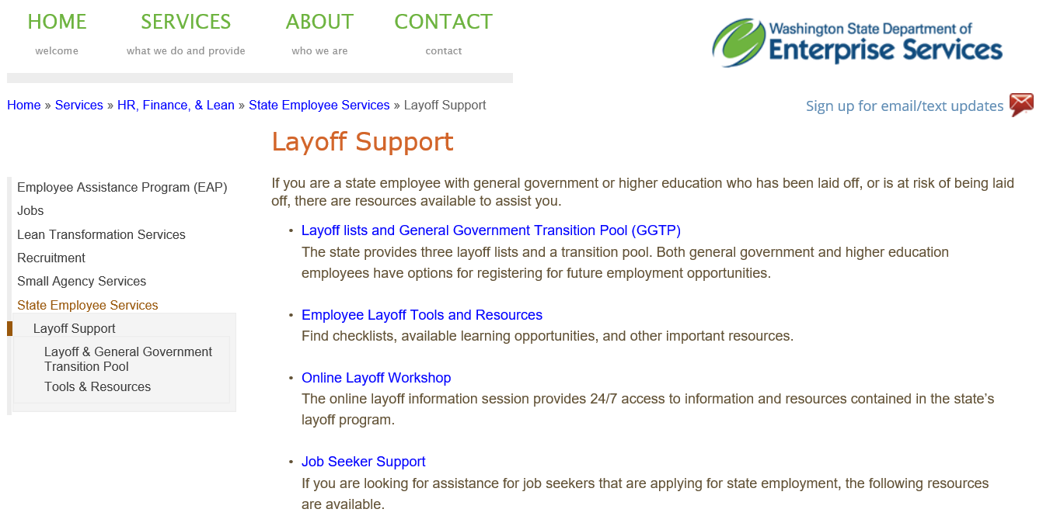
DES Layoff Support
www.des.wa.gov/services/hr-finance-lean/state-employee-services/layoff-support
Notes:
1) Checkout the Department of Enterprise Services web site at www.des.wa.gov. If you are a state employee with general government or higher education experience who has been laid off or is at risk of being laid off you will find many resource's available here to assist you. 2). When an employee is given official notice, but before they are separated – apply to the layoff list, before you are separated take your personal holiday (if you are entitled) because you do not get cashed out for it when you separate. Update your email address in the Employee Self Service. 3) after leaving state service – you will want to apply for health benefits and keep your layoff and General Government Transition Pool information updated.

Slide 11
DES Contacting Us
General Inquiries or Layoff Questions
CareersHelp@des.wa.gov or LayoffandGGTP@des.wa.gov
1-360-664-1960 or toll free 1-877-664-1960
Hours 8:00 a.m. to 5:00 p.m., Monday through Friday
Tools & Resources
Checklist, Employment Resources, Benefits links
http://www.des.wa.gov/services/hr-finance-lean/state-employee-services/layoff-support/tools-resources
Notes:
Please note we are here to help, check out our resources.

Slide 12
Notes:
When you are faced with layoff or separation from employment, what happens to your healthcare benefits? This summary includes information about your options to continue your healthcare coverage after layoff or separation.

Slide 14
Notes:
So, what happens to your employer-paid benefits? Your medical, dental, and basic life insurance will end the last day of the month in which you are in pay status for at least 8 hours. Employer-paid basic long-term disability ends the date your employment ends. Supplemental life insurance and optional long-term disability end based on the last premium contribution that was made through payroll deduction. Participation in the Flexible Spending Account (FSA) and Dependent Care Assistance Program (DCAP) ends the date employment ends. You may continue your auto/home insurance with Liberty Mutual, and your long-term care coverage through John Hancock. You will need to contact them to make other payment arrangements.

Slide 15
Options are based on your individual situation:
Continued employment through reversion, reduction in hours, or agency transfer.
Enroll as a dependent on a spouse or state-registered domestic partner’s, or parent’s account.
Self-pay for your self and eligible dependents
Retiree coverage.
Notes:
There are several options for continuing most of your coverage. Your individual situation will determine which options are available to you. The options include the possibility of continued employment; enrolling as a dependent on a spouse, state-registered domestic or to parents PEBB account; self-pay for your self and your eligible dependents, o reenroll in retiree coverage. Lets take a look at each of these options.

Slide 16
Option 1: Continued Employment
Laid off employees
Examples include: Revert to another position; have current position hours reduced; or transfer to another agency
Are eligible for the employer contribution with eight hours or more per month of pay status for up to 24 months.
Examples include: Revert to another position; have current position hours reduced, or transfer to another agency.
Must notify the employing agency of potential eligibility as a laid off employee (WAC 182-12-129).
After the 24th month, employee must re-establish eligibility under WAC 182-12-114.
Notes:
The first option is the possibility of continued employment. If you have the opportunity to revert to a previous position, have your current position’s hours reduced or transfer to another agency, even if the new position is not a benefits eligible position, you could maintain the employer contribution benefits as long as you have at least eight hours of pay status each month. Your benefits may continue for up to 24 months from your layoff effective date. If is your responsibility to notify the agency that you are potentially eligible for the employer contribution for benefits under WAC 182-12-129. At the end of the 24 months you must re-establish eligibility for benefits if you have not already done so.

Slide 17
Option 2: Coverage as a dependent
Medical/dental coverage:
No later than 60 days after losing coverage, your spouse, state-registered domestic partner, or parent must submit the required forms.
When the agency receives the form affects when coverage begins.
To avoid a break in coverage, the form must be submitted prior to the date your current employer coverage ends.
Life Insurance
Employment ending – transfer life insurance to a spouse/domestic partner’s PEBB account within 31 days of losing coverage.
Layoff – continue life insurance on a self-pay basis.
Notes:
The second option is to enroll in medical and dental as a dependent on your spouse, state-registered domestic partner or parent’s PEBB account. Your spouse, domestic partner or parent must submit the required forms to their employer no later than 60 days from the date you lose your coverage. You may also transfer your life insurance to a spouse or domestic partner’s PEBB account within 31 days of losing coverage or you may chose to continue your life insurance on a self-pay basis.

Slide 18
Option 3: Self-pay…
Layoff
Eligible for PEBB “Leave without Pay” coverage
Continue medical, dental, and/or life insurance coverage for up to 29 months.
Employment Ending
Eligible for COBRA coverage
Continue medical and dental coverage for up to 18 months.
For state registered/qualified domestic partners and their children not eligible for COBRA
PEBB Extension of Coverage
Continue medical and dental coverage for up to 18 months
Notes:
The third option is to self-pay your healthcare coverage. If you’re in layoff status you have the option to self-pay your medical, dental, and life insurance for up to 29 months. If your employment is ending you are eligible to continue your medical and dental coverage under COBRA for up to 18 months.

Slide 19
Option 4: Retiree coverage…
Must be eligible to retire per your retirement plan.
May use continuation of coverage to bridge to retirement.
Continue medical and dental coverage.
May have options to enroll in retiree life insurance.
Notes:
The fourth option is to continue your healthcare as a PEBB retiree. In order to enroll in retiree coverage you must be eligible to retire under your retirement plan. If you are not eligible because of the age requirement, you may use continuation of coverage to bridge to retirement. Retiree coverage includes medical and dental coverage. You may also be eligible to enroll in retiree life insurance. Retiree coverage includes medical and dental coverage. You may also be eligible to enroll in retiree life insurance.

Slide 20
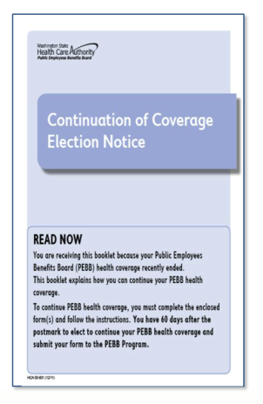
What to expect…
A Continuation of Coverage Election Notice in the mail
You have 60 days from the postmark date to enroll in coverage
You may enroll your eligible dependents
Self-pay rates apply
Notes:
You will receive a Continuation of Coverage Election Notice in the mail that explains these options for continuing your coverage on a self-pay basis. The notice does not include the retiree information but does direct you to resources if you are considering and are eligible for retiree coverage. Your dependents currently enrolled on your account may also be enrolled in continuation of coverage.

Slide 21
Resources…
PEBB website:
https://www.hca.wa.gov/public-employee-benefits/employees
PEBB program customer service:
1-800-200-1004
Notes:
This summary is a very brief overview of your options. To learn more about the continuation of coverage options visit the PEBB website at https://www.hca.wa.gov/public-employee-benefits/employees
or call the PEBB program at 1-800-200-1004. Thank you for your time and attention. My colleagues and I wish you good health.

Slide 22
Questions and answers around potential state government furlough and layoff for Public Employees Benefits Board (PEBB) Program subscribers
6/1/2020
I am an employee enrolled in PEBB benefits. If I am on temporary layoff for less than a month, what will happen to my PEBB Program benefits?
Each month your PEBB benefits (which include medical, dental, life, accidental death and dismemberment insurance (AD&D), and long-term disability (LTD) insurance) will continue as long as you are in pay status (as defined in WAC 182-12-109) for at least eight hours in that month.

Slide 23
I am an employee enrolled in PEBB benefits. If I am on temporary layoff and don’t have eight hours of pay status within a month, what will happen to my PEBB benefits?
Your PEBB benefits will end the last day of the month in which you were in pay
status for at least eight hours. You would be eligible to continue any combination
of medical, dental, life insurance, and AD&D insurance as described in WAC 182-
12-133 for up to twenty-nine months on a self-pay basis.
I am an employee who pays for supplemental coverage (such as supplemental life, supplemental AD&D, supplemental LTD, or auto/home insurance) through payroll deductions. If I stop working, or I am not receiving a paycheck, what happens to these coverages? Each of these coverages will be handled a little differently:
Supplemental life insurance: Your PEBB life insurance will continue each month
as long as you are in pay status for at least eight hours before the end of the
month. Your supplemental life insurance may be continued on a self-pay basis if
you are not in pay status for at least eight hours before the end of a month.
Supplemental AD&D insurance: Your PEBB AD&D insurance will continue each
month as long as you are in pay status for at least eight hours before the end of
the month. Your supplemental AD&D insurance may be continued on a self-pay
basis if you are not in pay status for at least eight hours before the end of a
month.

Slide 24
Supplemental LTD insurance: Your PEBB LTD insurance will continue each month as long as you are in pay status for at least eight hours before the end of the month. Your supplemental LTD insurance will end the last day of the month in which you were in pay status for at least eight hours. You may not continue basic or supplemental LTD insurance on a self-pay basis.
Auto/home insurance: Please contact Liberty Mutual at 1-800-706-5525 or visit one of their Washington offices to ask about alternate payment options to continue your coverage.
I am an employee who has Medical Flexible Spending Arrangement (FSA) or Dependent Care
Assistance Program (DCAP) and am laid off. What will happen to my Medical FSA and/or DCAP contribution amounts?
Your eligibility to participate in the Medical FSA will end the last day of the month in which you have eight hours of pay status. Your final paycheck may include Medical FSA contributions. You may be eligible to continue participating in your Medical FSA through accelerate contributions by paying your remaining contributions for the plan year out of your last paycheck. You may also continue your Medical FSA coverage under Consolidated Omnibus Budget Reconciliation Act (COBRA) by making post-tax contribution payments to Navia Benefit Solutions for the remainder of the plan year. There are no continuation options available for the DCAP. Please refer to the FSA termination form on Navia Benefit Solutions’ website for more information.

Slide 25
WorkSource is a federally funded partnership of state and local organizations that provide employment and training solutions at no cost.
A “One-stop” employment center providing free access to computers, copiers, phone, fax, and Wi-Fi.
Offices across the state, plus priority of service to Veterans and eligible spouses.
On site job search workshops, job fairs, and more.
Online services through WorkSourceWA.com
Find a local WorkSource office.
Notes:
WorkSource is a joint venture of organizations dedicated to addressing Washington State’s employment and training needs. We provide all information, technology, and services businesses need to thrive and job seekers need to achieve successful careers. Our partners include state, local government, and local community based organizations that provide a wide-range of employment and training services. There are over 35 WorkSource offices throughout Washington. You can find your nearest WorkSource from the https://www.worksourcewa.com
website.

Slide 26
WorkSourceWA.com
Post your resume, store cover letters, credentials, and more.
Search and apply for jobs.
Information about the labor market, apprenticeships, training programs, even a helpful budgeting tool.
Search for reemployment workshops and hiring events.
Find an office near you.
Notes:
WorkSource is a joint venture of organizations dedicated to addressing Washington State’s employment and training needs. We provide all information, technology, and services businesses need to thrive and job seekers need to achieve successful careers. Our partners include state, local government, and local community based organizations that provide a wide-range of employment and training services. There are over 35 WorkSource offices throughout Washington. You can find your nearest WorkSource from the https://www.worksourcewa.com
website.

Slide 27
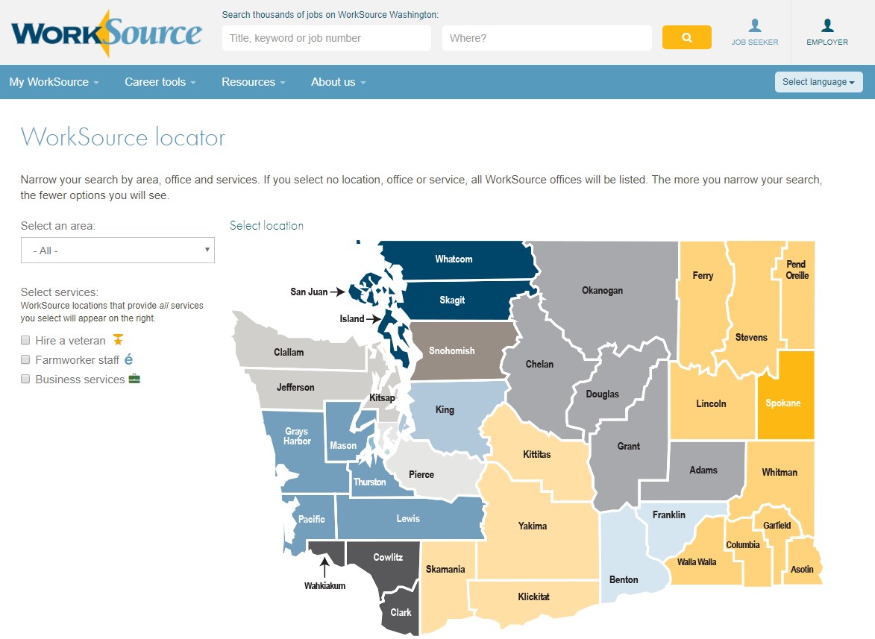
Notes:
WorkSource locations map.

Slide 28
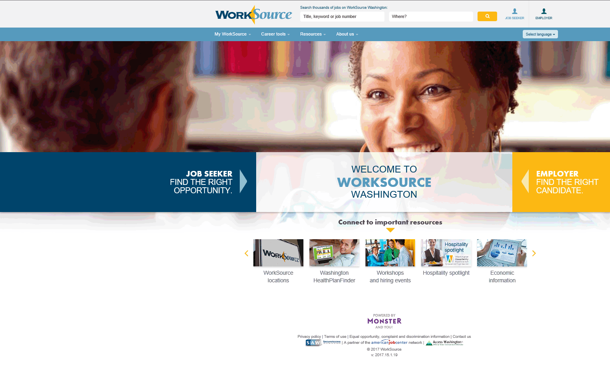
Notes:
This is a snapshot of our website www.worksourcewa.com. There is employment and training information here, including many helpful links. The links include open job orders, government job openings, a place to post your resume, labor market information, and many others.

Slide 29
Services for Job Seekers
Free use of computers, copiers, phones, faxes, and other career resources
Internet access to post your resume and find jobs
Job referrals and job search assistance
Hiring events and career fairs
Workshops on resume writing, interviewing, and job search strategies
Information on the fastest growing jobs and wages
Referrals to training and other community services
Information about Unemployment Insurance
Translation services
Auxiliary aids and services are available to people with disabilities upon request
Notes:
The services we provide at WorkSource include: Free use of computers, copiers, phones, faxes, and other career resources. Internet access to post your resume and find jobs. Job referrals and job search assistance. Hiring events and career fairs. Workshops on resume writing, interviewing, and job search strategies. Information on the fastest growing jobs and wages.

Slide 30
Dislocated Worker Program
The Workforce Innovation and Opportunity Act (WIOA) offers a program that helps people who have lost work through no fault of their own. Like you, they are “dislocated.”
Must be eligible to collect unemployment insurance benefits.
18 years or older
Legal to work in the U.S.A.
Registered with Selective Service (males only)
One-on-one assistance, training, education, and supportive services.
Notes:
If you are interested in learning more about training to a new career field: attend a Dislocated Worker Orientation or contact your local WorkSource about speaking with a Workforce Investment Act (WIA) counselor. Our first priority is to help you find a job. We do this by: Providing 1-on-1 career counseling, teaching you effective job search strategies, comparing your transferable skills to the needs of today’s job market, referring you to job openings, Referring you to workshops and other skill-building classes

Slide 31
What about Training?
If your skills are no longer up to industry standards or your occupation is declining, your Dislocated Worker Counselor will:
Help you explore training options
Research the labor market
Help you leverage training resources
Assist with career, education, and financial planning (limited tuition and other financial support may be available).

Slide 32
Worker Retraining
The Worker Retraining Program provides educational funding for laid off and dislocated workers who may want to upgrade their skills or start a new career path.
Funding is available through all community and technical colleges; may include tuition, books, and fees for up to three quarters. Short and long-term training options are available.
Certificates and Associate’s Degree (two-year program)
Assistance with navigating resources, partners, and the financial aid process.
One-on-one career counseling.
Notes:
Contact your local community or technical college for more information

Slide 33
The sooner you get started the better!
It’s a lot of work getting into training – timelines are critical.
Steps include:
Identifying “demand” jobs of the future
Finding the “right” training program
Applying for financial aid
Taking placement exams
Registering for classes
Completing Commissioner Approved Training (CAT) or Training Benefits (TB) application
Developing a financial plan

Slide 34
Financial Aid Resources
Free Application for Federal Student Aid
http://www.fafsa.ed.gov
Notes:
Websites you will want to visit to help with your financial plan include: www.fafsa.ed.gov

Slide 35
Unemployment Insurance
What is Unemployment Insurance?
How much will I get?
Where do I apply?
How do I file my weekly claim?
Severance Pay
Do I have to accept less money?
Responsibilities while claiming benefits
Frequently Asked Questions
Notes:
During this summary we will discuss: What is Unemployment Insurance? How much will I get? Where do I apply? How do I claim weekly benefits? How long am I entitled to benefits? Do I have to accept less money? Do I have to accept bump options? And we’ll answer some frequently asked questions.

Slide 36
What is Unemployment Insurance?
Designed to help workers unemployed through no fault of their own.
Benefits are a partial wage replacement while you are unemployed.
100% funded by employers
Notes:
What is unemployment insurance – Unemployment benefits are designed to provide you with temporary income when you lose your job through no fault of your own. Benefits only partly replace lost earnings to help you pay expenses while you look for new work. It is 100% funded by employers through payroll taxes – nothing comes out of the worker’s paycheck. If you quit or are discharged prior to being laid off, it may jeopardize your unemployment benefits. Benefits are not based on financial need.

Slide 37
How much will I get?
Benefits are based on earnings in an unemployment “base year”.
Weekly benefit amount is calculated using the two highest earnings quarters in your base year.
Minimum weekly amount is $188
Maximum weekly amount is $790
Notes:
How much will I get? Your earnings during a “base year” determine your weekly benefit amount and the maximum benefits payable on your claim. Your base year is the first four of the last five completed calendar quarters when you file your claim. You must have 680 hours of work during your base year to be eligible for benefits. If you do not have enough hours in the regular base year period, an “alternate base year” period of the last four completed quarters can be considered. The maximum and minimum weekly benefit amount is set in June for new claims filed beginning Sunday of the first full week in July. The maximum benefit amount that you can be eligible to receive would be 26 x your weekly benefit amount. You have 52 weeks from the effective date of your claim to file for your available weekly benefits.

Slide 38
Where do I apply for benefits?
You are encouraged to file online at www.esd.wa.gov
24 hours a day / 7 days a week
Unemployment Claims Center
1-800-318-6022 for assistance with new claims and filing weekly claims using the automated system
1-833-572-8400 for general questions
7:00AM - 4:00PM Mon – Sat
Notes:
You may apply for benefits by: Calling the unemployment claims center at 1-800-318-6022 Monday through Saturday from 7:00 AM to 4:00 PM except for State holidays, or going online at www.esd.wa.gov 24 hours a day, 7 days a week. Most claims can be filed online, be sure and follow all directions. Your claim is effective the week you file your online application. If you call to file your claim with a representative, call volumes are currently very high due to impacts from COVID-19 and it may be difficult to reach an agent.

Slide 39
Can I still file a claim if I move out of Washington State?
Yes. To be eligible for a claim in WA state, you need only to have worked in WA during your base year.
If you worked in WA state as well as another state(s) in the 18 months you may be eligible for an unemployment claim in WA.
If you are eligible for benefits in more than one state, you can choose which state to file for benefits, but you cannot file for benefits in more than one state using the same base year.
If you relocate after you apply in WA, you can change your address online at www.esd.wa.gov
Notes:
Moving outside Washington State – Once you establish a Washington claim, you may continue to draw from that claim, even if you move to a different state. You are required to register for work in the new state at the nearest employment office. Check the government pages of your local telephone directory for the location of the nearest office. If you move, you can change your address online at www.esd.wa.gov or by calling 1-800-318-6022

Slide 40
When will I get my first payment?
Generally two to three weeks from when you file your application
For unemployment claiming purposes, the week begins Sunday and ends Saturday at midnight
You can’t claim for a week until it’s over
The first eligible week is considered the “Waiting week”.
Currently, the waiting week is waived due to COVID-19 in order to get customers paid faster.
You can choose to receive payment by direct deposit or debit card
Notes:
When will I get my first check? To receive payment, you must file weekly claims. When you file your weekly claim, you will answer eligibility questions for the prior week. You are not paid for the first eligible week of your claim. It is a “waiting week” but you must claim the week to have it count. This means that you will be entering your third week of unemployment before you claim for a payable week. To be eligible for your waiting week, you must meet all eligibility requirements and be potentially eligible for at least $1.00 in benefits.
You cannot claim a week until the week is over, which is after midnight Saturday of the week you are claiming. We recommend you file your claim on Sunday, or Monday each week to ensure timely payment. You have from Sunday until Friday at 5:00 pm to file your weekly claim for the week that ends on Saturday. If you claim by telephone or on the Internet, you will usually receive your check within the same week. Direct Deposit or a debit card option is available. We can send your benefits directly to your bank or credit union account. It’s safe and convenient. You can sign up when you apply for benefits online or sign up later through our secure website. To get more information about direct deposit go to www.esd.wa.gov and type “Direct Deposit” in the search field.

Slide 41
How do I claim weekly benefits?
Online at www.esd.wa.gov or by telephone at 1-800-318-6022
Choose the weekly claim option (#1)
Create a Personal Identification Number (PIN)
Your PIN is your electronic signature
Notes:
Filing your weekly certification. You will be provided an overview of the claims process when you file your application. We will instruct you how to select your Personal Identification Number (PIN). You must set up a PIN to file your weekly claim by telephone at 1-800-318-6022 or on the Internet at www.esd.wa.gov

Slide 42
Federal CARES Act Programs
PEUC (Pandemic Emergency Unemployment Compensation)
PUA (Pandemic Unemployment Assistance)
FPUC (Federal Pandemic Unemployment Compensation)

Slide 43
PEUC (Pandemic Emergency Unemployment Compensation)
Provides an extension of up to 13 additional weeks of benefits, past the weeks allowed under regular unemployment.
If you have had an unemployment claim with a benefit year that ended on or after July 1, 2019, AND you do not qualify for a new unemployment claim, you may be eligible for PEUC.

Slide 44
FPUC (Federal Pandemic Unemployment Compensation)
Additional $600 added onto a regular weekly benefit amount. In order to be eligible for the additional $600, you must be eligible for at least $1 in regular unemployment benefits during the same week.
The additional $600 is payable on weeks filed between April 4th and July 25th of 2020.
Notes:
It is considered fraud to quit a job solely to get unemployment benefits.

Slide 45
PUA (Pandemic Unemployment Assistance)
Provides up to 39 weeks of benefits, minus any weeks of regular UI or extended benefits that you have received.
Separate benefit program that covers many people who do not qualify for regular unemployment.
To be eligible for benefits under PUA, you must be available for work and unemployed or underemployed for an approved COVID-19 related reason.
Notes:
You cannot be eligible for PUA if you qualify for any other regular unemployment benefits or PEUC.

Slide 46
How does severance pay affect my benefits?
There are different types of separation pay that you may receive after separating from a job. If you receive severance pay, it is not deductible from benefits.
Please report any type of separation pay that you receive from an employer, in order to determined if it is considered severance and whether it would impact your benefit payment.
Notes:
Severance pay is not deductible from your unemployment benefits. A cash-out of your vacation pay is also not deductible.

Slide 47
How does a pension affect my benefits?
Retirement Pension. If you are receiving retirement pay from an employer that you have worked for since the beginning of your base year, and that employer contributed to the fund, it is deductible from your benefits. The deduction amount is partially based upon the percentage of the employer contribution.
Social Security payments are NOT deductible from benefits
Notes:
Pension – Payments under any employer-paid retirement pension will be deductible from UI benefits. If the pension is based on your work for a base year employer and that employer contributed to or maintained the pension plan, the amount deducted is based on the amount you receive and the percentage of the employer contribution. Social Security payments are not deductible from Unemployment Benefits.

Slide 48
Are Unemployment Insurance benefits taxable?
Yes
You can choose to have 10% of your UI payment withheld.
Sent immediately to the IRS – you can’t get it back.
If you are later denied a week in which the 10% was withheld, the amount sent to the IRS is included in any “overpayment” amount.
Notes:
Are Unemployment Benefits taxable? Yes. Under federal income-tax laws, unemployment benefits are taxable. When you apply for unemployment insurance, you may elect to have the Department withhold 10% from your check and sent directly to the Internal Revenue Service or you may elect to pay any taxes due when you file your income tax return.

Slide 49
What are my responsibilities while claiming benefits?
You must be immediately available for and actively seeking suitable work.
Normally, to meet the requirements of eligibility for any week you file:
You must make a minimum of three job contacts, or;
Three approved in-person job search activities at WorkSource, or;
A combination of the above
Notes:
What are my responsibilities? To be eligible for benefits, you must be making a realistic work search and be willing to accept any suitable work. Suitable work is generally full time employment in an occupation in line with your prior training, experience, and education. Work would not be considered suitable if the wages, hours, or other working conditions are not as favorable as the average for your occupation in the local labor market. Each week you file a weekly claim, you must be able, available, and actively seeking work. Note: Due to the impacts of COVID-19, job search is currently optional. To find out when job searches will again be required, check esd.wa.gov for the most up-to-date information.

Slide 50
Reporting Earnings
Any pay you receive from an employer must be reported on your weekly claim.
This includes:
Earnings from work
Vacation pay or PTO
Sick pay
If you receive a cash out of vacation or sick pay, it is not deductible from benefits.

Slide 51
Can I go to school and still get UI benefits?
Potentially if approved for one of the following programs.
Commissioner Approved Training (CAT):
Not required to look for work
Includes Self-Employment Assistance Programs (SEAP)
Training Benefits (TB)
Not required to look for work.
Additional unemployment benefits
Must apply within applicable deadlines.
In most cases 90 days / be enrolled within 120 days
For TB dislocated workers, before end of benefit year.
Notes:
Can I go to school? Commissioner Approved Training (CAT). If you are attending or plan to attend full-time training, you may be eligible for Commissioner Approved Training (CAT). CAT is simply a waiver of the work search requirement – it does not provide additional benefits or pay any school-related expenses. Training Benefits If your training last longer than your regular benefits, you may also apply for Training Benefits (TB). You do not need to complete the CAT application if you are completing the Training Benefits application. You must apply for Training Benefits within 90 days of being notified of the program and you must be enrolled in approved training within 120 days of being notified of the program. Self Employment Assistance Program (SEAP). SEAP is another training program you may qualify for. This unique program allows eligible laid-off workers to collect unemployment benefits while participating in approved self-employment training. You can sign up for the program only if we determine you will likely use all of your unemployment benefits before finding a new job. We will mail you a letter if you are potentially eligible to participate.

Slide 52
What if I am denied benefits?
Decisions are always in writing.
You have the right to appeal. Instructions on how to appeal are included in every determination letter.
Hearings are conducted by the independent state of Office of Administrative Hearings (OAH).
OAH can affirm, modify, or overturn our decision.
Notes:
What if I am denied benefits? If you disagree with a written decision issued by us, you have the right to appeal the decision to the Office of Administrative Hearings, an independent state agency. Your appeal may be filed by mail to the address on the decision, or by fax to the number on the decision.

Slide 53
Unemployment Insurance Webinars
Due to the continued high demand for unemployment benefits, we are offering a new option for customers to learn more about Washington's Unemployment Insurance.
Visit esd.wa.gov and select the Benefits Webinar quick link on the left-hand side of the page under the Unemployment tab.
To respect individual confidentiality, this is not an opportunity to answer questions about individual or personal situations.
Notes:
Registration is free and there are several topics available to register for.

Slide 54
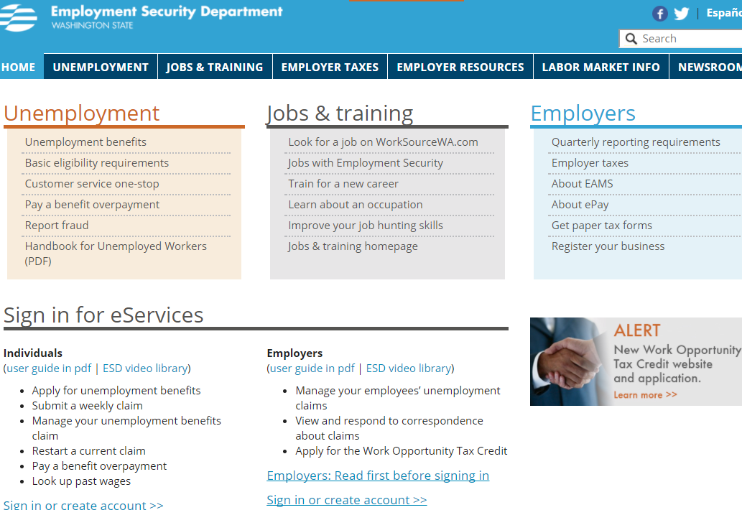
More Information on ESD
See our website www.esd.wa.gov for more unemployment information or to apply for benefits
Notes:
Additional information and “How to” videos are available online. Simply access www.esd.wa.gov and at the bottom of the page choose “Forms & publications.” Choose “Unemployment-insurance benefits forms and publications.” The videos provide basic UI benefit information in English, Spanish, and open caption formats. The following topics are available: Applying for unemployment benefits, Submitting a weekly claim, How to complete your job-search log, Training benefits program, Appealing a benefits decision. Also See our website at www.esd.wa.gov for additional information regarding the programs we have available if you are financially impacted by COVID-19.

Slide 55
Washington State Employee Assistance Program
For almost 50 years, the Washington State EAP has supported the wellbeing of public employees to promote a resilient and productive workforce.
EAP provides no-cost, confidential support to help you and your adult household family members with work and life challenges.
Contact us anytime
eap.wa.gov | 877.313.4455

Slide 56
What concerns can you bring to EAP?
Life & work changes, including coping with a layoff
Stress management
Financial & legal concerns
Relationship improvement
Family & parenting issues
Grief & loss
Domestic Violence
Anxiety & depression
Substance misuse
Bullying & harassment
Crisis support & management
Contact us anytime
eap.wa.gov | 877.313.4455
Notes:
The EAP provides support in a wide range of areas, including change, stress, financial concerns, relationships, family issues, grief, trauma, and mental health. I encourage you to think about using EAP for maintaining wellness—don’t wait until you are in a crisis to call us. We have a broad array of services to meet various needs and no concern is too big or too small to seek help from EAP.

Slide 57
EAP Counseling
I’m not getting along with my coworker and I’ve tried everything!
Assess concerns and provide resources.
By a licensed or certified professional
Up to 3 sessions per issue
Local (face-to-face) or by phone
For you and family household adults.
Distinct from outpatient therapy.
Free—fully funded by your employer
Easy and quick access
Short-term and solution-focused
Personal or work-related
Why do I feel so angry all the time?
I think my teen has a drinking problem.
I’m really stressed out about money right now!
I don’t want to be a burden on my daughter.
Contact us anytime
eap.wa.gov | 877.313.4455
Notes:
Our counseling services are sometimes referred to as an EAP assessment—which is an opportunity for you to meet with a professional counselor who will help identify your concerns, provide support, develop an action plan for any ongoing help you need, and connect you to resources. This happens over the course of 1-3 sessions, in person or by phone. And, you can use the EAP again in the future if you have a new problem to address.
Note that EAP is not just for you--other adults in your household can use EAP counseling services as well. If you need support for a child under 18, you as the caregiver would come without the child so that we can discuss the situation and the impact on the family, give you parenting support, and get you connected to the right child specialist for ongoing care if needed.
EAP differs from therapy in several ways:
First, we're free for you to use, so there's no copay, deductible, or bill that you have to worry about. Unlike therapy that goes through your health insurance, you don't have to have an approved diagnosis or medical necessity to use EAP. You can use EAP for a variety of issues that wouldn't necessarily fit into your mental health benefit, such as relationship issues.
Next, we provide easy and quick access. You don’t have to search for a counselor taking new clients; simply call us to get a referral. Clients are typically offered an appointment within one week of their intake call.
Also, EAP is designed to be short-term and solution-focused. It's a practical way of dealing with work or personal issues.
And lastly, as a workplace service, we will help assess any impact that your concern is having on your job and help you figure out how to manage that.

Slide 58
What you can expect
Free and Confidential
Easy to access (available for 3 months after separation)
Expert professionals
From everyday concerns to serious issues
Practical help
Caring and respectful
Culturally relevant
Supporting the WHOLE person
Contact us anytime
eap.wa.gov | 877.313.4455
Notes:
To end, here’s a summary of what you can expect from us. Washington State EAP is always free and confidential. We are accessible, expert professionals here to support you in all aspects of life and to offer practical help in a caring, respectful, and culturally relevant way. Our goal is to look at your needs holistically and provide resources to empower you to be your best self.

Slide 59
Department of Retirement Systems
How does career transition affect your retirement accounts?
Contact DRS for more information 800-547-6657

Slide 60
What happens when you . . .
Leave your job
Can you retire? (vested / eligible)
What about your contributions?
Retirement
Deferred Compensation Program (DCP)
What if you come back to work?
Transition to a new job
What about your contributions?
Retirement
Deferred Compensation Program (DCP)
Notes:
What happens to retirement contributions depends largely on you and the actions you take, or don’t take, when you leave employment. Retirement benefits are protected by law, so basically it is only those things you do which could affect this benefit. In order for a person to be entitled to a benefit they must first be vested. Vesting can take anywhere from five to ten years of service under your plan. Once vested the right to a benefit at the full retirement age for your plan is guaranteed. Eligibility, or more specifically the age at which you can retire, is determined by your plan. If you are unsure about vesting and eligibility please refer to the on-line Member Handbook for your retirement plan available from a link on the DRS Publications website. For some, this separation from service may mean retirement at a full or a reduced benefit amount. Washington State retirement benefits are Defined Benefit plans. Defined Benefit plans also provide for lifetime survivor benefit payments. Defined Benefit calculations are based on a formula that multiplies a designated percentage times your years of service under the plan (the Service Credit Years) times a period of highest earnings known as Average Final Compensation or AFC. Basically, a Defined Benefit rewards length of service because the longer you work and the more you are paid, the higher your benefit. Follow the link to estimate your Defined Benefit using the estimator on the DRS website.

Slide 61
Vesting and retirement eligibility
Are you vested?
System | Plan 1 | Plan 2 | Plan 3
PERS | 5 SCY | 5 SCY | 5 or 10 SCY
SCY = Service Credit Years
Plan 3 = 10 SCY or
5 SCY if 12 months SC earned after age 44 or if vested in Plan 2 before transfer to Plan 3

Slide 62
Vesting and retirement eligibility
When can you retire?
System | Plan 1 | Plan 2 | Plan 3
PERS | Age 60 & 5 SCY Age 55 & 25 SCY Any Age & 30 SCY === === === === === === === === === Age 65 & 5 SCY * Age 60 & 5 SCY | Retirement as Active or Inactive Age 65 & 5 SCY * Age 55 & 20 SCY | Retirement as Active or Inactive Age 65 & 10 or 5 SCY * Age 55 & 10 SCY
* Benefit reduced for an early retirement (actuarial or percentage)

Slide 63
Your retirement benefit
Defined Benefit – Guaranteed lifetime benefit
IRS Tax Code 401(a)
Survivorship options
Calculation based on:
A designated percentage
Service Credit Years (SCY)
Average Final Compensation (AFC)
1% or 2% x SCY x AFC = Benefit

Slide 64
Early retirement factors (benefit reduction percentages)
Age at Retirement | Minimum SCY but less than 30 SCY | 30 or more SCY member chooses 4/30/2013 | 30 or more SCY 5% Reduction 5/1/2013
64 | 90.3% | 97% or 100% | 95%
62 | 74.1% | 91% or 100% | 85%
60 | 61.1% | 85% or 95% | 75%
55 | 38.6% | 70% or 80% | 50%

Slide 65
You Leave Work but Don’t Retire?
Plan 1 or Plan 2:
Leave contributions in your account
Guaranteed benefit when eligible
Withdraw contributions & benefit is forfeited
Lump sum payment & applicable taxes on rollover
Plan 3
Access to Defined Contribution account
Manage online or on telephone
Four distribution options & applicable taxes
Defined Benefit guaranteed if vested
3% indexing if 20 Service Credit Years (SCY)
Notes:
As mentioned in the beginning, the actions you take will likely affect future benefit entitlements. Remember, once you are vested, the right to the Defined Benefit is guaranteed. Let’s examine some things you can do based on your plan. If you are in either Plan 1 on Plan 2 for your retirement system, leaving your contributions and interest accrual in the plan continues to guarantee your right to the benefit when eligible. If you withdraw your contributions and interest you forfeit the right to any future benefit. You cannot withdraw employer contributions; and no one is required to withdraw money at separation. If you are in Plan 3, you are in a Hybrid Plan which is half Defined Benefit and half Defined Contribution. The Defined Benefit is only guaranteed once you are vested. Through Indexing, the Defined Benefit may be larger if you wait to age 65 to start it and you had 20 Service Credit Years when you left employment. The Defined Contribution portion of your Plan 3 is that half to which you contributed and made investment choices. You have access to those funds anytime you separate from employment. You have four payment options that are explained in the Plan 3 Request for Payment of Defined Contribution Funds publication found on the Plan 3 website. You can start or stop payments at anytime; you may avoid early withdrawal tax penalty if at least age 55 and any payment that you receive from your defined contribution account will not affect Unemployment Insurance payments.

Slide 66
You Leave Work or Retire?
Deferred Compensation Program (DCP)
Access to your account
Manage account online or on phone
Transfer money to different funds
No transaction fees
Five distribution options & applicable taxes
You can change your options in the future
Notes:
If you have funds in the Washington State Deferred Compensation Program or DCP, you have access to those funds anytime you separate from employment. You have five payment options; you can start or stop payments at any time; there are no early withdrawal tax penalties, and any payment that you receive from your DCP account will not affect Unemployment Insurance payments. You are not required to begin withdrawing from your Plan 3 Defined Contribution or Deferred Compensation Program accounts until you reach age 70 & 1/2

Slide 67
You return to work at a later date
Are you returning to the same or a different retirement system?
Did you withdraw your contributions?

Slide 68
Your beneficiary designations
Update online for PERS and DCP – verify it is current
www.drs.wa.gov/oaa and select “My Account”
Sill working or separated but not retired
Beneficiary can be updated at any time
Survivor benefit or cash distribution
Use DB Access to view beneficiary and account information
Form also available on-line (print and mail)
Notes:
It is important for you to keep these forms up-to-date in the event you die and leave a balance in your account. These forms are the only way you can specify the payment of these assets following your death. Defined Benefit payments are guaranteed to vest and eligible plan members unless the member does something to remove his or her entitlement. Any person leaving employment, whether vested or not, is not required to withdraw any funds they contributed to their retirement plan or DCP. If you return to a DRS Covered Eligible position you will return to active retirement plan membership. If you separated as a PERS Plan 2 member and return to a PERS Eligible position, you come back as PERS Plan 2. If you return to a different retirement system eligible position, such as the Teacher’s Retirement System or TRS, you will then enter a different state retirement system. And finally keep yourself informed about your retirement benefit and options.

Slide 69
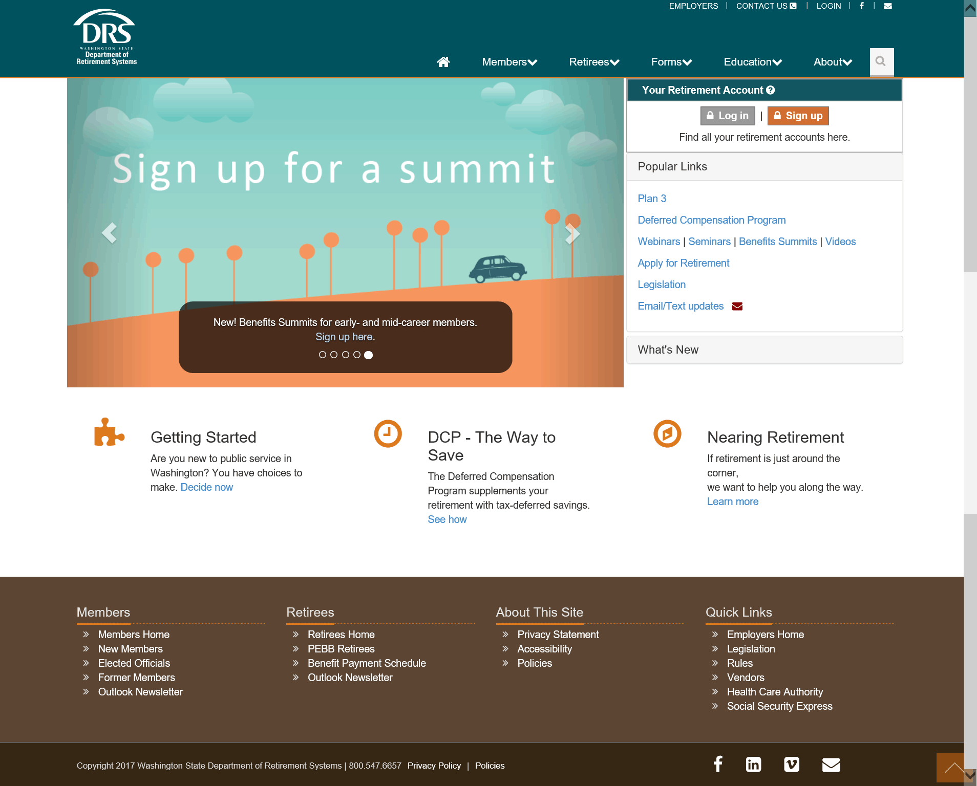
Department of Retirement Systems Resources available – www.drs.wa.gov
Account access
Notes:
You can call the Department of Retirement (DRS) for answers to questions or visit the DRS web site. The web site gives you access to everything you should know about these important employee benefits as well as access to your secure accounts through the window titled “Your Retirement Account”. Thank you.
Thank you.

Slide 70
Department of Retirement Systems
To recap:
Defined Benefit (DB) is guaranteed to eligible members.
When you leave your job, withdrawal of retirement or DCP contributions is optional
Plan membership is required if eligible employment continues or resumes.

Slide 71
Thank you from…
DES – Centralized Layoff Support
Office of Financial Management, State HR
Health Care Authority
WorkSource Washington
Employment Security
DES – Employee Assistance Program
Department of Retirement Systems

