Slide 1
Facilities Division Serving Government
Presented by Donna Albert, Tarah Kimbrough, and Cara McClarty

Slide 2
Agenda
Introductions
Greenhouse Gas Reduction Strategies
Real Estate Services Advanced Planning Process
Other Ways to Reduce Occupancy Expense
Workplace Strategies
Questions?

Slide 3
About DES Real Estate Services
Tarah Kimbrough
and Cara McClarty
Notes:
Tarah and Cara introduce themselves and tell what DES Real Estate Services does – 2 min

Slide 4
Real Estate Services (RES) Role
Provide efficient and cost effective space for state agencies, boards, commissions and educational institutions. To do this RES:
Manages 1,000 leases in state-owned and privately-leased facilities located in 38 out of 39 counties.
Covers 12 million square feet of office, warehouse, lab, classroom and other types of space
Negotiates rents for $180 million annual spend
Supports political subdivisions and other public agencies that may request assistance.
Buys and sells property for RES state customers.
Notes:
Our role: We are the real estate agents for the agencies. Just like when you hire a realtor to sell or help you buy a home, the agencies use us. Larger agencies have their own facilities staff versed in their locations and space needs (many also do not), but we handle the negotiations and transaction work associated with leasing space.

Slide 5
About DES Engineering and Architectural Services (E&AS)
Donna Albert
Notes:
Donna introduces herself and tells what DES Energy does (2 min, using following slides)

Slide 6
About DES Engineering and Architectural Services (E&AS)
OUR CLIENTS
Municipalities
K-12 School Districts
Public Hospitals
Colleges and Universities
Other State Agencies

Slide 7
About DES Engineering and Architectural Services (E&AS)
OUR SERVICES
Capital Projects
Architectural and Engineering Services
Green Building Advisor
Energy Services

Slide 8
About DES Engineering and Architectural Services (E&AS)
OUR SERVICES
Capital Projects
Architectural and Engineering Services
Green Building Advisor
Energy Services

Slide 9
About DES Energy Services
OUR SERVICES
Energy Life Cycle Cost Analysis (ELCCA)
Energy Star Portfolio Manager
Building Commissioning
Energy Savings Performance Contracting (ESPC)

Slide 10
About DES Energy Services
OUR SERVICES
Energy Life Cycle Cost Analysis (ELCCA)
Energy Star Portfolio Manager
Building Commissioning
Energy Savings Performance Contracting (ESPC)

Slide 11
Strategies and Tools to Reach GHG Goals Donna Albert, DES Energy Nov 4 - 5, 2015
Notes:
I want to talk about Greenhouse Gas Emissions first, so you can keep it in mind throughout this presentation. Reducing your greenhouse gas emissions starts with understanding where your emissions come from, and what your emissions reduction goals are.
Where do you think most of your emissions come from? (Talk about buildings and transportation, the two big sources.) This presentation will focus mostly on reducing emissions in your buildings, but when we talk about workplaces that are better suited to how we work now, you will see there are opportunities to reduce commutes.
Involve the audience -- Who is here from a State Agency? A community college or university? K-12 School Districts? Municipalities?
(Involve the audience) Do you have GHG reduction goals? What are they? (Get some responses from the crowd. Then show them the slide.)

Slide 12
DES Energy
GHG Reduction
State Agencies current goal is 15% reduction from 2005 levels by 2020
Trends (Federal Exec Order, Cities)
What expectations will your employees, students, faculty or the local community have in the future?
Notes:
If you work for a State Agency, College or University, your current goal is 15% reduction in GHG emissions by below 2005 levels by 2020. You have submitted a strategy to Department of Ecology for reducing GHG at your agency or college by 36% below 2005 levels by 2035.
You are probably already aware that carbon neutrality goals may be set by individual colleges or cities. The American College and University Presidents’ Climate Commitment (ACUPCC), includes establishing a target date for achieving climate neutrality, and mechanisms for tracking progress on goals. About 1/3 of our college and universities have signed this commitment.
Cities are setting goals more aggressive than the 15% by 2020 and 36% by 2035 goals (not just for city buildings – for everyone in the city): This could affect you if your buildings are in one of these cities. For instance, more than 1/3 of our community colleges are in a city that has signed the US Conference of Mayors Climate Protection Agreement.
Here are more trends, to be aware of:
In March 2015 Pres exec order for Federal agencies (goal of GHG reduction of 40% from 2008 levels by 2025), includes supply chain (will the States follow?)
California has a goal of reducing emissions by 80 percent by 2050, and in the spring of 2015 the Gov of California set an “interim” goal of 40 percent reductions GHG emissions from 1990 levels by 2030 for the State of California – not just for state agencies, for the whole state.
THE BOTTOM LINE: Your organization will be better off if you are actively pursuing more aggressive greenhouse gas emissions goals. Cultural and community expectations are changing. Schools, colleges and universities are recognizing that their students future is impacted by the fossil fuels they are burning now. Cities planning for increased stormwater flows and sea level rise are recognizing that their infrastructure is impacted by the fossil fuels they are burning now. Smart organizations are taking action and documenting greenhouse gas emissions reductions.
REFERENCES: RCW 70.235.050 (1) All state agencies shall meet the statewide greenhouse gas emission limits established in RCW 70.235.020 to achieve the following, using the estimates and strategy established in subsections (2) and (3) of this section:
(a) By July 1, 2020, reduce emissions by fifteen percent from 2005 emission levels;
(b) By 2035, reduce emissions to thirty-six percent below 2005 levels; and
(c) By 2050, reduce emissions to the greater reduction of fifty-seven and one-half percent below 2005 levels, or seventy percent below the expected state government emissions that year.
RCW 70.235.020
Greenhouse gas emissions reductions — Reporting requirements.
(1)(a) The state shall limit emissions of greenhouse gases to achieve the following emission reductions for Washington state: (i) By 2020, reduce overall emissions of greenhouse gases in the state to 1990 levels; (ii) By 2035, reduce overall emissions of greenhouse gases in the state to twenty-five percent below 1990 levels; (iii) By 2050, the state will do its part to reach global climate stabilization levels by reducing overall emissions to fifty percent below 1990 levels, or seventy percent below the state's expected emissions that year.

Slide 13
DES Energy
Using electricity or burning fossil fuels
=
Greenhouse Gas Emissions
Notes:
I’m going to make this simpler for you. You don’t need to calculate the emissions in each kWh of electricity, or each therm of natural gas every time you think about your GHG reduction goals. There are spreadsheets that do precise calculations for you. All you need to know is that using energy from any fossil fuel source creates GHG emissions, and the majority of the energy you use in your buildings comes from fossil fuels. If you reduce your energy use by 10%, you have reduced your GHG emissions by something close enough to 10%. Yes, use the GHG calculation spreadsheets periodically to track your progress. But for planning and project implementation purposes, just think of electricity, natural gas and gasoline as GHG emissions, because they are! REDUCING YOUR ENERGY USE WILL REDUCE YOUR GHG EMISSIONS APPROXIMATELY PROPORTIONALLY. Reducing energy use is the best thing you can do to reduce GHG emissions.
A side note: You will discover that initially you can save a lot using energy conservation and energy efficiency, but once you have the easy savings, it will become more difficult to reduce energy use further.
Don’t give up! New strategies and new ideas may help you find savings you didn’t think you could reach.
Technology also creates new opportunities – LED streetlights became cost effective for many cities in recent years, and LED lighting is becoming the norm in new buildings and building lighting retrofits.
You may have other options to further reduce your energy use by rethinking how you deliver your services.
One more side note for energy nerds: Yes, there is another way to get to almost 100% GHG emissions reductions in your buildings and small transportation. That would be to transition all our electricity generation to wind, water and solar sources, and then electrify our transportation systems. That’s the only way to get to the emission reductions we must achieve to avoid the worst effects of climate change. Don’t worry about that now. For purposes of meeting your agency or municipality GHG reduction goals, just focus on reducing energy use. The less energy we are using, the easier it will be to transition to green energy sources.

Slide 14
DES Energy
Low CO2 Emissions Energy Sources
Notes:
So what do you think is the greenest energy source? (let them guess)
It’s a trick question, the source is not pictured here.
The answer is “The energy you don’t use”
The greenest thing you can do is to stop wasting energy you don’t need, by pursuing energy efficiency and conservation.
Successful utility energy conservation programs in Washington state have already helped avoid adding new fossil fuel energy generation.

Slide 15
DES Energy
Set Goal – do you know your greenhouse gas reduction goal?
Planning – do your master plan and strategic plan incorporate greenhouse gas emissions reduction strategies?
Tracking – are you trending to the current goal?
Notes:
Do you know your GHG reduction goal? Are your GHG emissions reduction strategies incorporated into you master plan, and your strategic plan? Is good stewardship and conservation ingrained in your organizational culture? Do you think about how each decision will affect energy use?
You know that reducing energy use reduces emissions. Are you tracking the energy use of your buildings and transportation? Do you know if you are trending toward your goal? Is everyone in your organization aware of the goal, and working toward achieving it?

Slide 16
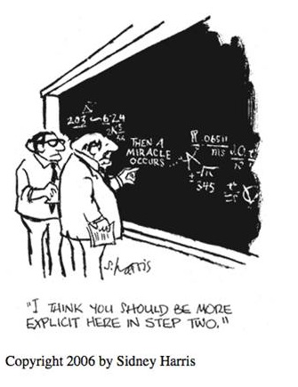
DES Energy
Planning
Notes:
Here’s one way to plan . . . It would be nice if we could count on a miracle.
Organizations which are achieving GHG reductions used these strategies:
They have made a Climate Action Plan
They have a Sustainability Advisory Committee
They are building very energy efficient buildings
They are reducing gasoline consumption; They are replacing aging vehicles with hybrids or electric vehicles
They use renovation projects as an opportunity to install energy efficiency measures
They take a systematic approach to improving building operating efficiency
They are actively monitoring building energy performance, and constantly looking for opportunities to improve it
They are working with their IT departments to make energy efficiency improvements
They have a Green Team that encourages conservation, by providing outreach and education to building occupants

Slide 17
DES Energy
Building Energy Tracking Example Department of Ecology
Building | Energy Use Intensity (EUI)
 | 2009 | 2010 | 2011 | 2012 | 2013 | Energy Star Score
ECY Bellingham Field Office | 46 | 34 | 37 | 36 |  | 72
ECY Central Regional Office | 70 | 89 | 73 | 55 | 51 | 77
ECY Eastern Regional Office | 62 | 63 | 57 | 48 | 50 | 96
ECY Lacey HQ | 68 | 63 | 66 | 56 | 54 | 94
ECY Northwest Regional Office | 50 | 48 | 49 | 46 | 47 | 83
ECY Padilla Bay National Estuarine Research Reserve (several buildings) |  |  | 50 | 43 |  | N/A
Notes:
This is an example of an agency using the Environmental Protection Agency’s free building energy benchmarking tool, Portfolio Manager, to track progress in reducing building energy use over time. The numbers you see are Energy Use Intensity (EUI), which is energy use per square foot. Look at the steady downward trend in building energy use. Ecology has done building energy retrofits using the Department of Enterprise Services Energy Savings Performance Contracting (DES Energy Program), including improvements to the building envelope, lighting, HVAC and controls. They engage building maintenance staff and agency management in finding operational energy savings.

Slide 18
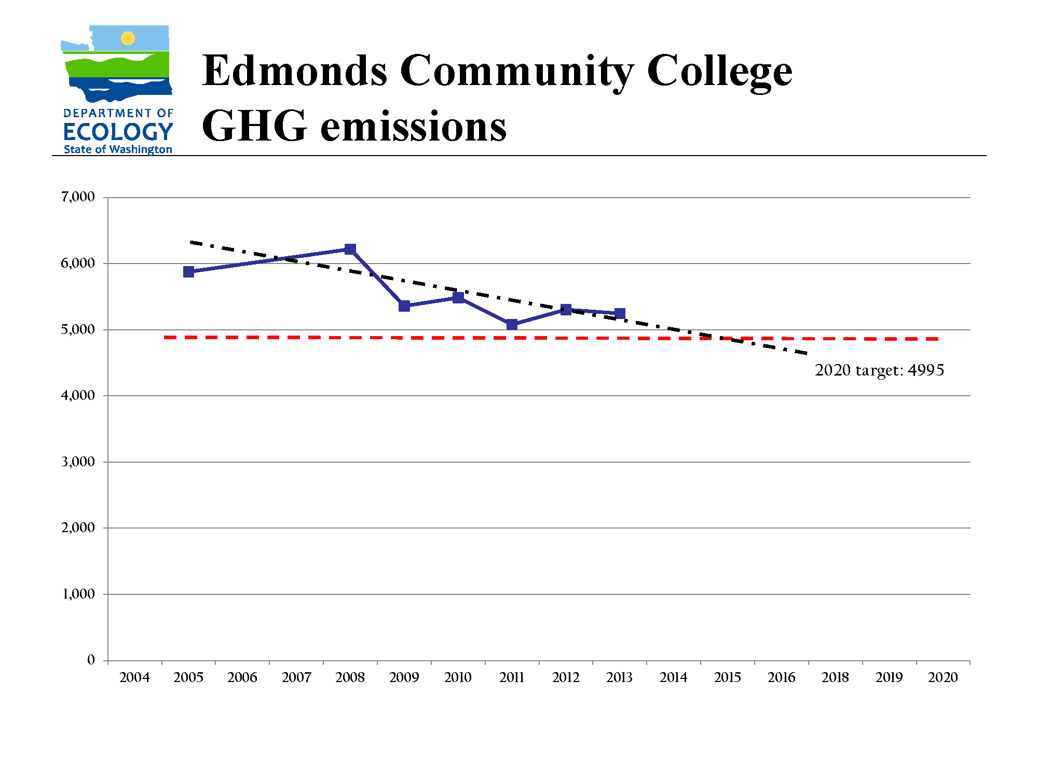
DES Energy
GHG Reduction Example
GHG Emissions
Goal
Trend
Notes:
I’m going to show you just two examples of the effect of facilities changes on college GHG emissions, on campuses that are actively striving to reduce emissions:
This is one of our community colleges that is succeeding in reducing emissions, in spite of adding more square footage and more students.
You can see the trend that results from college operations reducing energy use, working toward the goal. During this period of time the college has used DES Energy to do Energy Savings Performance Contracting projects that made improvements to lighting and HVAC. The spikes are new building space coming on line.
Strategies implemented at Edmonds Community College include: a Climate Action Plan, Green Building Standards, building energy retrofits using DES Energy Savings Performance Contracting services, facilities staff monitoring building performance, improvements to IT energy efficiency, and educational outreach to building occupants.

Slide 19
DES Energy
LWTC GHG Emissions
Notes:
Here is second example of one of our colleges, Lake Washington Technical College. This graph was given to me by the Facilities Director, who is striving to reduce GHG emissions.
A new LEED Platinum building was added here. The blue line shows greenhouse gas emissions for the campus. The green line is the emissions the campus would have had if the new building had been designed and built to make as much green energy as it used each year.
This graph shows the advantage of Zero-Net-Energy buildings that can make as much energy as they use.

Slide 20
DES Energy
First step to get out of a hole, is stop digging!
Think before adding energy using buildings!
Notes:
New buildings – (The first step to get out of a hole is to stop digging!)
Make sure you know your real space needs before you plan a new building. More mobile and computer saavy customers, students and employees may make your current space use assumptions out of date. Re-evaluate your space needs, and consider renovating existing buildings.

Slide 21
DES Energy
New Zero-Net-Energy-Capable (ZNE-C) Buildings add little to your energy use:
In the future, when solar panels are installed, these buildings may use less energy than they make each year.
Notes:
Set a high standard for best practices in new building construction. Several pilot projects have proven that Zero-Net-Energy-Capable (ZNE-C) construction is possible and economical. A Zero-Net-Energy-Capable building is a building that is designed and built to make as much energy as it uses in a year, when solar panels are added to it later.

Slide 22
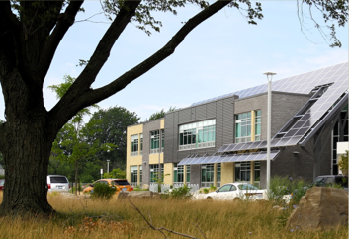
DES Energy
New buildings can be very energy efficient.
Notes:
This 58,000 sf K-12 building located in Ontario has an EUI of 25 kBtu/sf, achieved LEED Platinum, at a cost of $232/sf. It does not have sufficient solar PV installed to be Net Zero, but is an example of very low energy use. http://newbuildings.org/sites/default/files/NBI_ZNE_CaseStudy_Suzuki_1.pdf
A Zero-Net-Energy building makes as much energy as it uses in one year, usually in the form of solar panels on the roof. A Zero-Net-Energy-Capable building is designed to be energy efficient enough, with enough space on the roof or other location nearby to make as much energy as the building uses in a year.

Slide 23
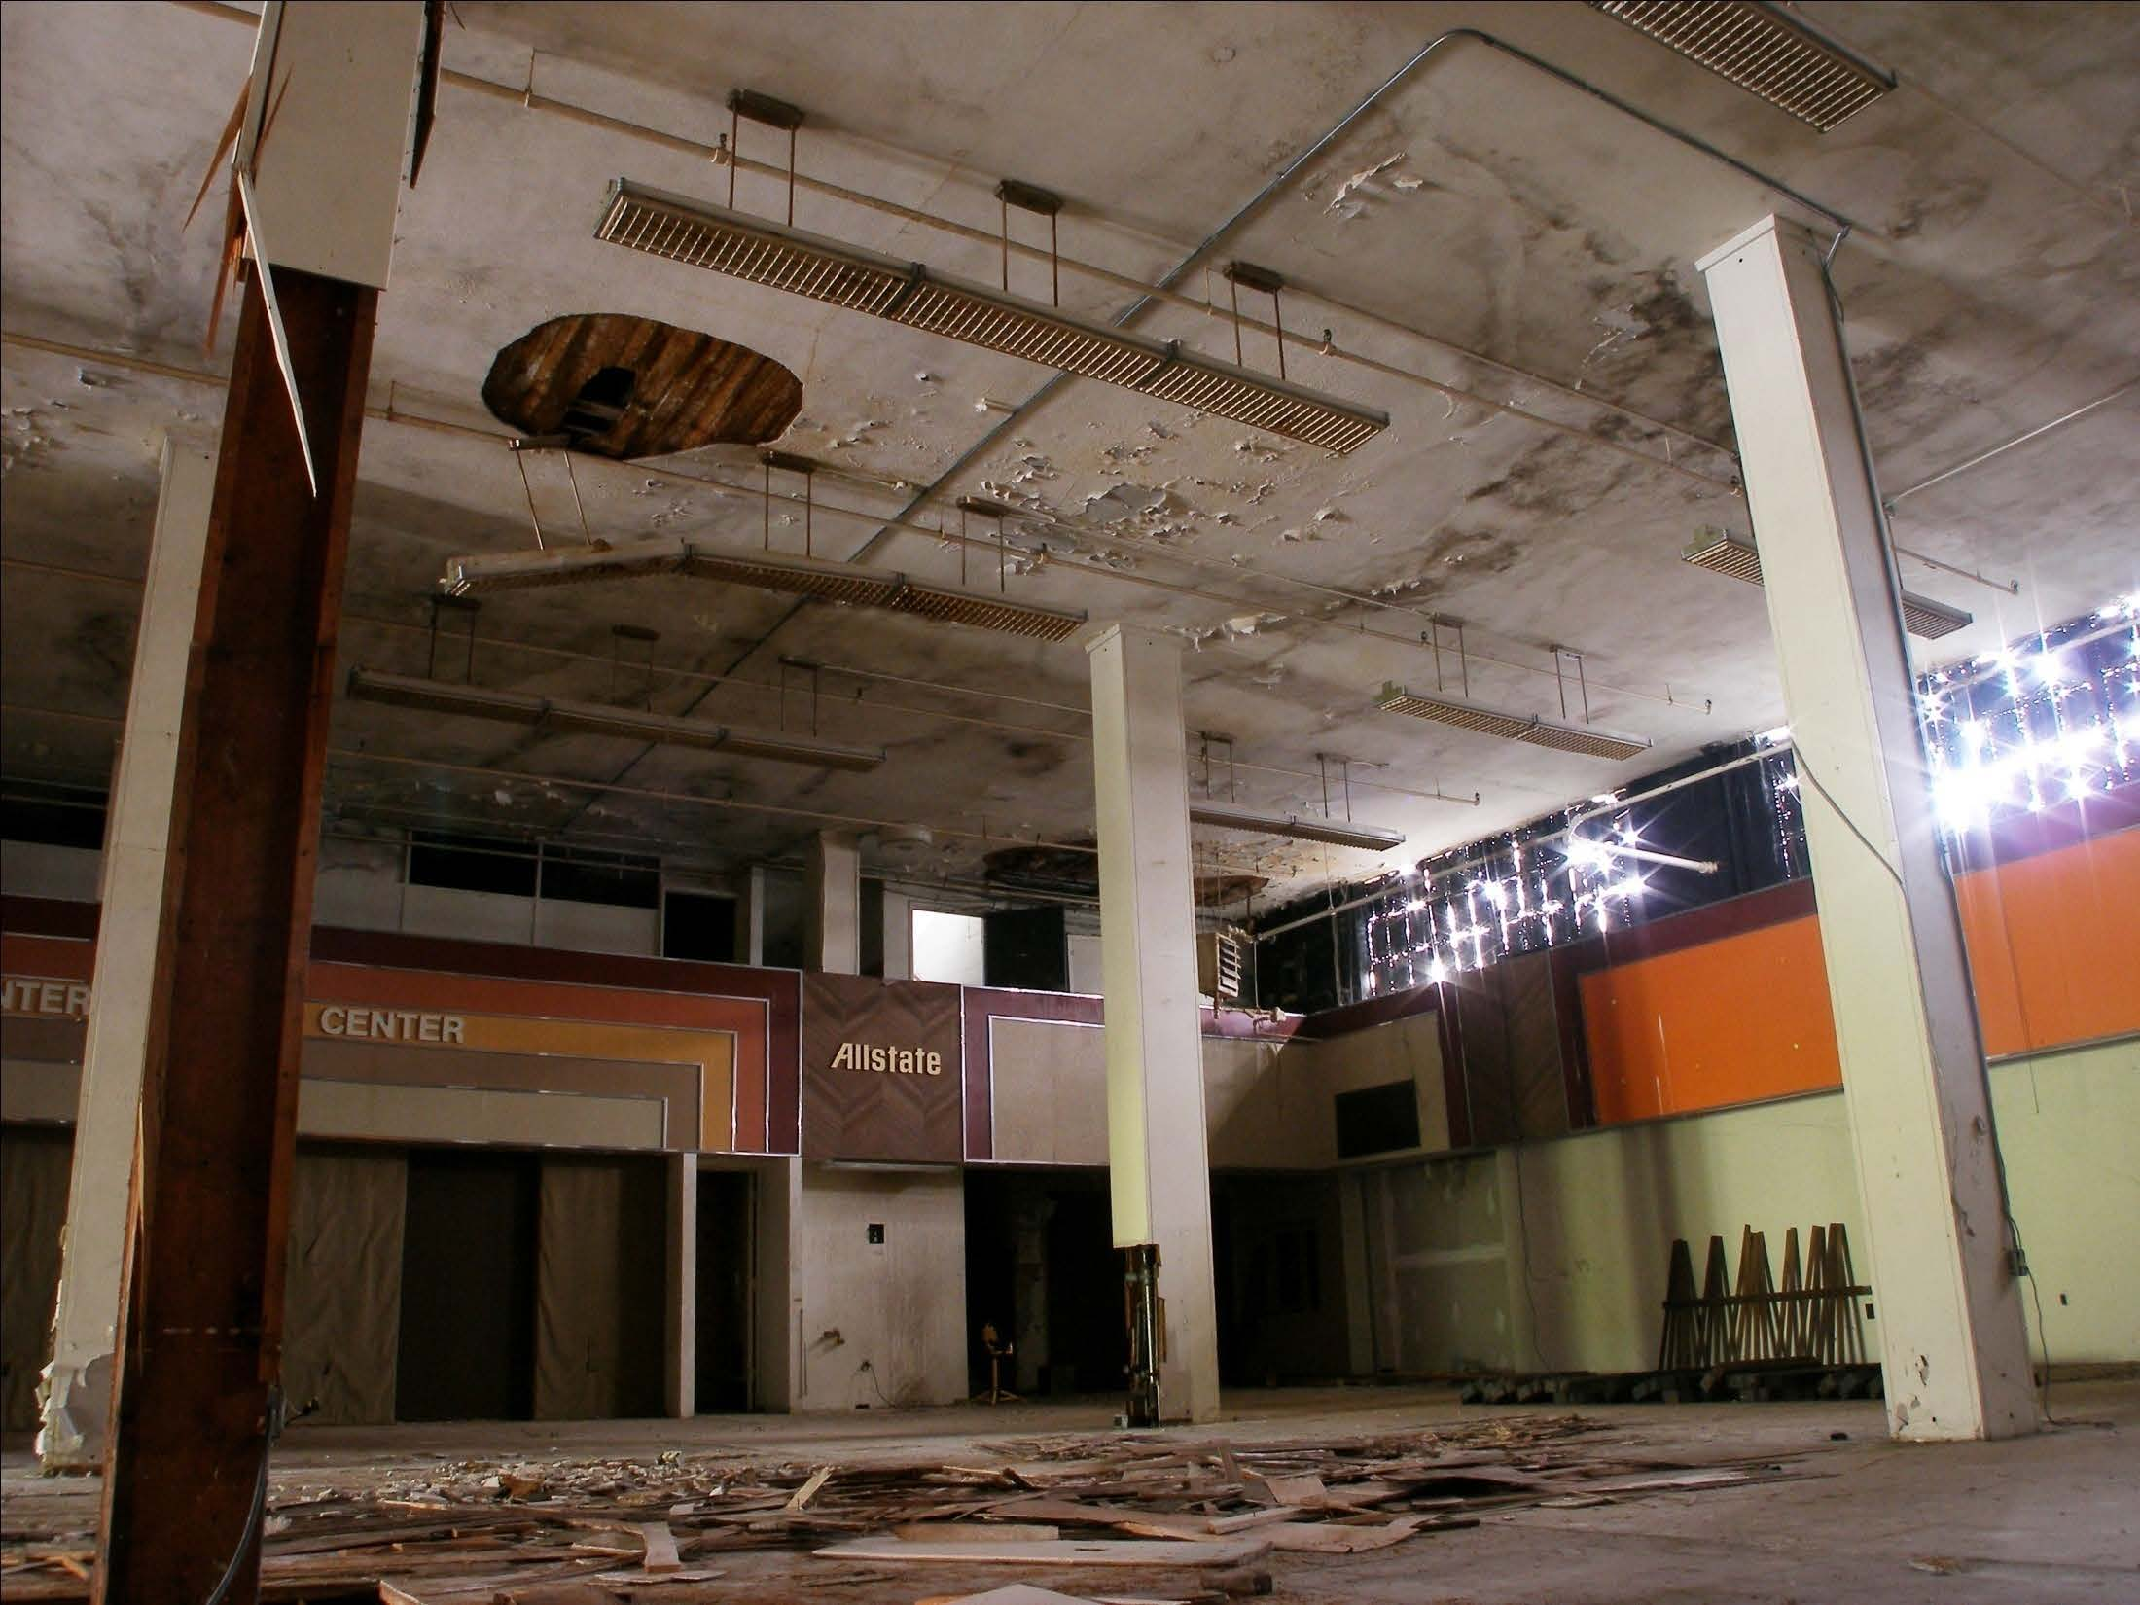
DES Energy
Renovations can reduce your energy use.
Notes:
This is a local example (before)

Slide 24
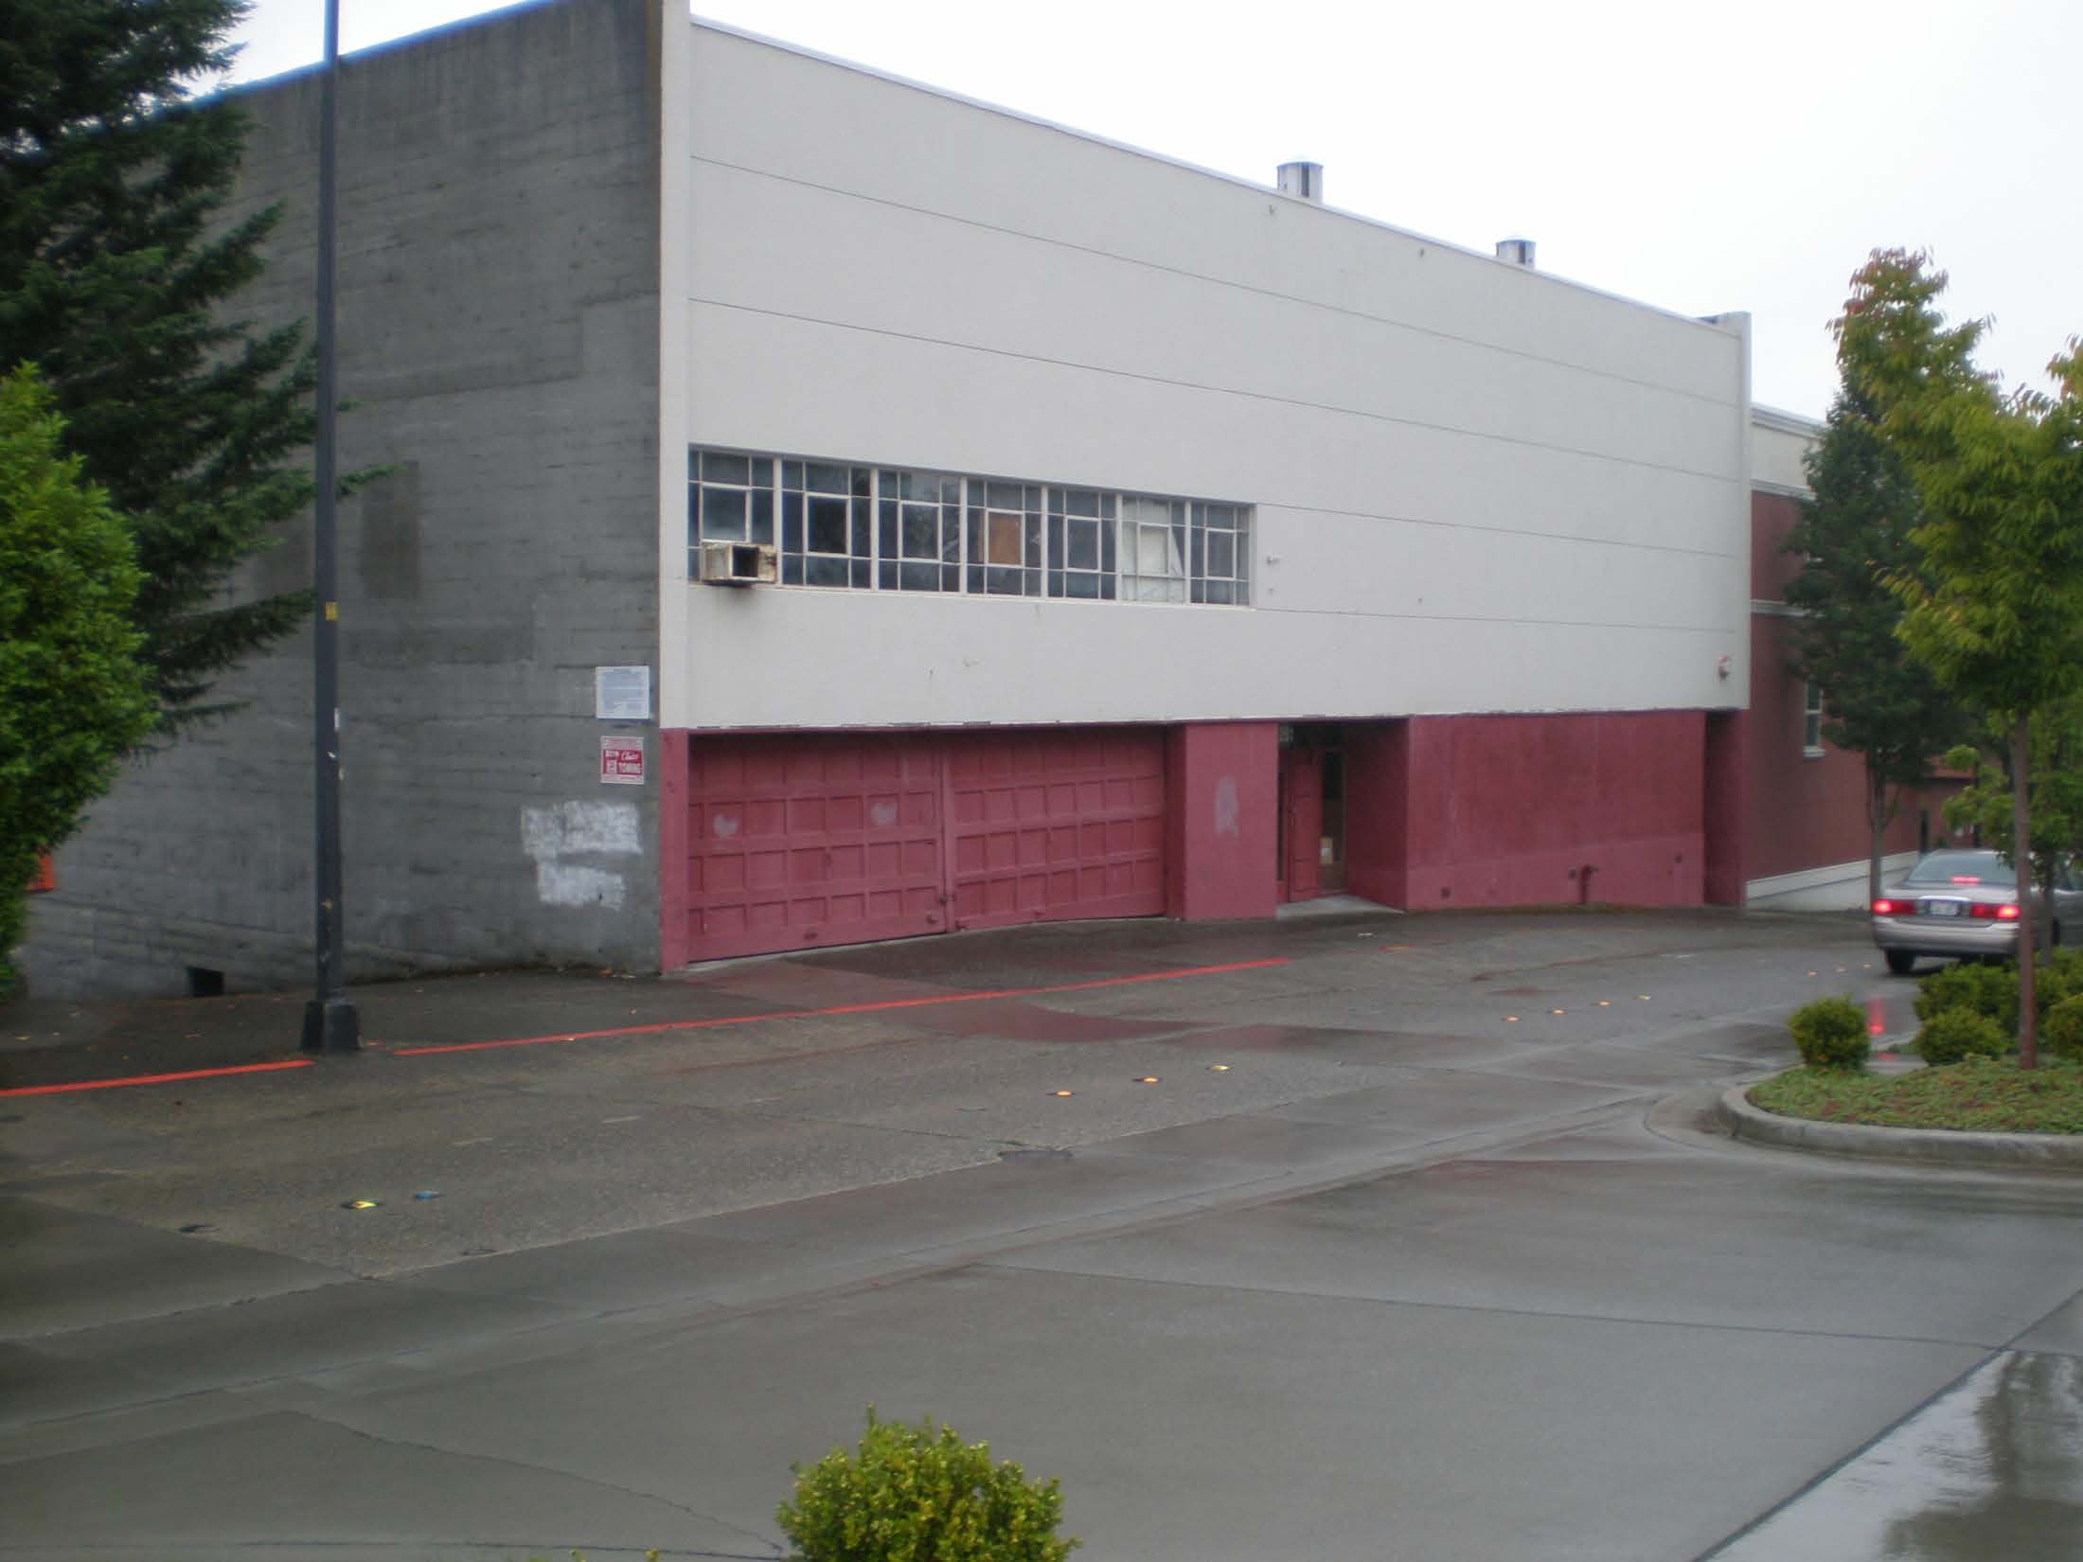
DES Energy
Renovations can reduce your energy use.
Notes:
(before)

Slide 25
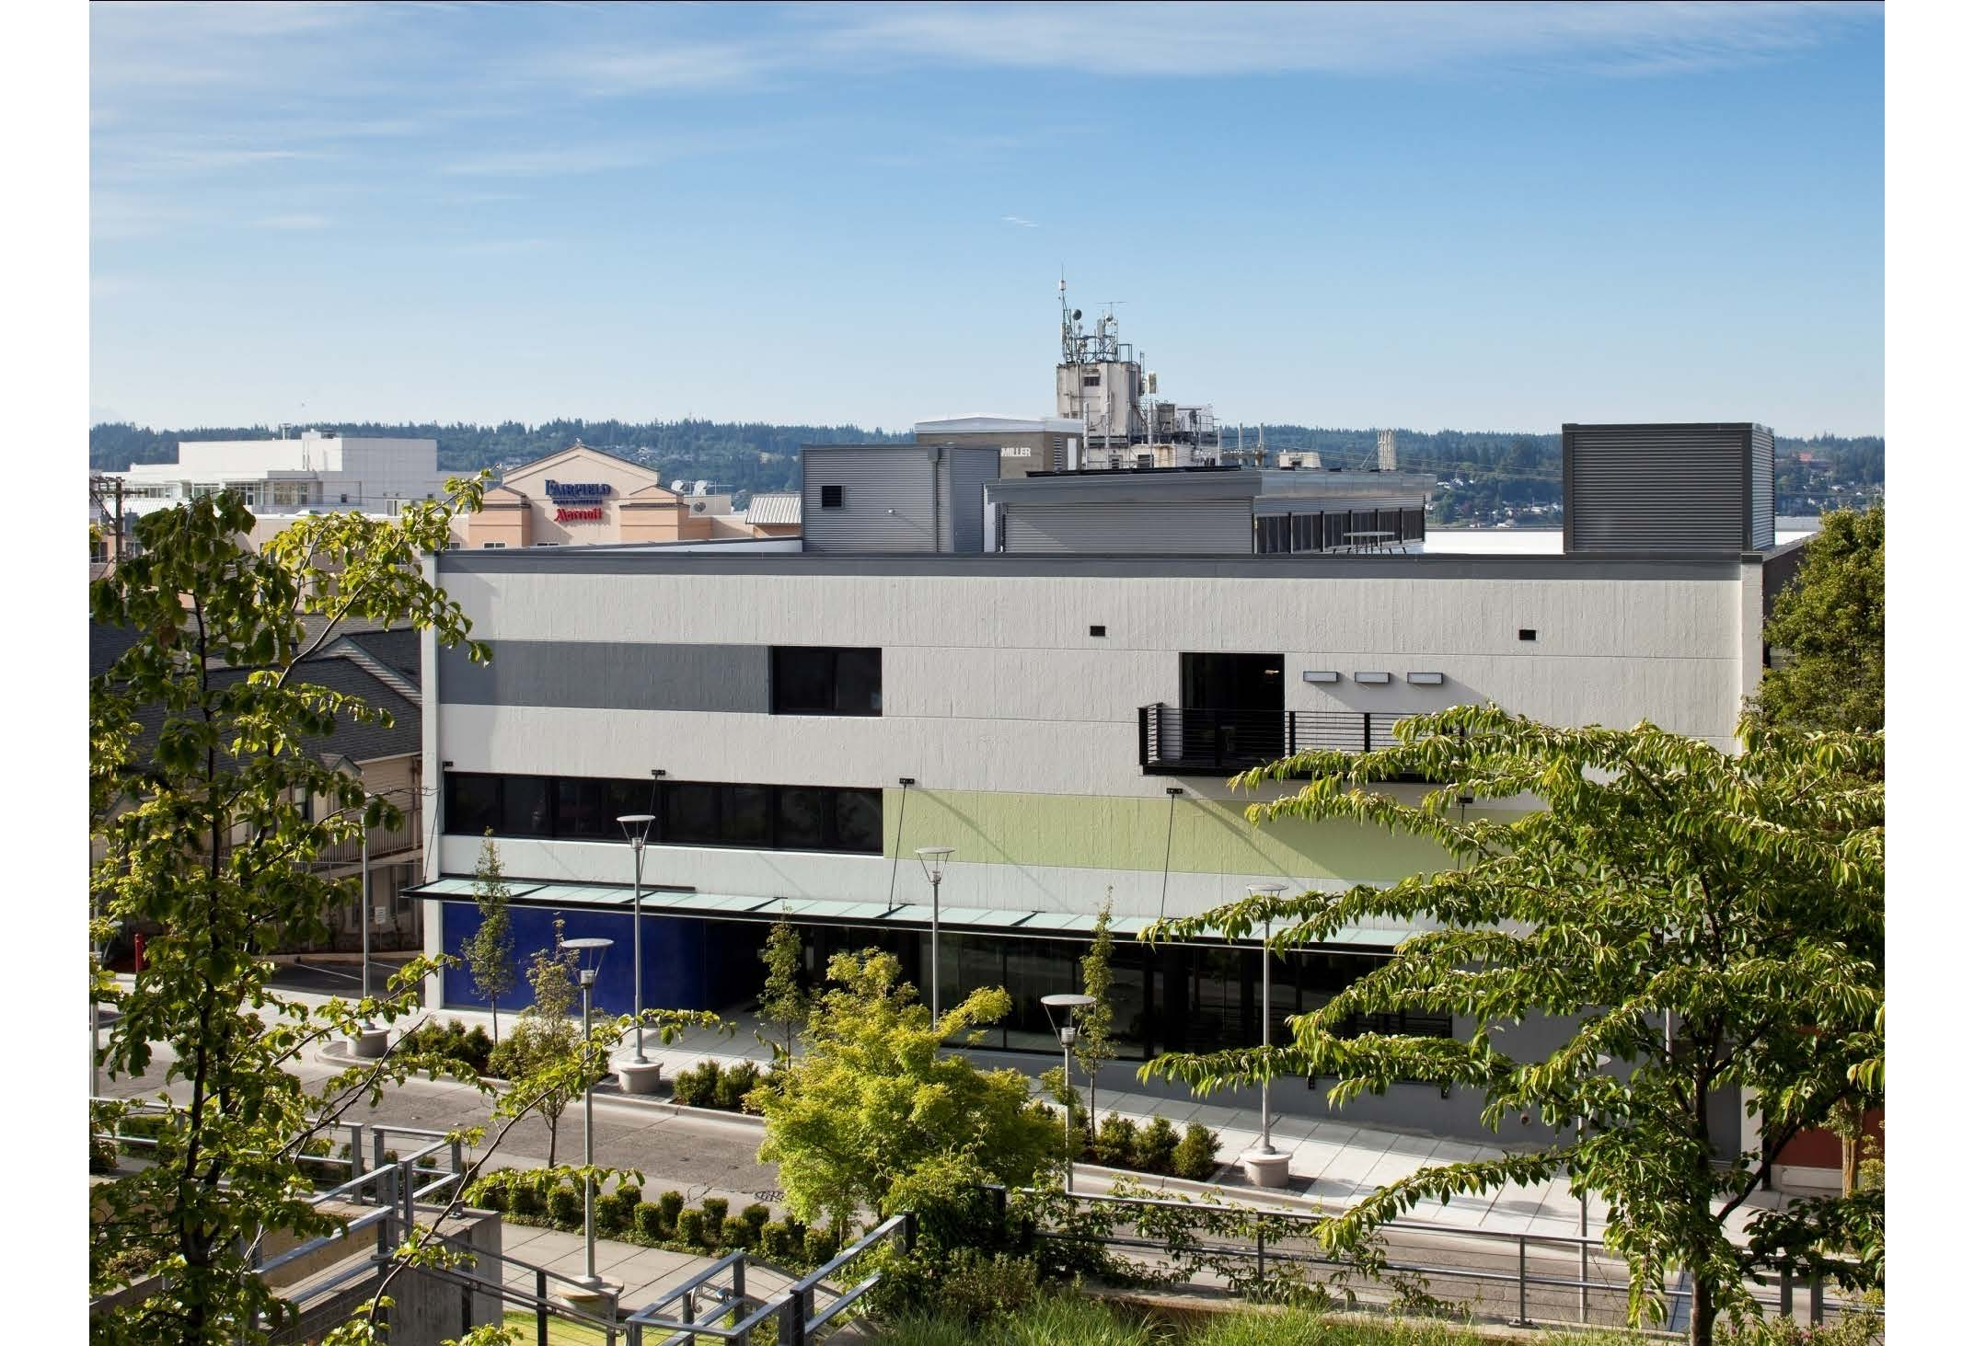
DES Energy
Renovations can reduce your energy use.
Notes:
(after) of a 39,000 sf renovation of an abandoned building in downtown Bremerton by Rice Fergus Miller, at a cost of about $109 per square foot.

Slide 26
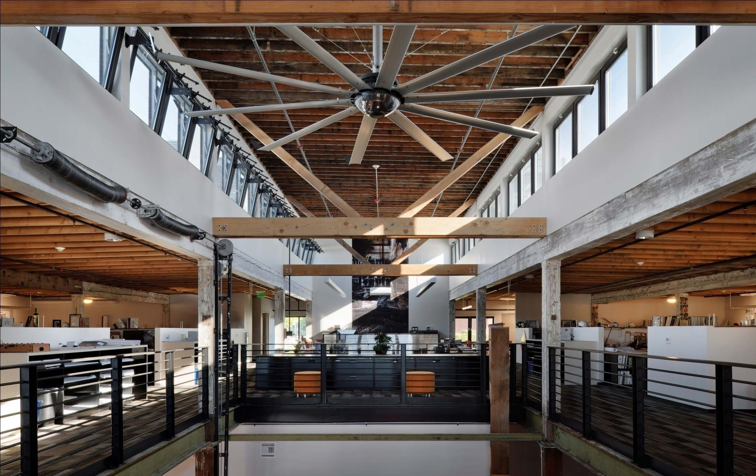
DES Energy
Renovations can reduce your energy use.
Notes:
The resulting office has an annual Energy Use Intensity (EUI) of about 24 kBtu/sf. http://newbuildings.org/sites/default/files/NBI_ZNE_CaseStudy_RiceFergusMiller_1.pdf

Slide 27
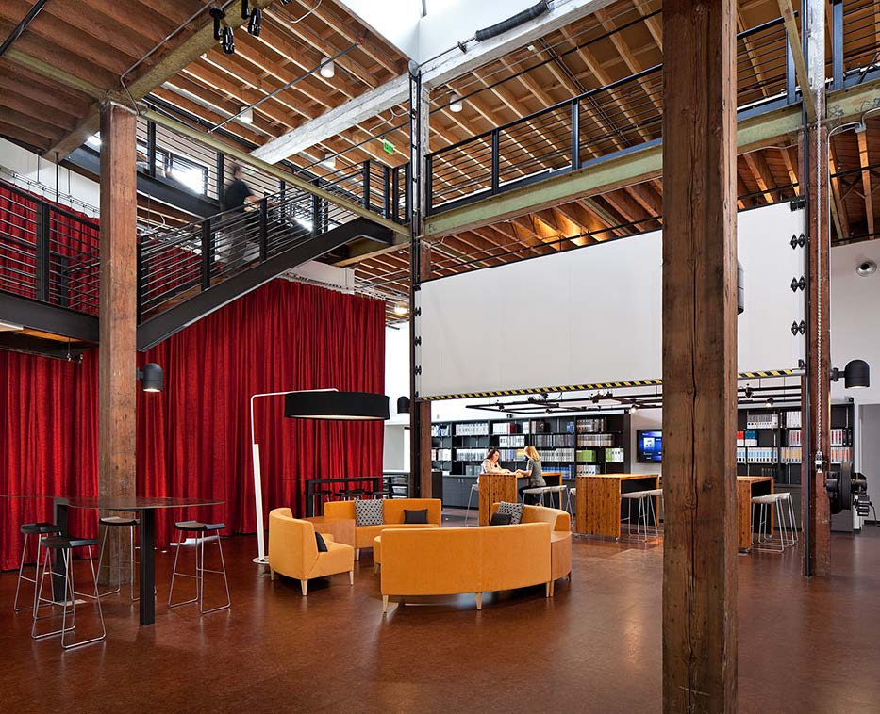
DES Energy
Renovations can reduce your energy use.
Notes:
Renovations are an opportunity to reduce your Greenhouse Gas Emissions!
Renovations can be Zero-Net-Energy-Capable (ZNE-C).
Call DES Energy for technical assistance with setting EUI goals, selecting the right architect, and delivering ZNE-C or very low energy use renovations.

Slide 28
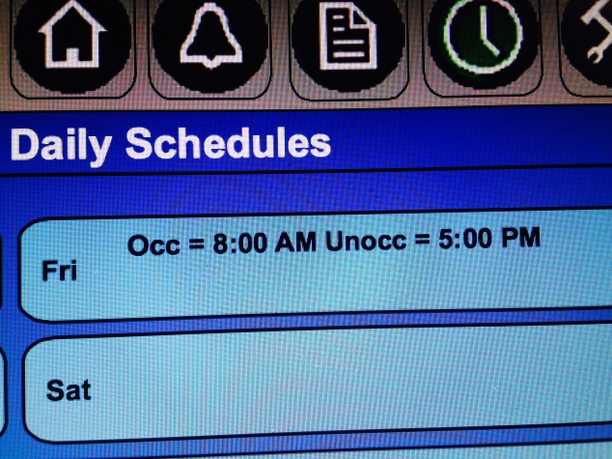
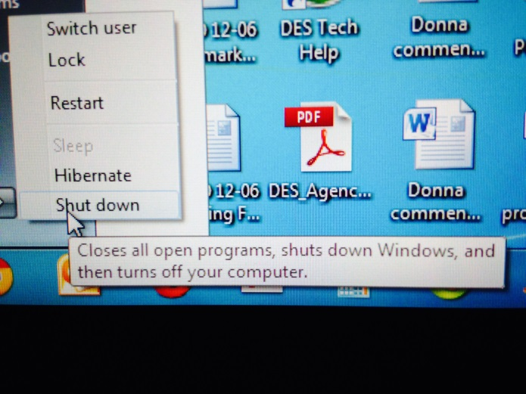
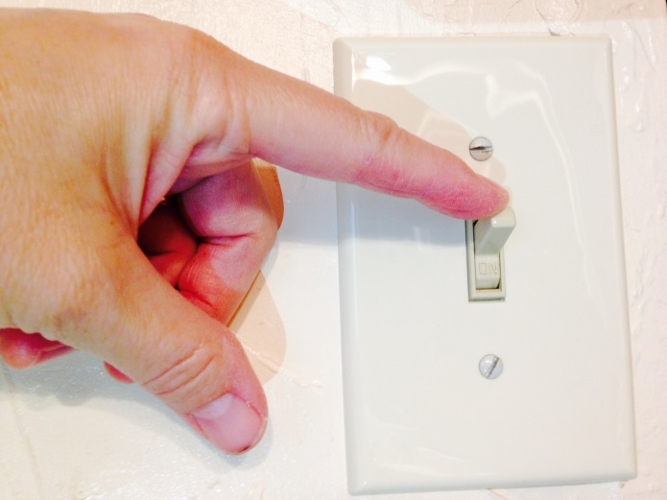
DES Energy
Save energy every day! Turn it off when you don’t need it!
Notes:
Pursue low cost energy savings in energy conservation (turning things off or down when not in use), scheduling (moving evening classes to one building, turning thermostat down and closing dampers when a building is unoccupied) and other operational changes (daytime cleaning, mobile workforce, virtual meetings). Consider hiring a Sustainability or Resource Conservation Manager to find and implement operational energy savings measures. Share best practices with others. Get training for your facilities staff – Building Operator Certification (BOC) training will pay for itself in energy savings and savings from good maintenance practices.

Slide 29
DES Energy
What does a DES Energy Savings Performance Contract do?
Identifies, designs and installs energy savings measures in facilities
Guarantees total project cost, performance and energy savings before construction starts
Notes:
DES Energy Savings Performance Contracting is a good way to reduce energy use in your buildings.
Since the Energy Program’s inception in 1984, the program has:
Managed statewide projects in over 400 public facilities
Installed more than $1 billion in energy efficiency projects
Reference, from Roger:
Since the Energy Program’s inception in 1984, the program has:
Managed statewide projects in over 400 public facilities
Installed more than $1 billion in energy efficiency projects
Saved more than 400 million kilowatt-hours of electricity
Saved more than 15.5 million therms of natural gas
Reduced Carbon(CO2) emissions by more than 270,000 tons
Helped customers receive more than $72 million in utility incentives
Public agencies have avoided more than $39.5 million in annual utility costs with an accumulated savings of over $183 million since 1984

Slide 30
DES Energy
Who can use DES Energy services?
School Districts
Cities, Counties and Ports
Universities and Community Colleges
State Agencies
Public Hospitals

Slide 31
DES Energy
Sequence of an ESPC project
Interagency Agreement
Preliminary audit
Investment grade audit
Design and construction
Measurement and verification

Slide 32
DES Energy
South Kitsap School District
Project Scope:
Heat recovery chiller and cooling tower for pool space, insulate two roofs, replace heat pumps at one school, lighting replacements in all facilities.
Benefits:
Energy savings, comfort, improved lighting, and maintenance savings.

Slide 33
DES Energy
South Kitsap School District
Cost:
$2,873,400 total project cost
State Treasurer loan $1,460,000
Puget Sound Energy grant $686,000
School District capital $727,400
Savings:
$262,300 annual savings

Slide 34
DES Energy
Resources:
DES – Energy Services, Green Building Advisor, other resources
WSU Energy – Plant Operations
DES Energy website
http://www.des.wa.gov/services/facilities/Energy
Notes:
DES E&AS Green Building Advisor (Sidney Hunt)
DES Energy technical expertise (ELCCA review, setting EUI goals for new buildings and renovations, Energy Savings Performance Contracts (ESPC))
DES Purchasing – State Contracts, how else can we help you?
DES Lean Facilitators

Slide 35
Real Estate Services (RES) Advanced Planning Process
Tarah Kimbrough
November 4 and 5, 2015

Slide 36
Renewal Problems & LEAN
RES previously started renewals when agency gave RES green light to move forward. Unfortunately that meant:
Leases were being negotiated too near expiration.
lease rates not optimal
127 leases had expired or were near expiration. Landlords and tenants uneasy.
risk was too high
RES lacked electronic tools
Lease portfolio housed in 25 year old database
No project management tools reporting via multiple spreadsheets

Slide 37
Renewals: What Changed?
RES begins renewals in the most recent Six Year Plan 24 months in advance.
Renewal process has eight milestones with time frames for each phase
Notes:
Key performance measures are tracked for timeliness and cost avoidance
Daily staff huddles keep focus on project pipeline and allow staff to share challenges
These milestones assist in transaction management and keeping things on track. We use these as a way to track agents productivity as well.
Initiate; when we reach out to the agency to set up a define meeting.
Define; RES agents meet with agency to discuss plan for renewal. Identify any issues, concerns with the space, maybe a need to move. When done this early, we have plenty of time to either not renew or proceed with new space.
Charter; Charter documents Charters are developed to capture scope, schedule, existing rent/budget & market rents
for the renewal and then a deferred maintenance inspection is done at the space. The RES agent also performs a market analysis to determine the target lease rate to renew at. These items are all sent to the agency for review and approval, if approved, RES is able to proceed with negotiations.
Market; This is where we can determine if other space is available in the market and this could be used as leverage during negotiations.
Negotiate; This is where the leasing agency commences negotiations. This process can take hours, days, weeks or months, so in this process we have ample time to negotiate to try and get the bet deal possible.
TAF; Once the leasing agent reaches agreement on the terms, they can begin drafting the lease document.
Execute; this is when the final document is executed and signed all around.

Slide 38
The Results
Calendar Year 2013: one year after implementing the new process, expired leases and leases within 6 months of expiring were reduced by 82%.
FY 2014: robust negotiations - $7.5 million cost avoidance
Fewer agency and landlord complaints about timeliness.
DSHS requested embedded RES staff
Embedded staff promote decision making and participate in DSHS strategic discussions
FY 2015: RES embedded staff approach expanded to Employment Security and DOC.
Targeted approach to agency challenges and better planning
$3.8 million cost avoidance for 131 leases executed in Fiscal Year 2015

Slide 39
New Space Problems & LEAN
Completed new space projects met expected occupancy dates 43% of the time. Causes were:
Authorizing cycles for relocations occur at intervals that don’t sync with lease end dates.
Project occupancy date, budget, and scope was established with little or no RES input.
Scope change and rework often occurred late in the process.
Notes:
Non-standard work and lack of role clarity.

Slide 40
New Space: What Changed
Initiate/Define: Solicitation Team Meeting
Review OFM pre-design, agency unique requirements, and target occupancy date
Review process, agree to roles and approve project schedule
Identify if additional subject matter experts are needed
Review, finalize and post solicitation documents
Develop and Distribute Request for Proposal
Pre-proposal conference (required for projects over 20,000 sf)
Administrative screening of proposals to ensure that basic requirements are met
Site Visits / Technical Evaluations
Each eligible site visited and presentations heard
Documents and discusses pertinent details and observations
Discussion regarding alignment of evaluations and requirements of proposals
Documents essential differences in proposals
Notes:
Make up front planning more robust so search or solicitation is more successful.
So solicitation for new space is when an agency is looking to move or acquire new space to expand their footprint. Space under 5,000 square feet can go straight to a market search i.e. go out and find space that they want. Space over 5,000 square feet must go through a formal solicitation process which is outlined here. It is outlined here and I will briefly go through it….

Slide 41
New Space: What Changed
Qualified proposers issued an invitation to negotiate
Final proposals, including incentives and inducements entered into Cost Calculator.
Proposals ranked from highest to lowest based on cost.
Final Evaluation Meeting
Side-by-side comparison of cost proposal to evaluation criteria to determine ranking from best value to least value.
Applies Blocking & Stacking (if applicable).
Determines ranking of best value proposals and recommendation of Apparent Successful Proposal.
Consistent with statute, OFM approval needed if highest ranking proposal is:
Over $1 million annually
Over 10 years in duration
New or planned construction
Notes:
Value of the process:
Strong documentation and clear roles create greater consistency and predictability.
Process delineation of responsibility and checks and balances so that no one person or group can unduly influence increasing fairness.
Documentation of expectations, decisions, escalation points, checkpoints and outcomes increases transparency.
It is cost effective for state and lessors adding greater rigor for higher value projects while bringing the correct level of diligence for lower value solicitations. Less cost increases competition.
Flexible to meet all known types of real property solicitation.
Able to sustain by incorporating feedback, refreshing the core process continually.
This is an example of using the best information available to simplify a very complex business process.
This process is consistent with Washington state law, administrative code, policy and industry best practices.

Slide 42
New Leases & Renewals What our customers want!!
100% of leases will be renewed before lease expiration
100% of leases will be consistent with customer budget at or below market rates.
100% of customer survey receiving consistent, timely, quality service.
100% of customers satisfied with renewal process communication.
100% of customers contacted 24 months in advance of lease expiration to “initiate” renewal process.
Notes:
Speak to the audience about whether this would match up with their expectations?
These were the goals and metrics when RES started the 2 year renewal process, and we are continuing to try and meet these goals!

Slide 43
Other Ways to Reduce Expense
Use brokers to best advantage
Optimize portfolio
Space standards
Track Utilization
Alternative workplace strategies
Collect data for future improvements
Energy conservation

Slide 44
How RES uses Brokers
Researched how other states use brokers
10 out of 50 states have broker contracts
Scope of services ranges from targeted to extensive
Michigan engaged brokers in 2008 for rapid downsize
Florida and New York - comprehensive services for portfolio optimization
Tennessee and Virginia - portfolio assessment
Colorado, GSA, Oregon and Virginia have convenience contracts for select services from transactional to design and project management
Washington put convenience contract in place in August 2015
Notes:
Overall: Colorado, Florida, Georgia, (Illinois), Michigan, Minnesota, New York, Oregon, Tennessee, Virginia, West Virginia have contracts
Portfolio optimization: maximize occupancy in owned (need to know vacancy levels & which properties are space efficient or not), strategy by region (New York)
Strategic portfolio assessment: condition assessment of owned vs. leased master planning (Tennessee & West Virginia)
Convenience contracts: Colorado, Oregon & Virginia use brokers for transactions in major metro areas or for larger deals; Oregon, Tennessee, Virginia provided design, project management, and consolidation coordination services

Slide 45
How Brokers Help
Seattle market experiencing double digit increases in market rents
Broker selected to provide market comps for two large Seattle renewals.
85,000 SF renewal completed with $2.1 million cost avoidance over 5 year term.
Notes:
How many brokers does RES have to tap into in the broker pool?
Areas of the state – King, Snohomish, Pierce, Clark, Spokane & Tri-Cities.

Slide 46
Cost Saving Measures
Energy efficient buildings
Facility Space Standards
Alternative Workplace Strategies
Notes:
SUMMARIZE:
RES leasing practices relative to Energy Star ratings – renew if building scores 75 or greater; RES staff directing landlords to resources to improve energy efficiency.
Facility space standards – helps agencies meet their needs while being efficient with state resources and building in the flexibility for future change
By collecting up-to-date seating counts, agencies and customers are better armed to improve utilization via Alternative Workplace Strategies Donna will speak to.

Slide 47
Why a Space Standard
RCW 43.82.010 (9) To maximize space utilization “DES shall make space utilization studies, establish standards for use by state agencies.”
Space is the second largest expense next to salaries of any operating division.
“Facility efficiency” means:
Controlling costs (space is expensive)
Standardizing levels of service
Prudent management

Slide 48
Goal of DES Space Standards
Adopt space standard(s) that are:
Specific enough to be consistently applied
Broad enough to meet the unique business needs of state agencies
Support Alternative Workplace strategies
Provide guidance for identifying potential exceptions and criteria to apply to them
Adopt standards for managing and reporting on exceptions to space standards as a measure of facility efficiency
Notes:
Draft standards have been presented to agency stakeholders and will now go to OFM for review, input, and approval.

Slide 49
Guiding Principles for Space Allocation
Space Allocation & Staff Positions
Open Plan
Anticipating Change
Cost Containment
Staff is not entitled to specific workstation sizes.
Most employees shall be provided open area workspaces. Enclosed offices are limited.
Higher proportion of furniture systems vs. built spaces allow more flexible layouts and reduce cost of initial buildout.
Space savings from efficient layouts.
Move people not furniture.
Reuse existing tenant improvements.
Notes:
Open plans are more energy efficient, promote light for better work environment
Flexible open plans cost less to build, leave room for better rent negotiation, provide future flexibility for agency reconfiguration

Slide 50
DRAFT Space Standards Update
Proposed Changes to Space Standards
SF / FTE changed to be SF/ workstation
Metric goals will be tiered to facility size (small, medium, large)
Goal of 10% office ratio to 90% cubicles
Measure office/administrative area separately from special use/purpose areas + add proportionate load factor
Notes:
SF / Workstation rather than SF/ FTE

Slide 51
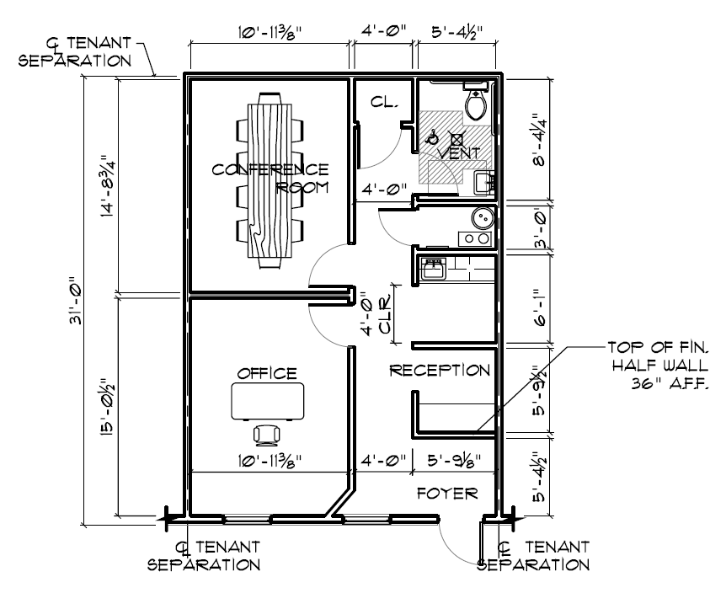
Metric varies by Suite Size
Square foot per workstation metric varies by size
Small (up to 999 SF) = 280 SF/workstation
Medium (1,000 SF to 9,999 SF) = 215 SF/workstation
Large (10,000 SF or greater) = 185 SF/workstation
Small suites (i.e. this 650 sq. ft.) often cannot achieve the efficiency of large facilities

Slide 52
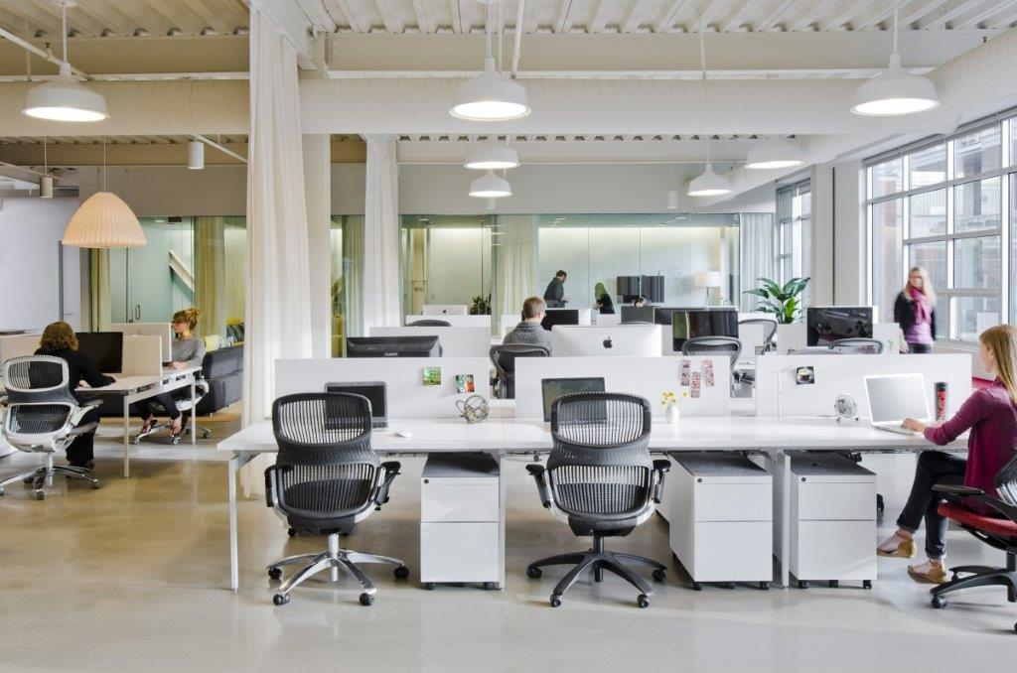
High Tech Open Office
Open offices maximize light, increase collaboration, decrease buildout costs

Slide 53
Collaborative Areas
Contemporary offices offer informal areas to meet, collaborate, and touch down stations for staff who are more mobile.

Slide 54
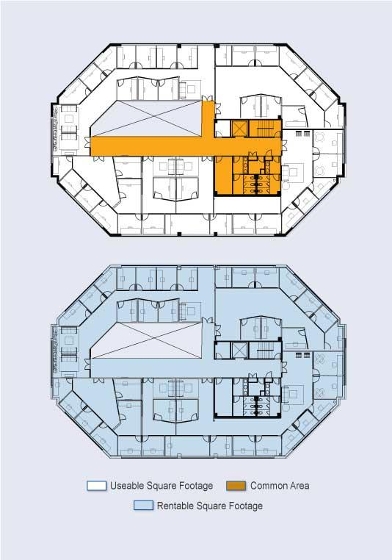
Usable Admin. Area + Load Factor
The load factor is a % of common building area that includes the main building lobby, common corridors, restrooms, elevator lobbies, mechanical rooms, etc. Rentable square is the usable square feet + the load factor.
Notes:
The load factor is a measure of building efficiency.
--Low load factor, more efficient building – tenant leases less space
--High load factor, less efficient building – tenant leases more space

Slide 55
Overview : DRAFT New Standards
New Standards propose a tiered efficiency measure by facility size.
New Standards do not specify the amount of individual workstation space.
The new Standards provide a maximum threshold not an “entitlement” for an agency.
DES and agencies will continue to advocate for further innovation and space efficiency as stewards of state resources.

Slide 56
DRAFT Exemption to Standards
An EXEMPTION is required if:
The site has a Rentable/Usable load factor over 10% consistent with Modified Predesign; or
The Special Use Area (Service Delivery or Other) exceeds 45% of the Usable Area; or
The square footage per workstation exceeds the thresholds defined for the suite size; or
The number of private enclosed offices exceeds 10% of the total workstations or one private enclosed office in worksites with less than ten workstations.

Slide 57
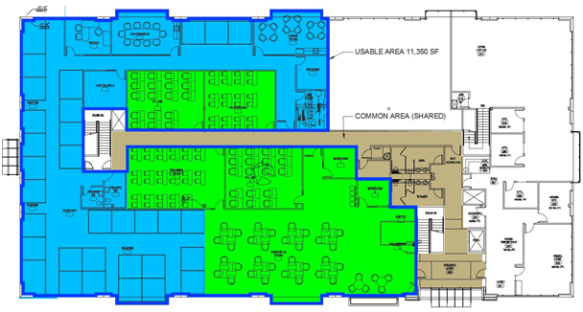
Example – Office/Admin
Notes:
How might these standards apply to me?
Here’s an example of the layout for an Employment Security WorkSource Center
The old measurement combines blue & green area, counts 35 seats (1 office, 34 cubicles), adds 10% load factor for 12,312 rentable square feet.

Slide 58
Implement & Collect Data
Collecting the space efficiency information will allow DES to:
Revise future space standards with better data on actual space usage
Assist in planning consolidations or restacks
Measure space usage as DES has improved headcount numbers
Improve DES ability to provide efficient space that satisfies customers needs.

Slide 59
Workplace Strategies Donna Albert, DES Energy Nov 4 - 5, 2015
Notes:
Workplace Strategies, Workplace of the Future, Total Workplace – what is this?

Slide 60
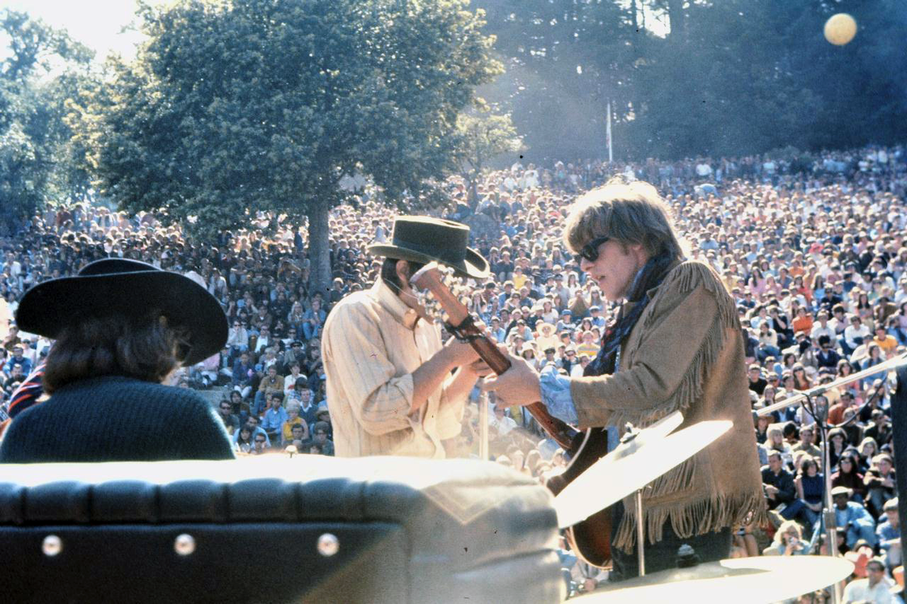
DES Energy
Notes:
Before we talk about the Workplace of the Future, we’re going back to 1967. Great music. The Rolling Stones, Jimi Hendrix, Janis Joplin, and the Beatles were all playing. The shelby Mustang GT-500 Fastback was the car. The Summer of Love happened in 1967. We were wearing bell bottoms, headbands, tie dyed shirts and sandals. A new house averaged $14,250. Rent was $125. Gas was 33 cents a gallon. We read the first Rolling Stone Magazine, and watched the first Superbowl.

Slide 61
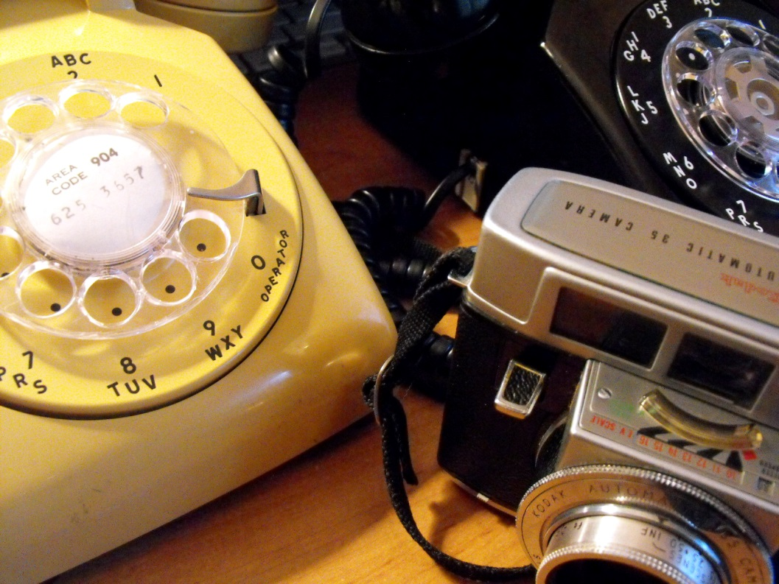
DES Energy
Notes:
Remember rotary phones and film cameras? 1960s technology.

Slide 62
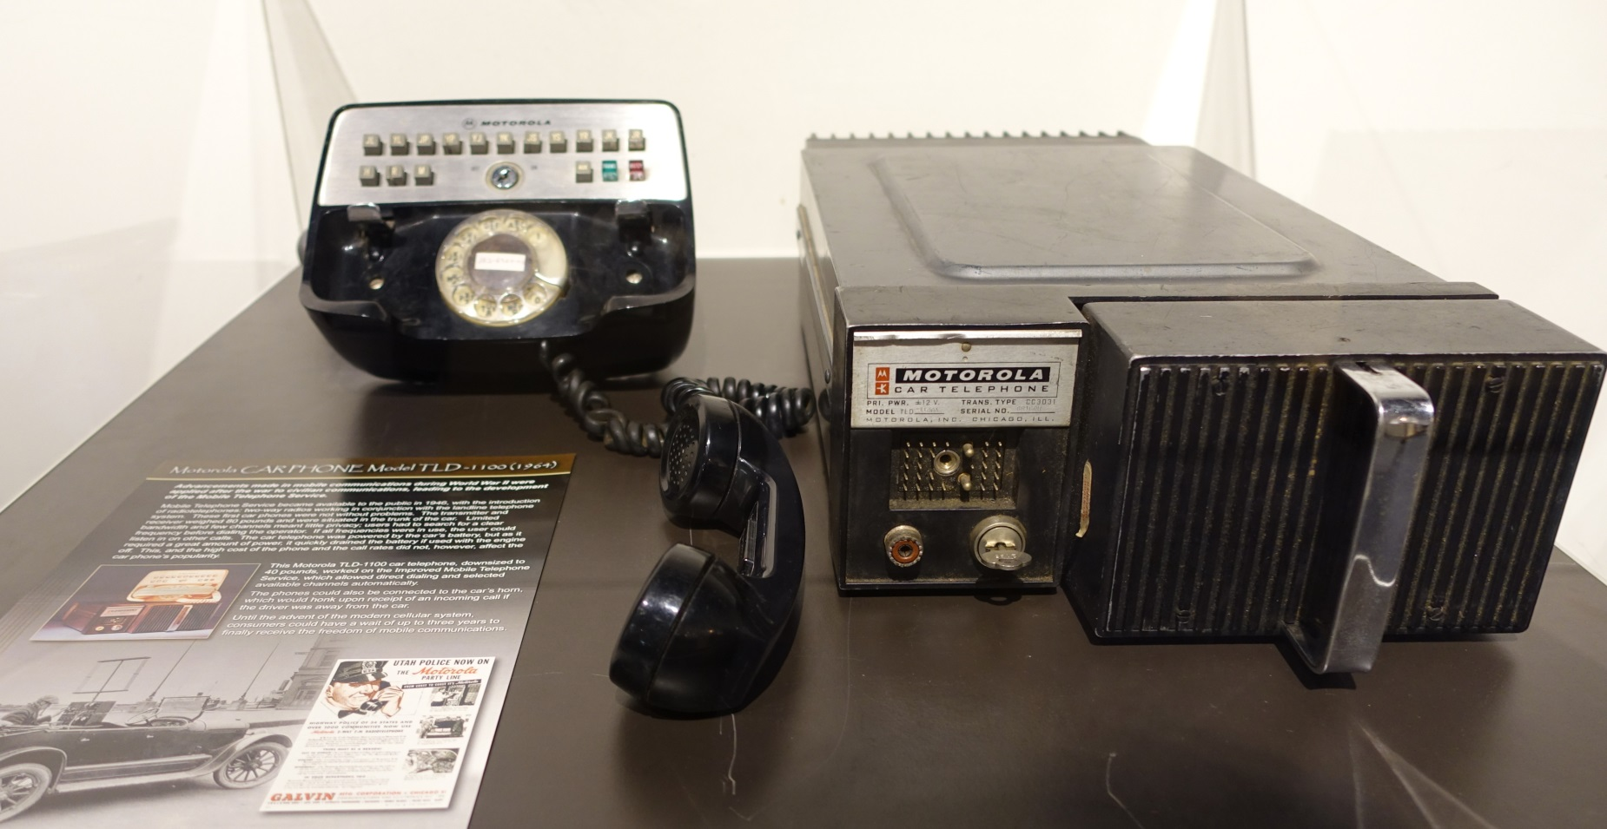
DES Energy
Notes:
Anyone know what this is? You could find these in a very few cars in 1967. A “mobile” phone.

Slide 63
DES Energy
Notes:
Anyone remember these? Did you use one? The great IBM Selectric.

Slide 64
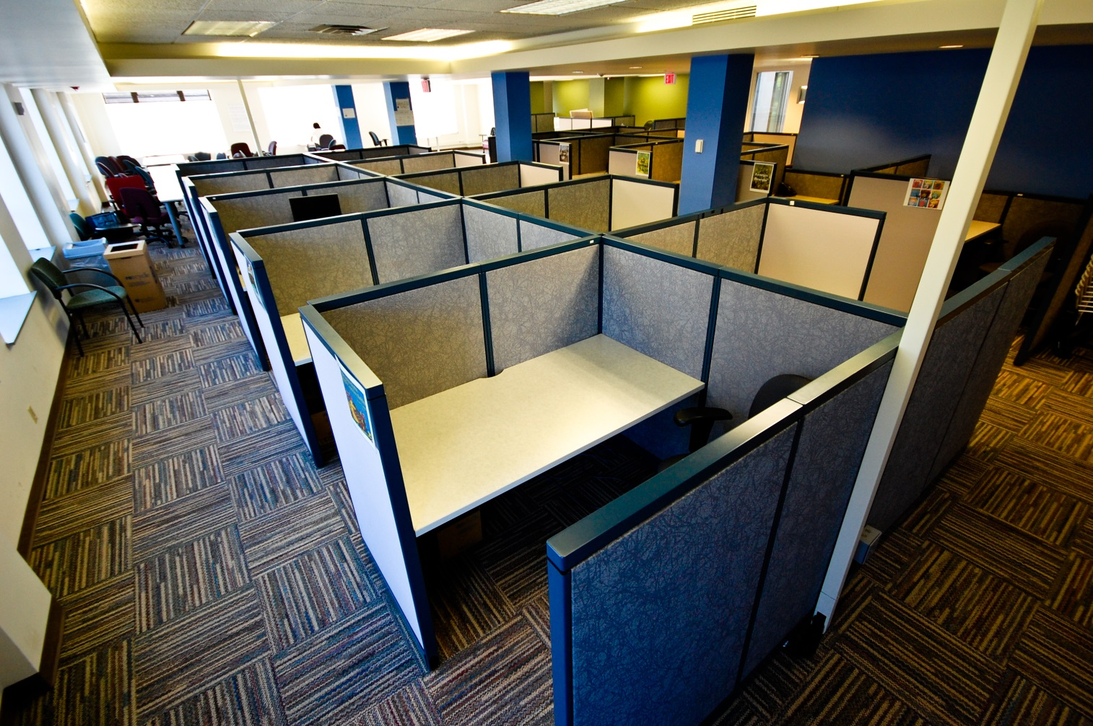
DES Energy
Notes:
The cubicle was created in 1967. At the time, private offices were for managers, and many large offices were open rows of desks. The cubicle was provided some privacy. It was intended to be easy to rearrange, to make the workplace flexible. In practice, cubicles are often semi-permanent because of the need for electrical and computer network cables.

Slide 65
DES Energy
Notes:
Back to the Future.

Slide 66
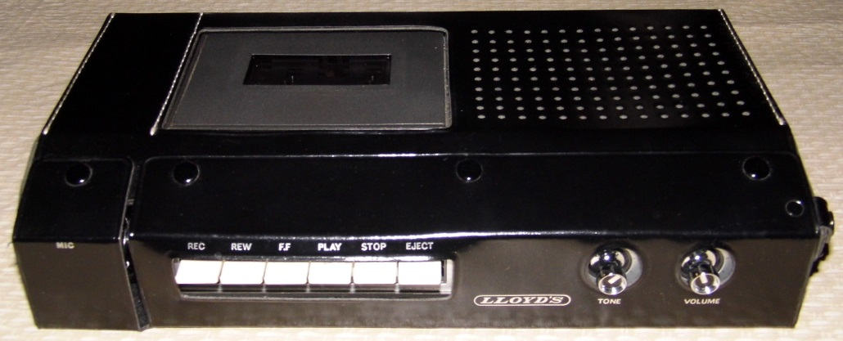
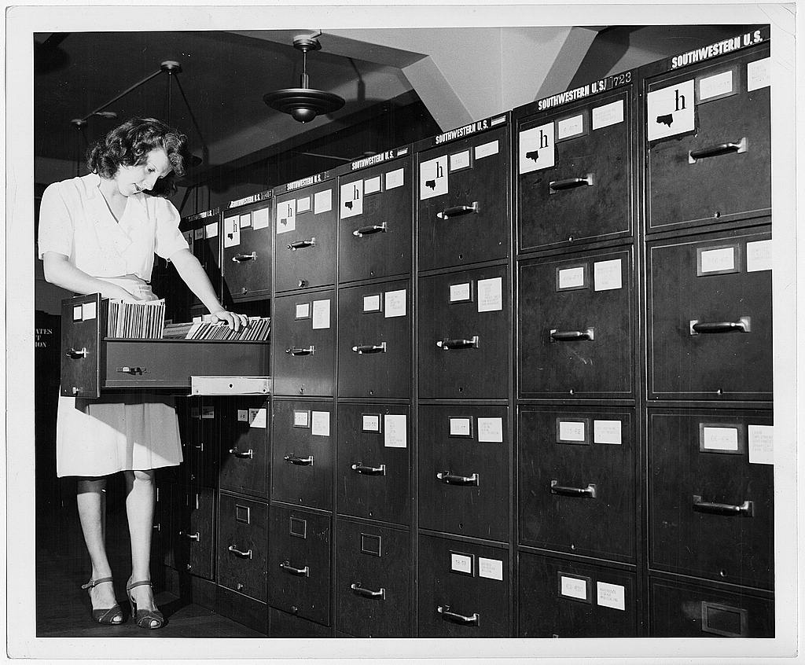
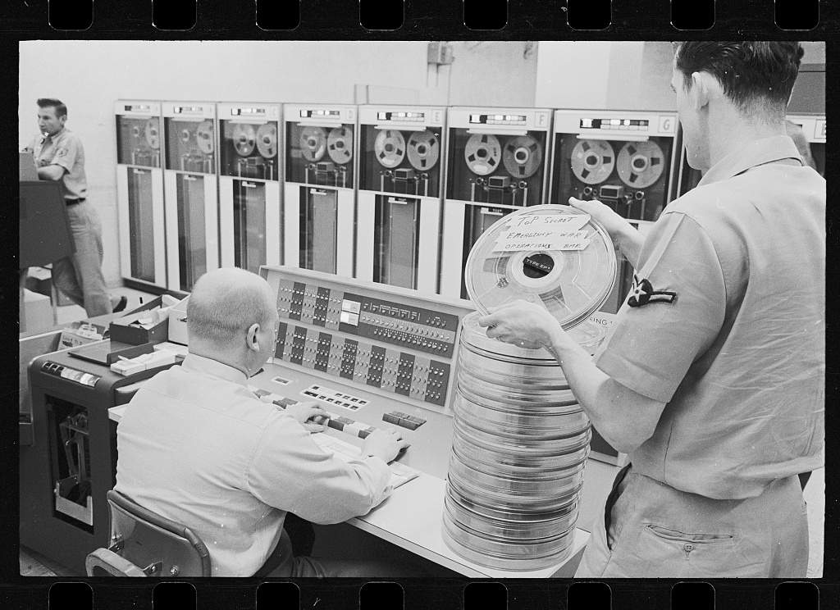
DES Energy
Notes:
Now all this is much smaller and more portable

Slide 67
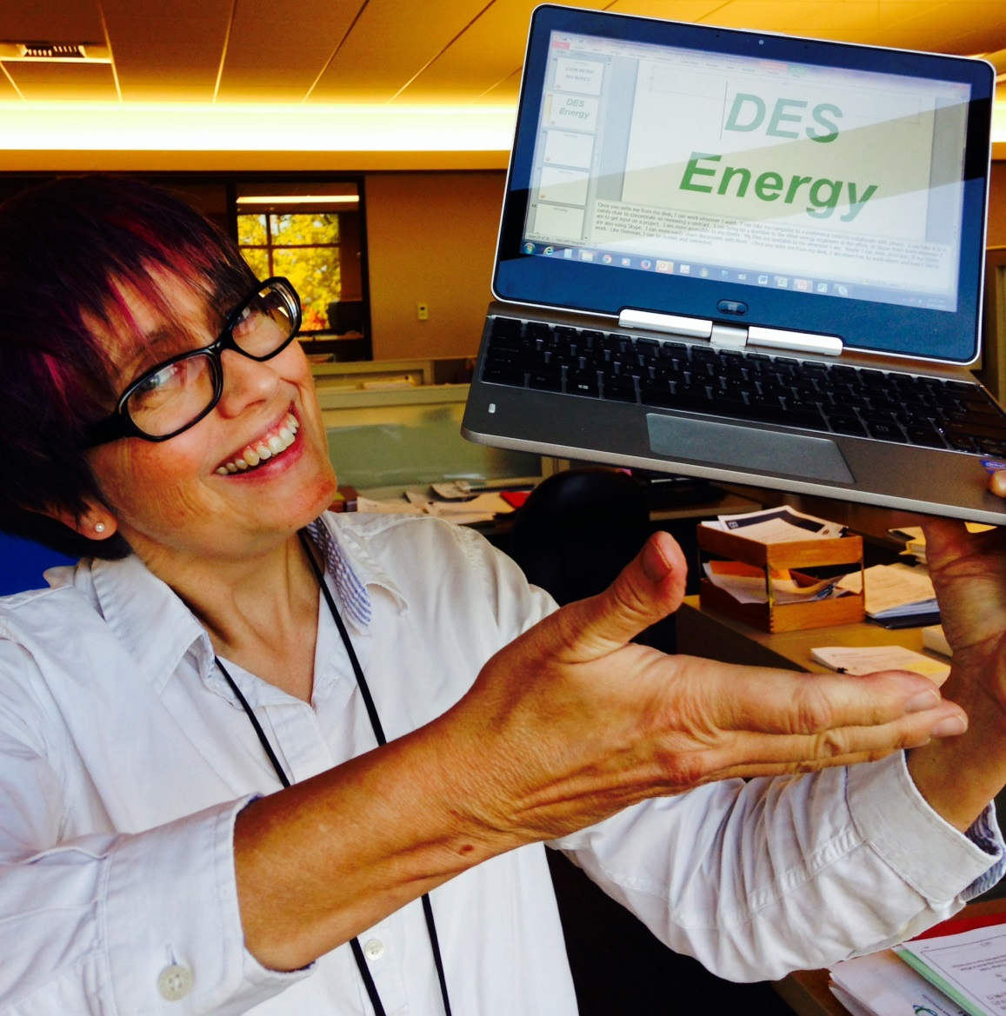
DES Energy
Notes:
Here it is! My little computer. Holds more documents than many rooms full of file cabinets. Camera, voice recorder, calculator, word processor, data base, computer. Can make phone calls and do video conferences. Look mom, no wires! If you have good wi-fi, and if your documents are accessible anywhere in the cloud, you can work anywhere.

Slide 68
DES Energy
Notes:
My cell phone is not only a phone, it’s a video phone, it’s a camera, a video camera, a recorder, a calculator. It’s a computer 1000 times faster and with 500,000 times more data storage than the computer that landed a man on the moon. It fits in my pocket, and works wherever I go.

Slide 69
DES Energy
Notes:
All of this 1967 technology is in the palm of my hand.

Slide 70
DES Energy
Kids Today!
Notes:
So, here’s my 15 year old grandson, Donovan. Mobile on his cell phone. He is connected to his friends all the time. He plays games and uses instant messaging to chat with the other players – in Asia, Europe, Africa and Australia. He does his homework on his phone, and sends it to his teacher in the cloud. His music is in the cloud. I saw him the other day playing a fast and complex first person shooter strategy game, with other players in other cities, accessing maps and lists, while chatting with his friends in Grays Harbor on his phone about specific basketball plays used in a game they had all watched earlier, while listening to his music. Donovan is not tied down to any place or time.

Slide 71
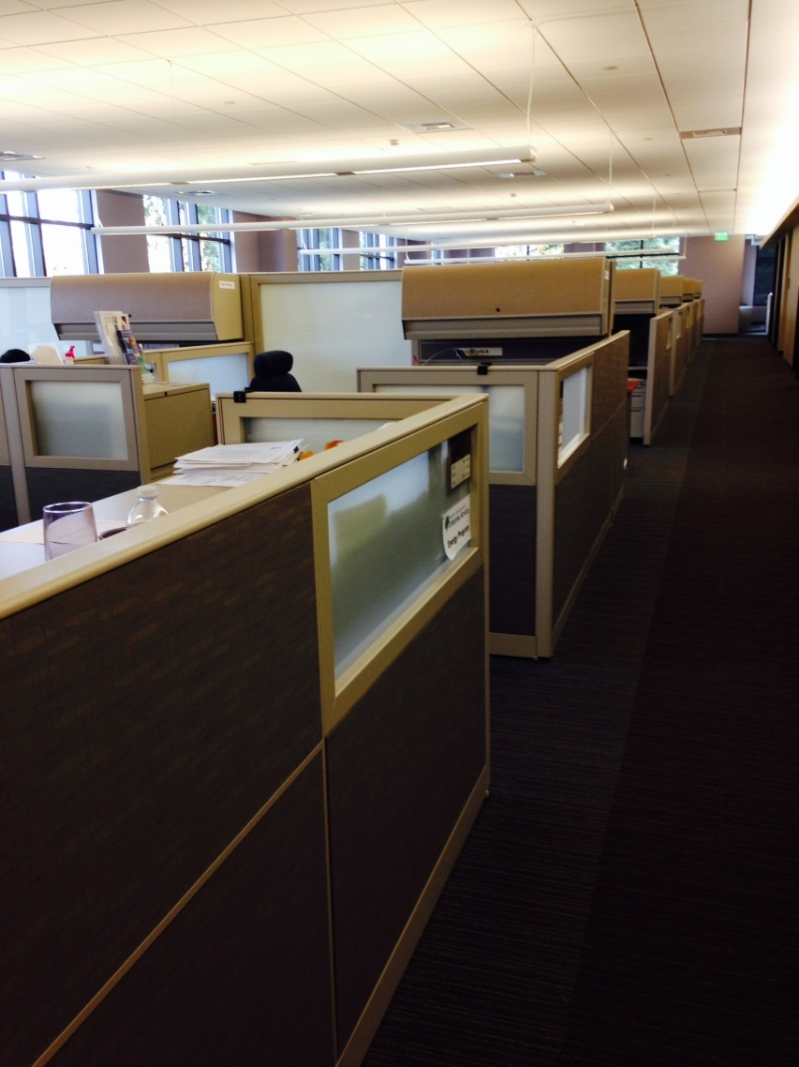
DES Energy
Notes:
Will Donovan work here? (my cubicle neighborhood)

Slide 72
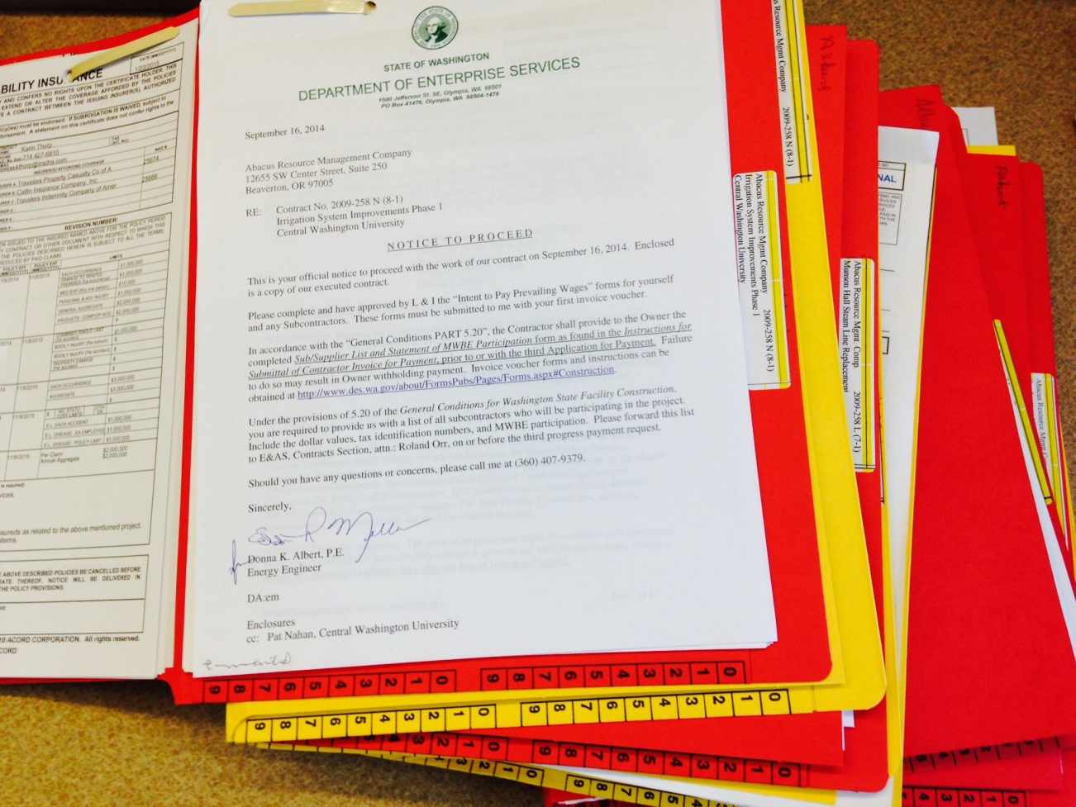
DES Energy
Notes:
With this? (paper files)

Slide 73
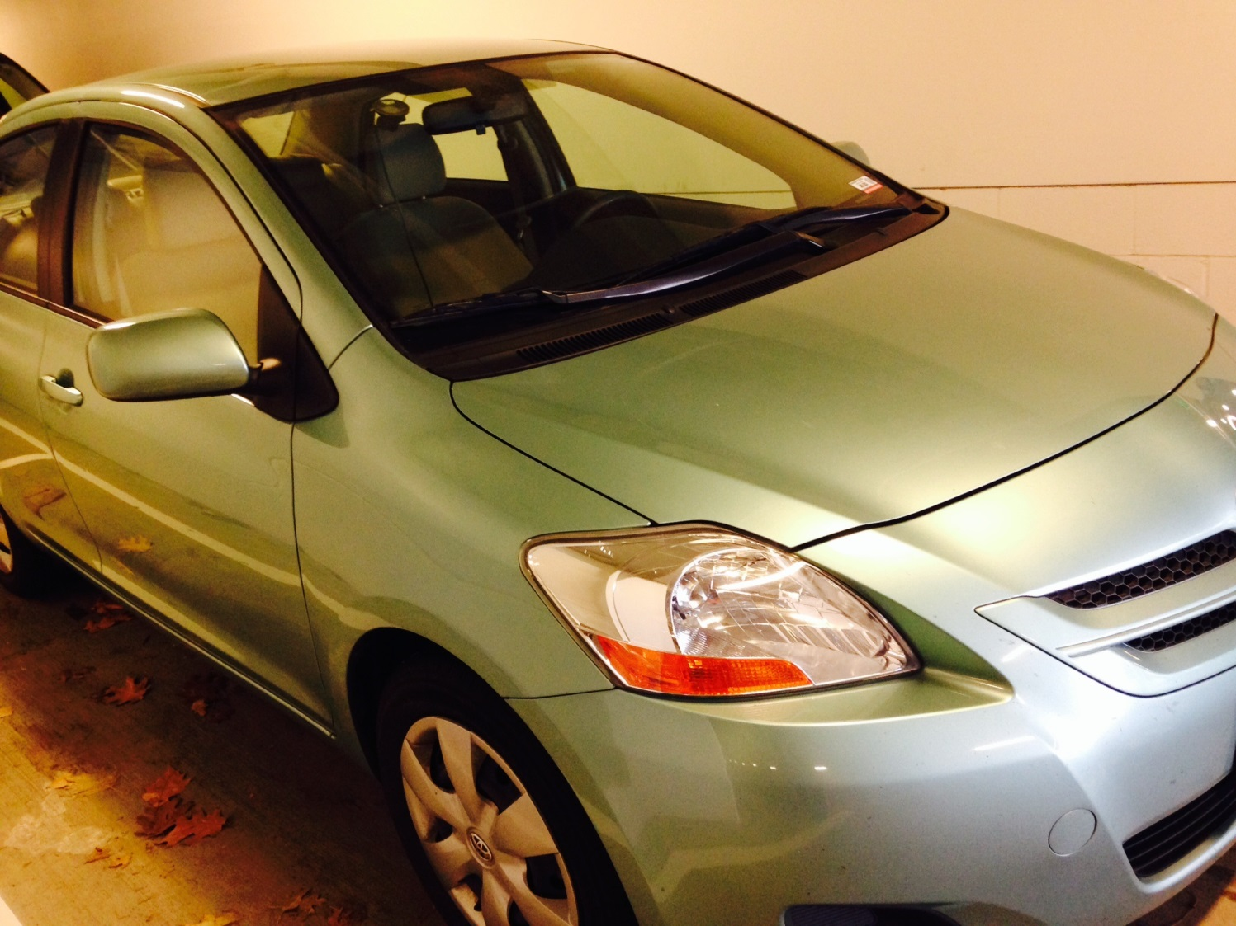
DES Energy
Notes:
Will he get into this to drive 3 hours to Ellensburg for a meeting . . .

Slide 74
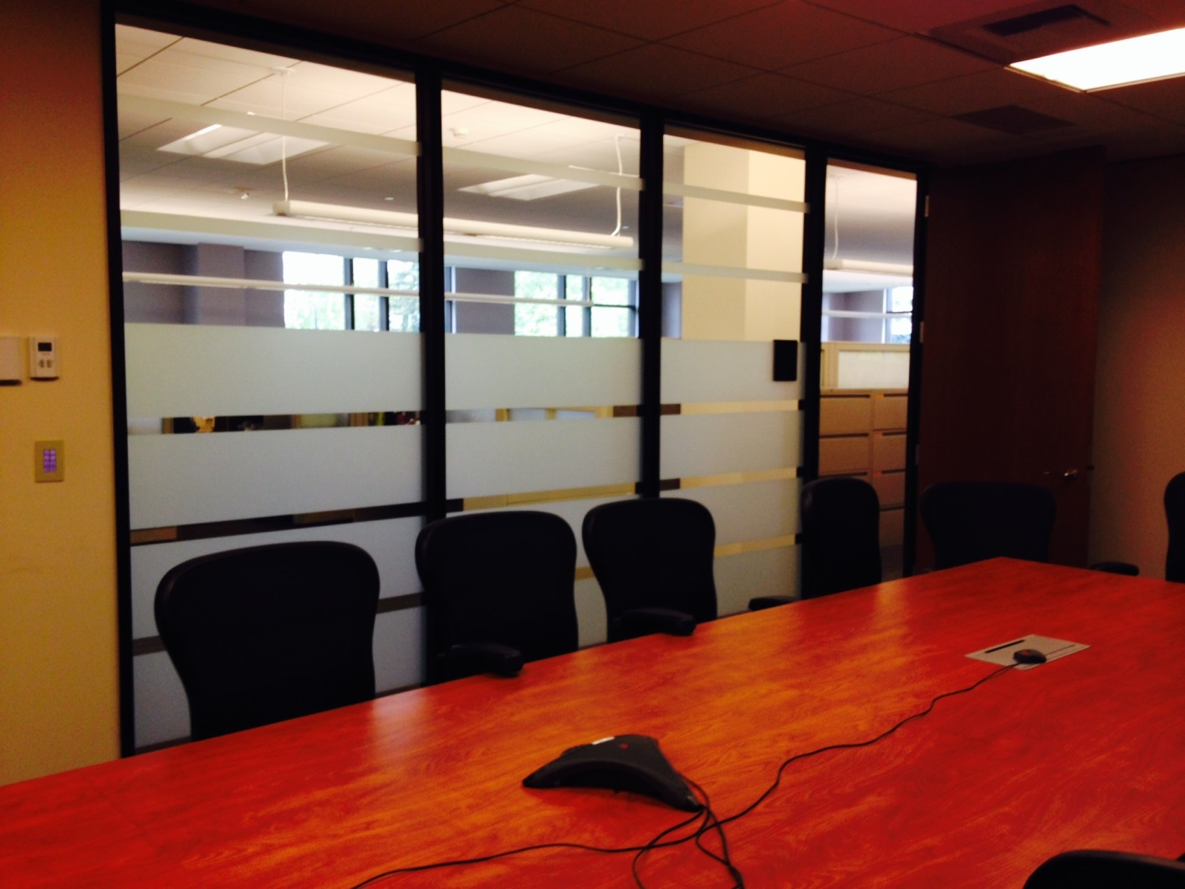
DES Energy
Notes:
In one of these? (conf room w table)

Slide 75
DES Energy
Notes:
Donovan’s generation is in the workplace now! They are in their 20s. They are Native Technology Users. They expect to be mobile. They expect IT services to work smoothly and intuitively. They can help us get this right.

Slide 76
DES Energy
NEW TERMINOLOGY:
Workplace of the Future
Workplace Strategy
Space Utilization
Teleworking
Unaddressed Work Stations
Total Workplace
Mobile Workforce
. . . And many more . . .
Notes:
Let’s talk about how the way we work is changing. There is lots of relatively new terminology out there. Should we call these changes to how we work the “Workplace of the Future”? Maybe more like the “Workplace of the Present” because it’s here now. Workplace Strategy is one way to describe it. I think of better Space Utilization as making space better fit how we work now. But you can really boil all of this down to one thing that underlies all the rest . . .

Slide 77
DES Energy
It’s All About MOBILITY
Notes:
It’s all about MOBILITY.

Slide 78
DES Energy
LOOK MOM!
NO WIRES!

Slide 79
DES Energy
Notes:
Once you untie me from my desk, I can work wherever I want. I can take my computer to a conference room to collaborate with others. I can take it to a comfy chair to concentrate on reviewing a contract. Where I am can become irrelevant. I can bring up a question to the other energy engineers in the office, or Skype them from wherever I am to get input on a project. I am more accessible to my clients.

Slide 80
DES Energy
Notes:
My files are available to me wherever I am. I can even drive less, if my clients are also using Skype. I can more easily share documents with them. Once you untie me from my desk, I am more free to work where and how I like to work. Like Donovan, I can be mobile and connected.

Slide 81
DES Energy
Paperless?
Notes:
Is there a place for paper in this mobile world? Never say never. (Play video)

Slide 82
DES Energy
Examples and Pilots
Notes:
Let’s look at some examples.

Slide 83
DES Energy
GSA HQ Example
Improved Continuity of Operations in emergencies
More efficient use of space
Better equipped for productivity
Improved recruitment and retention
Better work/life balance
Reduced commutes
Notes:
The Federal services agency, GSA has been exploring the benefits of worker mobility for 10 years or so. Benefits of mobility are described in the GSA white paper “Leveraging Mobility, Managing Place”:
Benefits to Business:
Improved Continuity of Operations in emergencies
More efficient use of space
Better equipped workforce
Improved recruitment and retention
Benefits to People:
Better work/life balance
Reduced commutes

Slide 84
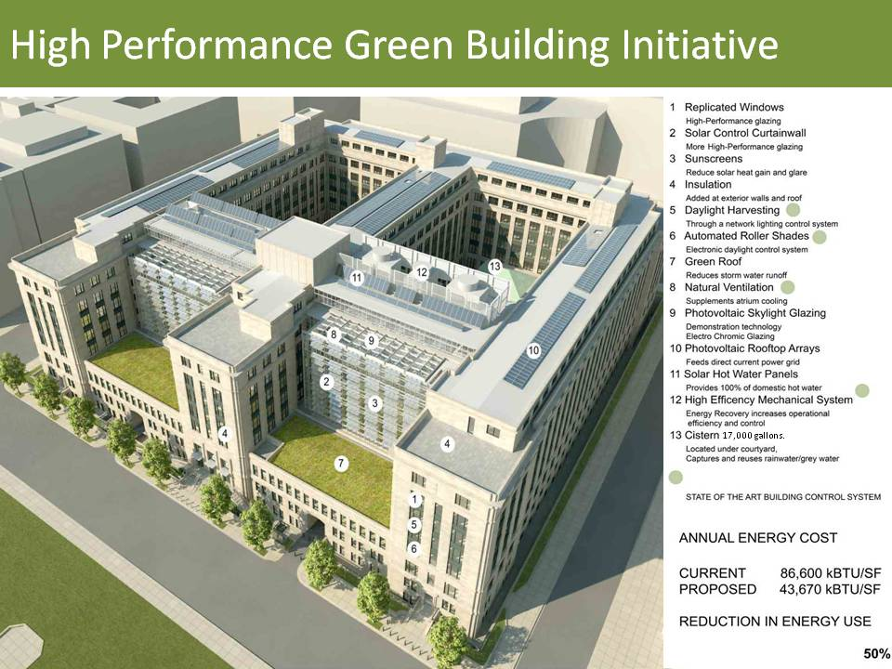
DES Energy
Notes:
Here’s the Renovation of the 1800F, the GSA HQ Building. 100 year old building. The renovation cut energy use PER SQUARE FOOT by 50%.

Slide 85
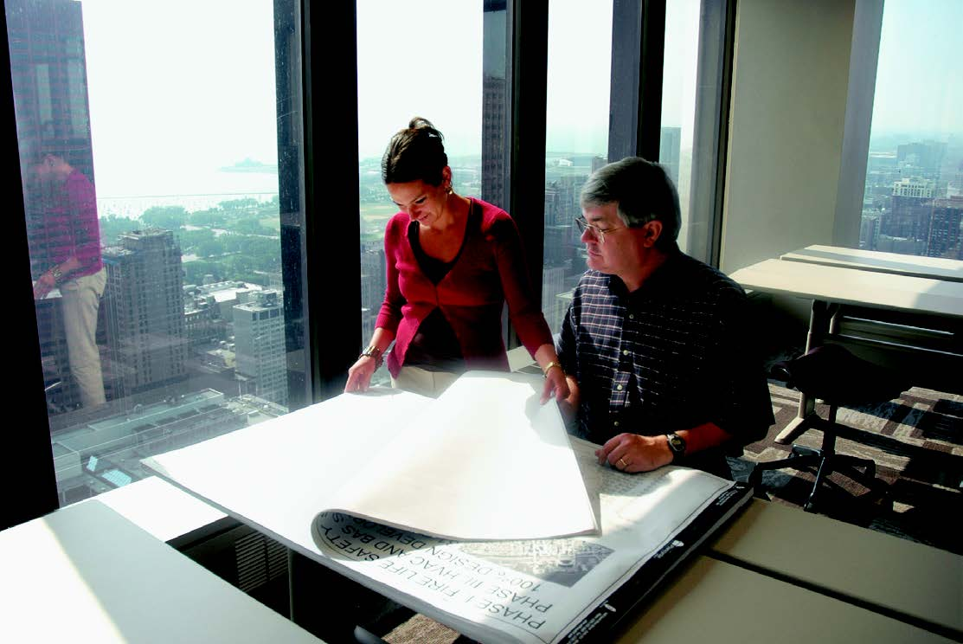
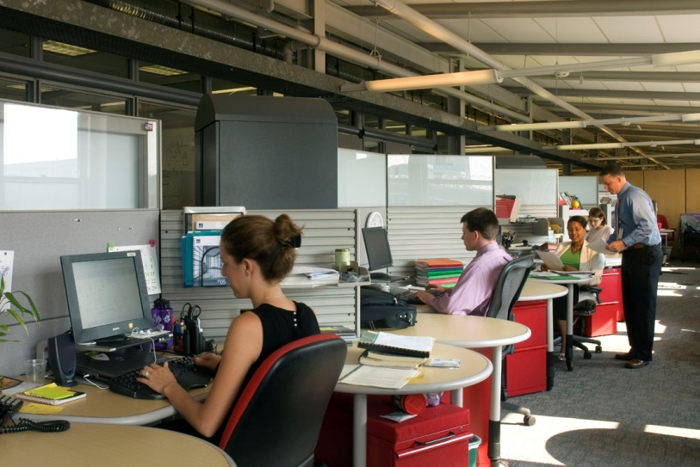
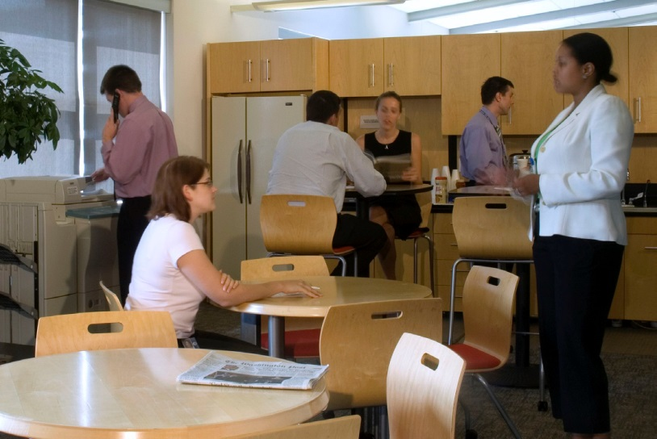
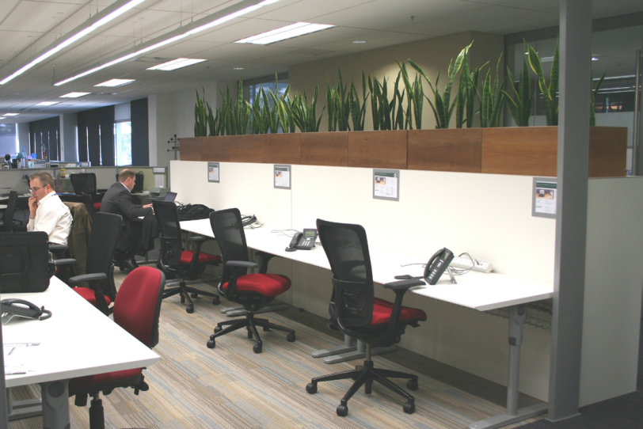
DES Energy
Notes:
The capacity of the building was also increased from 2,200 employees to over 4,000. So energy use PER PERSON was also dramatically reduced. Not by crowding people together, but by designing the space for how people work. Before the building was renovated, cubicle space was typically 40% occupied. That wasted space was used to create a variety of non-assigned spaces available for everyone to choose how and where they will work – quiet spaces, collaborative spaces, team spaces, comfy reading chairs, conference rooms.

Slide 86
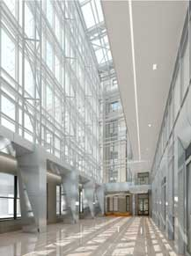
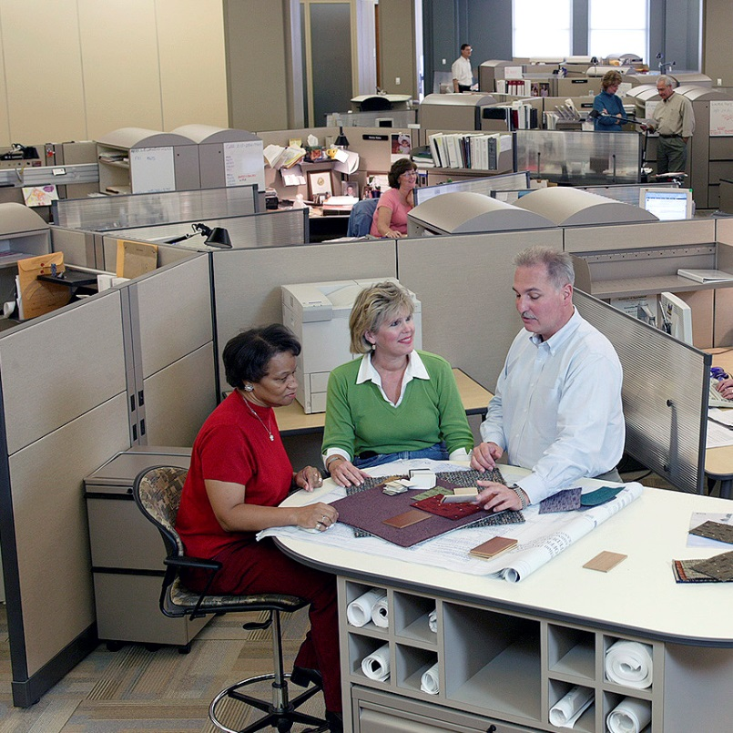
DES Energy

Slide 87
DES Energy
Notes:
GSA used the move to break up silos, rethink their organizational culture, and renew their focus on innovative customer service.
What does this have to do with Greenhouse Gas Emissions? GSA estimates that using these strategies they could reduce GHG emissions of their portfolio of Federal Offices by almost 40%.

Slide 88
DES Energy
40%

