Slide 1
OMWBE certification and the certified business directory
Caleb McInvaille | September 22, 2020

Slide 2
Agenda
What is OMWBE
Certification
Directory
Directory exercise
Q&A

Slide 3
What is OMWBE?
OMWBE is a state agency that certifies minority owned, women owned and other small businesses. OMWBE is the official certifying body for Washington state.
OMWBE works with agencies to increase their supplier diversity and spending on diverse businesses.
OMWBE works to develop and support supplier diversity and equity best practices.

Slide 4
What is Certification?
Businesses owned by women and minorities or other groups come to OMWBE.
OMWBE verifies the business is legitimate and independent, and that it meets the certification criteria.
OMWBE tracks spending on certified businesses to gauge the state of equity in public spending by the state.

Slide 5
What types of certification does OMWBE provide?
Federal Certification is a program of the US Department of Transportation. For transportation projects funded by the US Department of Transportation.
State Certification is a program of the State of Washington. Projects include any work or product state agencies and other public entities. Provides access to Linked Deposit Loan Program.
Many firms are both federally and state certified.

Slide 6
Specific types of certification
Federal Certification
Disadvantaged Business Enterprise (DBE)
Airport Concession Disadvantaged Business Enterprise (ACDBE)
Small Business Enterprise (SBE)
State Certification
Minority Business Enterprise (MBE)
Minority Women Business Enterprise (MWBE)
Women’s Business Enterprise (WBE)
Combination Business Enterprise (CBE)
Socially and Economically Disadvantaged Business Enterprise (SEDBE)

Slide 7
Certification criteria
Small business
Gross receipts under $23.98 million, and for profit
Woman or minority owned
At least 51% ownership
Controlled by woman or minority owners
Need to have knowledge/experience in the field and needs to have both legal and actual control over the company
Owners must be economically disadvantaged
Generally, net worth under $1.32 million, and income under $350,000

Slide 8
Certification criteria
Able to perform work
Business needs access to equipment, staff, and necessary licenses needed to perform it’s work
Assign firms specific NAICS codes
State certification only
Need to show that the business has registered with the Washington Secretary of State. Does not need to be a Washington Business
Federal certification only
Owner needs to be a US citizen or permanent resident

Slide 9
Certification process
Online certification application, available on our website
Detailed questions and documentation about the owner and business.
Fee: $25 for federal or both certifications, $50 – 100 for state. Similar fees for renewal
Timeline
Federal Certification – Takes up to 90 days, with an in person interview component
State Certification – Takes up to 60 days, no interview
Each application gets assigned to an analyst, who verifies the business meets the certification criteria
Renewal
Federal certification renews every year, state every three years

Slide 10
OMWBE Directory
OMWBE maintains a public directory that lists all companies we certify. The directory is available at
https://omwbe.wa.gov/directory-certified-firms
https://omwbe.diversitycompliance.com/
The directory is the official list of certified firms. If a firm appears on the directory, it is currently certified
The directory updates daily

Slide 11
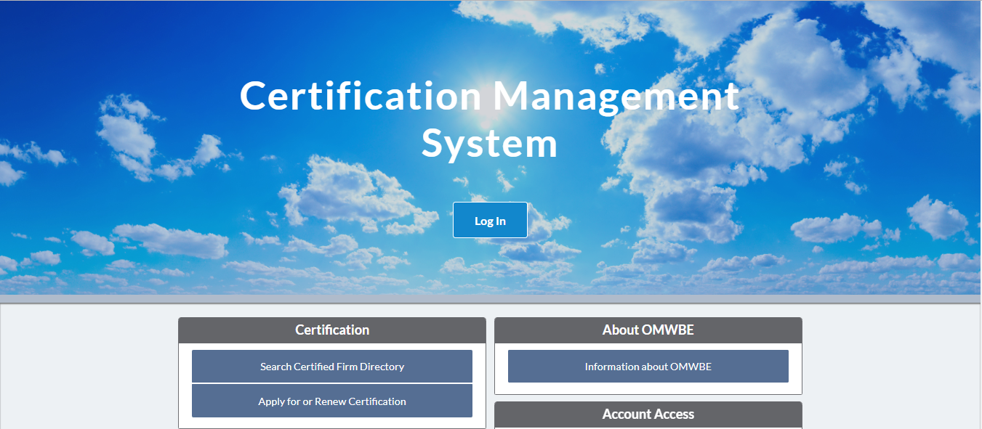
What is OMWBE?
OMWBE is a state agency that certifies minority owned, women owned and other small businesses. OMWBE is the official certifying body for Washington state.
OMWBE works with agencies to increase their supplier diversity and spending on diverse businesses.
https://omwbe.diversitycompliance.com/

Slide 12
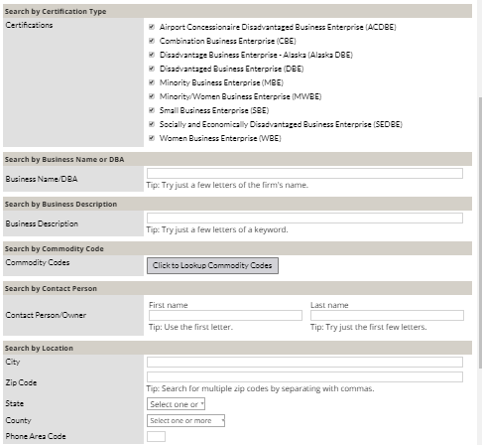
Many Ways to Search
Limit searches by
Certification type
Business Name
Business Description
Commodity Code
Contact person
Location
Reference

Slide 13
Example Search

Slide 14
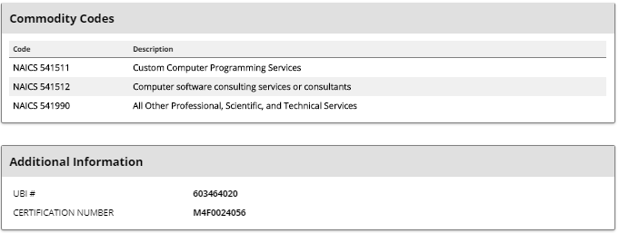
Available Information

Slide 15
Search by Certification Type
Make sure you are searching for firms with the correct certification type. Federally certified firms (DBE, ACDBE and SBE) are not always State certified (MBE, MWBE, WBE, CBE and SEDBE) and vice versa.
Special notes
The SBE that appears on the OMWBE directory is a federal certification and is not the same as the WEBS SBE self certification.
DBE firms automatically receive a SBE certification.
Some federally transportation projects require a UDBE (underutilized DBE), certification. Search for this under reference.

Slide 16
Search By Business Description
When businesses apply for certification, they include a business description along with their application. OMWBE reviews the description to ensure the business and the business owner has the ability to perform this type of work.
No general convention for drafting business descriptions.

Slide 17
Business Description Search Tips
Use fewer words, and incomplete words, particular as the second word in a search for best results.
For example “Software Developer” yields no results, and “Software Develop” yields 26 firms.
Don’t use incomplete words as the first word of a multiple word search.
For example “Soft development” yields no results.

Slide 18
Search by Commodity Codes
When businesses are certified, they receive specific North American Industry Classification System (NAICS) codes according to the work they perform.
Unlike WEBS, OMWBE verifies the firm has the equipment and expertise to perform this general type of work before assigning a code.
NAICS codes can have from two to six digits. With more digits being a more specific code. All firms are assigned six digit NAICS codes.
Six digit NAICS codes have an umbrella code, that is broad and covers multiple work types, and more specific sub-indexes.

Slide 19
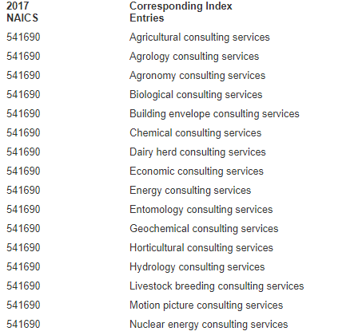
Example Code: 541690 Other Scientific and Technical Consulting Services
…..And more that do not fit on this page

Slide 20
Finding the correct codes
Finding the correct NAICS code can be difficult.
541990 - All Other Professional, Scientific, and Technical Services includes a wide variety of work, from Electronic Communications Verification, to Business Brokers.
Use NAICS drilldown tables or searches to find the correct code:
https://www.census.gov/cgi-bin/sssd/naics/naicsrch?chart=2017
https://www.naics.com/

Slide 21
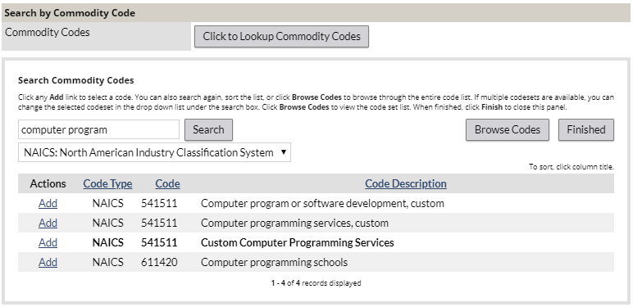
Search For Codes in the system
Bold means an umbrella code, which includes the work in other sub codes
Click “Add” to search under the code. More codes means more results.

Slide 22
NIGP to NAICS conversion tables
If you know the NIGP code that associates to the type of work, use a NAICS conversion table
http://porthouston.wpengine.com/wp-content/uploads/2016/08/NAICS_Code-NIGP_Code_Conversion_Chart.pdf

Slide 23
Commodity code search tips
Always search for the umbrella code (in bold) first, before looking for more specific codes, as it is most likely to be available.
Even if some firms come up under the umbrella code, try searching with the specific sub-code as well for more results.
Look through the codes of companies you find on searches to help you find more codes to search by.
Add additional codes if you are unsure which code is proper. More codes mean more results.

Slide 24
Exercise
Easy: looking for a graphic design firm
https://omwbe.diversitycompliance.com/
Medium: looking for a company that sells phone accessories
https://omwbe.diversitycompliance.com/
Impossible: looking for a management consultant in Garfield County
https://omwbe.diversitycompliance.com/

Slide 25
Additional tips
If you’re not finding any firms, start with a very broad keyword in the business description, and narrow down your search from there.
Even if some firms come up under the umbrella code, try searching with the specific sub-code for more results.
Look through the codes of companies you find on searches to help you find more codes to search by.
You can always search by multiple areas, such as limiting to graphic design firms in King County.
We are always available to help if you have any questions about certification, or are having difficulty getting information about a firm.
Call (360) 664 – 9750 and one of our analysts can help.

Slide 26
Questions?
Caleb McInvaille | CalebM@omwbe.wa.gov | (360) 664-9751

