Slide 1
City of Pasco
Zone 3 Reservoir Storage Tank
Project Review Committee | Project Approval
June 24, 2021

Slide 2
CITY OF PASCO ZONE 3 RESERVOIR STORAGE TANK ORGANIZATIONAL CHART
Dave Zabell Pasco City Manager
Robynne Thaxton JD, FDBIA DB
Legal Counsel
Thaxton Parkinson, PLLC
Steve Worley Project Director Director of Public Works
Maria Serra, PE CIP Manager – Design Advisor
Kent McCue, Construction Manager – Construction Advisor
Construction Manager
Construction Manager
Construction Manager
D-B RFQ/RFP - 10%
Design - On-call
Construction - On-call
D-B RFQ/RFP - 10%
Design - 10%
Construction - 10%
On-call for all Services
Matt Walker, AIA, CCM, DBIA Principal-in-Charge/Advisor Hill International, Inc.
Becky Blankenship, DBIA Project Manager
Hill International, Inc.
Brittany Whitfield, PE
Senior Engineer
City of Pasco
Construction Manager
D-B RFQ/RFP - 10%
Design - 5%
Construction - 5%
D-B RFQ/RFP - 90%
Design - 90%
Construction - 50%
D-B RFQ/RFP - 50%
Design - 50%
Construction - 75%
Lorraine Mead, PE, LEED AP, DBIA
Scheduler Hill International, Inc.
Patrick McCord, DBIA Senior Estimator Hill International, Inc.
Debbie Selzer Document Controls Specialist Hill International, Inc.
D-B RFQ/RFP - 10%
Design - 10%
Construction - 15%
D-B RFQ/RFP - 10%
Design - 10%
Construction - 15%
D-B RFQ/RFP - 10%
Design - 10%
Construction - 15%
Notes:
Steve – 1 min

Slide 3
Zone 3 Reservoir Storage Tank
Project Overview
Proposed 3.5 MG potable water, elevated reservoir
Current regional water distribution – serves 73,000 residents
Population projected to nearly double in next 20 years
Current combined storage capacity deficit of ~4.31MG
Potential 0.5MG increase in demand from new industrial customer
Deficit projected to increase to 4.96MG in 2023
Most immediate water storage need is within Zone 3
Scope includes land acquisition, reservoir design/construction
Increases system resiliency
Addresses a current system deficiency
Contributes to reliable water service for current/future ratepayers
Supports economic development
Notes:
Maria– 2 min

Slide 4
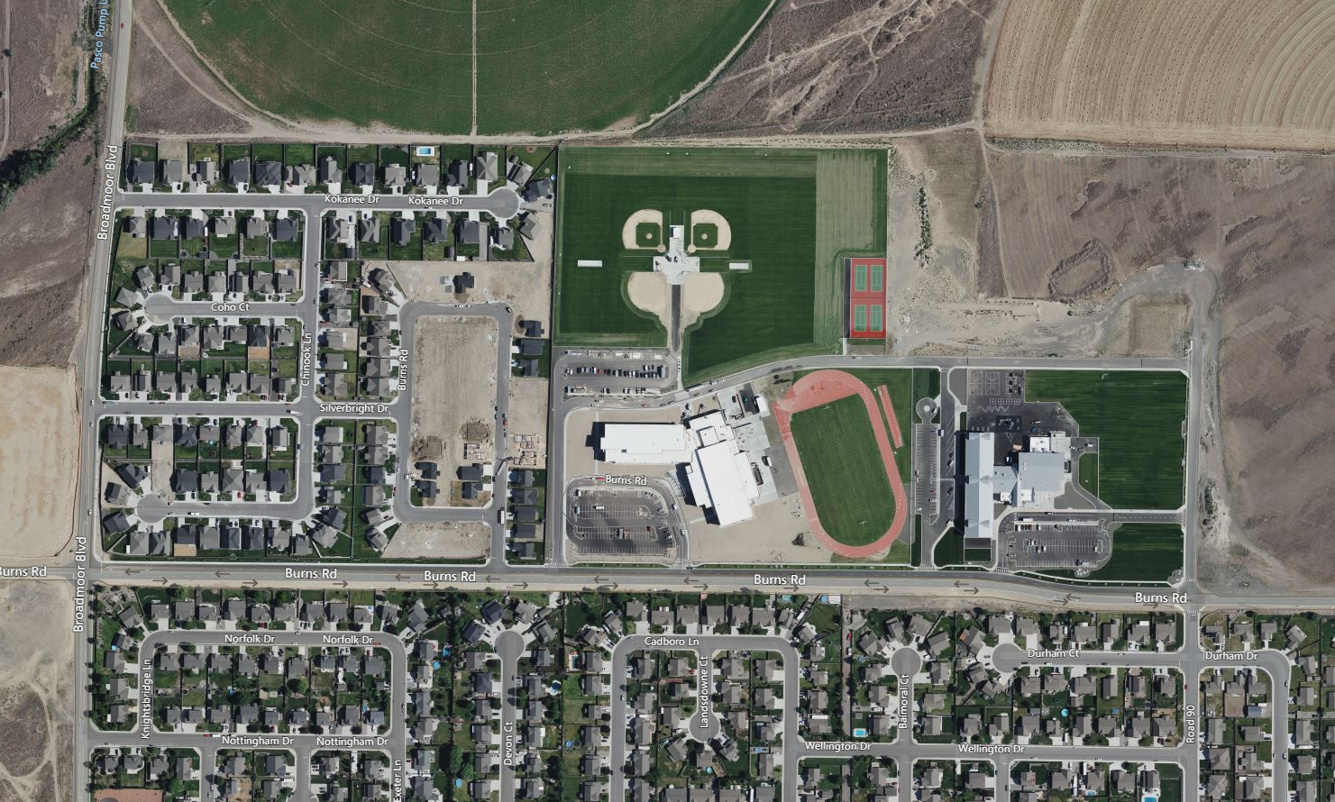
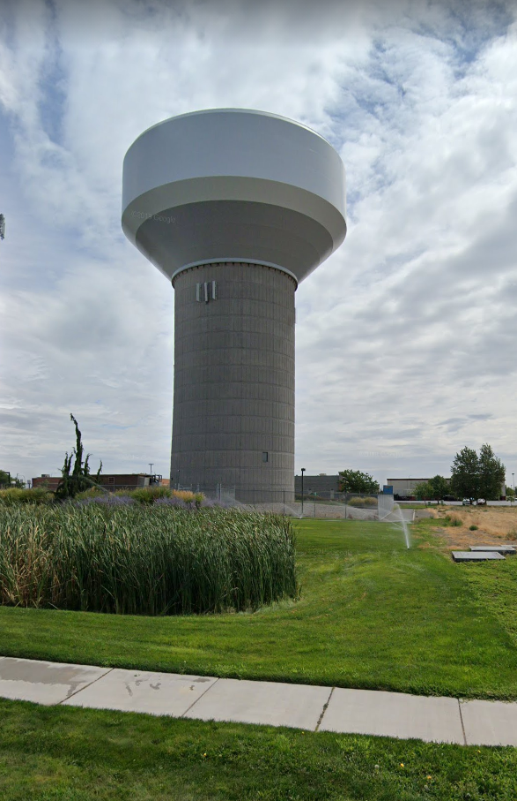
Zone 3 Reservoir Storage Tank
Project Overview
Notes:
Brittany - 1 min

Slide 5
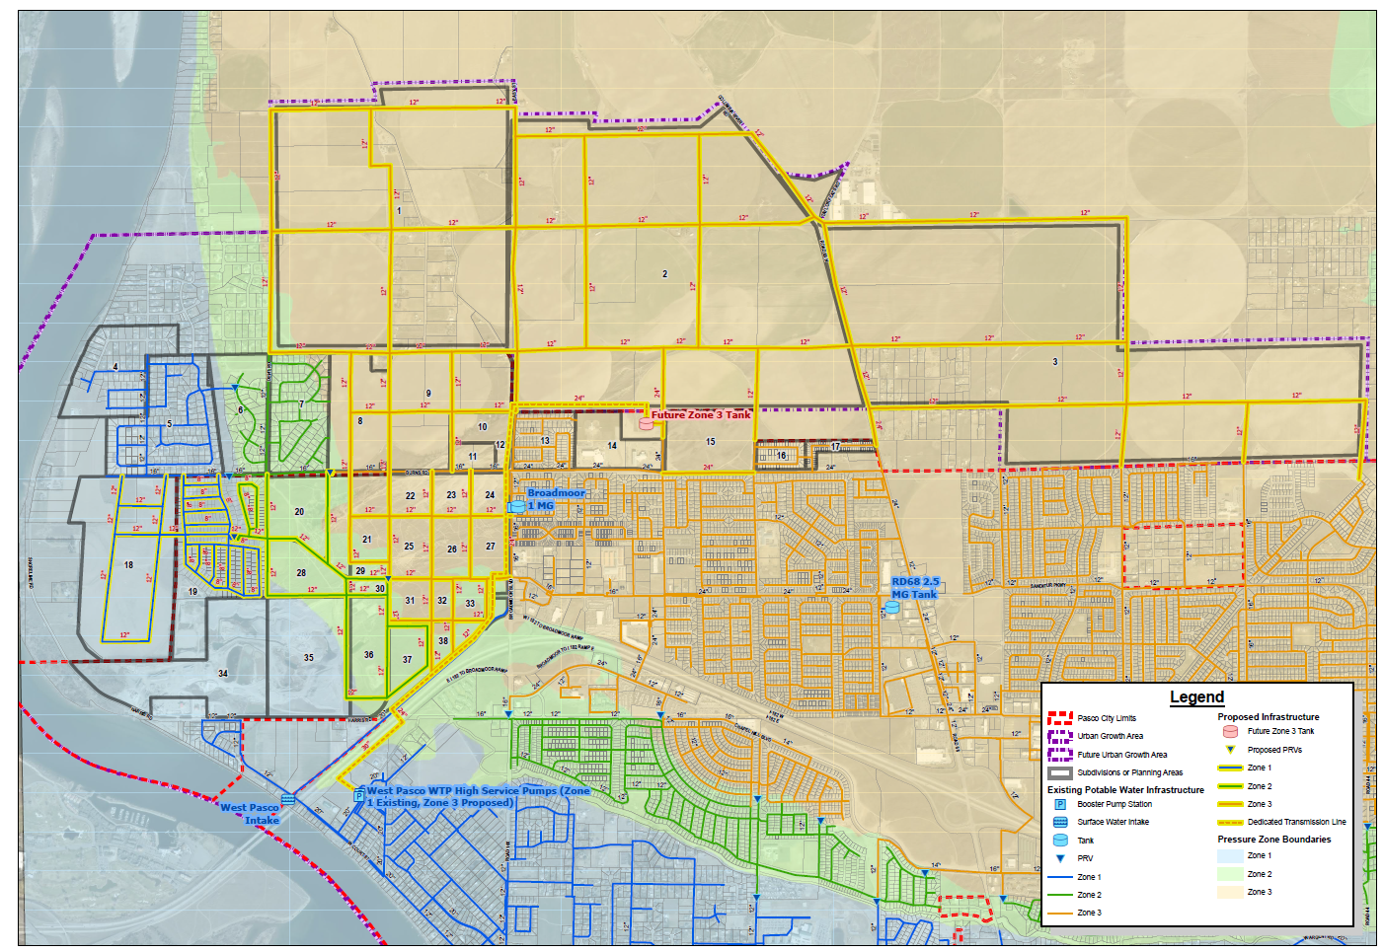
Zone 3 Reservoir Storage Tank Proposed water System Plan
Notes:
Brittany - 1 min

Slide 6
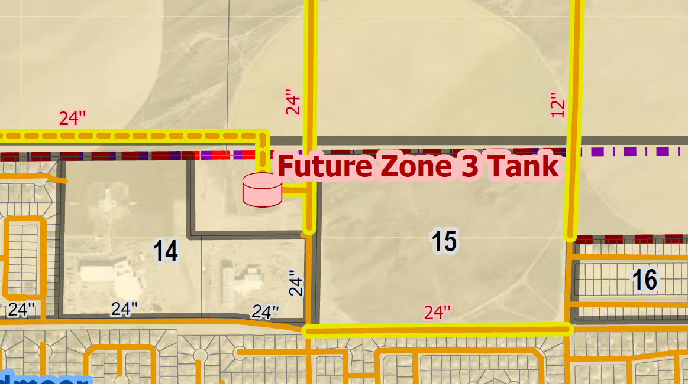
Zone 3 Reservoir Storage Tank
Project Overview
Notes:
Brittany - 1 min

Slide 7
Zone 3 Reservoir Storage Tank
Preliminary Project Budget
Professional Services $ 650,000
Construction Cost $ 9,490,000
Contract Admin/Other $ 1,060,000
Other Related Project Expenses $ 500,000
Total Project Cost $ 11,700,000
Notes:
Maria- 2

Slide 8
Zone 3 Reservoir Storage Tank
Preliminary Project Schedule
D-B RFQ Advertisement Jun 25, 2021
D-B SOQs Due Jul 29, 2021
Announce Shortlist Aug 13, 2021
Issue RFP Aug 18, 2021
Proposal Due Sept 30, 2021
DB Team Interviews Week of Oct 4, 2021
Selection of DB Team Week of Oct 25, 2021
NTP/Design Phase Nov 15, 2021
Validation/Set GMP Nov 2021 - Mar 2022
Phase 2/Construction NTP Mar 21, 2022
Substantial Completion Jun 30, 2023
Notes:
Becky – 1 min

Slide 9
Zone 3 Reservoir Storage Tank
Procurement Approach
Request for Qualifications
Successful Experience w/Projects of Similar Scope and Complexity
Team Organization
Experience developing GMP collaboratively with Owner
Shortlist no more than three finalists
History in soliciting and/or utilizing OMWBE subcontractors
Include draft contract
Request for Proposal
Management approach specific to the project
Innovation and Problem Solving
Interactive Proprietary Meetings
Statutorily required evaluation factors, SBE/DBE inclusion plan
Price related factor: Fee
$5,000 honorarium
Limited required proposal submittals
Consistent with other projects
Notes:
Robynne – 2 min

Slide 10
Zone 3 Reservoir Storage Tank
OMWBE Inclusion Strategy
Outreach to industry organizations (AGC, ASCE, etc.), encourage participation of OMWBE Certified & small businesses
RFQ: past performance of utilization of OMWBE Certified Businesses
RFP: Inclusion Plan for Certified & small businesses, included in scoring criteria
Notes:
Robynne – 1 min

Slide 11
Zone 3 Reservoir Storage Tank
Benefits of Design-Build Delivery
RCW 39.10.300(1)(b) “Greater Innovation or efficiencies between the designer and the builder”
Maximum possibility for coordination of design and construction phasing to provide greatest project value, cost efficiency, and design for a water storage reservoir with above average capacity and unique structural requirements.
RCW 39.10.300 (1)(c) “significant savings in project delivery time”
Progressive Design-Build is the fastest delivery method. Starting construction work prior to completion of design results in a significantly reduced schedule.
An earlier completion date for the Zone 3 Reservoir Water Storage project will avert the water shortage projected in 2023 for the Zone 3 area. This is critical for serving the critical needs of the Pasco community as soon as possible.
RCW 39.10.280(2)(a) “Substantial Fiscal Benefit”
The budget is limited to fit within the City’s project budget. The Design-Builder will be required to design within that budget.
The Design-Builder’s involvement in the development of the scope shifts more risk of the performance of the project to the design-build team.
Notes:
Robynne – 2 min

Slide 12
Zone 3 Reservoir Storage Tank
Additional Questions
QUESTION
Has a site been identified?
QUESTION
Have negotiations begun and to what extent have you allowed for this acquisition in the project schedule?
QUESTION
Do you anticipate the PDB to be involved in the land acquisition process?
Notes:
Steve – 2 min

Slide 13
Open Discussion

Slide 14
Thank You!

