Slide 1
Skyline Hospital Modernization Project
Presentation for PRC Approval GCCM Project Delivery
September 26, 2019

Slide 3
Agenda – Dick
Introductions - Dick
Skyline Hospital - Robb
Project Team - Dick
Purpose of GCCM Application - Dick
Project Description - John
Benefits of GCCM Project Deliver – Dick
Schedule - Dick
Summary/Questions - Robb

Slide 4
Skyline Hospital-Robb
Originally constructed in 1952 through the Hill-Burton Act, with the addition of one wing in the early 1970’s. A second $2.7 million renovation in 1998 enhanced the facility with a surgery suite, an emergency room, physical therapy building, laboratory and admitting area. A year later, the hospital purchased an adjoining seven-acre parcel of land to facilitate long-range plans
2010 $15M Patient Bed Wing GCCM Process
More recently, Skyline has added specialty services to better serve the community. These include:
General Surgery
Infusion Services
Podiatry
Current Status is a Critical Access Hospital
Importance Of Modernization Project
Goals and Expectations

Slide 5
Project Team -Dick
Skyline Hospital-Robb Kimmes CEO
Overall Responsibility
DBPMLLC-Dick Bratton PM/Owner Rep
Project Management
Onset to Completion
Ongoing GCCM Experience w/SPMC /LCCHC/Samaritan/KVH
Blue Room-John McLean AOR
Variety of GCCM Project Experience
Considerable Healthcare Experience
GCCM Credible A/E Team Composition
Foster Pepper - Counsel
Contract Experience with RCW 39.10
AIA A133/201 and AIA B133 in draft form

Slide 6
Purpose of GCCM Application-Dick
Skyline Hospital Project Importance
Project Meets GCCM Criteria
Critical Scheduling, Phasing, Transition
Early GCCM Interaction Required for Successful Project
3 step selection process
Schedule and Operational Management
Keep all functions operational during construction
Cost Advice
Rural Remote Location
Early Team Interaction for Scope Evaluations/Options
Benefit to Community
Skyline Hospital Team Fully Prepared

Slide 7
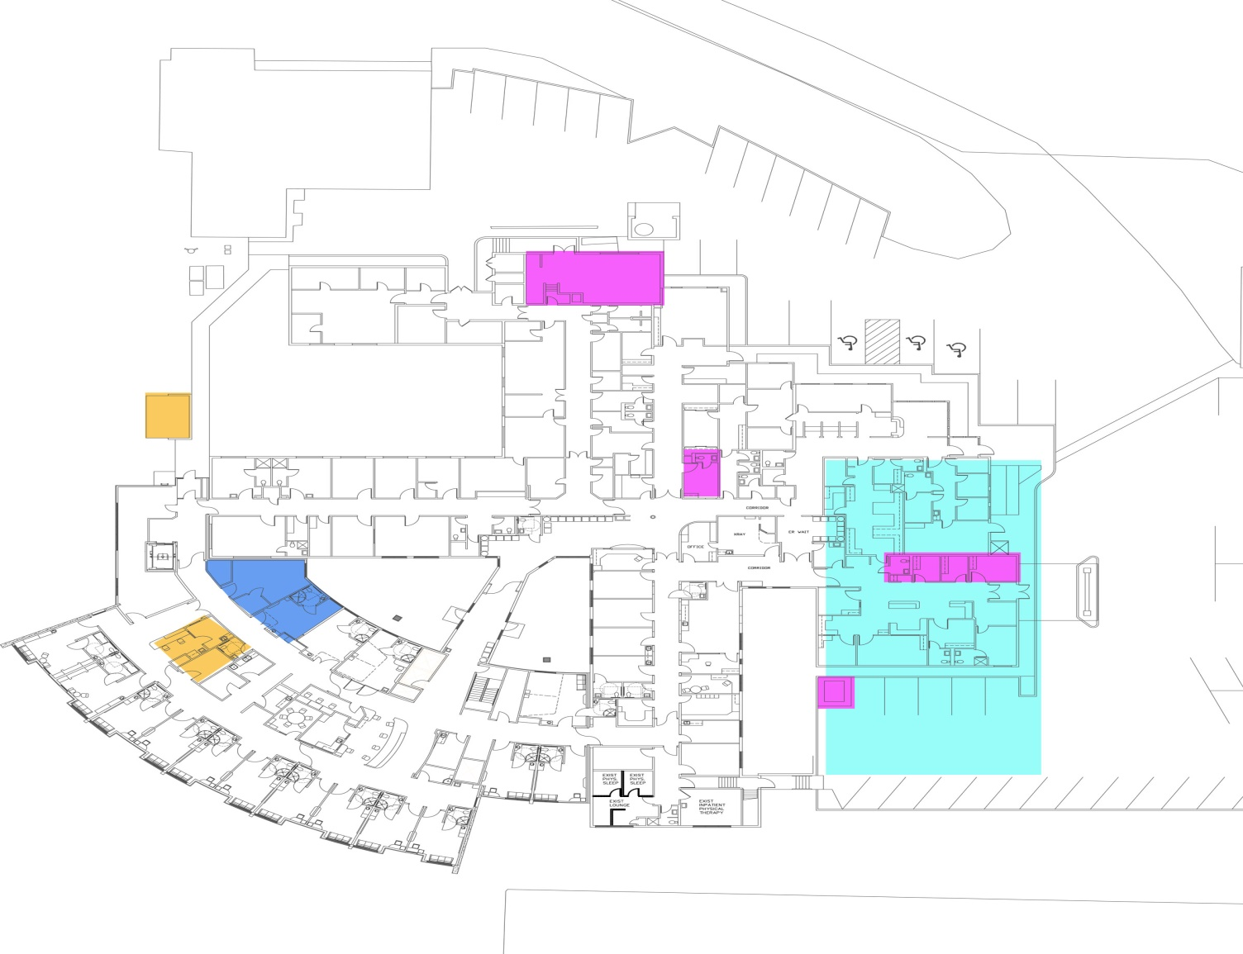
Project Description-John

Slide 8
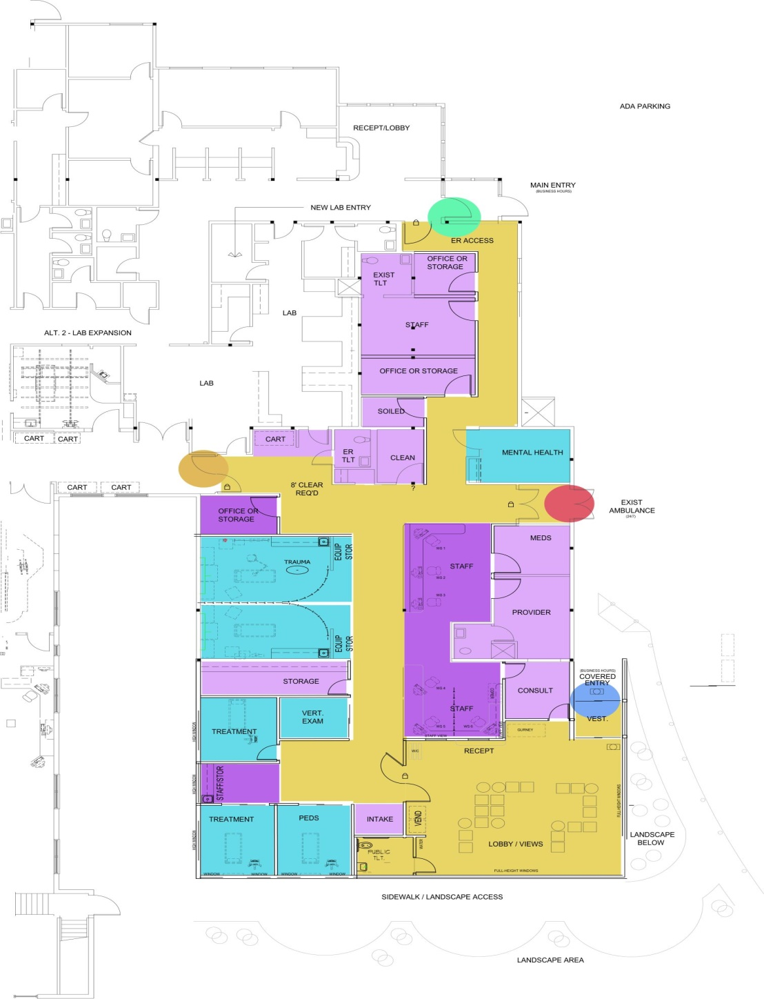

Slide 9
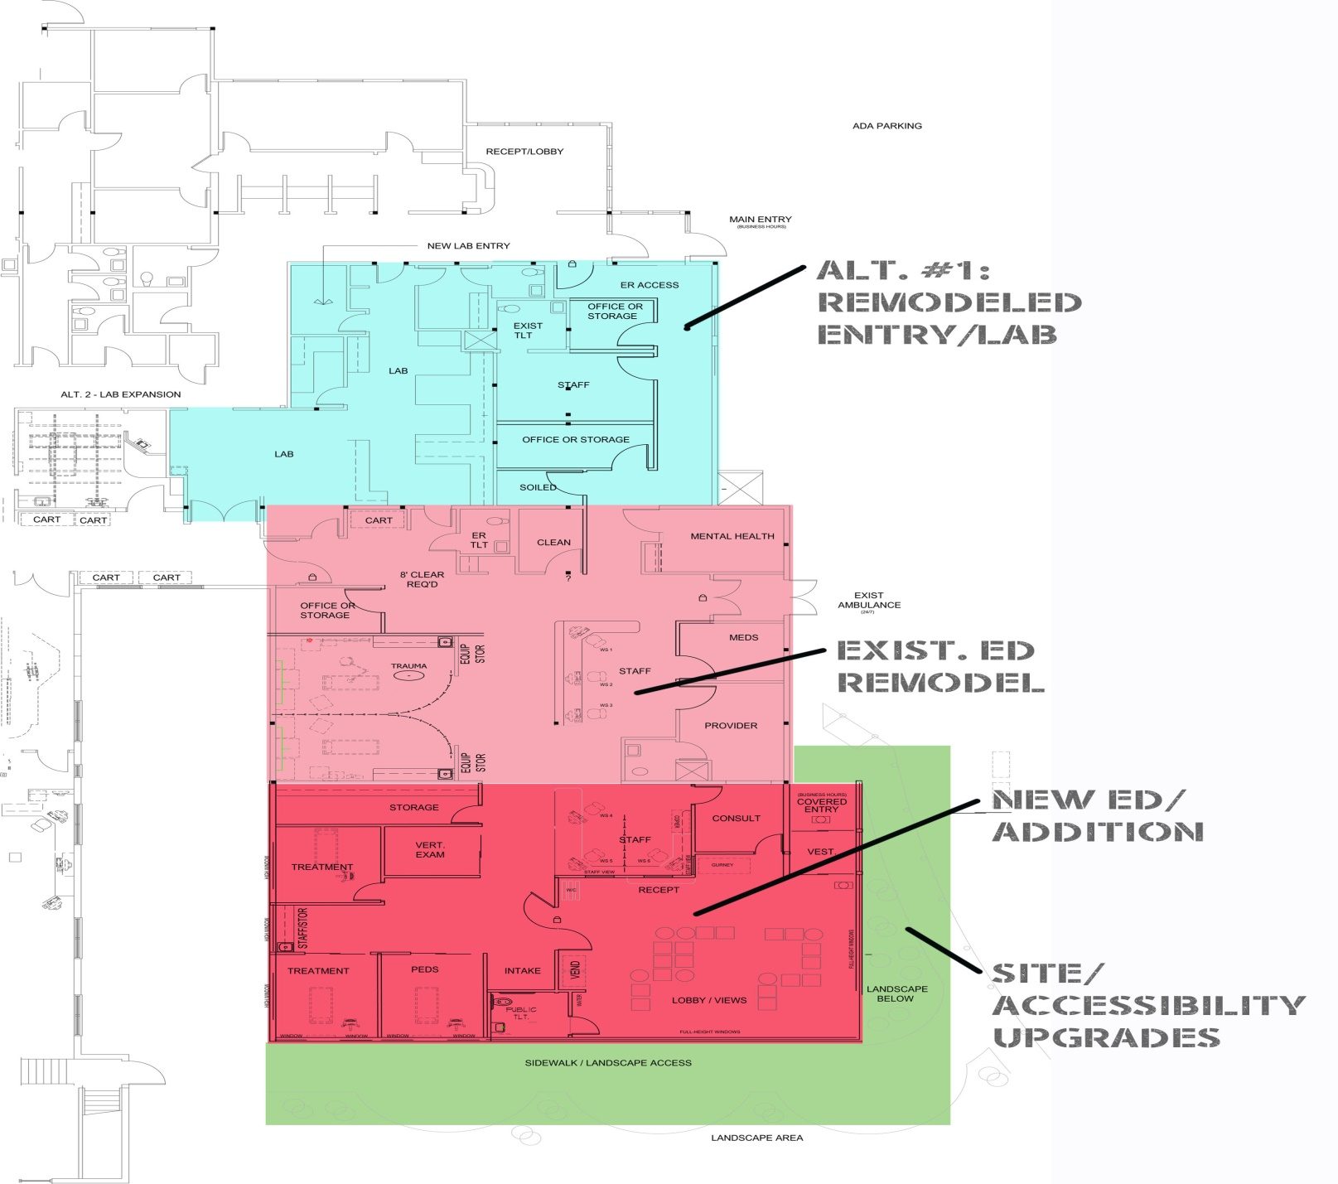

Slide 10
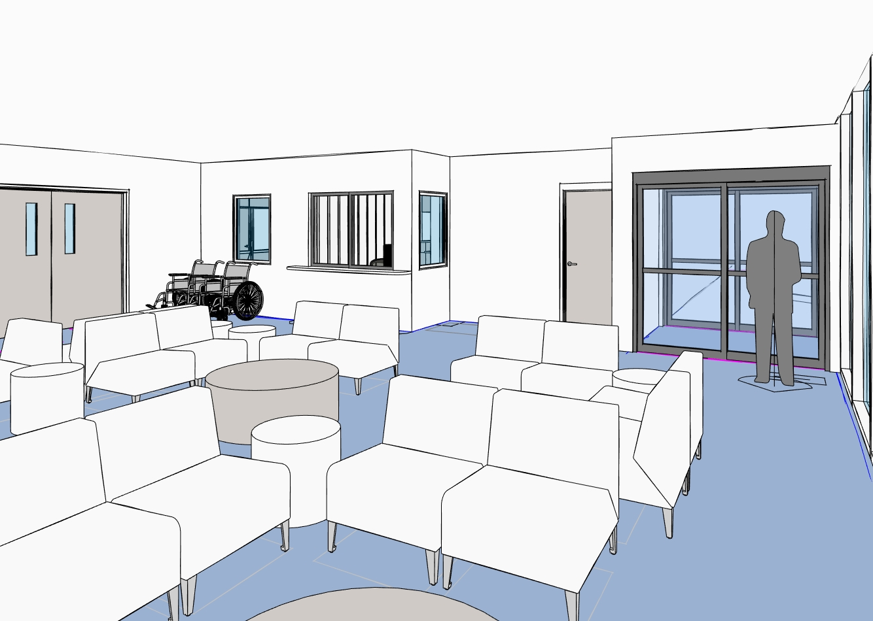

Slide 11
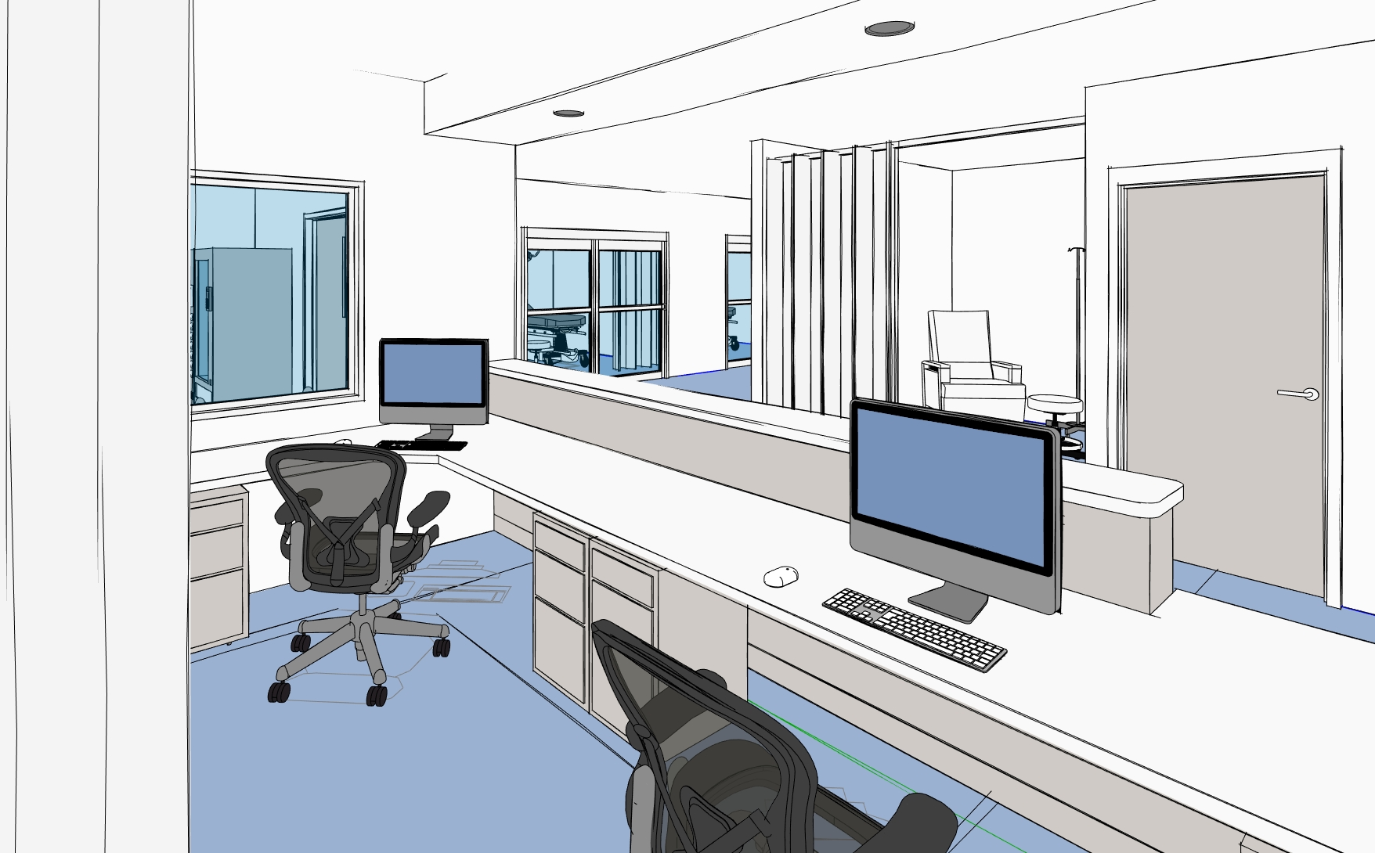

Slide 12
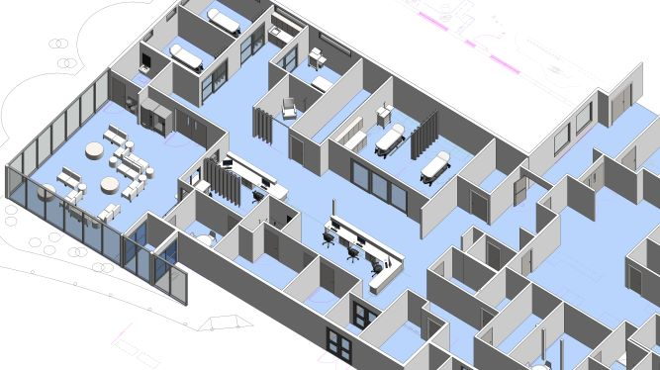

Slide 13
Benefits of GCCM Project Delivery-Dick
Owner/Designer/Contractor Collaboration
Utilize Team Expertise Early at DD
Compliant to RCW 39.10 Policies & Procedures
Review of Hospital Operations Challenges
Establish Budget/Provide DD with Budget Advice
Identify and Coordinate Long Lead Items
Full CD Set Detailed with GCCM Input
MACC at 90% CD, VE and Budget Reconciliation
Interactive Design/Contractor/PM Team Group Effort for BIM Modeling and Clash Mitigation
GCCM Influence and Coordination of Move Transition

Slide 14
Schedule-Dick
GC/CM PCARB Application Submittal August 20, 2019
SH PRC Presentation September 26, 2019
GC/CM Delivery Approval October 7, 2019
Official State Authority Notice October 2019
GC/CM RFQ Due November 2019
GC/CM Interviews November 2019
GC/CM RFFP-Selection November 2019
DD Design Complete / Baseline Estimate January 2020
Baseline MACC 90% Construct Docs February 2020
Construction Docs 100% March 2020
Permitting March 2020
Final MACC March 2020
Site Mobilization April 2020
Construction Completion May 2021

Slide 15
Summary-Robb
Applicant Final Comments
Questions

