Slide 1
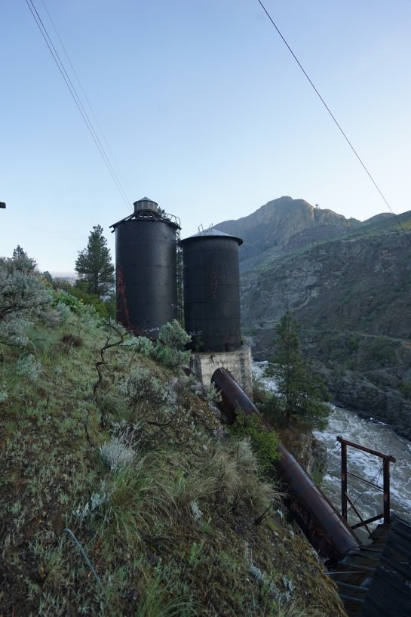
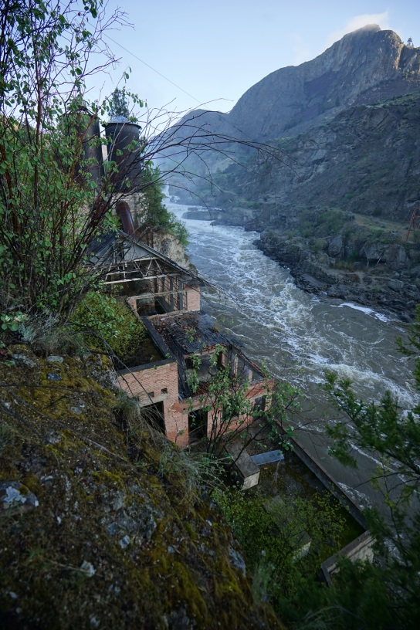
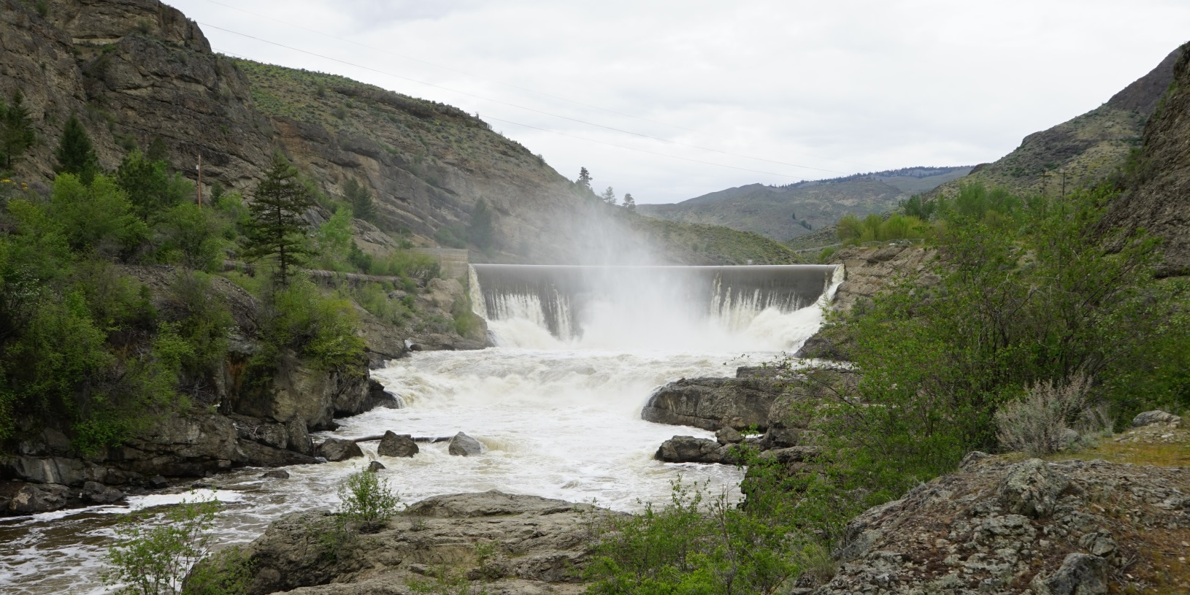
Okanogan PUD | Enloe Dam
Project Review Committee | Project Approval Presentation |
Design Build Contracting
April 27, 2017

Slide 2
Overview
District Background
Project Location, History and Scope
District’s Goals
Team Organization Chart
Project Budget and Schedule
Approach to D-B Procurement and Agreement
Benefits of Design Build Approach
Questions

Slide 3
District Background
Public Utility District No. 1 of Okanogan County (District) serves the electricity and broadband needs of Okanogan County, the largest county in the state of Washington @ 5315 sq-miles).
District formed by voters in 1939 and has a Board consisting of three elected officials serving six year terms on a staggered basis.
In 1945 District completed purchase of Washington Water Power electric system (including Enloe Dam and Power Plant).
TODAY-
~100 Employees serving 15,700 customers
104 miles of 115-kV transmission line and 16 substations.
1373 miles of overhead and 437 miles of underground distribution line.
Main electric power sources – BPA, Wells Hydro, Nine Canyon Wind Farm
Standard and Poor’s A bond rating; Moody’s A1 bond rating
Enloe Dam and retired power plant

Slide 4
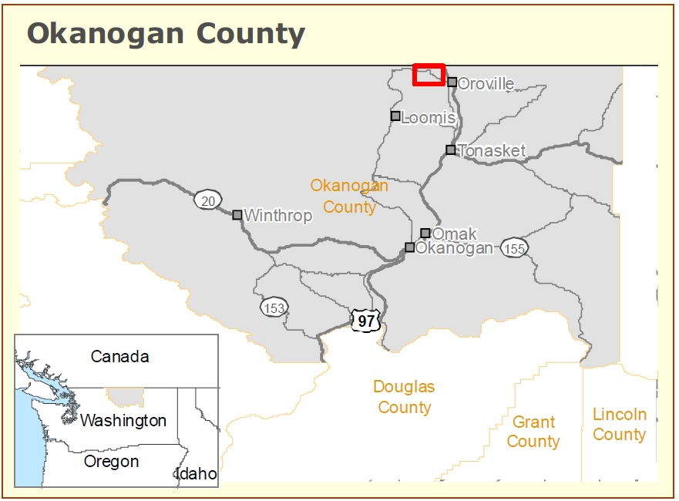
Project Location

Slide 5
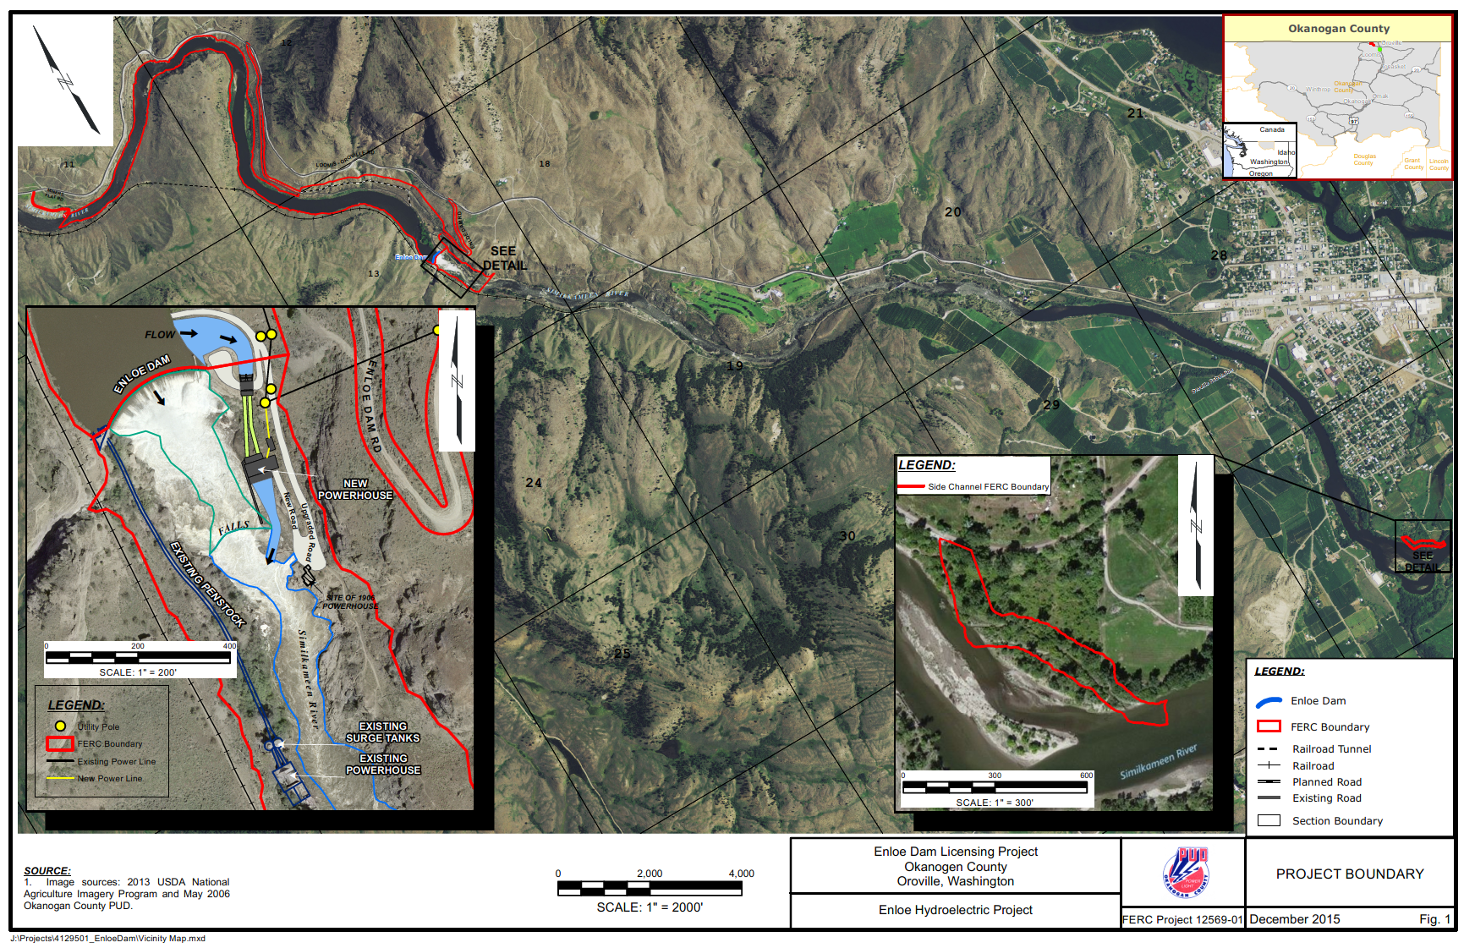
Project Map
Location – Similkameen River 3.5 miles NW of Oroville, WA.
A 50 Year FERC License for a 9 MW power plant issued July 2013.

Slide 6
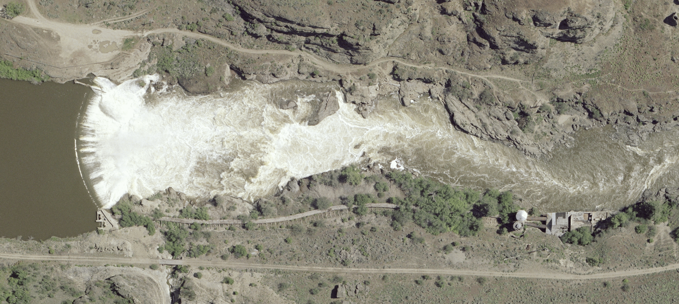
Enloe Dam History
Dam and 3.6-MW hydroelectric power plant constructed in 1920s.
Power plant decommissioned in 1958 when low-cost electric power from Bonneville System became available.

Slide 7
New Power Plant

Slide 8
SCOPE – New Power Plant
Enloe Dam Modifications – Addition of crest gates and outlet works,
Power Headworks - New intake channel, power intake, and penstocks on the east bank next to the existing dam,
Power Plant - New 9-MW hydroelectric power plant and tailrace channel on east bank of the river downstream of the existing dam,
Interconnection - New electric substation and a short interconnection to the District’s existing distribution system.

Slide 9
SCOPE – New Power Plant

Slide 10
SCOPE – New Power Plant
Enloe Dam Modifications – Addition of crest gates and outlet works,
Power Headworks - New intake channel, power intake, and penstocks on the east bank next to the existing dam,
Power Plant - New 9-MW hydroelectric power plant and tailrace channel on east bank of the river downstream of the existing dam,
Interconnection - New electric substation and a short interconnection to the District’s existing distribution system.
Other Features
Improvements to public recreation facilities.
New fish habitat enhancement facilities.
Electric Power Generation - Estimated average output - 45 GWh/year.

Slide 11
District Goals
Cost - Minimize cost of owning Enloe Dam including incremental costs and benefits of hydropower generation.
Project Finance, Operations and Maintenance – Best fit with District’s ongoing commitments, operations and resources.
Quality – Meet electric utility quality standards.
Safety – Maintain safety of human life and property.
Climate Change – Help reduce carbon emissions.
Environment – Resource stewardship and enhancement.
Compliance – Comply with laws, permits and approvals.
Collaboration – Partnership with D-B Team and Regulators.
Risk – Best allocation between participants.
Schedule – Meet milestone dates in FERC License.

Slide 12
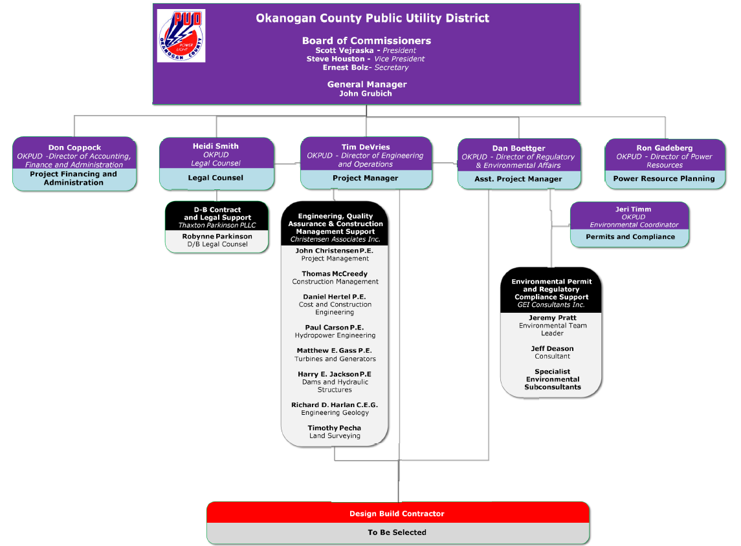
Team Organizational Chart

Slide 13
Project Budget
Item | Cost ($)
Professional Services | $5,807,000
Design & Construction Costs | $15,050,000
Equipment and Furnishings | $9,879,000
Contingencies | $4,415,000
Other Related Project Costs | $4,653,000
Use Tax | $2,696,000
Total | $42,500,000

Slide 14
Activity & Schedule
ACTIVITY | SCHEDULED DATES
D-B Project Management Consultant | COMPLETE
PRC Approval | 12/01/2016 APPROVED Subsequently revoked 3/15/2017 due to appeal
Issue D-B RFQ | December 13, 2016
D-B SOQ’s Due | January 13, 2017 Received SOQ’s from 9 Firms AECOM, ASI, CF MALM, GRAHAM, KIEWIT, MAX KUNEY, McMILLEN JACOBS, MOUNTAIN STATES HYDRO, SNC LAVALIN/AECON
Short List Firms/Issue D-B RFP | February 17, 2017
Proposals Due | March 31, 2017
New PRC Hearing | April 27, 2017
Award D-B Contract | May 15, 2017

Slide 15
Design- Build Procurement
RFQ
Team Organization
Successful Experience with Projects of Similar Scope and Complexity
Experience developing GMP collaboratively with Owner
Shortlist - no more than five finalists (District shortlisted four)
RFP
Approach to meeting District Goals
Interactive Proprietary Meetings
Innovation/Problem Solving
Collaboration approach with District and Regulators
Honorarium - $10,000
Alternate DBFOM proposals invited

Slide 16
Design-Build Agreement
Validation Period
Validate information from the Owner.
Refine owner requirements and project scope.
Develop design criteria - Basis of design documents.
Innovation and value engineering options.
Permitting/Compliance approach.
Develop target schedule and budget.
Develop GMP, Fixed Price or other price approach.
Update schedule
Contract amendment.
2. Execution Period
Complete permitting in collaboration with District
Ongoing regulatory compliance with District.
Complete engineering design.
Equipment procurement.
Construction.
Operation & Maintenance (Optional).

Slide 17
Benefits of Design-Build Approach
RCW 39.10.280(2)(a) “will provide a substantial fiscal benefit”
Innovation, cost savings and other benefits from value engineering executed by the District/D-B team.
Cost-risk benefits in allocating design, integration and performance risk to the D-B team.
Alternative financing, operations and maintenance proposal will provide District with significant benefit.
RCW 39.10.300(1)(a) “The construction activities are highly specialized and a design-build approach is critical in developing the construction methodology”
Hydro power plant construction requires close collaboration between designer, generating equipment supplier and installation contractor.
RCW 39.10.300(1)(b) “The projects selected provide opportunity for greater innovation or efficiencies between the designer and the builder”
Early contractor involvement to address constructability issues, develop practical construction plans and to finalize environmental plans and protection measures.
Integration of design, permitting, procurement and construction of power facilities creates opportunities for innovative and cost-effective solutions.
RCW 39.10.300(1)(c) “significant savings in project delivery time would be realized”
Project delivery time reduced by early initiation of equipment procurement and by overlapping final engineering design with equipment procurement and construction.

Slide 18
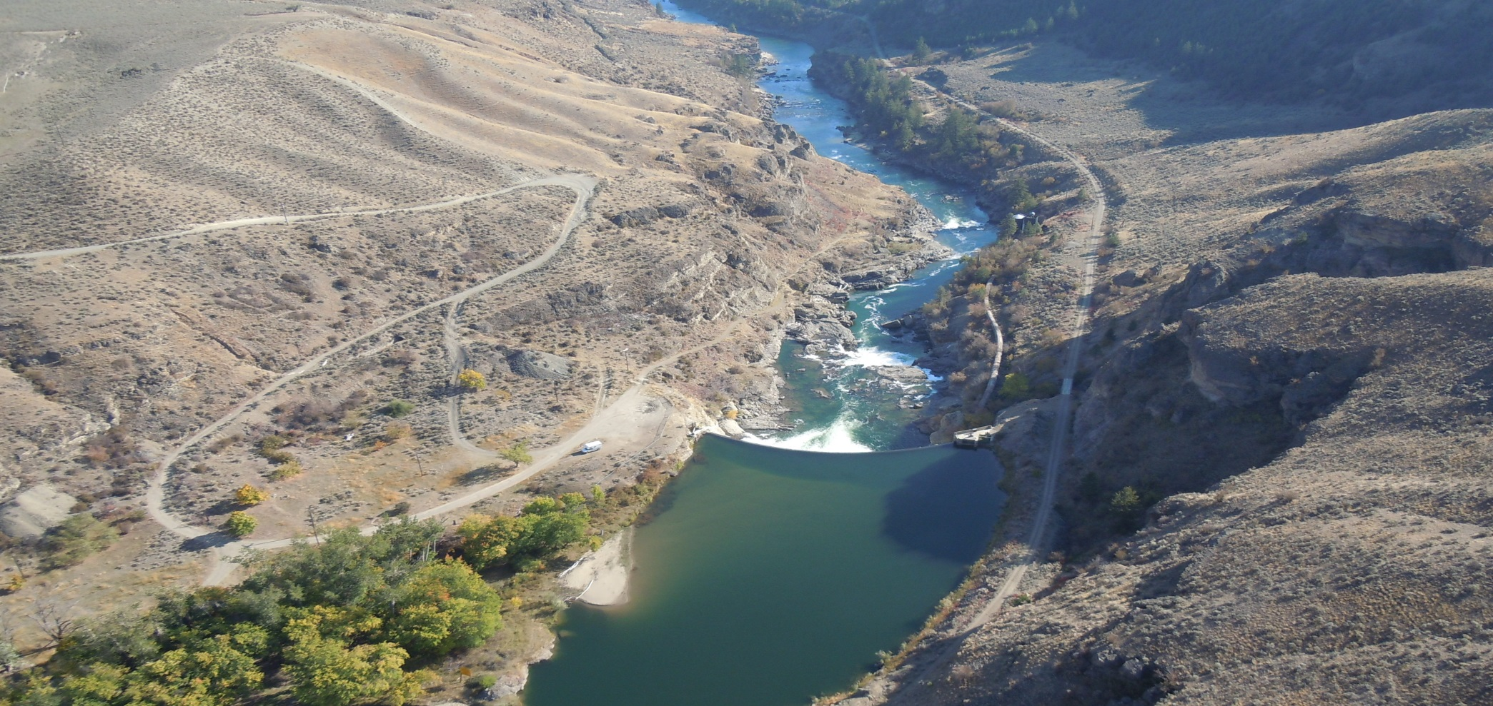
Questions?

