Slide 1
Peninsula Metropolitan Park District PenMet Parks Community Recreation Center
Application to use the GC/CM Delivery Method
MAY 28,2020 Presentation
The mission of the Peninsula Metropolitan Park District is to enhance the quality of life by providing parks and recreation opportunities for our community.

Slide 2
Presentation Agenda
Introduction of Key Team Members
Project Overview
Scope, Schedule and Budget
GC/CM Project Delivery Method
Team Organization Chart and Qualifications
Agency Experience
Summary
Questions

Slide 3
Introductions

Slide 4
The Project Team
Peninsula Metropolitan Park District
Doug Nelson, Executive Director
Glenn Akramoff, Senior Operations Manager
Eric Guenther, Planning Manager
Ed Lewis, Project Manager
Parametrix
Jim Dugan, Principal-in-Charge
Dan Cody, APD Advisor
Joe Missel, Project Manager
Perkins Coie
Andrew Greene, Perkins Coie, External GC/CM Legal Advisor

Slide 5
The Project Team
Peninsula Metropolitan Parks District
Mark Roberts, Internal Legal Council
BLRB Architects
Ron Harpel, AIA, Principal in Charge
Sarah Fischer, AIA, Project Manager

Slide 6
Project Overview

Slide 7
Project Overview – Site Location
N

Slide 8
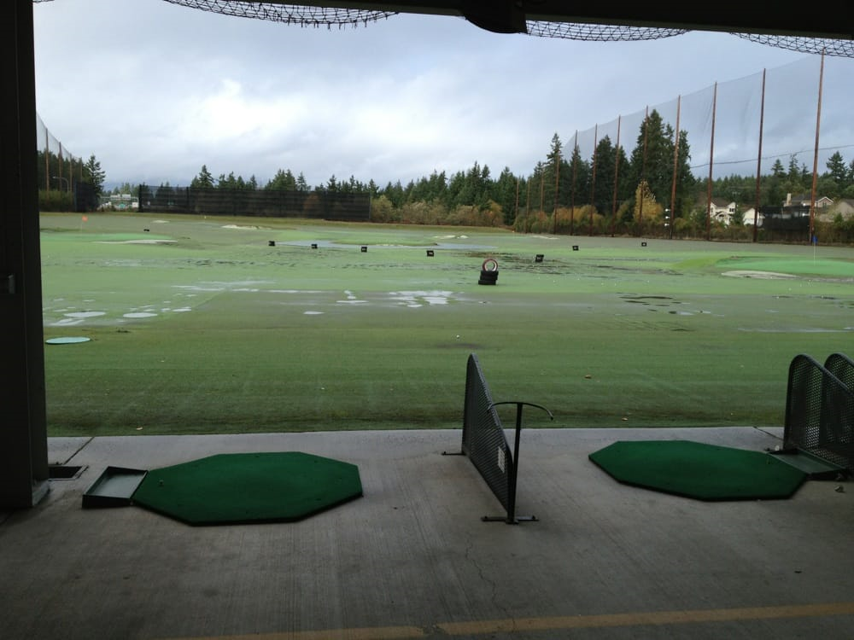
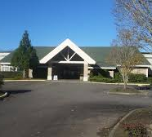
Former golf driving range; approximately 17 acres
Existing approx 4,000 sq. ft. pro shop/clubhouse building
Driving range with double tier covered tees
Mini golf center
A parking lot and other supporting site amenities
Remaining property consists of open field in center and undeveloped property to the north end
Project Overview Existing Facility

Slide 9
PenMet Parks Community Recreation Center Project Overview
Existing buildings will be renovated to house office spaces, meeting rooms, activity space and support space for District operations.
Existing building currently houses some of the District functions/staff and is anticipated to remain occupied and operational during construction.
Existing mini golf center and the parking lot will remain open during construction.
A new building and associated site amenities will be constructed where the current driving range field exists.
Parking to be developed to the east and north of the new building
An outdoor event area to the south and walking trail which connects to a regional Pierce county trail are also part of the project.

Slide 10
Scope, Schedule and Budget

Slide 11
Project Overview – Scope and Budget PenMet Parks Community Recreation Center Project Overview - Scope and Budget
Category | Budget
Costs for Professional Services (A/E, Legal, etc. @ 15% of construction) | $ 2,574,000
Estimated project construction costs (including construction contingencies) | $17,160,000
Equipment and furnishing costs | $ 1,201,200
Off-site costs | $ included
Contract administration costs (Owner, PM/CM, etc. @ 6% of construction) | $ 1,029,600
Contingencies (owner project contingency @ 5% of construction) | $ 858,000
Other project related costs (soft costs) | $ 1,821,560
Sales Tax (Construction and FF&E @ 7.9%) | $ 1,355,640
Total | $26,000,000
*Budget Information is preliminary and subject to change

Slide 12
Project Funding
The District currently has $10M in cash reserves on hand that can fully fund the design and certain costs for the project.
In order to preserve some cash reserves, The District is pursuing the issuance of $18M in Limited Tax General Obligation (LTGO) bonds to fund the majority of the project.
Funding for the A/E design, GC/CM advisor services and the GC/CM preconstruction services is being provided from the cash reserves until the LTGO bonds are in place.
Remaining cost of PM/CM services, design services and construction of the project will be funded from a combination of funds from the LTGO bonds and cash reserves.

Slide 13
Why GC/CM Delivery Method for the PenMet Parks Community Recreation Center

Slide 14
BUDGET Having the GC/CM on board during design to make recommendations on value engineering, programming, and innovative alternatives will assist the District in maximizing program, staying within the limited project budget and making the best value decisions. OCCUPIED FACILITY The existing building houses District staff and program functions that will remain operational during construction of the new building. In addition the mini golf center and the parking lot that serves these areas will need to remain operational. PHASING Construction work will have to be scheduled and phased for construction and operational activities. GC/CM input on schedule, phasing and construction logistics during design and permitting phases will assist the A/E and Owner in making prudent, efficient and timely decisions.
GC/CM AS THE APPROPRIATE DELIVERY METHOD

Slide 15
Complies with 3 of the 5 Statutory Criteria
(1) Implementation of the project involves complex scheduling, phasing, or coordination.
(2) The project involves construction at an occupied facility which must continue to operate during construction.
(3) The involvement of the General Contractor/Construction Manager during the design stage is critical to the success of the project.
(4) The project encompasses a complex or technical work environment.
(5) The project requires specialized work on a building that has historic significance.

Slide 16
Public Benefit: From this ….
GC/CM involvement in the design process will help plan for and reduce the potential for impacts due to cost escalation, product availability problems and labor shortfalls.
A GC/CM Contractor is highly motivated to maintain a schedule that they had a hand in developing.
The GC/CM delivery process offers an “open book” cost accounting of the work which will allow the team to track costs and forecast effectively.
The GC/CM will participate in value-engineering and constructability reviews early in the design process. This helps ensure cost-effective and value-based design and construction solutions.
The potential for serious construction claims and litigation is diminished because of the collaborative relationships among GC/CM, Owner and design team.

Slide 17
Team Organization Chart and Qualifications

Slide 18
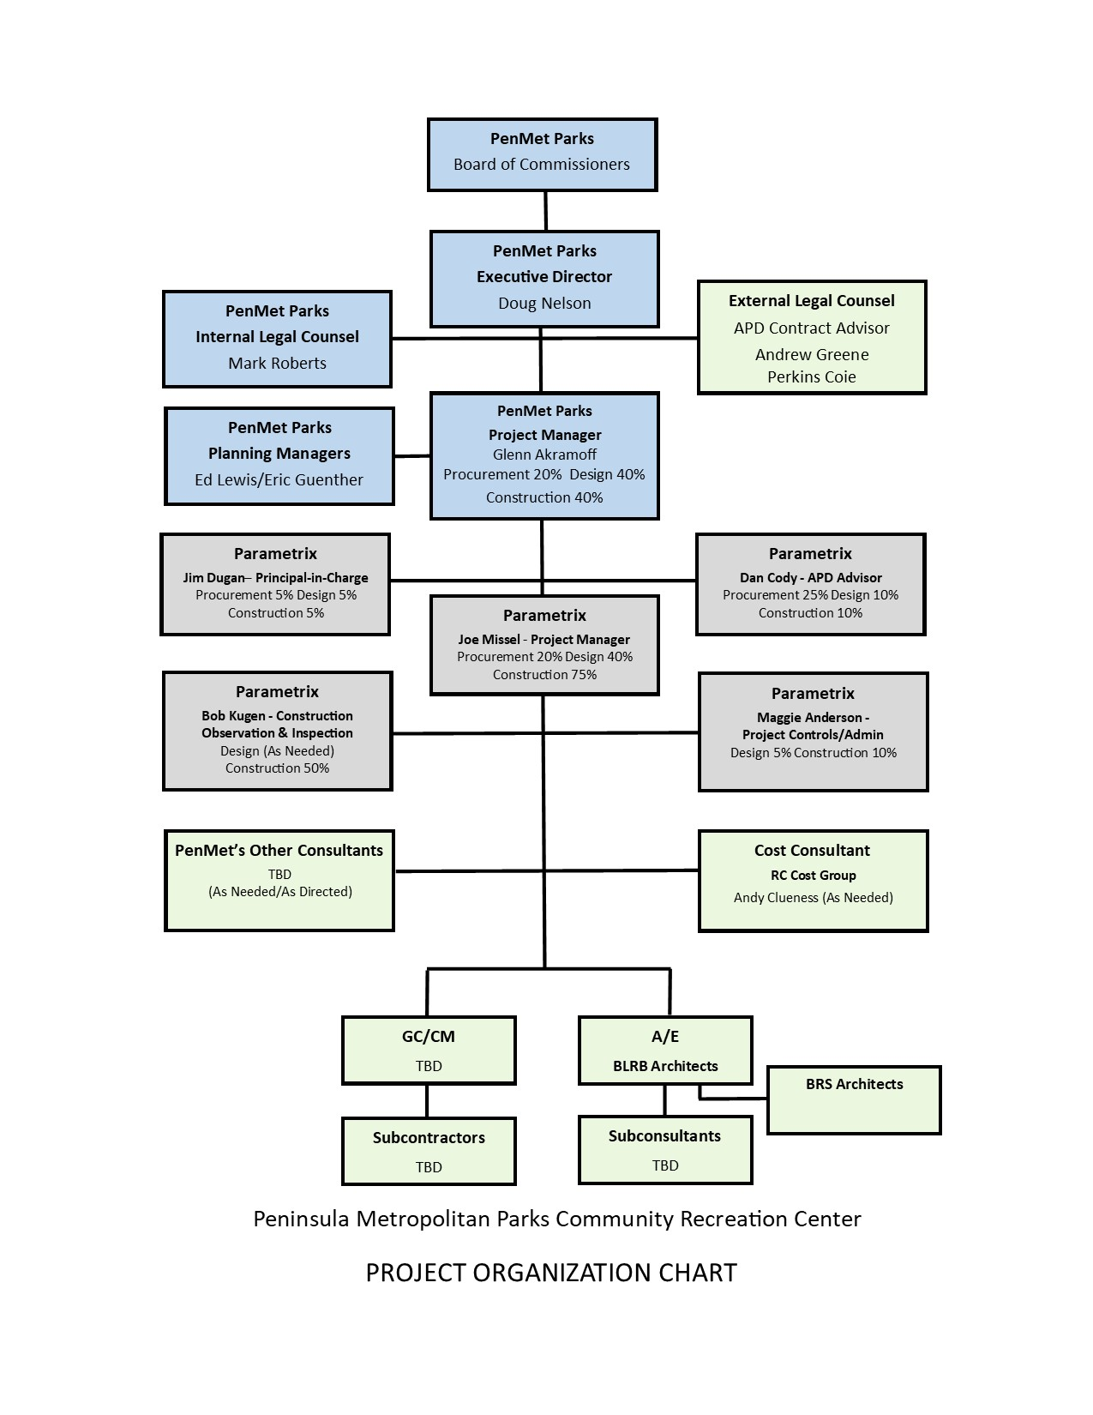

Slide 19
PenMet Parks Leadership Team
PenMet is new to the GC/CM method of project delivery.
PenMet Team members are registered to attend the AGC GC/CM Workshop on June 11/12.
PenMet has on-staff project managers and project support that have successfully managed capital improvement projects.
PenMet satisfies the public body qualifications by staff augmentation with consultants who provide depth of GC/CM experience
Parametrix: Jim Dugan GC/CM Principle in Charge, Dan Cody GC/CM Procurement Manager & GC/CM Advisor, Joe Missel Project Manager
Andrew Greene/Perkins Coie provides legal counsel for GC/CM compliance

Slide 20
Project Team GC/CM Experience

Slide 21
Glenn Akramoff Interim Sr. Operations Manager Peninsula Metro Parks District | 30 yrs. Local Municipal Government within Washington State Glenn’s experience includes positions of Operations and Maintenance Manager, Public Works Director and City Manager, Interim Executive Director for PenMet Parks District from March to December 2019 Projects: Covington Community Parks Phase 1 $3M, Covington Wax Road and SR 518 Improvements Phase I and II $12M, Covington 168th Pl Extension and Improvement $6.5M, Covington 256th Street and 164th Ave Improvements $6.5M, Covington Interim Maintenance Facility Design and Construction $200K, Lake Forest Park City Hall Design and Construction $3.2M
Ed Lewis Capital Projects Manager Peninsula Metro Parks District | 40+ yrs. Project/Construction Management: Planning, design, engineering & construction of industrial and commercial businesses. Projects: PenMet Parks Hale Pass renovation $600K, Gig Harbor, WA, PenMet Parks Sehmel Homestead Turf Field & Parking Light project $638K, Sehmel Homestead Maintenance Building and Restrooms $1.7M, PenMet Parks Sehmel Homestead Turf Infield Replacement $957K, Mitsubishi/Universal Can Corp, Tokyo, Japan $273.5M, Fountain Can Corporation, Taipei, Taiwan $199.8M
Eric Guenther Planning and Special Projects Manager Peninsula Metro Parks District | 30 yrs. Local Park Planning Arranges contracting for appraisals, property surveys and assessments. Manages the process for selecting and contracting with project designers and contractors. Manages project budget through closeout. Projects: PenMet Parks Hale Pass renovation $600K, Gig Harbor, WA, PenMet Parks Sehmel Homestead Turf Field & Parking Light project $638K, Sehmel Homestead Maintenance Building and Restrooms $1.7M, PenMet Parks Sehmel Homestead Turf Infield Replacement $957K, Sehmel Homestead Park $11M

Slide 22
Jim Dugan Principal in Charge and GC/CM Advisor Parametrix | 42 yrs. Of Design & PM/CM 25 GC/CM Projects: Recent Projects Include; Rainier Beach High School $238.3M, New Headquarters, Lakehaven Water and Sewer District $42.2M, Columbia River High School Mod/Add, Vancouver Public Schools $39.5M, Three Elementary School Replacement, Auburn School District $157.7M, New Headquarters, Chelan County PUD $136.36M, RI & RR Dam Support Facilities, Chelan County PUD $70M, Four Elementary School Replacement Program, Auburn School District $208M
Dan Cody GC/CM Procurement Manager & GC/CM Advisor Parametrix | 33 yrs. Of Design & PM/CM 18 GC/CM Projects: Recent Projects Include; Rainier Beach High School $238.3M, New Headquarters, Lakehaven Water and Sewer District $42.2M, Columbia River High School Mod/Add, Vancouver Public Schools $39.5M, Three Elementary School Replacement, Auburn School District $157.7M, New Headquarters, Chelan County PUD $136.36M, RI & RR Dam Support Facilities, Chelan County PUD $70M, Four Elementary School Replacement Program, Auburn School District $208M
Joe Missel, RA, Assoc. DBIA Project Manager Parametrix | 30 yrs. Of Design & PM/CM Projects: Recent Projects Include; North Thurston High School Phase 3, North Thurston School District $5M, Bush Middle School, Tumwater School District $13M, Tumwater Middle School, Tumwater School District $16M, North Thurston High School Phase 2, North Thurston School District $28M, Moctezuma’s Restaurant, Tukwila WA $1.3M, North Thurston High School Phase 1, North Thurston School District $22M.

Slide 23
Summary
Project is funded with the appropriate budgets
Project meets qualifying RCW 39.10 criteria
Project Management Plan for this project is developed and has clear and logical lines of authority
Project team has the necessary experience in addition to continuity for this project
Project team has the capacity for this project
Project team is prepared and ready to proceed
GC/CM RFP is complete and is ready to publish

Slide 24
Questions

Slide 25
Thank you

