Slide 1
Ridgefield School District

Slide 3
Introductions

Slide 4
Project Team

Slide 6
Critical Needs

Slide 9
Where we Learn Matters

Slide 10
The Phases / The Projects

Slide 12
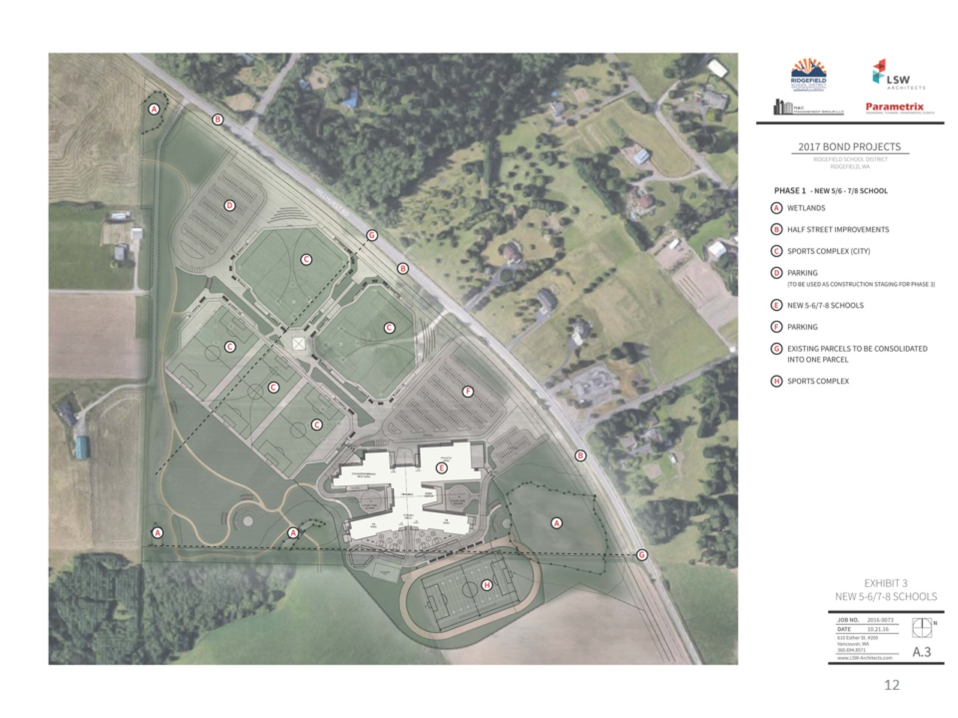

Slide 13
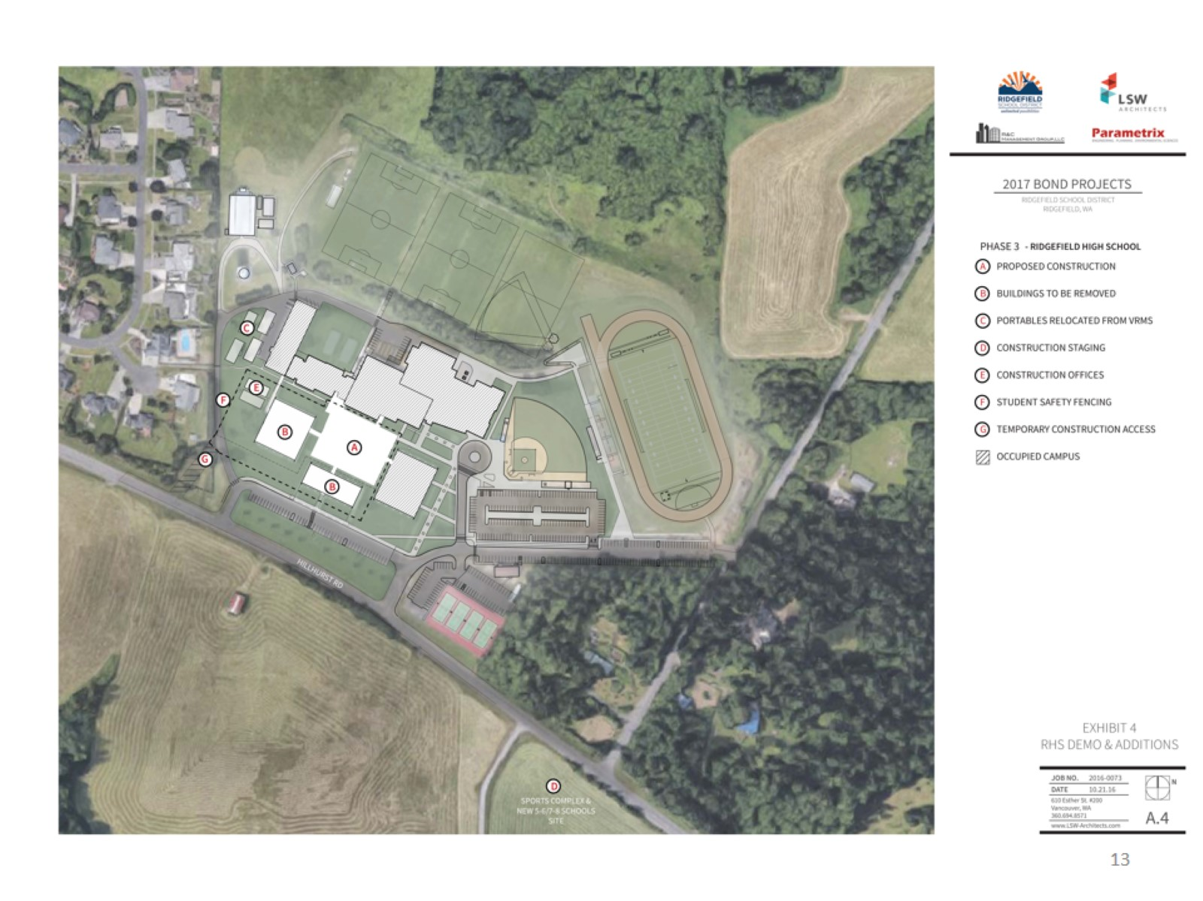

Slide 14
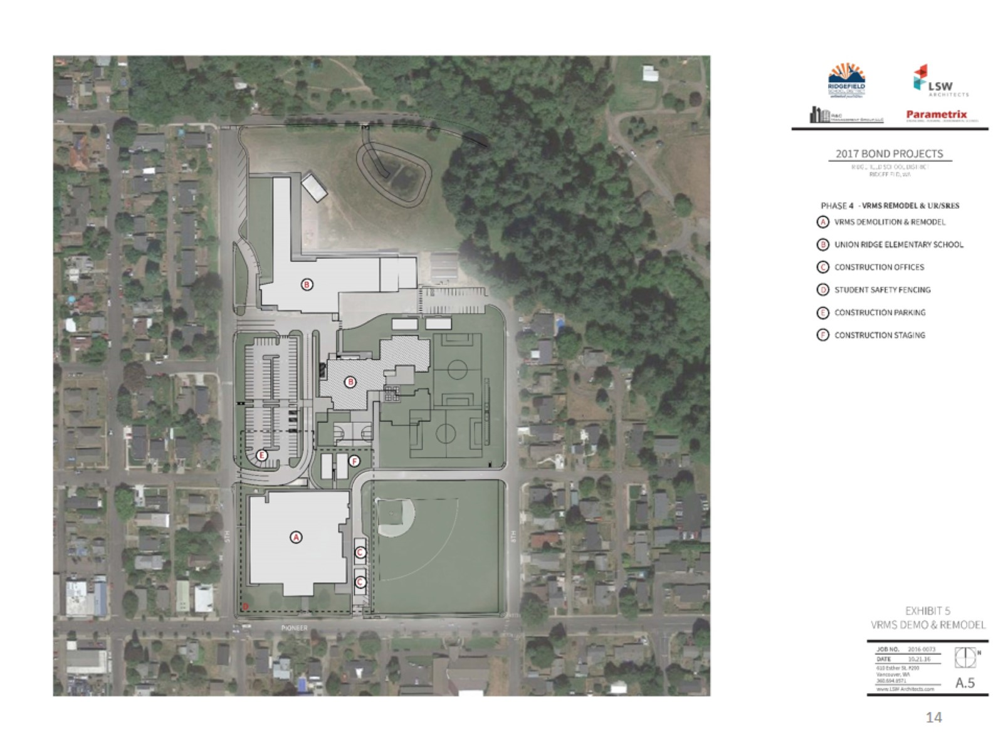

Slide 15
Interdependent Parts = One Project

Slide 17
Why GC/CM?

Slide 18
GC/CM Criteria We meet 4 of the 5 criteria

Slide 22
Public Benefit

Slide 23
Management Plan

Slide 24
Project Budget

Slide 26
2017 RSD BOND PROJECT BUDGETS

Slide 27
Project Schedule

Slide 28
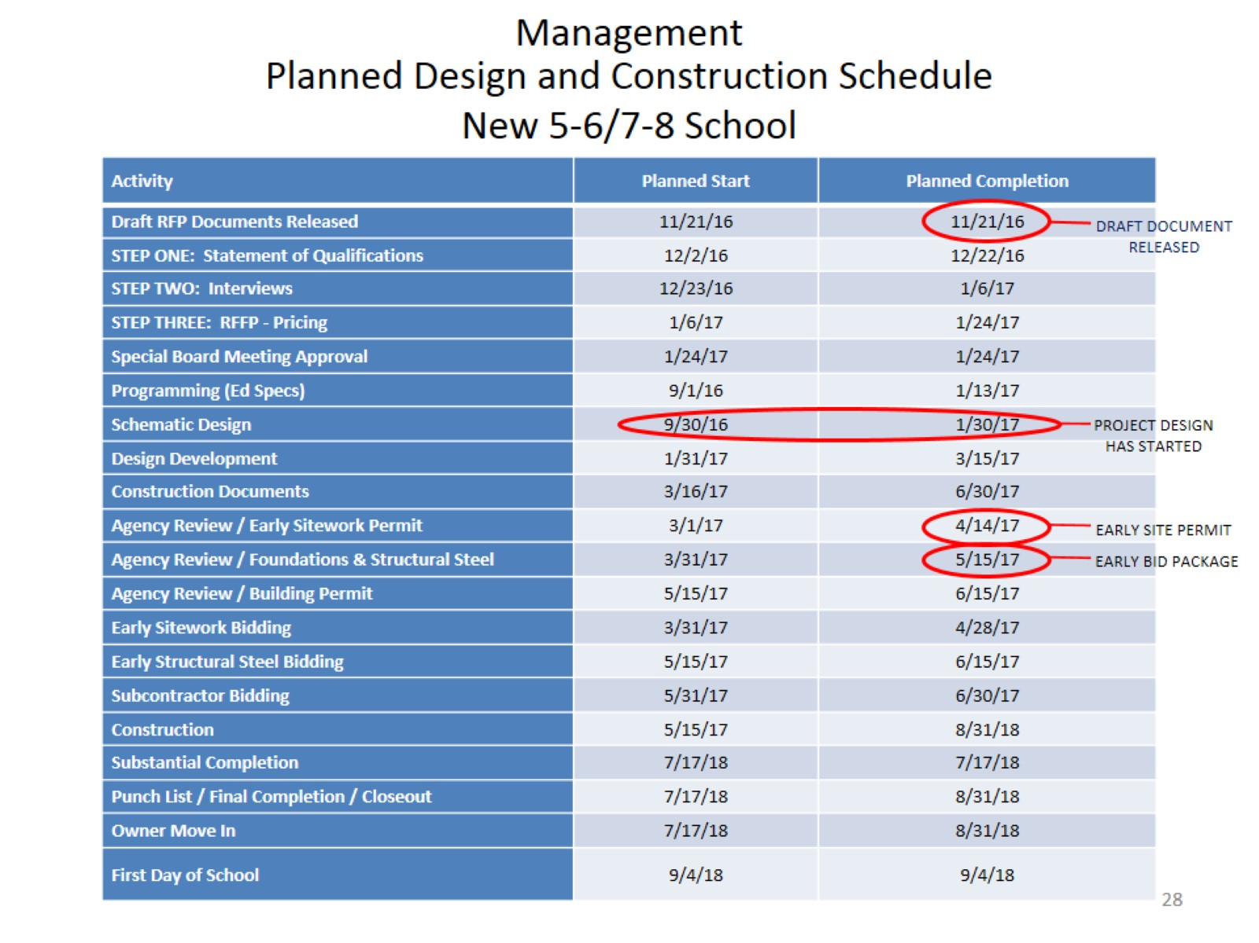
Management

Slide 30
Summary

