Slide 1
Purchasing and Procurement Training Project
Overview and Update
June 19, 2014
Melanie Buechel, DES
Notes:
Pick a logo for the main page of your presentation. Delete the other logo.

Slide 2
Project Purpose and Vision
The purpose of the Procurement Training Project is to develop and implement the curriculum, policy, registration and reporting mechanisms; and necessary supporting technology; if any, to meet the legislative mandates as described in RCWs 39.26.110.
The project is broken out into smaller projects: Initial Training Phase, Training Program Development Phase, Foundation Phase, and to be determined Future Phase(s).
The vision of the current Foundation Phase is to meet the legislative mandate by enabling state agency employees who are responsible for developing, executing, or managing procurements or contracts, or both, to complete Department approved training by July 1, 2015.

Slide 3
Legislation – RCW 39.26.110
RCW 39.26.110, Training, states:
The department must provide expertise and training on best practices for state procurement.
The department must establish either training or certification programs, or both, to ensure consistency in procurement practices for employees authorized to perform procurement functions under the provisions of this chapter. When establishing training or certification programs, the department may approve existing training or certification programs at state agencies. When establishing programs or approving existing programs, the department shall work with agencies with existing training programs to ensure coordination and minimize additional costs associated with training requirements.
Beginning July 1, 2013, state agencies must require agency employees responsible for developing, executing, or managing procurements or contracts, or both, to complete department-approved training or certification programs, or both. Beginning July 1, 2015, no agency employee may execute or manage contracts unless the employee has met the training or certification requirements or both as set by the department. Any request for exception to this requirement must be submitted to the director for approval before the employee or group of employees executes or manages contracts.

Slide 4
Project Timeline
Phase 1 Class Content Development 5/1/14 - 7/18/14
Phase 2 Class Content Development (Approx) 7/31/14 - 12/19/14
Today
Start 12/13/12
1st Quarter
3rd Quarter
1st Quarter
3rd Quarter
1st Quarter
3rd Quarter
Initial Training Phase (Immediate Needs) 12/13/12 - 4/23/14
Foundation Phase 5/1/14 - 5/13/15
Finish 7/1/15
Training Program Development Phase 11/18/13 - 6/30/14
Procurement Reform Legislation Effective 1/1/13
Public Knowledge Engaged 11/18/13
Procurement 101 (Alpha/Interim) 4/30/14
Class Rollout Phase 2 - Go Live 12/21/14
Future Phase(s) TBD 7/1/15
Training Advisory Group Established 3/23/13
Purchasing & Procurement 101 (Beta) 7/8/14
Class Rollout Phase 1 - Go Live (Tentative) 7/28/14

Slide 5
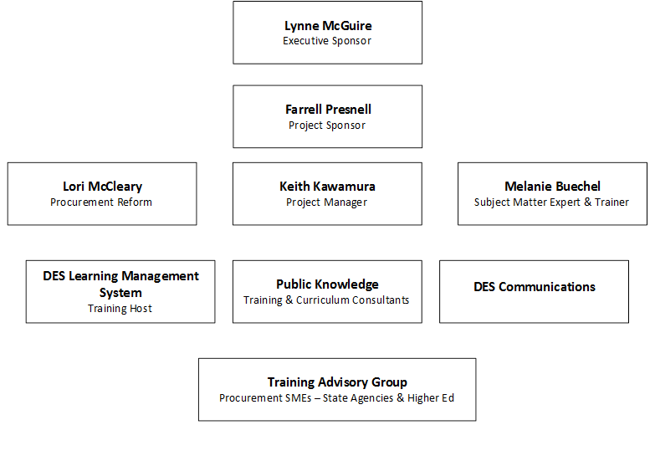
Project Organization Structure

Slide 6
Project Phases at a Glance
2012-2013
06/2013 – 07/2014
06/2014 – 07/2015
11/2014 – 6/2014
Post 07/2015
1 - Preliminary Planning
3- Training Program Development Phase
4- Foundation Phase
5- Future Phase(s) – Expansion on Core Training
2- Initial Training Phase (Meet Immediate Need)

Slide 7
Preliminary Planning
TAG Formation
Representatives from over 20 Washington agencies
March 2013
RFP for Training Development Vendor
Two RFPs released August 2013
October 2013
Public Knowledge Engaged November 2013
Procurement Reform Workgroup
Group formed May 2012
Recommendations Submitted by Group September 2012
One of 18 Different Work Groups Established to Address Procurement Reform Legislation

Slide 8
Initial Training
Agency Contract Reporting
Contract Reporting Training for the initial pilot group and two opt-in phases.
Procurement 101
Interim training covering overview of procurement requirements under chapter 39.26 RCW – Procurement of Goods and Services
Sole Source / Emergency Contracts / Direct Buy
Class designed for personnel who develop, manage, execute and/or file Sole Source, Emergency or conduct Direct Buy
Notes:
Sole Source, Emergency, Direct Buy - This two hour class is designed for agency and higher education personnel, who develop, manage or execute sole source and/or emergency contracts for goods and/or services. The first hour will provide an introduction to statutory and regulatory requirements and how they apply to agencies' real life contracting needs. The second hour will provide a review of the contract filing process from the initial writing stages to the sign-off process at DES, including a demonstration of the Sole Source Contracts Database (SSCD).
Contract Reporting – The training was designed for the initial pilot agencies with reports due in October 2013 and Opt-in 1 in February 2014, reports due March 30, 2014, and Opt-in 2, with reports due on June 30, 2014.
Next trainings will begin in July 2014 for the first formal reports due from all agencies on September 1, 2014
Overview of Procurement and Contract Management in the State of Washington -
This 6-hour class is designed for agency and higher education personnel who develop, manage and execute contracts for goods and/or services. The class will provide an overview and introduction to statutory and regulatory requirements under chapter 39.26 RCW, as well as best business practices, for competitive, sole source, direct-buy and emergency contracts. Additionally, the training will cover topics, including but not limited to, delegation of authority, the competitive process, conflict of interest, exceptions, exemptions and critical thinking to determine procurement options available, development of statement of work, contract management and monitoring, risk assessment and mitigation, and transparency.
This class did not meet the training requirements under RCW 39.26.110

Slide 9
Training Program Development Phase Project Vision
Washington’s Procurement Training and Certification Program ensures that state procurement professionals, contract managers and executive management have the knowledge, skills and abilities to procure goods and services to support the business of state government.
The Program will:
Be adequately funded
Communicate training and certification requirements for specific jobs
Emphasize critical thinking skills and innovation
Provide cost-effective and accessible training
Provide creative and innovative courses
Address adult learning styles
Provide course materials that are easy to access and update
Implement clear and transparent evaluation and testing processes
Be sustainable and maintained over time
Enable agencies to receive appropriate delegation of authority

Slide 10
Training Development Phase Needs Assessment Results
Information Gathering
Interviews with DES staff and stakeholders
Focus groups with representatives of various Washington state agencies
Results
75% of survey respondents indicated that purchasing or procurement (or both) accounts for over half their job responsibilities
Training topics rated with high priority include:
Survey of procurement professionals statewide with over 200 responses
Requirements gathering for courses and certification
Gap Analysis: inventory of current training curricula and materials available through DES and other Washington agencies
Complex and Risky Procurements
Basic Procurement Overview
Contract Management
IT Procurements
Scope & Requirements Definition
Visioning sessions with TAG

Slide 11
Training Program Development Phase Deliverables
Parameters
Learning Objectives
Scope of Training
Template/Format
DES Standard Look & Feel
Course Content & Materials
Presentation (PPT)
Workbook
Instructor Orientation Guide
Test
Evaluation
Course Evaluation Form
Lessons Learned Session

Slide 12
Foundation Phase
Course Content Development
Phase 1 May – July 2014
Phase 2 July – Dec 2014
Learning Management System
Registration
Course Roll Out
Phase 1
Phase 2
Employee Training Profile Information
Testing
Reporting
Notes:
Registration – usually done through the LMS Coordinators or training coordinators for each agency/institution of higher ed but it depends on the individual processes

Slide 13
Foundation Courses
Purchasing and Procurement 101
General purchasing and procurement information
Contract Management 101
Other Foundation Courses
Small Acquisitions
Rules, Regulations and Best Practices
Executive Management Purchasing & Procurement 101
Procurement Ethics
Anticipated Future Offerings
IT Procurement Academy
Purchasing & Procurement 101 – lite
WEBS
Agency Contract Reporting
Roles and responsibilities for purchasing and procurement
Procurement options and processes
Purchasing processes
Resources for purchasing and procurements
Agency roles and responsibilities and strategic alignment
Statements of Work
Components of contracts
Client Service Contracts
Approaches to contract monitoring
Risk Assessment and Management
Understanding contract terms and conditions
Corrective Action
Communication with Contractors
Employee vs. Contractor
Principals of Public Contracting
Competitive Procurement and Best Practices
How to Develop Requirements
Developing Statements of Work
Evaluation Processes and Methodologies
How to Write a Solid Procurement Document
Small and Diverse Business Outreach Methods
Contract Termination
Use of Master Contracts
Performance Based Contracting
More TBD by DES and TAG
Negotiations
Purchasing and Procurement 101
General purchasing and procurement information
Contract Management 101
Other Foundation Classes
Small Acquisitions
Rules, Regulations and Bes Practices
Executive Management Purchasing & Procurement 101
Ethics
Anticipated Future Offerings
MEL WILL FILL IN
MEL WILL FILL IN
MEL WILL LIST OUT CORE CONCEPTS
WEBS*
Agency Contract Reporting*
Sole Source/Emergency/Best Buy*
Roles and responsibilities for purchasing and procurement
Procurement options and processes
Purchasing processes
Resources for purchasing and procurements
Agency roles and responsibilities and strategic alignment
Statements of Work
Components of contracts

Slide 14
Required Attendees Broken Down by Typcial Work/Tasks
Procurement Professionals
Purchasing/Procurement Coordination
Executive Management
Ensures Agency compliance with procurement laws/policies and procedures
Conducts small procurement from Master Contacts
Initiate procurement need
Supply Chain Management
Advises on procurement law\policy/procedures
Develops procurement documents and contracts
Develops specifications
Vendor cures and terminations
Negotiations
Manages procurement risks
Filing and Reporting
Partners with and advises contract managers
Contract Managers
Develops deliverables and specifications
Ensures budget resources
Partner with Contract office to ensure compliance
Negotiations
Manage risk and Monitor contracts
Communicate with Contractor
Provide technical assistance to Contractors
Authorizes procurement
Requests additional delegated authority and exemptions
Executes contracts or delegates authority
Sometimes manage contracts or participates in procurement activities
P-Card purchases w/in limits of authority
Conducts low risk direct buys
Supplies inventory and stockrooms – office
Small Purchasers

Slide 15
Staff to Course Matrix
Procurement Professional | Contract Manager | Executive Management | Small Purchasers
Ethics | Ethics | Ethics | Ethics
Purchasing and Procurement 101 | Contract Management 101 | Executive Management Purchasing and Procurement 101 | Small Acquisitions
Rules and Regulations | Rules and Regulations | Rules and Regulations | Rules and Regulations

Slide 16
Purchasing and Procurement 101 3 Modules
Module 1 – Purchasing & Procurement Introduction and Roles and Responsibilities
Module 2 – Key Rules and Regulations and Purchasing & Procurement Decisions
Module 3 – Purchasing and Procurement Processes
Details of purchasing and procurements
Basics of purchasing and procurement in State of WA
Introduces key purchasing and procurement steps
Roles and responsibilities of stakeholders involved in procurement
The importance of Contract Management
Risk Management for procurements
Briefly review basics on contract ethics
Brief history of Procurement Reform
Procurement phases and key decision points
Procurement options
Exceptions and exemptions
Direct buy
Competition
Sole Source and emergency procurements
Amendments
How to apply critical thinking to purchasing and procurement
Understanding the importance of competitive procurement
How to conduct competitive procurements
Understanding the importance of transparency in procurement

Slide 17
Purchasing and Procurement 101 Sneak Peek
Link to Materials

Slide 18
Next Steps
Limited Beta offering for Purchasing & Procurement 101 – July 8, 9 and 10, 2014
Instructor-led webinar
Additional Purchasing & Procurement 101 offerings will be scheduled

Slide 19
Thank you
Questions?

