Slide 1
Enterprise Procurement Policy Workshop
08.18.21

Slide 2
Presented By
DES Enterprise Procurement Policy Workgroup
Guest Panel Members
Christine Warnock
Drew Zavatsky
Brooke Jensen
Zoë Mroz
Shana Barehand
Timolin Abrom (OMWBE)
Dr. Karen Johnson (Office of Equity)
Jennifer Montgomery (WDVA)

Slide 3
Housekeeping Items
Virtual Participation
By email invitation through the Zoom registration process
Policy documents are posted on our webpage.
Audio and Technical Issues
Use Chat function in Zoom for assistance (do not use Q&A)
Documents, PowerPoint Presentation, and Workshop Recording will be made available after the Workshop

Slide 4
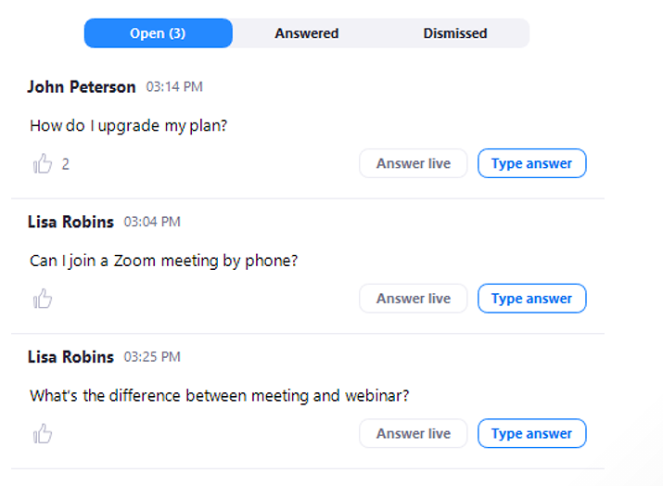
Feedback Options
Zoom Webinar Functions
Chat
Q&A
Polls

Slide 5
Feedback Options Continued
Additional Feedback Options
Post-webinar Survey
Submit Feedback Form directly to the Enterprise Procurement Policy Team Mailbox: DESmiEnterpriseProcurementPolicy@des.wa.gov
ALL FEEDBACK DUE OCTOBER 31, 2021

Slide 6
Workshop Agenda: Session 1 - vendors
Item | Agenda Topic | Purpose | Time
1 | Intro Purpose of Workshop Feedback Housekeeping Items | Feedback on Drafts | 8:30-8:45 (15 minutes)
2 | Supplier Diversity Policy, which includes EO 19-01 | Share Draft | 8:45-9:55 (70 minutes)
3 | Q&A Period | Feedback on Draft | 9:55-11:25 (90 minutes)
4 | Wrap Up/Next Steps | Information Sharing | 11:25-11:30 (5 minutes)

Slide 7
Workshop Agenda: Session 2 – Agencies and Nonprofits
Item | Agenda Topic | Purpose | Time
1 | Intro Purpose of Workshop Feedback Housekeeping Items | Feedback on Drafts | 1:30-1:45 (15 minutes)
2 | Supplier Diversity Policy, which includes EO 19-01 | Share Draft | 1:45-2:55 (70 minutes)
3 | Q&A Period | Feedback on Draft | 2:55-4:25 (90 minutes)
4 | Wrap Up/Next Steps | Information Sharing | 4:25-4:30 (5 minutes)

Slide 8
Workshop Objectives
Introduce partners
Share draft policy documents
Supplier Diversity (includes EO 19-01)
Policy
Procedure
FAQ
Glossary
Obtain meaningful feedback on the policy and related documents

Slide 9
Policy Development Process
Draft Policy Concept
Share Draft Concept with Stakeholders
Present Draft Concept at Workshop
Collect Feedback
Review Feedback
Draft Policy Based on Feedback
Assemble Work Group for Policy Draft Development
Conduct Additional Research
Share Draft
If
Yes
Present Draft Policy at Workshop
Collect Stakeholder Feedback
Review & Respond to Feedback
Another Round of Feedback is Necessary?
Include Feedback in Final Draft
Develop Training
Publish Policy
Send Final Policy to DES Director for Final Review and Signature
Complete Final Policy and Related Training

Slide 10
Supplier Diversity Policy partners

Slide 11
Supplier Diversity Policy
The team wants your input on a proposed draft Supplier Diversity policy, which includes Executive Order 19-01.
The Team consists of:

Slide 12
Who we are – OMWBE
Established in 1983, OMWBE was created to mitigate societal discrimination and other barriers to minority- and women-owned businesses participating in public works and providing goods and services.
“…. minority and women-owned businesses are significantly
underrepresented and have been denied equitable competitive opportunities in contracting”
- RCW 39.19.010

Slide 13
What WE do – Core services
Certification
Linked Deposit Program
Supplier Diversity
Governor’s Subcabinet on
Business Diversity

Slide 14
How we do it – Supplier diversity
Plans to maximize opportunity for small, minority and women-owned businesses
Establish annual goals for each cabinet agency and educational institution
Report spending and post
Compliance
Each state agency shall adopt a plan to ensure minority and women-owned businesses are afforded the maximum practicable opportunity to participate in public works and goods and services. The plan shall include specific measures the agency will undertake to increase the participation.
- RCW 39.19.060

Slide 15
What is included in agency plans?
A statement of commitment from the agency head to achieve the goals and to maximize opportunities for certified businesses
Identification of the person given the responsibility and authority to ensure implementation of the plan
A listing of specific measures will take to increase participation of certified businesses
For agencies with one hundred or more employees shall include detailed procedures for the following:
Communicating the policy and appropriate procedures to all staff;
Training of staff involved in implementation;
Annual forecasting of contracting, procurement, other expenditure activity, and goalsetting by class of contract;
Setting individual contract goals;
Monitoring and ensuring compliance of contractors and vendors;
Maintenance of records regarding contract awards, purchase orders, and other expenditures as required in this chapter;
Regular provision of data to the office on all expenditures as required in WAC 326-40-050;
Resolving disputes and investigating complaints; and
Review and revision of contracting and procurement documents, policies, and practices which hinder or create barriers to successful implementation of the plan.

Slide 16
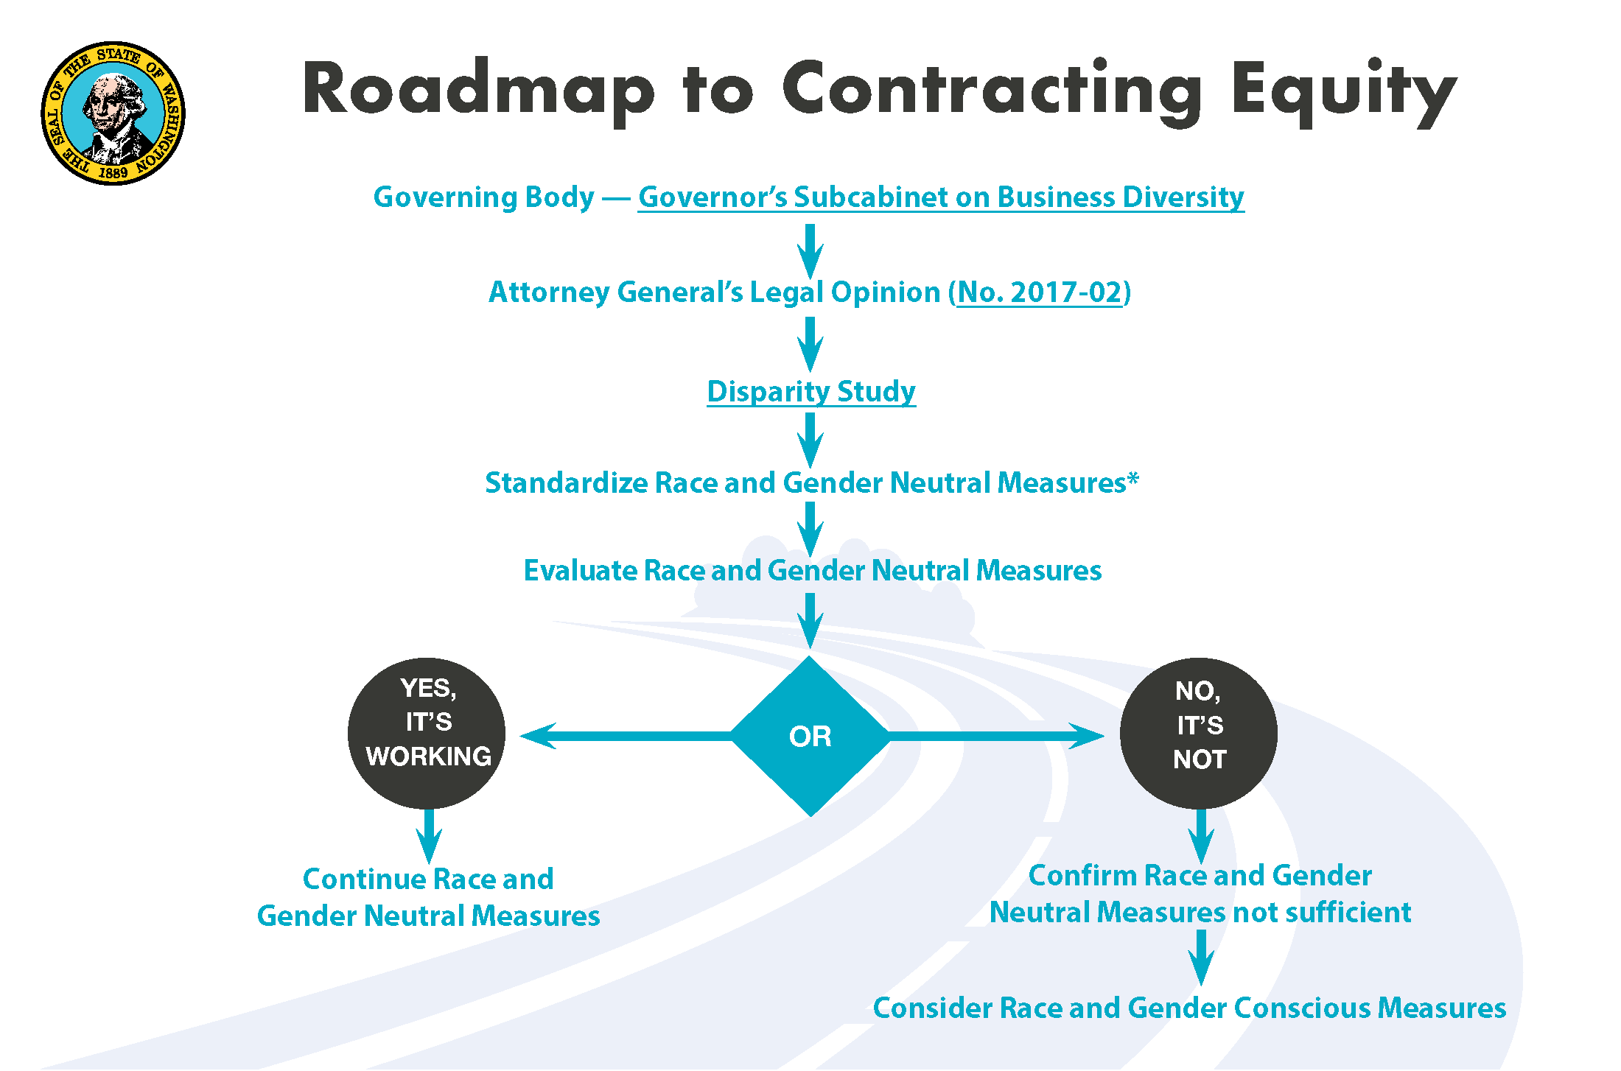
How is the subcabinet driving change?

Slide 17
Tools for Equity in Public Spending
Best practices, tools, guides, templates, and more available on our website.
Additional releases over the next year, plus training offerings on all topics
OMWBE will monitor progress of agencies in using these tools and best practices, and measure statewide M/WBE participation
bit.ly/2X7hEWr

Slide 18
What does the Office of Equity Do?
Develop the state’s five-year equity plan
Help the state develop language-access requirements
Remove barriers to accessing state services
Decrease inequities across state government
Help agencies develop their own Diversity, Equity & Inclusion (DEI) plans
Promote systemic and cultural changes by introducing best practices & change management to agencies
Design online performance dashboard that measures agencies’ progress toward equity goals

Slide 19
Alignment with the Office of Equity
Lay a strong foundation. Center equity in all of our operations, programs, and interactions.
Maximize the system we have. Through stronger policy, integration, and collaboration across systems, sectors, and jurisdictions to make the most of the system we have.
Build the system we need. Begin to dismantle racism by addressing root causes through bold systemic and cultural change.
Blueprint for a Just & Equitable Future: 10-Year Plan to
Dismantle Poverty in Washington, p. 50

Slide 20
OVERVIEW OF WDVA
Connect veterans and their family members to the benefits and services they earned through their military service.
Provide long-term care in four State Veteran Homes (Orting, Port Orchard, Spokane, Walla Walla) for honorably discharged veterans, widows or spouses, and Gold Star Parents.
Provide claims assistance and counseling services for veterans and their family members.
Honor veterans in their final resting place in a State Veterans Cemetery.
Please visit www.dva.wa.gov, email benefits@dva.wa.gov, or call 1-800-562-2308.

Slide 21
What does DVA Do?
Certifies businesses owned by honorably discharged veterans and service members. Certification is quick, free, and easy.
Provides outreach and referrals to support veteran and servicemember owned businesses.
Assists prime contractors and state agencies in locating certified businesses to meet their diverse spend goals.

Slide 22
Alignment with EO 19-01 and WDVA
Incorporated OMWBE inclusion plan into annual procurement and contracts training.
Centralized reporting structure of purchasing staff to increase oversight of inclusion plan.
Increased involvement and participation of purchasing and contracting staff in planning and forecasting future procurements.
Master Contract search tool is utilized prior to all non-routine purchases.
OMWBE directory is utilized prior to all non-routine purchases.

Slide 23
Executive Order 19-01
Executive Order 19-01 (signed on 5/13/19)
DES in conjunction with the Department of Veteran’s Affairs (DVA), and the Office of Minority and Women Business Enterprises (OMWBE), is responsible for establishing a new policy regarding procurement practices and preferences to promote state agency contracting with veteran owned businesses.

Slide 24
Veteran-Owned Business Purchasing Goals
ESB 5041 (RCW 43.60A.200) 3% Non-competitive purchases
Governor’s Executive Order 13-01 5% all purchases

Slide 25
Policy coordination
Existing Laws/ EO 19-01
Subcabinet/ Community of Practice
Disparity Study
Tools for Equity in Public Spending
Training
Supplier Diversity Policy

Slide 26
Supplier Diversity Policy

Slide 27
What is Supplier Diversity?
Intentional practice
Includes specific groups based on priorities and/or law
Supplier diversity policies often look at remedying discrimination for groups protected under the federal civil rights act.
Discrimination includes both intentional and disparate impact

Slide 28
RCW 39.26.010(22)
To qualify as a small business – the business must:
Be a Washington state business that:
Has fifty or fewer employees; or
Has a gross revenue of less than $7 million; or
Is certified with the Office of Minority and Women-Owned Business Enterprises*
*only applies to non-preference strategies

Slide 29
Reason For Policy
Ensure that all procurement professionals use race and gender neutral strategies to increase the amount of contracts that are awarded to small, diverse, and certified veteran-owned businesses.
Small, diverse, and veteran-owned businesses face barriers that prevent their equitable access to state goods and services contracts and procurements

Slide 30
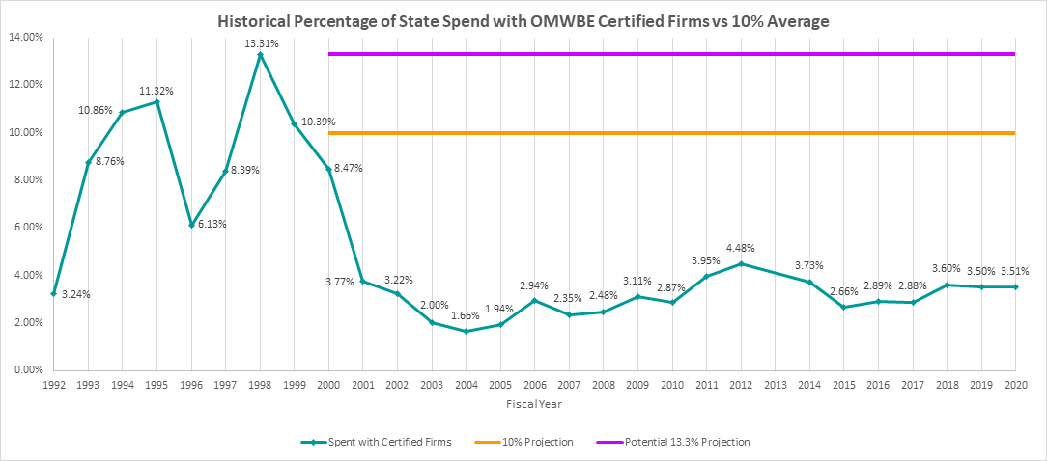
percentage of state spend with MWBE-certified businesses over time

Slide 31
Disparity study data
Distribution of Contract Dollars by Race and Gender
Data reflects utilization of total contract dollars.
 | Black | Hispanic | Asian | Native American | White Women | MWBE | Non-MWBE
Total Dollars | $35,084,771 | $16,473,011 | $21,385,446 | $49,726,396 | $321,380,620 | $444,050,245 | $2,413,069,447
% Share of Total Dollars | 1.23% | .58% | .75% | 1.74% | 11.25% | 15.54% | 84.46%

Slide 32
Agency Leadership Commitment
Implement this policy by…
Reinforcing and supporting compliance with OMWBE’s annual supplier diversity inclusion plan;
Identifying agency leader(s) with the responsibility for increasing spend with small, diverse, and veteran-owned businesses;
Setting a timeline for achieving goals;
Completing training within 6 months.

Slide 33
Chat Question 1
Time Remaining
What are some ways to ensure that leadership commitment happens?

Slide 34
Required for all competitive and non-competitive Purchases
Implement this policy by…
Forecasting
Outreach
Transparency
Training
Documenting Compliance

Slide 35
Forecasting: Procedure
Agency Supplier Diversity Leader(s)
Procurement
Staff
Sets expectations for forecasting on all competitive and non-competitive procurements.
Provides forecast data to Agency Leadership Team every six months.
Conducts forecasting to identify contracting opportunities and diverse suppliers
Publicly posts all the agency’s forecasted procurements
Refresh every 6 months

Slide 36
Outreach Planning: Procedure
Agency Supplier Diversity Leader(s)
Procurement
Staff
Designates a point of contact for outreach that can speak to agency’s purchasing activities.
Assesses the agency’s current outreach efforts
Identifies outreach efforts and establishes an outreach plan
Identifies events to attend where the agency will reach small, diverse, and veteran-owned businesses.

Slide 37
Conducting Outreach: Procedure
Agency Supplier Diversity Leader(s)
Procurement
Staff
Reports on agency outreach efforts to the agency leadership team.
Conducts outreach to small, diverse, and veteran-owned businesses for every procurement.
Engages in post-outreach follow up to gain feedback for improvements

Slide 38
Supplier Diversity In Procurements Training
Completed within 6 months of the effective date of this policy
Agency Leaders
Staff responsible for small purchases, competitive procurements, and contract management activities
Training is to be developed after policy draft is finalized

Slide 39
Contracting Transparency: Procedure
Agency Supplier Diversity Leader(s) post quarterly on the agency’s website:
Forecasted Opportunities
Outreach Plan and Outreach Goals
Agency Supplier Diversity Leader(s) contact info
Agency progress in achieving supplier diversity goals
Plan for maximizing opportunity for small, diverse, and veteran-owned businesses
Agency’s supplier diversity spending trends
Competitive only: Bids from the awarded contractor(s), to include all submittals

Slide 40
Zoom Poll 1
Time Remaining
What reporting cadence is most appropriate:
Quarterly
Every 6 Months
Annually
Other (put answer in chat)

Slide 41
accountability
Policy
Increased transparency on agency planning
First time enterprise supplier diversity policy & procedure
Reinforces leadership commitment, review, and reporting
Compliance measured with Procurement Risk Assessment
OMWBE’s compliance role

Slide 42
Chat Question 2
Time Remaining
What suggestions do vendors have for greater accountability?

Slide 43
Required for All Competitive Procurements
Implement this policy by…
Awards under $150,000 or 25% of all
Pre-bid Conferences
Procurement Language
Other Strategies

Slide 44
Awards Under $150,000 or 25% of all
Option A
Option B
Awarding competitively procured contracts valued less than $150,000
Awarding 25% of all competitively procured contracts

Slide 45
Zoom Poll 2
Time Remaining
Which option do you suggest?
Option A
Awarding competitively procured contracts valued less than $150,000
Option B
Awarding 25% of all competitively procured contracts

Slide 46
Pre-bid Conferences
Meeting held by the buyer with potential bidders prior to the opening of the solicitation for the purpose of:
Answering questions
Clarifying any ambiguities
Responding to general issues to establish a common basis for understanding all of the requirements of the solicitation
Required
Use with all competitive solicitations, advertisements, and contracts

Slide 47
Pre-bid Conference: Procedure
Agency Supplier Diversity Leader(s)
Procurement
Staff
Sets expectations for holding pre-bid conferences for every competitive solicitation.
Collects data reports and provide to Agency Leadership Team
Establishes pre-bid date, time, location
Must include a phone-in and/or virtual option.
Holds pre-bid conferences for every competitive solicitation
Provide attendance reports to agency leadership

Slide 48
Zoom Poll 3
Time Remaining
Should pre-bid conferences be:
Reserved for complex or large solicitations; or
Required for all competitive solicitations.

Slide 49
Procurement Language: Procedure
Procurement
Staff
Agency Supplier Diversity Leader(s)
Meets with internal and external stakeholders
Identifies existing language that is unnecessary and/or restrictive
Revises language
Reports progress to Agency Leadership Team

Slide 50
Additional Procurement and Contracting Strategies
Use one or more of the strategies listed below
Unbundling
Award points to small and veteran-owned businesses.
Subcontractor Inclusion Plan
Reserved Award Contract
Award HubZone Points
Other strategies, as determined by each agency.

Slide 51
Unbundling: Procedure
Agency Supplier Diversity Leader(s)
Procurement Staff:
May unbundle by…
Sets expectations for conducting an unbundling analysis during the solicitation development process.
Reports progress to Agency Leadership
Geographic area
Size and Complexity
Category
Manufacturer
Products & Services
Timing & Delivery

Slide 52
Awarding Evaluation Points: Procedure
Agency Supplier Diversity Leader(s)
Procurement
Staff
Sets expectations for providing evaluation points to small and/or veteran-owned businesses when applicable.
Reports progress to Agency Leadership
Includes language in the solicitation to allow evaluation points for small and/or veteran-owned business.
Awards evaluation points to small and/or veteran-owned businesses.

Slide 53
Subcontractor Inclusion Plan: Procedure
Agency Supplier Diversity Leader(s)
Procurement
Staff
Sets expectations for the use of subcontractor inclusion plans when applicable.
Reports progress to Agency Leadership
If there will be subcontractors, the agency may include a subcontractor inclusion plan in the procurement solicitation.
Evaluates inclusion plans based on supplier’s genuine efforts.

Slide 54
Reserved Award: Procedure
Agency Supplier Diversity Leader(s)
Procurement
Staff
Sets expectations for using a small/veteran-owned business reserved award approach when applicable.
Reports progress to Agency Leadership
Determines if a contract may result in multiple awards.
Identifies in the solicitation that some of the contract awards are reserved for small and/or veteran-owned businesses.

Slide 55
Hubzone Points: Procedure
Agency Supplier Diversity Leader(s)
Procurement
Staff
Sets expectations for providing evaluation points to businesses that are certified by the Small Business Administration as HUBZone businesses, when applicable.
Reports progress to Agency Leadership
Conducts market research to find if businesses located in Washington HUBZones sell goods and/or services to fulfill needs.
Applies HUBZone points during the bid evaluation

Slide 56
Exception to this Policy
Emergency Purchases, see:
RCW 39.26.130, Emergency purchases.
DES Policy #DES-130-00, Making Emergency Purchases of Goods and Services

Slide 57
Agency support
DES Resources
Enterprise Supplier Diversity Policy
Procurement Inclusion & Equity Team
Small Agency Procurement Services
OMWBE Resources
Supplier Diversity Team
Toolkit Support Sessions

Slide 58
Chat Question 3
Time Remaining
What do agencies need for support?

Slide 59
Resources and Supplemental Documents for this Policy
Procedure: Enterprise Services Procedure #PRO-DES-090-06
Guideline: Enterprise Services #GDL-DES-090-06
FAQ: Enterprise Services FAQ
Glossary: Enterprise Services #GLO-DES-090-06
Sample Contract Language (to be developed)
Other Tools for successfully implementing the requirements (to be developed)

Slide 60
Q&A

Slide 61
Feedback Discussion
Is there anything missing?
Are the policy and procedure drafts clear and easy to understand?
What are the challenges you foresee with implementing this policy and procedure?
What are potential solutions to these challenges?
Any other comments/feedback?

Slide 62
Next Steps

Slide 63
timeline
August 18, 2021
Enterprise Procurement Policy Workshop
Early 2022
Enterprise Procurement Policy Workshop
October 31, 2021
Stakeholder Feedback Due
2022 (TBD)
Training Development
Policy Launch

Slide 64
Next Steps (cont.)
Please provide feedback by October 31st, 2021.
Feedback options:
E-mail the Feedback Form to DESmiEnterpriseProcurementPolicy@des.wa.gov
Contact one of the Enterprise Procurement Policy team members (see next slide)
DES Policy Team will compile feedback and use to make appropriate revisions to policy draft(s).
Revised policy draft(s) will be shared with stakeholders prior to finalization.

Slide 65
thank you
DESmiEnterpriseProcurementPolicy@des.wa.gov
Feedback due 10/31/2021
Policies Under Review
Feedback Form

Slide 66
DES Enterprise Procurement Policy Team
EPP Staff | Phone/E-mail | Areas of Concentration
Drew Zavatsky Procurement Risk Assessment Administrator | (360) 407-7915 Drew.Zavatsky@des.wa.gov | Risk Assessments, Delegations of Authority requests, Sole Source/Emergency Filings, Enterprise Procurement Policies
Christine Warnock Enterprise Procurement Policy Manager | (360) 407-9398 Christine.Warnock@des.wa.gov | Enterprise Procurement Policies, Sole Source/Emergency Filings, and Protest Officer responsibilities
Zoë Mroz Management Analyst | (360) 407-8502 Zoe.Mroz@des.wa.gov | Risk Assessments, Sole Source/Emergency Filings, Enterprise Procurement Policies, and Delegations of Authority requests
Brooke Jensen Sole Source Oversight Administrator | (360) 407-8720 Brooke.Jensen@des.wa.gov | Sole Source/Emergency Filings, Enterprise Procurement Policies, and Protest Officer responsibilities

Slide 67
Thank You!

