Slide 1
November 20, 2019
Program Update
Procurement Customer Advisory Group (PCAG)
Notes:
Not a ton of time for questions
Opportunity to understand what the questions are and to synchronize communication between us

Slide 2
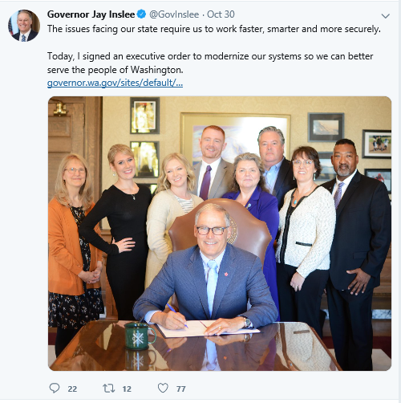
Executive Support
Executive Order 19-04, One Washington: Modernization of State Administrative Business and Systems was signed by Governor Inslee on October 30, 2019!
Executive Order 19-04:
Provides the vision to executive branch agencies
Reinforces the major transformation that will be required for agency staff and processes
Describes the expectations for systems modernization
Notes:
Lessons learned
Clear direction to agencies
Size of the lift
Challenge of herding cats

Slide 3
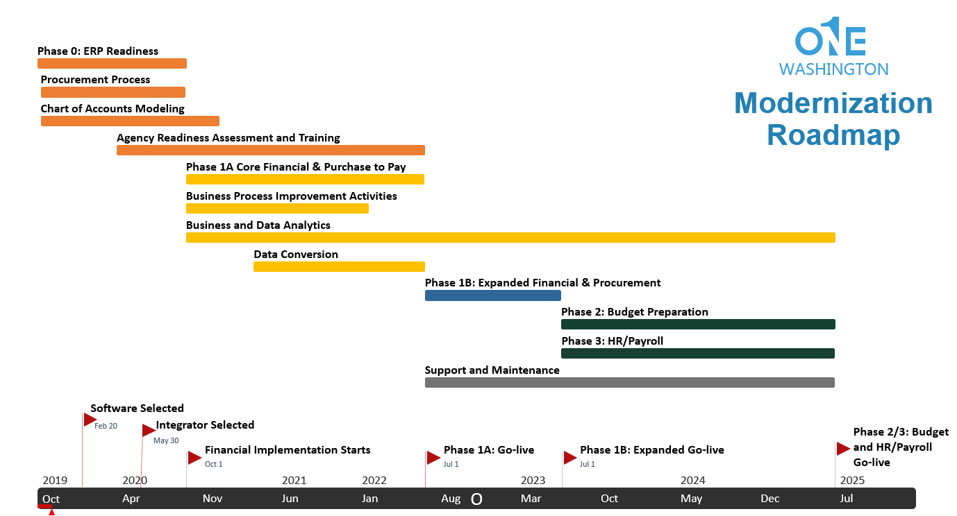
Scene setting - Roadmap

Slide 4
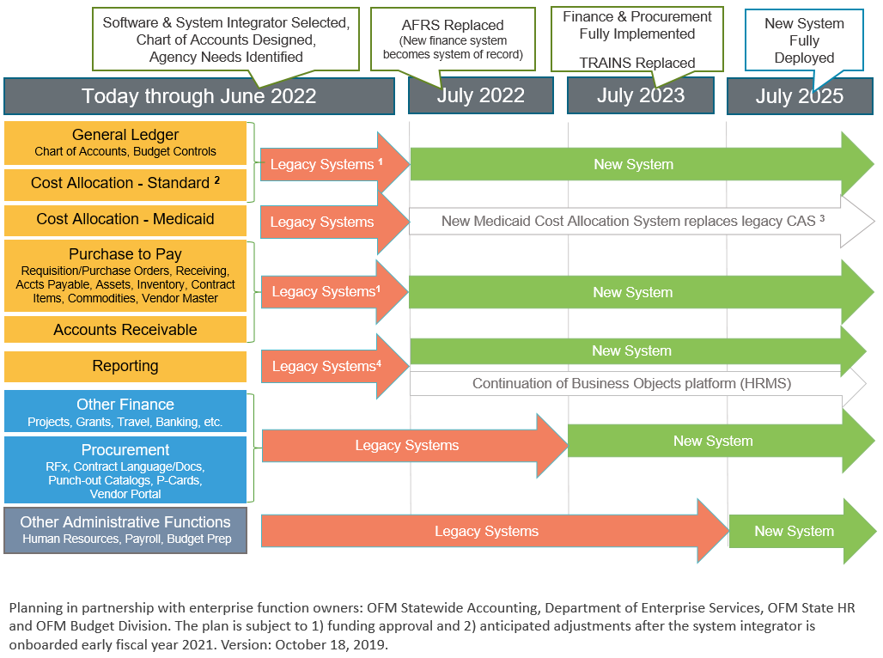
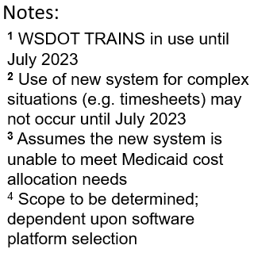
Scene setting – Functional roll-out (scope)

Slide 5
Understanding Agency Requests
Agency Request | Launch Date | Due Date | Agencies Included
System/Interface Inventory | 10/16 | 12/9 | All
Baseline Readiness Survey | 11/12 | 12/6 | All
Benchmarking | 11/13 | 12/12 | 28 Agencies
High level descriptions:
Agency system/interface request: This information will provide input to the RFP process for a systems integrator. At a high level, the data will help us answer, “Which agency systems require interfaces to the new system vs. which are potential candidates for replacement by the new system?”
Deloitte baseline readiness survey: The “people” side of change is often the most challenging area for large transformation efforts. The first step in organizational change management is knowing where we are. The baseline readiness survey will help us answer, “What is the initial level of support that agencies need for OneWa? How much organizational change management is needed?”
Hackett Group survey & benchmarking: This work compares the state’s performance against peer group data made available through Hackett. The output is expected to bolster the business case for transforming the state’s administrative business functions. It will help us answer, “What efficiencies can the state gain in its administrative operations?”

Slide 6
FOR MORE INFORMATION:
TO PROVIDE
FEEDBACK:
Website: one.wa.gov
Email: onewa@ofm.wa.gov
onewa@ofm.wa.gov

