Slide 1
Best Practices for
Biennium Scheduling
Marty Mattes
Bates Technical College,
(253) 680-7156
mmattes@bates.ctc.edu
Notes:
Introduction:
Short and sweet

Slide 2
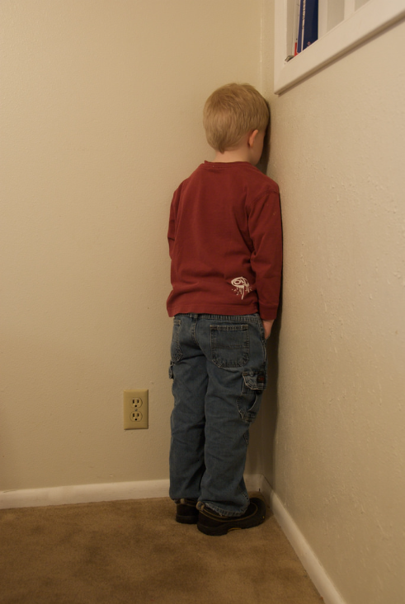
Story about Timeout with Aunt Marsha
Notes:
Late 60’s/early 70’s (Grade School)
Both parents worked.
After school, walked to Aunt Marsha’s.
Aunt Marsha’s daily goal was to teach us good behavior.
Found many occasions to imprint her lesson goal.
When we did not conform to her behavioral expectations – Everyone went to a corner – and she had just the right number of corners for everyone.

Slide 3


1-hour in the corner or Kiss and makeup
Notes:
Back in the day, lessons seemed to be taught by handing out consequences.
Just one kid acted up and everyone paid the price.
To a corner that had our name on it.
How to get out?
Spend one solid hour in the corner or kiss and make up.
I don’t recall any of us ever kissing and making up to get out early and the hour in the corner was grain-by-grain excruciating.
BTW Aunt Marsha actually had an hour glass she used just for these occasions and not until the last grain of sand landed, were we allowed out of the corner.

Slide 4

Fast Forward
Notes:
Let’s put my personal issues to the side and transition to more current times “Bad behavior slide”

Slide 5

Minor Project Expenditure Patterns
34 Community & Technical Colleges
Target spend line
2013-15 - $68M
Spent 89.3% = $61M
Reapprop 6.1% = $4.1M
Lapsed 4.6% = $3.1M
Summer Breaks
2011-13
Spent 60.6%
Reapprop 39.4%
Lapsed 0.0%
2015-17 All Colleges
thru December
53%
47% 2013-15 (Dec)
45% 2011-13 (Dec)
July
Oct
Jan
April
July
Oct
Jan
April
June
Fiscal Month 24 includes closing adjustments.
Notes:
The legislature has been observing what they believe to be bad behavior.
2011-13 and prior biennia typical expenditure pattern = 60% ± spent in biennium allocated.
2013-15 not much better spending trajectory = Lapsed $3.1M
2015-17 (through Dec.) only 53% of allocation spent compared to 47% in 13-15 and 45% in 11-13 biennia.

Slide 6
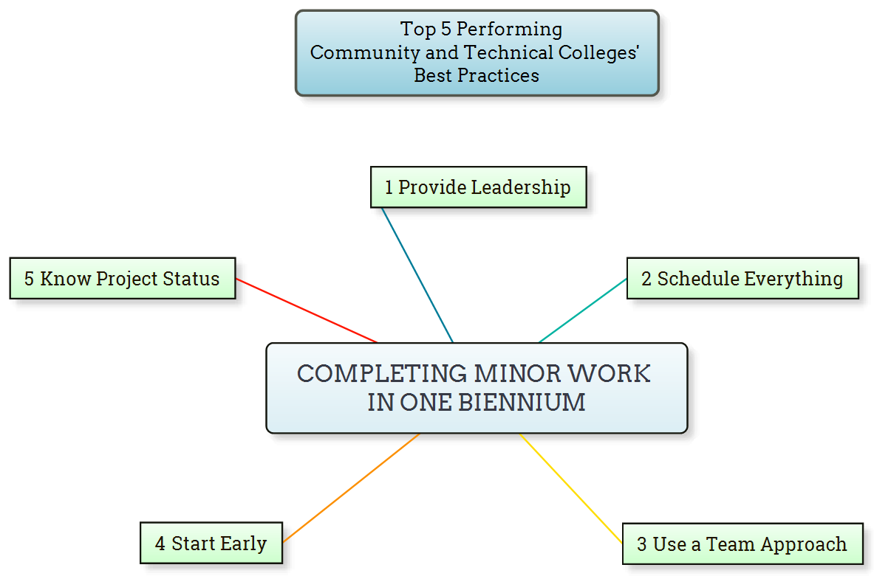
Common Themes (Success Strategies)
Notes:
Let’s look at some information related to best practices by five of our 34 community and technical colleges put in to practice this biennium.

Slide 7

Provide leadership
  Create a vision for the Goal.
  Motivate and inspire people to engage with the vision.
  Coach and build a team to effectively achieve the goal.
  Manage delivery toward accomplishing the goal.
Notes:
Paint a picture of what is needed, why it is needed, and the benefits of accomplishing the goal.
Performing outdoor and roofing work during good weather season.
Combining jobs to take advantage of a JOC.
Completing work so programs can teach and operate in better spaces….
Make connections and provide incentives for people to participate with accomplishing the goal.
Relate the work to agency operational goals and initiatives.
Identify how organizational units will benefit from the work being complete early…
Involve key staff and stakeholders.
Provide and allow project ownership
Educate and inform the team with project information such as goals, outcomes and benefits.
Coordinate and balance the conflicting interests of all members and stakeholders.
Keep the team and project on task toward goal achievement.

Slide 8
Schedule everything
  Administrative tasks.
  Delivery methods.
  Consultant/contractor selection.
  Team meetings.
  Document development, permitting, construction and closeout.
  Furnishing, moving, setup, and occupancy.
Notes:
The point here is not to educate anyone in this room about project needs, scopes of work or when to schedule around organizational calendars.
Scheduling is a tool that is used with all project partners to ensure everyone else is supporting the same plan.
To accomplish this goal you might consider using different scheduling tools for various constituents.

Slide 9
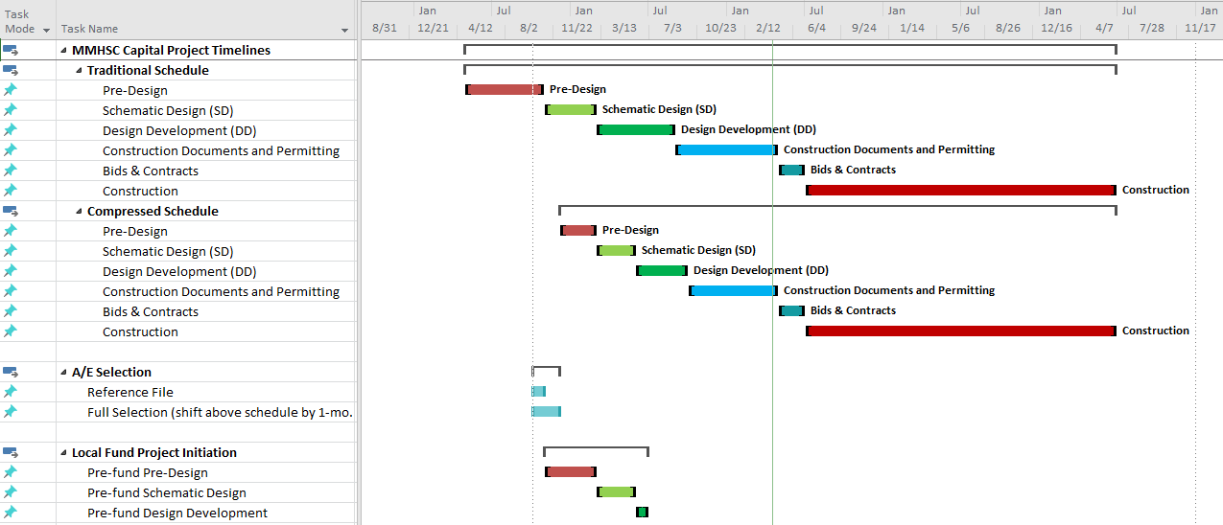
MS Project Schedule
25 days
20 days
15 days
15 days
5 days
102 days
36 days
180 days
Notes:
Examples:
MS Project for design and construction teams.

Slide 10
Office Timeline Schedule
25 days
East Annex - Sun Screen Removal
10/19/2015 - 11/20/2015
20 days
East Annex Air Handler Unit13 Replacement
12/14/2015 - 1/8/2016
15 days
East Wing - Roof Repairs
10/5/2015 - 10/23/2015
15 days
East Wing Stucco Repairs
10/12/2015 - 10/30/2015
5 days
Auditorium Partition Replacement
1/4/2016 - 1/8/2016
102 days
Main Building Brick Repairs
1/11/2016 - 5/31/2016
36 days
South Campus - Diesel Shop Exhaust Improvements
1/11/2016 - 2/29/2016
180 days
10/24/2016 - 6/30/2017
Sheet Metal Program Renovation/Relocation
2015
Oct
2016
Apr
Jul
Oct
2017
Apr
2017
Today
Notes:
Office Timeline for agency administrators, Board of Trustee reports and general college communications.

Slide 11
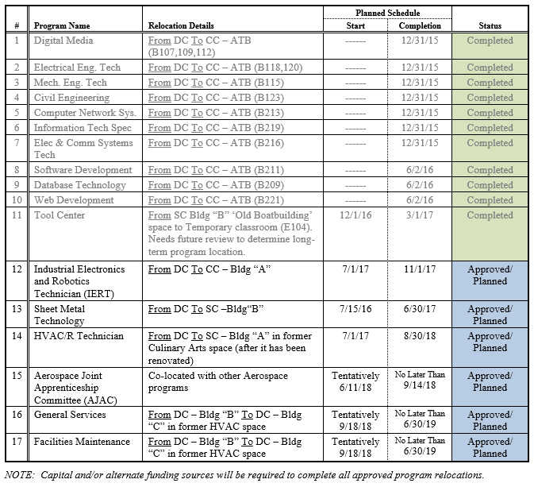
MS Word Schedule
25 days
20 days
15 days
15 days
5 days
102 days
36 days
180 days
Notes:
MS Word for agency stakeholders:
Facilities, Instructional Deans, Faculty, and/or affected departments.

Slide 12
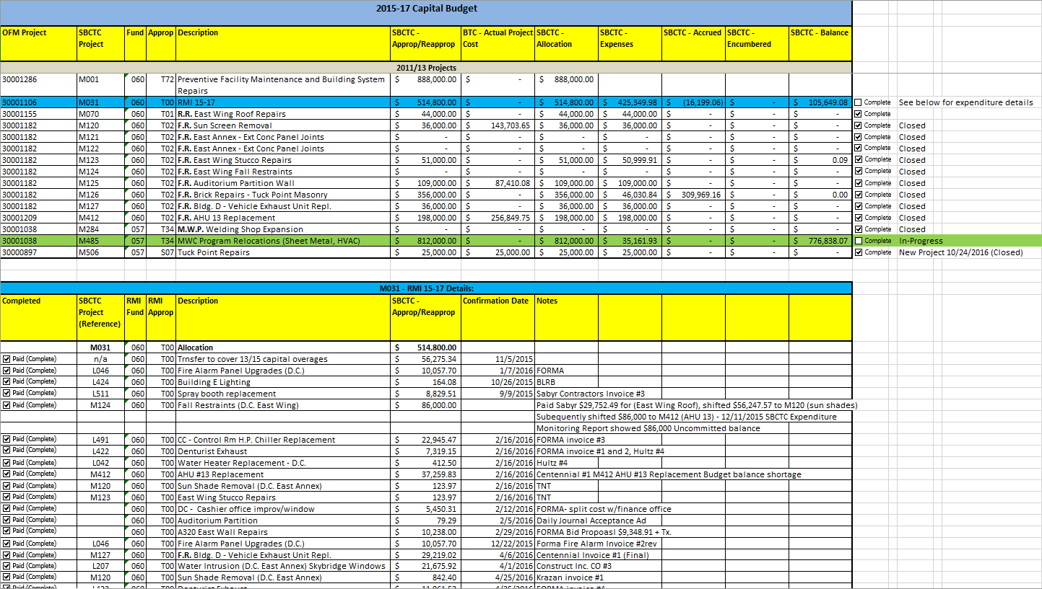
MS Excel Schedule
25 days
20 days
15 days
15 days
5 days
102 days
36 days
180 days
Notes:
MS Excel for finance and budget staff.

Slide 13
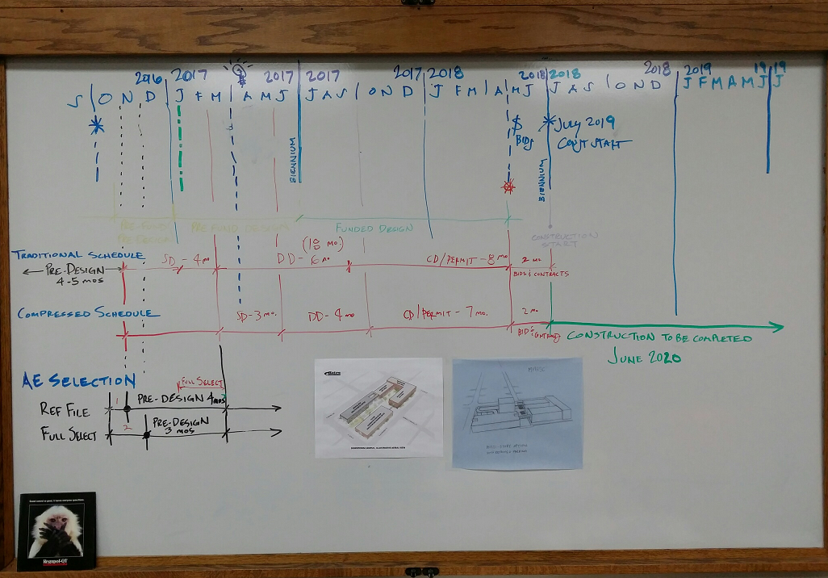
Office White Boarding
25 days
20 days
15 days
15 days
5 days
102 days
36 days
180 days
Notes:
And one of my favorites:
Old school white boarding for project team planning discussions.

Slide 14
3. Use a team approach
  Involve many people early and often.
    Of coarse the construction management team
      DES, agency, A/E consultants, contractors
    Identify value added stakeholders.
      Regulatory agencies, administrators, faculty, staff and students
Notes:
Value of team approach can:
Identify more issues earlier leading to quicker resolutions.
Spreads project ownership across broader agency audience encouraging project champions and supporters.
Assures quality of outcomes and quality of completed work environments.

Slide 15
4. Start early
  Define project needs, scope and costs prior to start of biennium.
  Submit PWR’s right away (July 01).
  Meet with E&AS PM to plan selections, design and construction schedules for the biennium.
  Identify long lead items across all projects and order as early as feasible.
Notes:
Take advantage of no-cost activities that can be completed prior to the start of the biennium allocations.
Start working with PM’s right away and plan regular progress meetings.
Plan ahead.

Slide 16
5. Know the project status
  Where are the budgets at key milestones?
  Is the project schedule at risk of scope creep or unforeseen conditions?
  Budget savings and/or shortfalls should be anticipated prior to project closeout.
  Budget shifts should be made to create new projects or cover existing project shortages as early as the commitments can be made.
Notes:
Value proposition to knowing the Status
Allows you to make and steer decisions driving schedule and budget, keeping capital projects on target to complete early in the biennium.

Slide 17

Where does all of this lead us?
Notes:
Do we end up Back in the corner at Aunt Marsha’s for continued bad behavior?
or
Do we Soar toward good standing with State Board, OFM and the Legislature faster than a speeding bullet?

Slide 18
Minor Project Expenditure Patterns
34 Community & Technical Colleges
Target spend line
2015-17 Top 5 Colleges
thru December
Summer Breaks
81%
2015-17 All Colleges
thru December
53%
47%
45%
July
Oct
Jan
April
July
Oct
Jan
April
June
Fiscal Month 24 includes closing adjustments.
Notes:
To put this all into perspective:
The average of the five top performing colleges using these five common theme (best practices) has:
Completed and spent 81% of their allocations by December in the 18th month.
Outperformed the same biennial completion and spending of all other colleges at only 53%.
And outperformed completion and spending of previous biennia which average expenditures were approximately 46% by the same 18 mos. time period.

Slide 19
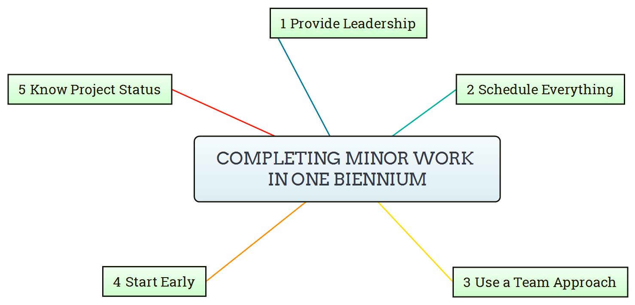
Best Practices for Completing Minor Work
Common Themes (Success Strategies)
Notes:
Success with five easy ingredients:
Provide Leadership
Schedule everything
Use a team approach
Start early and
Know the project status.

