Slide 1

Client Workshop
April 18, 2017
Project Delivery Methods
Notes:
Please mention:
Restroom locations
Emergency Exits
There will be a break in the morning, boxed lunches, and an afternoon break

Slide 2

Project Delivery Methods
Design-Bid-Build
Small Works Roster
Job Order Contracting
General Contractor\Construction Manager
Design-Build
Panel Questions & Answers

Slide 3
Project Delivery Methods
Design-Bid-Build
Jeff Gonzalez, Project Manager
Engineering & Architectural Services

Slide 4
Design-Bid-Build
Most common delivery method for public works projects
Linear process – Project is fully designed prior to bidding the construction contract
Services are segregated into separate contracts between owner/architect and owner/contractor

Slide 5
Design-Bid-Build
Contactor competition is based on low bidder
Construction costs are “known” at the time bids are received
Construction alternates are then decided based on bids and budget

Slide 6
Design-Bid-Build
Separates design and construction, used for projects of any size
Invitation to bid
Contractor hired
Awarded to responsible bidder with lowest responsive bid
Architect/ Engineer hired
Construction cost established
Phases:
Predesign
Design
Construction
Source: JLARC analysis of public works contracting procedures, Sunset Review, Dec. 2012.

Slide 7
Design-Bid-Build
Architect / Designer
Owner
Contractor Selection Process Here
Sub-Consultants
General Contractor
Sub-Contractors

Slide 8
Benefits of Design-Bid-Build
Traditional project delivery method that is familiar
Owner has control over the design process
Architect works directly for the owner
Good alternative when construction risks are relatively low and pricing is the most significant factor
Contractor selection is non-subjective, simple, and quick

Slide 9
Considerations/Challenges of Design-Bid-Build
Not an integrated delivery method – Contractor does not have early involvement during design
Does not easily allow for contractor input as it relates to the design
Firm pricing isn’t known until the time bids are received
Contractor selection is based solely on price, not performance

Slide 10
Considerations/Challenges of Design-Bid-Build
  Owner warrants the sufficiency of the plans and specs to the contractor
  Owner liable for any mistakes between plans, specs, and performance
  Project is constructed per plans and specifications
  Plans and specifications must be clear and without ambiguity

Slide 11
Design-Bid-Build
Thank you!
Jeff Gonzalez, Project Manager
Engineering & Architectural Services
Jeff.Gonzalez@des.wa.gov
(360) 407-7942

Slide 12
Project Delivery Methods
Small Works Roster
Jonathan Martin, Project Manager
Engineering & Architectural Services

Slide 13
Small Works Roster
Small works roster contract procedures RCW 39.04.155
1981 - Small Works procedures began modestly, with a limit of $25,000. Only four specific state agencies; General Administration, Fisheries, Game, and Parks and Recreation Departments were authorized to the SWR.
1991 – Limit raised to $100,000
2000 – Limit raised to $200,000
2009 – Limit raised to $300,000
Notes:
Brief History of Washington State’s Small Works Process

Slide 14
Small Works Roster
The Small Works Roster (SWR) is a pool of pre-approved contractors licensed in the State of Washington who have applied for and been placed on the roster.
The SWR can be used for projects under $300,000 Total Construction Cost.
  Makes it easier for contractors to compete for public works projects
  Helps reduce the cost of bidding small projects
  Faster pace procurement process
  Known bidder pool
Notes:
Brief History of Washington State’s Small Works Process

Slide 15
Small Works Roster
Is project under $300K
Print the roster
Complete the notification page and proof for spelling, grammar and readability
Forward to Contracts office
PM assembles Bid Package
  Scope Summary
  Front End Documents
  Drawings
Run the Roster
  Tweak Contractor types and specialties to obtain a usable list
  Minimum of at least 5 firms
Following Bidding Deadline – process as per usual procedure
SEND
PM obtains project number
PM fills out the SWR Notification Worksheet
Print copy of the notification email showing date and time and addressees for contract file
Prepare Bid Summary Sheet
OR
PM puts date timelines together with Facility
  Date to send notification
  Deadline for response of interest
  Date of walkthrough
  Deadline and location for bid submittal
Following Walkthrough place copy of sign-in form in contract file
PM may use On-call or from A/E Reference File
Respond to requests for Bid Documents, note firms on Roster

Slide 16
Small Works Roster
Thank you!
Jonathan Martin, Project Manager
Engineering & Architectural Services
Jonathan.Martin@des.wa.gov
(360) 407-9353

Slide 17
Project Delivery Methods
Job Order Contracting (JOC)
Dennis Flynn, Project Manager
Engineering & Architectural Services

Slide 18
Job Order Contracting
A competitively bid fixed-price contract for multiple construction projects delivered on a work order basis.
Unit prices from R.S. Means for establishing lump-sum fixed prices for work orders.
Contractor provides coefficient that is applied to line items from R.S. Means.
Contracts can be awarded for up to three years @ $6M per year.

Slide 19
JOC Projects
Projects that have a short timeline to complete
Projects that can have an abbreviated design
Projects that would benefit from early Contractor involvement
Multi-discipline projects
Bundled projects
Projects under $350,000

Slide 20
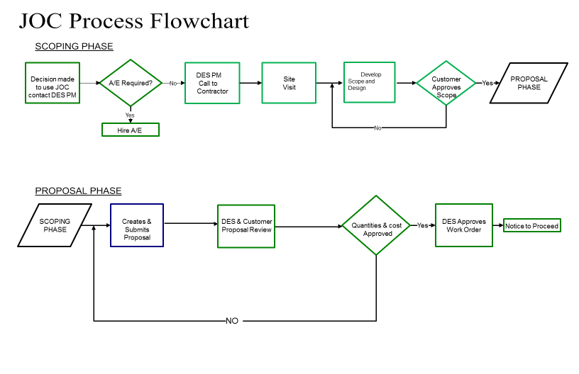
Job Order Process

Slide 21
Benefits of Job Order Contracting
Joint scoping and incidental design decreasing design cost and reduces change orders
Contractor works with Owner to make project work within budget
Can Reduce total project time by 10%-20%

Slide 22
JOC Considerations
JOC may not be the preferred delivery method if:
  Detailed design is required
  Intensive CA is required
  Competitive bids are preferential

Slide 23
JOC Contractors
NW Region- Saybr
SW Region- Centennial (at capacity)
Western WA- Forma (at capacity)
Eastern WA- Burton (at capacity)
Statewide- Burton (at capacity)
Statewide- Centennial (contract pending)
New Contracts for Statewide and SW Region will bid this spring

Slide 24
Job Order Contracting
Thank you!
Dennis Flynn, Project Manager
Engineering & Architectural Services
Dennis.Flynn@des.wa.gov
(360) 407-7934

Slide 25
Project Delivery Comparison
Project Delivery Options
Option | $ Limits | When to Use | Advantages | Disadvantages | RCW Ref.
Design-Bid-Build | — | When other options don’t make sense | Competition that most contractors understand | Contractor not a participant in design | 39.04
Job Order Contract (JOC) | $350k (w/COs) | Need it fast Simple with few trades | Convenient | Pay for convenience | 39.10. 420-460
Small Works Roster | $300k (w/COs) | Small, simple projects | Less design Shorter time | Low bidder interest can result in few or no bids | 39.04. 155
Notes:
Brief History of Washington State’s Small Works Process

Slide 26
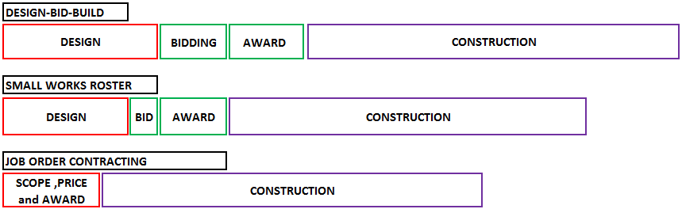
Relative Schedule Comparisons
Between Contracting Methods
Assume: $200,000 Construction Cost + Non-Elective Change Orders/Basic Design Requirements/120 Day Construction Duration

Slide 27
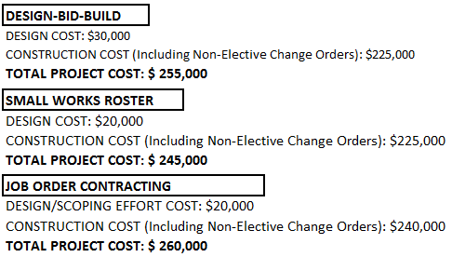
Relative Total Project Cost Comparisons Between Contracting Methods
Assume: $200,000 Construction Cost + Non-Elective Change Orders/Basic Design Requirements/120 Day Construction Duration

Slide 28
Project Delivery Methods
General Contractor\
Construction Manager
Christopher Gizzi, Project Manager
Engineering & Architectural Services

Slide 29
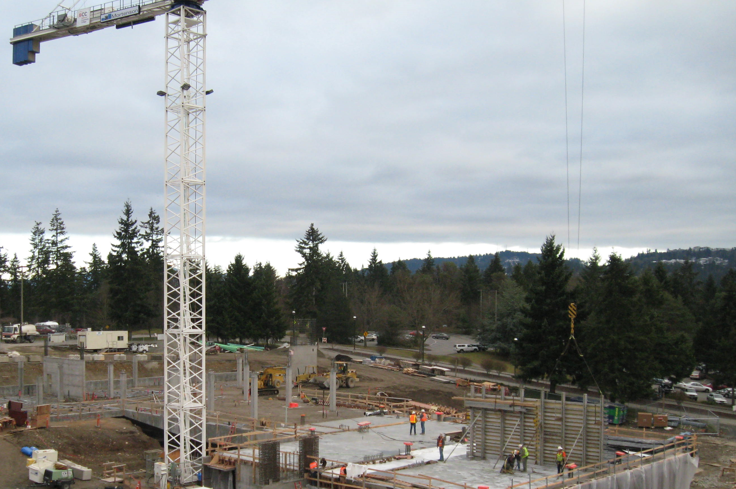
General Contractor\
Construction Manager
GC/CM – GCCM
General Contractor Construction Manager
CM/GC – CMGC
Construction manager General Contractor
CM/R – CMR - CMAR
Construction Manager at Risk

Slide 30
General Contractor\
Construction Manager
The GC/CM project delivery method allows an owner to engage a construction manager during the design phase to provide constructability input.
The GC/CM is generally selected on the basis of qualifications, past experience, and a competitively bid fee factor or a best-value basis.
During the design phase the construction manager provides input regarding scheduling, pricing, phasing, and other input that helps an owner design a more constructible project.
At approximately 90% design completion the owner and the construction manager negotiate a Maximum Allowable Construction Cost (MACC) and Total Construction Cost (TCC) for the construction of the project based on the defined scope and schedule.
If this price is acceptable to both parties, they execute a contract for construction services.

Slide 31
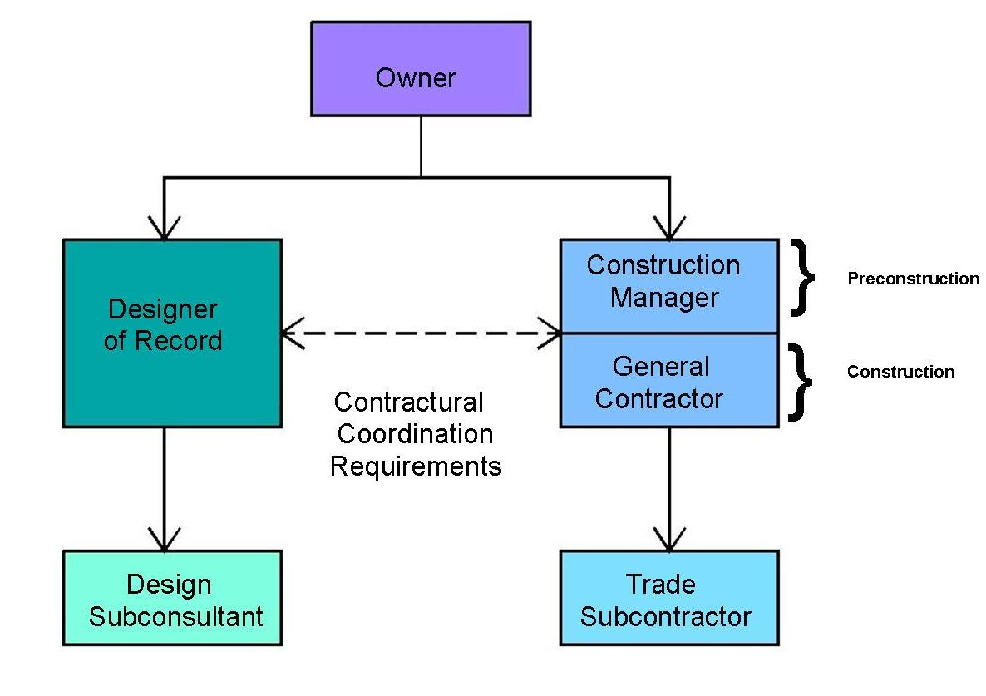
GC/CM Delivery Method
With the GC/CM project delivery method, the design firm and construction firm are both contracted to the owner.

Slide 32
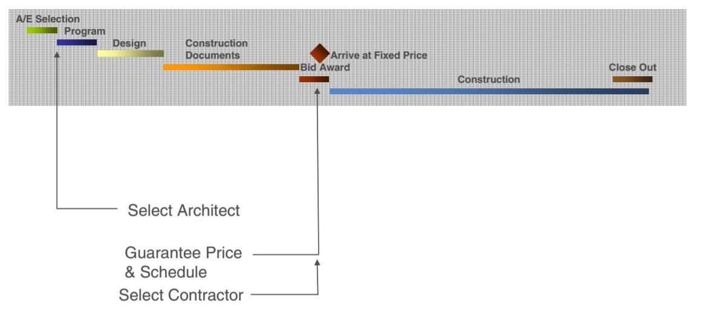
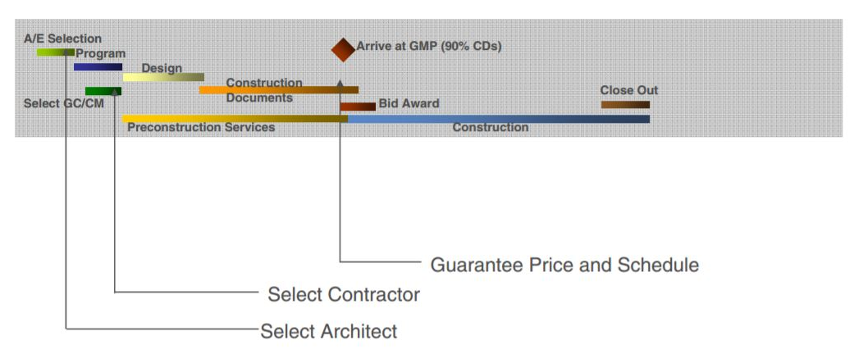
Method Schedule Comparison
Design Bid Build
GC/CM
Images Mortenson Co.

Slide 33
Delivery Method Comparison
Project Component | Design-Bid-Build | General Contractor / Construction Manager (GC/CM) | Design-Build
Architect/Engineer Selection Timing | Select at Beginning of Design Phase | Select at Beginning of Design Phase | Select as part of contractor team after facility programming.
Competition | Qualifications based with negotiated fee. | Qualifications based with negotiated fee. | Qualifications and fee-based as part of contractor team.
Role | Fully design project in advance of construction working closely with owner. | Fully design project in advance of construction working closely with owner and selected GCCM. | Design project under direction of contractor to meet programming requirements. Part of design may extend into construction.
Contractor Selection Timing | Select at completion of design | Select at 30% design Enter Construction contract at 90% design | Select as part of AE team after facility programming
Competition | Low Bidder | Combination of qualification s& sealed bid fee. Owner and GC/CM negotiate MACC at 90% design, if parties cannot agree on MACC, owner may either put the project out for bids or negotiate next highest ranked GC/CM. | Qualifications and fee-based as part of team with A/E.
Role | Construct project per plans and specifications. Select and manage subcontractors. | Assist Owner & A/E in design phase with independent cost estimates, constructability reviews, and cost saving suggestions. Package subcontractor work for sealed, publicly opened bids per A/E plans &specs. Manage subcontractors & self-perform work. | Lead A/E in design project per programming requirements. Construct project per design-build team construction documents, Select & manage subcontractors
Subcontractor Selection and Competition | By contractor using contractor selection criteria. | Low bidder on sealed, publicly opened bids managed by Contractor. | By Contractor using Contractor selection criteria.
Project Price | Negotiated A/E Fee Lump Sum Construction bid Approved Change Orders | Negotiated A/E Fee GCCM Sealed Bid Fees for General Cond.’s Lump Sum Subcontractor Construction bids Approved Change Orders | Programming Costs Lump Sum DB Construction Bid Approved Change Orders

Slide 34
RCW 39.10.340
How does GC/CM Meet Requirements for Competition?
Under GC/CM, a public agency advertises a Request for Proposals and selects a general contractor based on qualifications and price to provide pre-construction design assistance and construction management.
At about 90% completion of architect’s documents, the Owner and GC/CM jointly agree to a Negotiated Maximum Allowable Construction Cost (MACC) and Total Construction Cost (TCC).
Actual construction work is then competitively bid to sub-contractors in the same manner as traditional design-bid-build process by issuing solicitations for the work, receiving sealed bids and awarding based on low bid.
Project Costs exceeding the Negotiated MACC are the responsibility of the GC/CM. Project savings are returned to the owner.
State requirements (e.g. Diversity, Prevailing Wage, Retainage, etc,) are included in the GC/CM contracts and passed down to subcontractors.

Slide 35
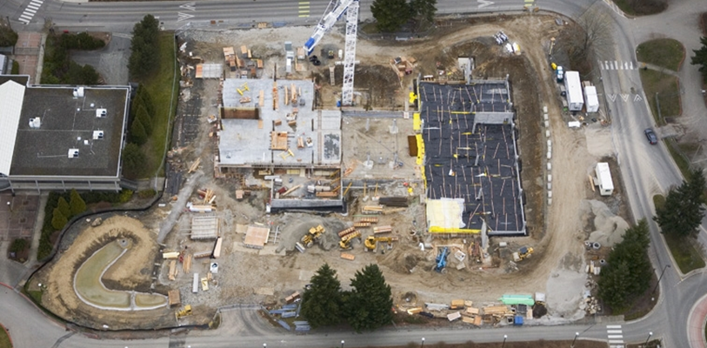
Advantages to GC/CM
GC/CM can provide input on phasing and sequencing need for projects that must remain operational during construction.
Allows ‘fast track’ construction to start while detailing structures, interiors, and systems by awarding site work, foundations, and long lead items (such as precast concrete and major equipment contracts – Note: contingent on permitting agency cooperation)

Slide 36
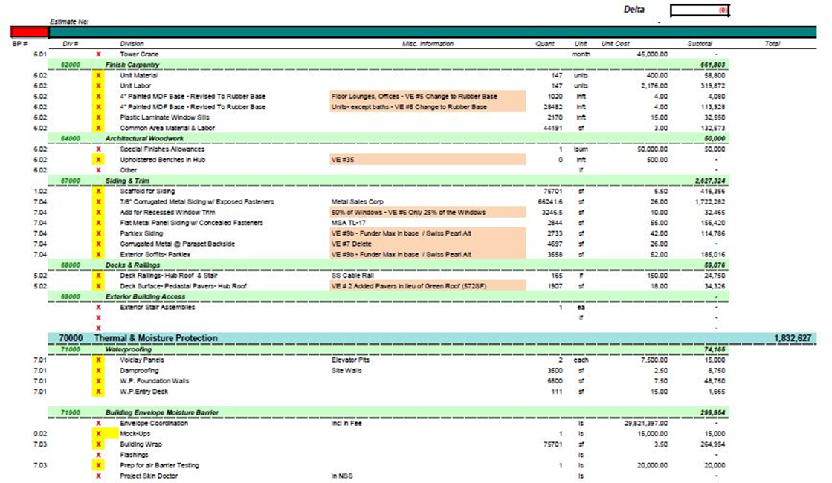
Advantages to GC/CM
GC/CM Is able to provide constructability reviews and independent cost estimates throughout the design phase of the project.
GC/CM aids in evaluating system options and obtaining real time cost estimates.
Image Walsh Construction

Slide 37
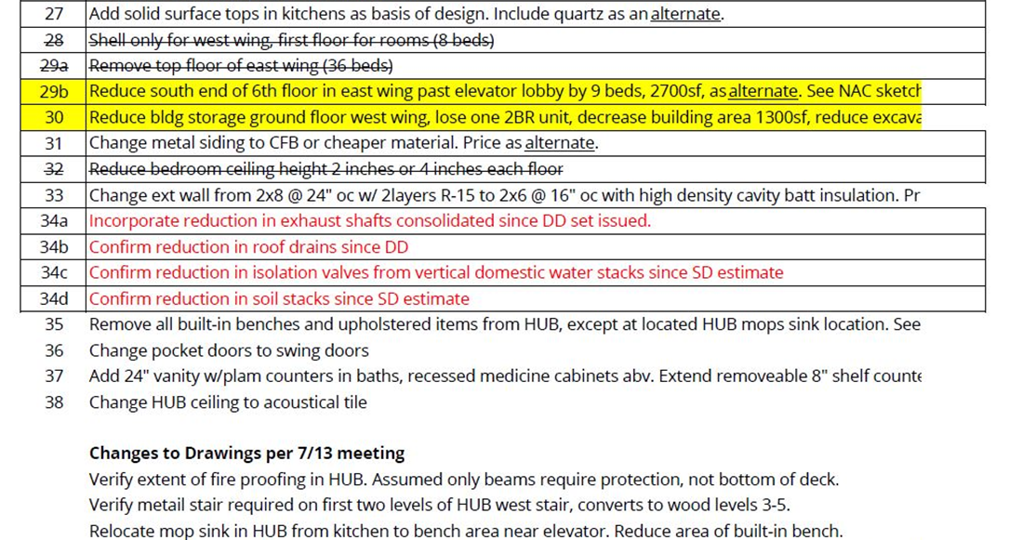
Advantages to GC/CM
GC/CM has valuable experience on cost savings that could be incorporated into the design.
Provides constructor’s input into systems, labor and materials availability, work and trade sequencing, and construction methodologies that can reduce design and construction time and costs.
Image
NAC Architecture

Slide 38
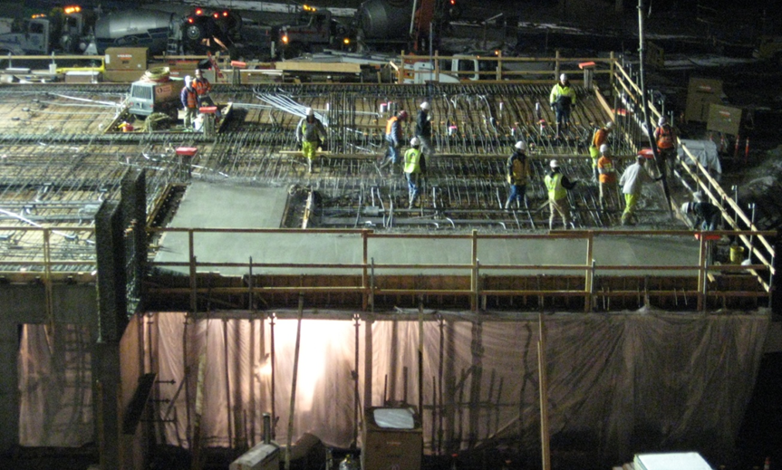
Advantages to GC/CM
GC/CM can become familiar with the intricacies and challenges of a complex project during design and carry that knowledge into construction.
Challenges the entire project team to stay within budget by allowing full and frank discussions of the cost and schedule implications of various design solutions, thereby allowing the owner to make informed cost-benefit tradeoff decisions.

Slide 39
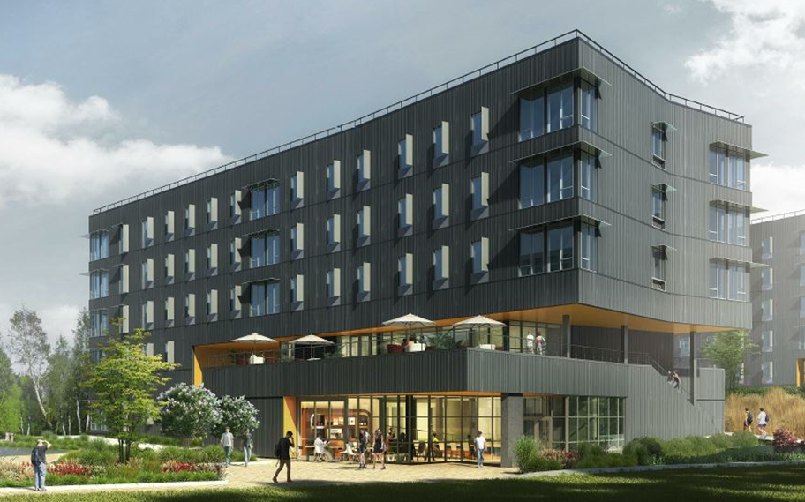
Advantages to GC/CM
Constructor well qualified to perform the work and not just the low bidder.
Provides the construction team the opportunity to jointly develop an aesthetically pleasing operational , functional, space-efficient building design utilizing low maintenance and reduced life cycle systems.

Slide 40
Potential Challenges
Determining a fair and reasonable GMP for the project in relation to the AE’s design vision, the owner’s requirements, the public entity’s expectations and the GC/CM’s proposal.
Determining the GC/CM’s risk contingency percentage for the project.
Determining when the GC/CM will give a Total Construction Cost for the project.
Determining the number of bid packages and the level of detail required for each phase of the design (impacts AE Fees), when the TCC will be confirmed, and the amount (%) necessary for the GC/CM’s estimating contingencies and escalation factors.
Understanding the difference in how construction cost is categorized, i.e. cost of the work, GC/CM Fee, general conditions, negotiated support services, risk contingency, construction ‘contingency’, and management reserve.
Determining how planning and permit timelines align with design and construction milestones.

Slide 41
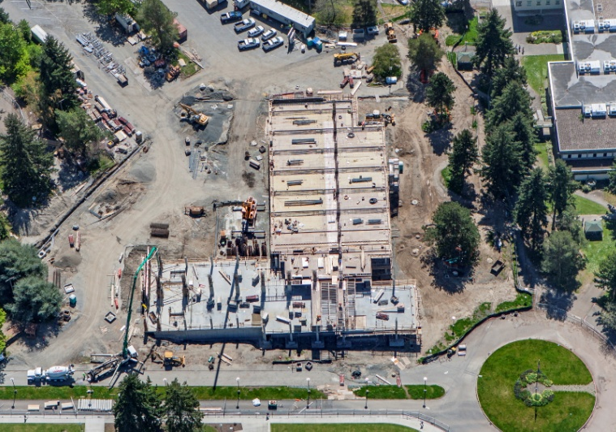
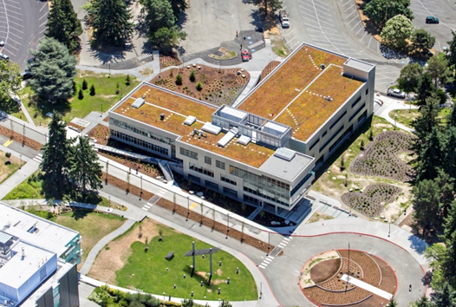
Potential Challenges

Slide 42
Owner Challenges
Managing the disruption of construction activities on an occupied campus including traffic impacts due to hauling routes and material deliveries,
Dedicating personnel to the design and construction process. Representatives need the authority to make final decisions and garner consensus from various agency hierarchies. This is a vital role in the process. The agency will produce benefit from the process in direct relation to their ability to make timely decisions, understand the particular needs and requirements of the project, stay current with project issues and generally drive the process.
Working with local building/planning departments to give advance notice of intention, clear regulatory hurdles, and pre-construct infrastructure that could impact project delivery timelines.
Managing cash flow and payments to consultants, testing agencies, contractors, and jurisdictions.
Planning the purchase, delivery, storage, and installation of furnishings & equipment.
Maintaining perspective, understand the sausage-making aspect of the work, and having fun!

Slide 43
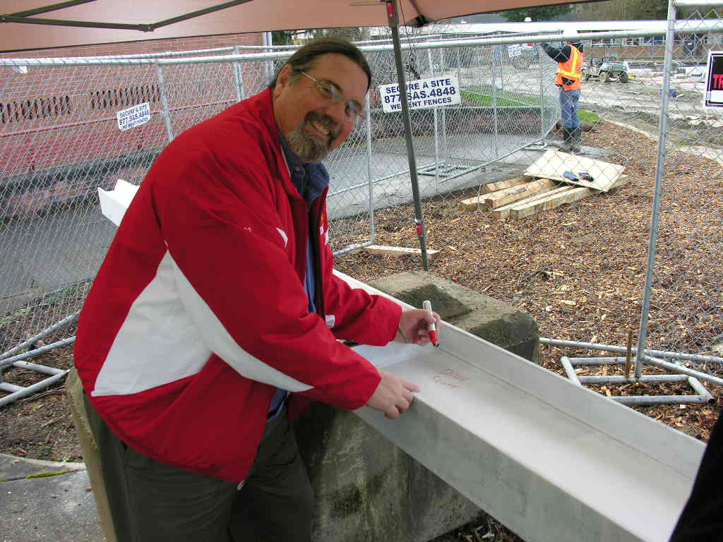
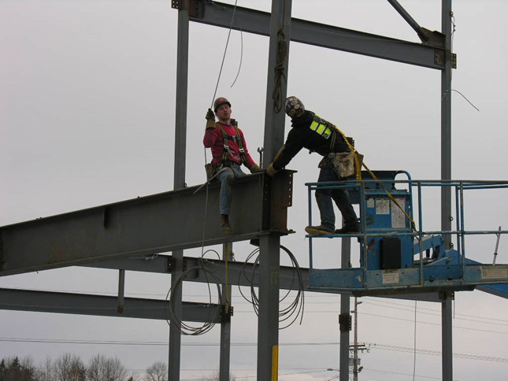
Owner Challenges

Slide 44
General Contractor\
Construction Manager
Thank you!
Christopher Gizzi, Project Manager
Engineering & Architectural Services
Christopher.Gizzi@des.wa.gov
(360) 407-9304

Slide 45
Project Delivery Methods
Design-Build
Robynne Parkinson, Attorney
Thaxton Parkinson, PLLC
rparkinson@rtp-law.com
(206) 909-5290
See Design-Build Presentation

Slide 46
Design-Build
Thank you!
Robynne Parkinson, Attorney
Thaxton Parkinson, PLLC
rparkinson@rtp-law.com
(206) 909-5290

Slide 47
Project Delivery Methods
Panel
Questions?

