Slide 1
Bethel School District
Graham-Kapowsin High School Addition and Renovation
GC/CM Application for Project Approval
Application Presentation

Slide 2
Graham-Kapowsin High School Addition and Renovation Agenda
Project Overview
Project Budget
Project Schedule
Why is this Project Appropriate for GC/CM
Provides a Fiscal & Public Benefit
Meets the Qualifying Criteria
Project Team Experienced & Knowledgeable
Summary
Questions
Page 1

Slide 3
Graham-Kapowsin High School Addition and Renovation Project Overview
Graham-Kapowsin High School was constructed in 2004
Funding approved in 2019 bond issue
26,000 SF of new classrooms
2,000 SF addition to commons
5,000 SF of new administration space
4,000 SF for a new weight room
4,470 SF additional locker room area
Renovations to existing commons and administration
Page 2

Slide 4
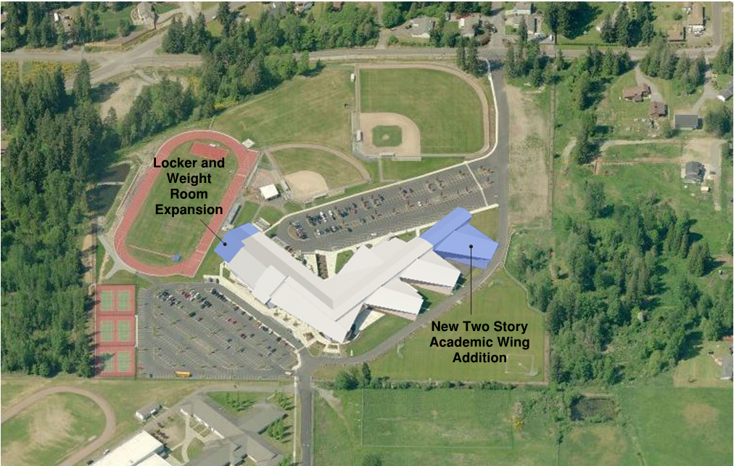
Graham-Kapowsin High School Addition and Renovation Project Overview: Site Plan
Page 3

Slide 5
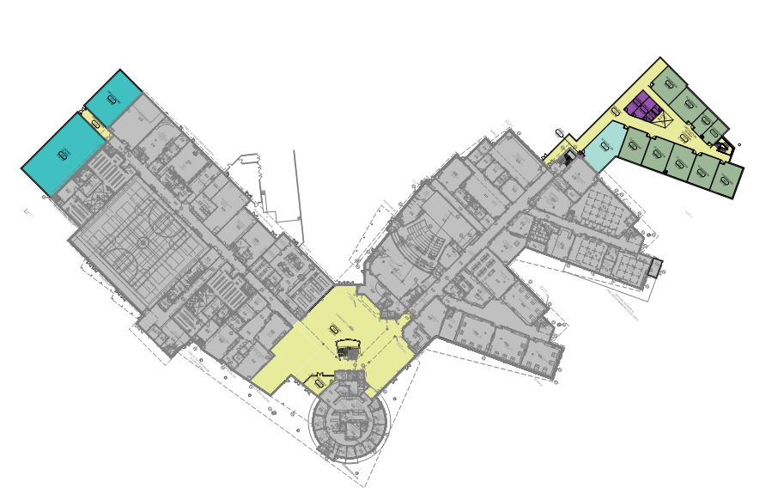
Graham-Kapowsin High School Addition and Renovation Project Overview: Floor Plan
New Locker and Weight Room
New Classrooms
Renovate/New Commons
Page 4

Slide 6
Graham-Kapowsin High School Addition and Renovation Project Budget
Costs for Professional Services | $ 2,900,000
Estimated project construction costs | $ 18,600,000
Equipment and furnishing costs | $ 900,000
Off-site costs | $ 1,000,000
Contract administration costs | $ 400,000
Contingencies | $ 2,800,000
Other related project costs | $ 800,000
Sales Tax | $ 2,277,000
Total | $ 29,677,000
Funding was approved by the community in the 2019 bond issue
Page 5

Slide 7
Graham-Kapowsin High School Addition and Renovation Schedule - Key Dates
GC/CM Approval & Selection Process
Submit Application to PRC | April 19, 2020
PRC Presentation and Determination | May 28, 2020
Issue RFQ for GC/CM | June 3, 2020
Shortlist & Issue RFP for GC/CM | June 30, 2020
Complete GC/CM Process | July 22, 2020
Programming and Design
Programming | May – June 2020
Schematic Design | Aug – Oct. 2020
Design Development | Nov. 2020 – Apr. 2021
Construction Documents | May 2021 – Dec. 2021
Subcontractor Bid Package Bidding | Jan. – Mid Feb. 2022
Agreed upon GMP Amendment Signed | Mid Feb. 2022
Construction
Start Construction | April 15, 2022
Substantial Completion – New Classrooms | June 30, 2023
Substantial Completion – Renovations & Gym | July 31, 2023
BCD Technology and Move-in | July – August 2023
Start of School | Sept 7, 2023
Page 6
Notes:
Discuss Design Timeline
GC/CM on board early, prior to SD

Slide 8
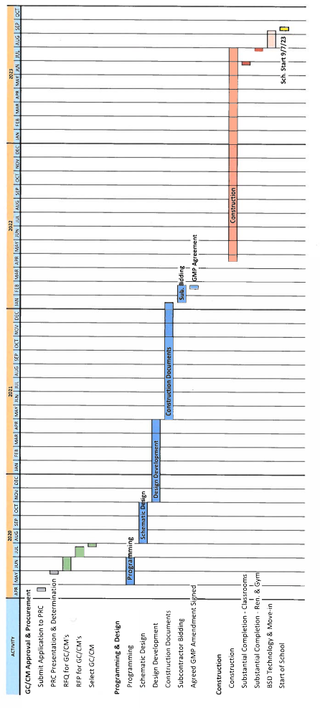
Graham-Kapowsin High School Addition and Renovation Project Schedule

Slide 9
Graham-Kapowsin High School Addition and Renovation Why GC/CM is Appropriate for this Project (Meets qualifying criteria under RCW 39.10.340)
GC/CM provides Substantial Fiscal & Public Benefit
The GC/CM will provide current market condition estimates that are critical to the District, so the project is delivered on schedule vs having a less certain outcome at bid time using the D-B-B process.
The Existing High School Must Continue to Operate
Participation by the GC/CM during the design phase will improve mitigation planning for noise, student and public safety, site access, and schedule issues.
Page 8

Slide 10
Graham-Kapowsin High School Addition and Renovation Why GC/CM is Appropriate for this Project (Meets qualifying criteria under RCW 39.10.340)
Complex Scheduling, Phasing, and Coordination
The participation of an experienced GC/CM during the design process will enable the project team to identify issues, seek and test potential design and logistics options, and incorporate agreed solutions into the contract documents.
Involvement of the GC/CM is Critical during Design
In this current extremely busy construction climate, it is critical that the District attract quality contractors with the experience to perform the work. Given that the project includes an addition to an occupied site, the District believes the GC/CM procurement method is critical to procuring such a contractor who can also attract a stable of qualified subcontract bidders.
Page 9

Slide 11
Graham-Kapowsin High School Addition and Renovation
Knowledgeable & Experienced
Project Team
District Construction & Planning Department has years of construction experience
Personnel have multiple years of project experience
Project Team has previously worked together on alternate delivery projects
Page 10

Slide 12
Graham-Kapowsin High School Addition and Renovation Project Team
Bethel School District
Superintendent
Tom Seigel
Construction & Planning
Cathie Carlson - Director
Project Manager
Proc.- 10%, D - 20%, C - 20%
Jeff Dryden
Assist Project Manager
Proc.- 10%, D - 20%, C - 35%
Marlene Anglemyer
Construction Manager
D - 5%, C - 50%
Hainline
Chuck Hartung - GC/CM Advisor
Richard Shiroyama - Scheduling
Procurement - 20% (CH)
Design - 10%
Construction - 5%
Perkins Coie LLP
Andrew Greene, Mica Klein
Legal Counsel
Throughout - 5%
NAC Architecture
Philip Riedel - PIC
Proc.- 10%, D - 30%, C - 10%
GC/CM
TBD
Page 11

Slide 13
Graham-Kapowsin High School Addition and Renovation Project Team Members
Cathie Carlson – BSD Director of Construction and Planning
Ms. Carlson has been with the BSD for nearly 14 years and the Director of Construction for the last 5 years. She was a key team member on the first two design build projects for public K-12 schools in Washington.
Jeff Dryden – BSD Assistant Director of Construction and Planning
Mr. Dryden has over 30 years of experience in construction and project management. Mr. Dryden has worked on multi-million dollar Design-Build and Design-Bid-Build projects.
Marlene Anglemyer – BSD Construction Project
Ms. Anglemyer has over 16 years of experience on both public and private construction projects. She is skilled at managing all phases of construction projects.
Page 12

Slide 14
Graham-Kapowsin High School Addition and Renovation Project Team Members
Philip Riedel AIA – NAC Architecture
Philip is a Principal Architect and the PK-12 Market Sector Leader at NAC Architecture. He has been leading educational projects at NAC for 20 years, including on GC/CM public school projects in Washington and Montana.
Design Team
Civil Engineer: Sitts & Hill Engineers
Landscape Architect: Weisman Design Group
Structural Engineer: Coughlin Porter Lundeen
Mechanical Engineer: Metrix Engineers
Electrical Engineer: NAC Engineering
Acoustical Engineer: Greenbusch
Owner's Cost Estimator: RC Cost Group
Page 13

Slide 15
Graham-Kapowsin High School Addition and Renovation Project Team Members
Mica Klein, Andrew Greene, and Graehm Wallace - Legal, Perkins Coie
The District is represented by Perkins Coie LLP’s Construction Group. Perkins Coie has represented more owners on GC/CM projects approved by the PRC than any other firm in Washington and has deep experience with Chapter 39.10 RCW alternative project delivery.
Page 14

Slide 16
Graham-Kapowsin High School Addition and Renovation Project Team Members
Chuck Hartung – GC/CM Advisor, Hainline
Mr. Hartung has over 40 years of experience in architecture, project management, construction management and construction consulting on both public and private projects. He has served directly as Project Manager and/or Owner’s Representative on complex multi-million-dollar GC/CM and GMP projects.
Richard Shiroyama – GC/CM Scheduling Consultant – Hainline
Richard Shiroyama, PE, a 27-year construction industry veteran, is Hainline’s Project Controls Manager and works with a wide variety of clients. Richard has provided scheduling review services for several GC/CM projects.
Page 14

Slide 17
Graham-Kapowsin High School Addition and Renovation Team Member Experience
 |  |  |  |  | Role During Project Phases
Name | Summary of Experience | Project Names | Project Size | Project Type | Pre-Design | Design | Construction
Cathie Carlson | Director of Construction and Planning - BSD | Challenger High School Phase 1 | $4M | DBB | Director | Director | Director
 |  | Educational Service Center Phase 1 & 2 | $4.3M | DBB | Director | Director | Director
 |  | New Bethel High School | $130M | DBB | Director | Director
 |  | Elementary School #18 | $32M | DBB | Director | Director
 | Assistant Director of Construction - BSD | Pierce County Skills Center Phase 3 | $8.7M | DB | Asst. Direct. | Asst. Direct. | Asst. Direct.
 | Facilities Planner - BSD | Bethel Learning Center | $2.5M | DB | Facilities Planner | Facilities Planner | Facilities Planner
 |  | Transportation Center/Central Kitchen | $19M | DB | Facilities Planner | Facilities Planner | Asst. Direct.
 |  | Shining Mt Elementary | $10M | DBB | Facilities Planner | Facilities Planner | Facilities Planner
 |  | Clover Creek Elementary | $12.7M | DBB | Facilities Planner | Facilities Planner | Facilities Planner
 |  | Spanaway Elementary | $9.3M | DBB | Facilities Planner | Facilities Planner | Facilities Planner
 |  | Spanaway Lake High School | $25M | DBB | Facilities Planner | Facilities Planner | Facilities Planner
Jeffrey Dryden | Assistant Director of Construction -BSD | New Challenger High School | $4M | DBB | - | - | Asst. Direct.
 |  | Educational Service Center Phase 2 Improvements | $1.8M | DBB | - | - | Asst. Direct.
 |  | New Bethel High School | $130M | DBB | Asst. Direct. | Asst. Direct. | -
 |  | Elementary School #18 | $32M | DBB | - | Asst. Direct. | -
 | Public Works Officer (Director of Facilities and Construction) | New Base Fitness Center | $12M | DB | Director | Director | Director
 | US Navy, Naval Air Station Fallon | New Water Treatment Plant | $20M | Modified DB | Director | Director | -
 |  | Barracks Renovations | $6M | DB | Director | Director | Director
 |  | Airfield Improvements | $5M | DBB | Director | Director | Director
 |  | Airfield Hangar Renovations | $12M | DB | Director | Director | Director
 | Program Manager - US Navy | Construction of 400 Police Facilities for Afghan National Police | $200M | DBB | Program Manager | Program Manager | Program Manager
Page 15

Slide 18
Graham-Kapowsin High School Addition and Renovation Team Member Experience
 |  |  |  |  | Role During Project Phases
Name | Summary of Experience | Project Names | Project Size | Project Type | Pre-Design | Design | Construction
Marlene Anglemyer | Project Manager - BSD | New Challenger High School | $4M | DBB | PM | PM | PM
 | Project Manager | Transportation Building Preservation | $39.5M | DBB | PM | PM | PM
 | State of Washington | NRB Building Fire Suppression | $11.0M | DBB | PM | PM | PM
 |  | Capitol Court Building Envelope Repairs | $3.1M | DBB | PM | PM | PM
 |  | Columbia Basin College Social Sciences & World Language Buildings | $15.7M | DBB | PM | PM | PM
 |  | Seattle Central College Maritime Academy | $11.6M | DBB | PM | PM | PM
 |  | Centralia College Student Commons/Center | $26.5M | DBB | PM | PM | PM
 |  | Dept. of Veteran's Affairs Skilled Nursing Facilities | $35.3M | DBB | PM | PM | PM
 |  | 1063 Block Office Building | $64.6M | DB | PM | PM | PM
 |  | Bates Technical College Mohler Communications Technology Building | $20.8M | DBB | PM | PM | PM
 |  | Green River Community College Student Life | $23.6M | DBB | PM | PM | PM
 |  | Bellevue College Health Sciences Building | $24.8M | DBB | PM | PM | PM
 |  | South Puget Sound Community College Campus Center Redevelopment | $24.3M | DBB | PM | PM | PM
 |  | Tacoma Community College Harned Center for Health Careers | $21.4M | DBB | PM | PM | PM
 |  | Lower Columbia College Health & Sciences Bldg | $26.1M | DBB | PM | PM | PM
Chuck Hartung | GCCM Advisor | The Conference Center – WSCC | $25M | GCCM | PM | PM | PM
 | Hainline | Meadowdale Middle School – ESD | $42.2M | GCCM | GCCM Con | GCCM Con | GCCM Con
 |  | Transportation Facility & Central Kitchen – BSD | $19M | DB | DB Consult | DB Consult | DB Consu'lt
 |  | Elders Community Center – MIT | $12M | GMP | PM | PM | PM
 |  | Pierce County Skill Center – BSD | $6.1M | DB | DB Consu'lt | DB Consu'lt | DB Consu'lt
 |  | Maintenance and Transportation Facility – ESD | $23.3M | GCCM | GCCM Con | GCCM Con | GCCM Con
 |  | Alderwood Middle School – ESD | $50M | GCCM | GCCM Con | GCCM Con | GCCM Con
 |  | Lynndale Elementary School – ESD | $25M | GCCM | GCCM Con | GCCM Con | GCCM Con
 |  | Mountlake Terrace & Lynnwood Elementaries | $49M | GCCM | GCCM Con | GCCM Con | -
 |  | Madrona Elementary School | $25M | GCCM | GCCM Con | GCCM Con | GCCM Con
Richard Shiroyama | Scheduling Review | University of WA Medical Center | $170M | GCCM | - | - | Sched. Rev.
 | Hainline | Alderwood Middle School - ESD | $50M | GCCM | - | - | Sched. Rev.
 |  | Lynndale Elementary School - ESD | $25M | GCCM | - | - | Sched. Rev.
 |  | Mountlake Terrace & Lynnwood Elementaries ESD | $49M | GCCM | - | - | Sched. Rev.
 |  | Madrona Elementary School - ESD | $25M | GCCM | - | - | Sched. Rev.
Philip Riedel | Architect | Snohomish High School, Snohomish, WA | $75.7M | GC/CM | Ed Planner | PA | PA
 | NAC Architecture | East Helena High School, East Helena, MT | $29M | GC/CM | PM | PM | PM
 |  | Summit Sierra High School, Seattle, WA | $4.8M | Negotiated | PM | PM | PM
 |  | Lakes High School, Lakewood, WA | $54.7M | GC/CM | PA | PA | PA
 |  | Bethel High School, Bethel, WA | $125M | D/B/B | PIC | PIC | PIC
 |  | Enumclaw High School, Enumclaw, WA | $45M | D/B/B | PM | PM | PM
 |  | Wilson High School, Tacoma, WA | $30M | D/B/B | PM | PM | PM
 |  | Auburn High School, Snohomish, WA | $80.5M | D/B/B | PM | PM | PM
 |  | Dessie Evans Elementary School, Puyallup, WA | $37.4M | D/B/B | PM | PM | PM
Page 16

Slide 19
Graham-Kapowsin High School Addition and Renovation Bethel School District Experience
Project # | Project Name | Project Description | Contracting Method | Planned Start | Planned Finish | Actual Start | Actual Finish | Planned Budget | Actual Budget | Reason for Budget or Schedule Overrun
1 | Elementary 18 | New construction -80,000 sf K-5 elementary school | DBB | Apr-20 | Jul-21 | Apr-20 |  | $33M
2 | New Bethel High School | 250,000 sf High School on new site | DBB | Apr-21 | Jun-23 |  |  | $130M
3 | Challenger High School Phase 1 | New construction - 9,000 sf admin/classroom building on existing campus | DBB | Apr-19 | Dec-19 | Apr-19 | Jan-20 | $4M | $4.2M | Selected bid alternates
4 | Educational Service Center | Two phase tenant improvements | DBB | Oct-17 | Dec-19 | Oct-17 | Dec-19 | $4.3M | $4.3M
5 | Pierce County Skills Center Phase 3 | New construction - 26,000 sf culinary arts, admin office and campus commons | DB | Mar-14 | Apr-15 | Mar-14 | Mar-15 | $8.7M | $8.7M
6 | Transportation -Central Kitchen | Transportation Center servicing 220+ buses, 6 bay shop and administrative offices. Central Kitchen prepares all food for distribution to schools. | DB | Mar-13 | Jul-20 | Apr-13 | Aug-14 | $19M | $19.8M | Found significant amount of contaminated soil while excavating for bus lift pits.
7 | Bethel Learning Center | 5,000 sf educational/community facility | DBB | Mar-12 | Aug-12 | Mar-12 | Sep-12 | $2.5M | $2.5M
8 | Clover Creek Elementary | 63,000 sf new construction | DBB | Mar-11 | Aug-12 | Mar-11 | Aug-12 | $12.7M | $12.7M
9 | Shining Mt. Elementary | Renovation of 47,000 sf school and 4,400 sf addition | DBB | Jun-11 | Aug-12 | Jun-11 | Aug-12 | $10M | $10M
10 | Spanaway Elementary | 57,000 sf new construction | DBB | Aug-10 | Aug-11 | Aug-10 | Aug-11 | $9.3M | $9.3M
11 | Spanaway Lake High School | Renovate 150,000 sf and 22,000 sf addition | DBB | Mar-09 | Aug-10 | Mar-09 | Aug-10 | $25M | $25M
Page 17

Slide 20
Graham-Kapowsin High School Addition and Renovation Summary
GC/CM method provides a fiscal benefit
GK-HS Project meets the RCW qualification requirements
District and team have the necessary knowledge & experience to manage the project
Management plan for the project is in place
Funding has been authorized
Page 18

Slide 21
Bethel School District
Thank you for your time
Questions
Page 19

